Slide 1
Improving School Attendance
Filling the seats!

Slide 2
Learning Intentions
Provide two critical resources divisions and schools can use to improve student attendance
Introduce five strategies to improve student attendance
Present examples of attendance improvement efforts in Virginia School Divisions
Notes:
Mike
Provide two critical resources to improve student attendance: VDEO Resources & Attendance Works
Five Strategies to Improve Student Attendance: Engage Students and Parents; Recognize Good and Improved Attendance; Monitor Attendance Data and Practice; Provide Personalized Early Outreach; Develop Programmatic Response to Barriers.
Examples of Attendance Improvement Efforts in Virginia including Lunenburg, Westmoreland
The Role of Suspension in Attendance problems
Attendance and Accreditation

Slide 3
Two Invaluable Resources
VDOE Website
Attendance Works
http://www.doe.virginia.gov/support/prevention/attendance-truancy/attendance-truancy-va-students/index.shtml
https://awareness.attendanceworks.org/
Notes:
Mike
http://www.doe.virginia.gov/support/prevention/attendance-truancy/attendance-truancy-va-students/index.shtml
https://awareness.attendanceworks.org/

Slide 4
Using the VDOE Modules
VDOE Website
Use a Team Jigsaw
Notes:
Mike

Slide 5
Five Strategies to Improve Student Attendance
Engage Students and Parents
Attendance improves when a school community offers a warm and welcoming environment that emphasizes building relationships with families and stresses the importance of going to class every day.
Developing a school-wide school culture that promotes a sense of safety and respect and where students feel connected and know that someone notices, in a caring manner, when they missed school.
Helping families understand what their children are learning when they are in school and the negative effects of chronic absenteeism on realizing their hopes and dreams for their children.
Notes:
Howard Attendance improves when a school community offers a warm and welcoming environment that emphasizes building relationships with families and stresses the importance of going to class every day. The key is developing a school-wide school culture that promotes a sense of safety, respect and personal responsibility, where students feel connected and know that someone notices, in a caring manner, when they missed school. A key component of the engagement is helping families understand what their children are learning when they are in school and the negative effects of chronic absenteeism on realizing their hopes and dreams for their children. Too many parents and students do not realize that just missing two days each month can be a problem, and often leads to falling behind in the classroom. Even fewer families realize that absenteeism is a problem as early as kindergarten and preschool and building the habit of attendance in the early grades can influence their children’s chances of graduating from high school.

Slide 6
Five Strategies to Improve Student Attendance
Recognize Good and
Improved Attendance
School communities can send a clear message that going to school every day is a priority by providing regular recognition and incentives to students and families who have good and improved attendance.
The goal is not to focus on perfect attendance since the children who struggle the most will soon be left out of such activities.
Incentives and contests take advantage of the fact that students often respond better to positive recognition and peer pressure than they do to lectures from parents and teachers.
Simple rewards—recognition from peers and the school through certificates or assemblies, extra recess time, homework passes or even dancing in the hallways—go a long way toward motivating students.
Notes:
Howard
School communities can send a clear message that going to school every day is a priority by providing regular recognition and incentives to students and families who have good and improved attendance. Keep in mind that the goal is not to focus on perfect attendance since the children who struggle the most will soon be left out of such activities. Incentives and contests take advantage of the fact that students often respond better to positive recognition and peer pressure than they do to lectures from parents and teachers. Incentives don’t need to be costly. Simple rewards—recognition from peers and the school through certificates or assemblies, extra recess time, homework passes or even dancing in the hallways—go a long way toward motivating students.

Slide 7
Five Strategies to Improve Student Attendance
Monitor Attendance Data and Practice
Have a team to monitor their data, use it to organize their attendance improvement strategy and ensure chronically absent students receive support.
The best way to identify students with chronic absence, is to use the attendance data already collective by schools to examine which and how many students are missing 10% or more of the school year. Remember Students who miss 10% of the school year or 18 days are considered chronically absent. This includes both excused and unexcused absences including suspensions.
Ideally, data is also to monitor trends over time by grade and subgroup. Schools can also use data prior to the beginning of the school year to assess how many students are likely to need additional supports and then determine how to put in place sufficient resources.
Notes:
Sandi
Ideally every school has a team to monitor their data, use it to organize their attendance improvement strategy and ensure chronically absent students receive support. The best way to identify students with chronic absence, is to use the attendance data already collective by schools to examine which and how many students are missing 10% or more of the school year. Ideally, data is also to monitor trends over time by grade and subgroup. Schools can also use data prior to the beginning of the school year to assess how many students are likely to need additional supports and then determine how to put in place sufficient resources. Attendance Works has created free data tools–the DATT and the SATT–to examine patterns and identify which students are at risk due to poor attendance. Link to DATT and SATT pages. The best approach is for district data staff to use these tools (or adopt existing data dashboards to produce similar reports) and then provide data on a regular basis to school administrators.

Slide 8
Five Strategies to Improve Student Attendance
Provide Personalized Early Outreach
Use data to trigger early caring outreach to families and students who are already missing too many days of school.
Outreach is essential for identifying barriers to attendance — hunger, access to health care, homelessness, transportation or other challenges.
The help provide supports or resources that would help improve attendance.
Outreach must be personalized to meet the needs of your students
Notes:
Rick Perhaps the most critical strategy is using data to trigger early caring outreach to families and students who are already missing too many days of school. Such outreach is essential for identifying barriers to attendance — hunger, access to health care, homelessness, transportation or other challenges — and the supports or resources that would help improve attendance. New York City’s success mentor strategy now being replicated in at least 30 cities has been especially successful in combating chronic absence. Personalized outreach.

Slide 9
Five Strategies to Improve Student Attendance
Develop Programmatic
Response to Barriers
If large numbers of students are affected by chronic absence, that suggests some type of systemic barrier or barriers are at play.
Once it is clear that chronic absence is a problem in your school and for which groups of children, use qualitative and quantitative information to examine what factors might be affecting attendance.
If possible, engage other agencies and families in the process so they can use their insights to shed light on the challenges and get engaged in coming up with realistic solutions that draw upon the assets they can bring to bear.
Identifying the barriers to attendance can indicate the appropriate solutions.
Notes:
Rick
If large numbers of students are affected by chronic absence, that suggests some type of systemic barrier or barriers are at play. Once it is clear that chronic absence is a problem in your school and for which groups of children, use qualitative and quantitative information to examine what factors might be affecting attendance. If possible, engage other agencies and families in the process so they can use their insights to shed light on the challenges and get engaged in coming up with realistic solutions that draw upon the assets they can bring to bear. Identifying the barriers to attendance can indicate the appropriate solutions, whether that involves, for example, establishing uniform closets, improving access to health care, launching walking school buses, providing tutoring, offering mentoring, developing morning or afterschool care and other approaches.

Slide 10
Five Strategies to Improve Student Attendance
Notes:
Mike

Slide 11
Using the VTSS Model for Attendance in Lunenburg Schools

Slide 12
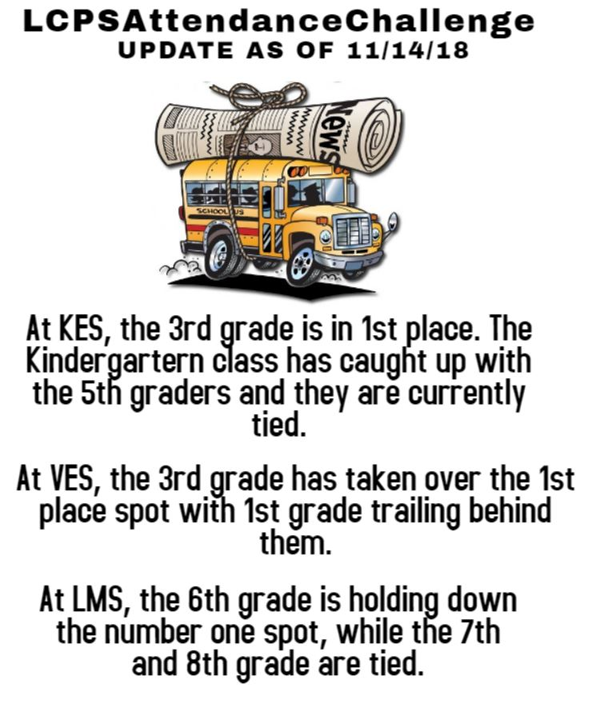
Examples of Attendance Improvement Efforts in Virginia
Spotlight on Lunenburg County Schools:

Slide 13
Examples of Attendance Improvement Efforts in Virginia
Spotlight on Westmoreland County Schools:
Notes:
Rick

Slide 14
Discussion: What are you doing in your school or division to improve attendance?
Notes:
Sandi

Slide 15
Thank you for your participation!
Please remember to sign in and leave your email address for a follow-up evaluation survey
Notes:
Sandi

