Slide 1
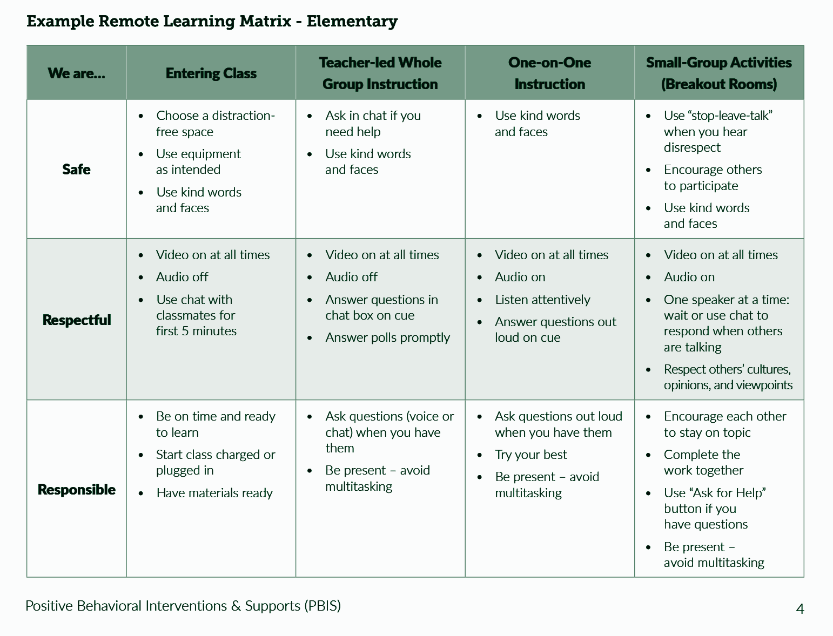
Remote Learning Matrix
Elementary

Slide 2
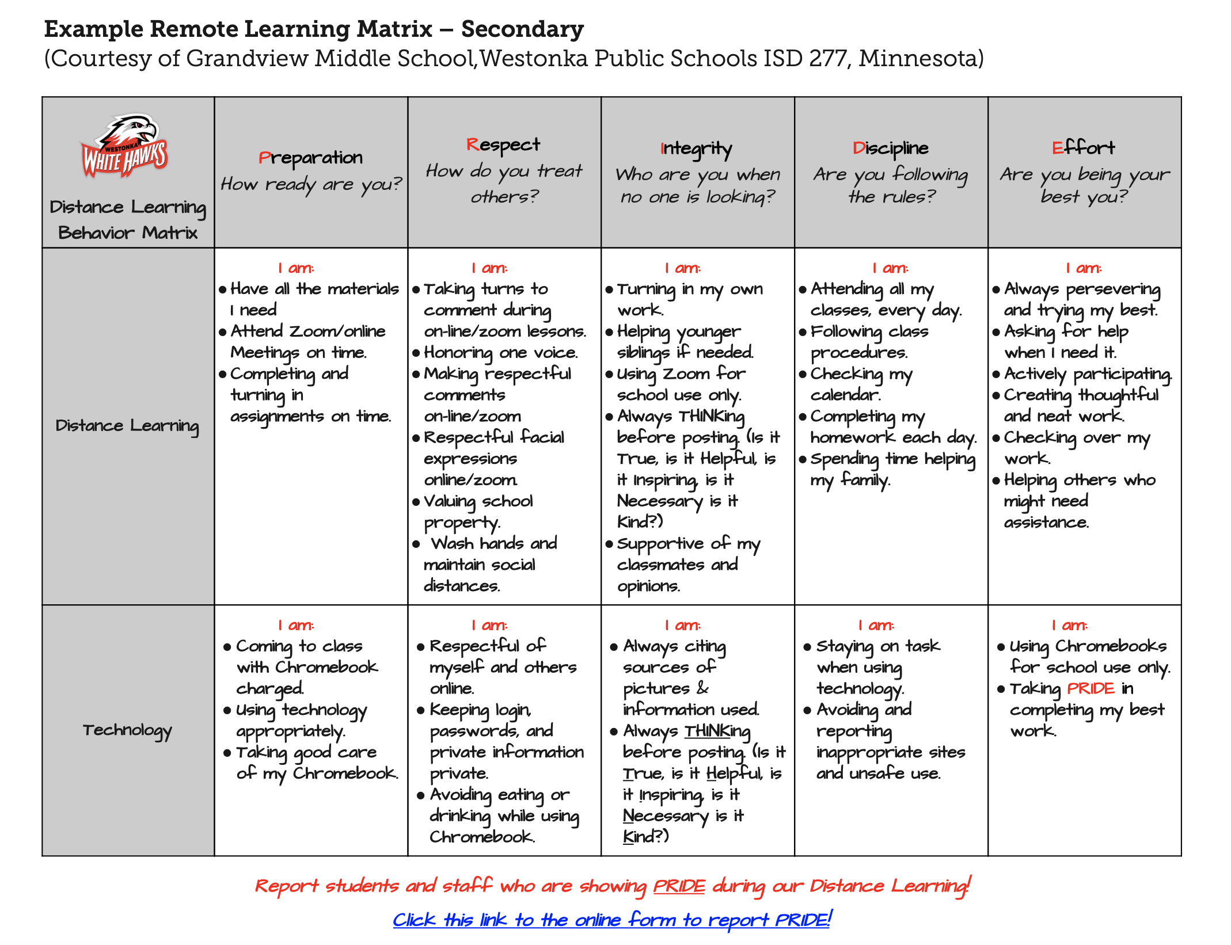
Remote Learning Matrix
Secondary

