Slide 1
What is Most Critical for Divisions? Supporting Students, Staff, and Families - Part 1
Virtual Administrators Community of Practice Session August 6, 2020

Slide 2
Thank you for joining us for today’s Community of Practice! We will begin at 3:30.

Slide 3
Please introduce yourself and sign in to the Chat Box. Please include:
your name, division, school name, email address and preference of breakout session (elementary, middle or high school)
Welcome!
Notes:
Sherol

Slide 4
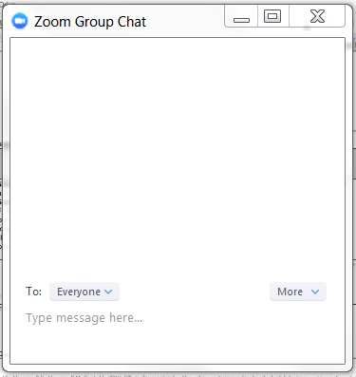
Navigating ZOOM!
CHAT
MUTE YOUR MICROPHONE
HIDE YOUR VIDEO CAMERA
SHARE YOUR SCREEN
Please mute your microphone unless speaking to the group.
Notes:
Sherol

Slide 5
Share your name, division, and school
Notes:
Sherol

Slide 6
Please be sure to complete the brief evaluation after the webinar!
Evaluation Link:
https://redcap.vcu.edu/surveys/?s=MWWRYETR4A
Notes:
Sherol

Slide 7
Our Long Term Goal for Administrative COPs:
Administrator Networking

