Slide 1
Advanced Tiers and Special Education
Advanced Tiers Community of Practice
March 9, 2021

Slide 2
Attendance
Please register your attendance at:

Slide 3
Virtual Norms

Slide 4
Zoom Notes
Watch for the flashing orange alert which notifies you of a new chat
Closed captions are available
If you don’t see a full screen; some of the slide is cut off, choose “display options” to change your screen display

Slide 5
Who is With Us?
District Administrators | Building Administrators | School Counselors
General and Special Education Elementary Teachers | General and Special Education Secondary Teachers | Other…Tell us in the Chat!

Slide 6
Current Learning Environment?
All Virtual | Hybrid | All Face-to-Face

Slide 7
Learning Intentions
Participants will
Align and clarify advanced tiers and special education core vocabulary
Describe specially designed instruction across tiers in a multi-tiered system of supports

Slide 8
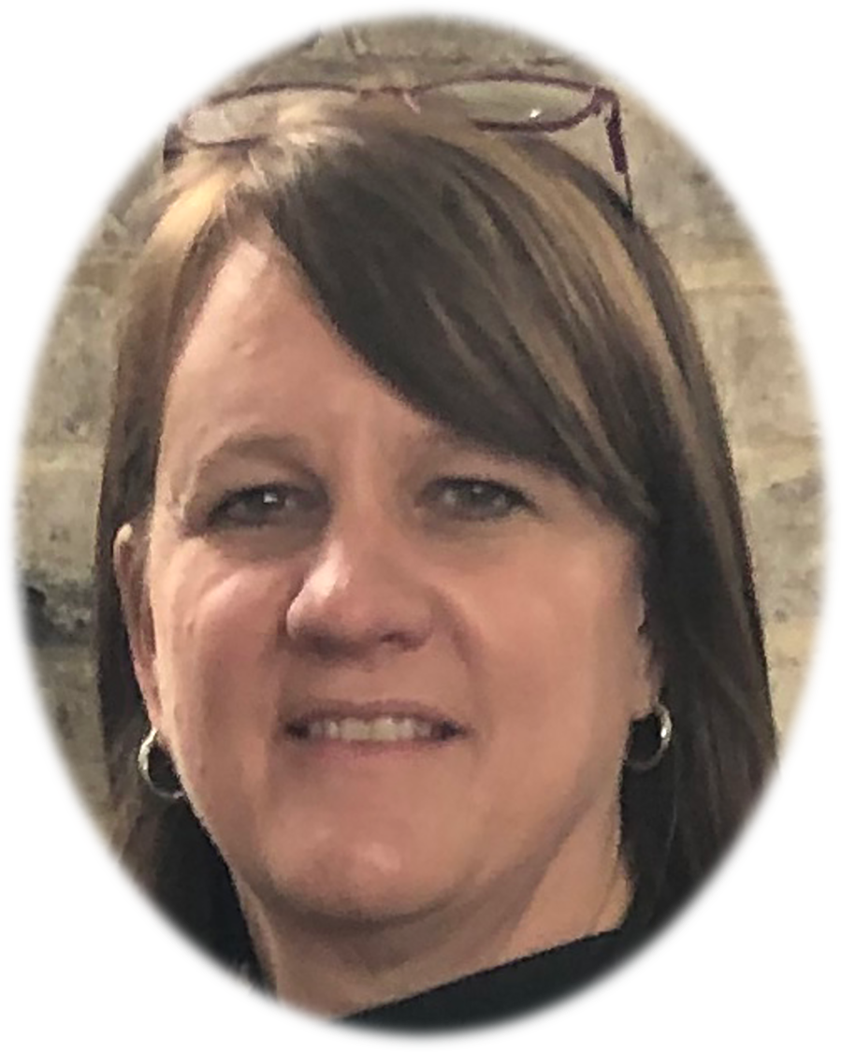
A Warm Welcome...
Region 5 T/TAC @ JMU:
Functional Behavioral Assessments
Classroom and Behavior Management
Standards-based IEPs
Specially Designed Instruction
Co-teaching
Assistive Technology
Tiered Systems of Support
Gina Martin, M.Ed

Slide 9
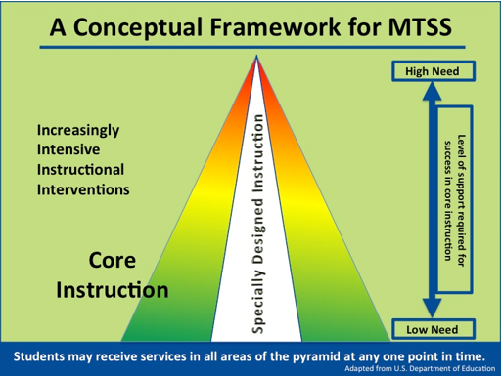
Special Education in VTSS

Slide 10
Special Education T or F
Students receiving special education services are first and foremost general education students
Special education services and specially designed instruction complement, not replace advanced tier interventions.

Slide 11
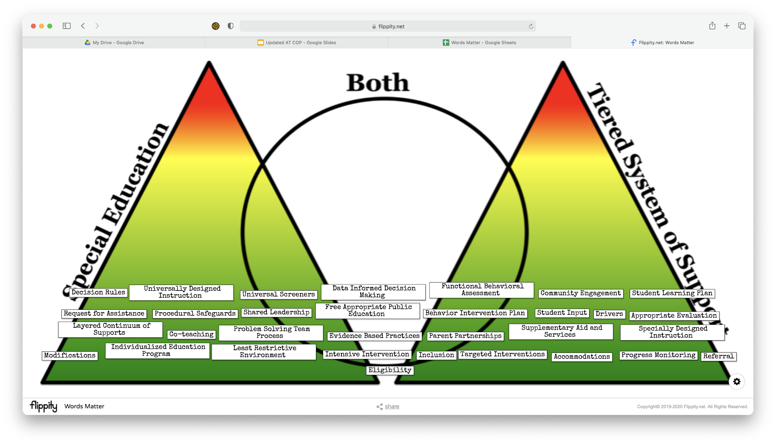
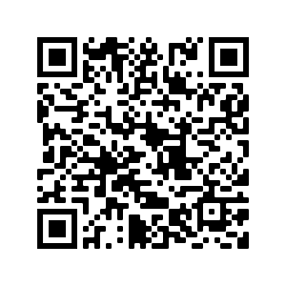
Words Matter!

Slide 12
Words Matter!
Drivers
Referral
Modifications
BIP
Decision Rules
Progress Monitoring
FBA
Targeted Interventions
IEP
Tiered System of Support
Request for Assistance
Eligibility
Accommodations
Intensive Interventions
Procedural Safeguards
Appropriate Evaluation
Student Learning Plan
Parent Partnerships
SDI
Supplementary Aid & Services
Problem Solving Team Process
LRE
Universal Screeners
UDL
Layered Continuum of Supports
Shared Leadership
Data Informed Decision Making
Co-teaching
Community Engagement
FAPE
Evidence Based Practices
Student Input

Slide 13
Special Education in VTSS-2019
October 2019
Attendance
Spanish
Theater
English
History
P.E.
Earth Science
Geometry

Slide 14
Special Education in VTSS 2021
September 2021
Attendance
Check In-Check Out
Spanish
Attendance
Virtual Learning
Specially Designed Instruction
Theater
P.E.
History
History
English
Theater
Spanish
Earth Science
Differentiated Learning
Geometry

Slide 15
What is Special about Special Ed? Characteristics

Slide 16
What is Special about Special Ed? For Whom, By Whom, Where

Slide 17
What is Special about Special Ed? Universal Design for Learning

Slide 18
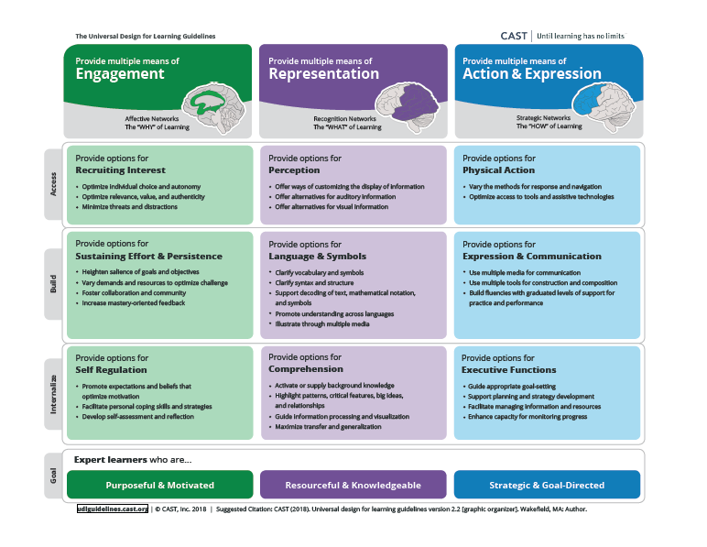
Universal Design Principles

Slide 19
Break-Out Room Roles
Facilitator-facilitate introductions and discussion
Recorder-record responses on Padlet
Time Keeper-prompt transition to next question and discussion end
Reporter-Share summary during large group report-out

Slide 20
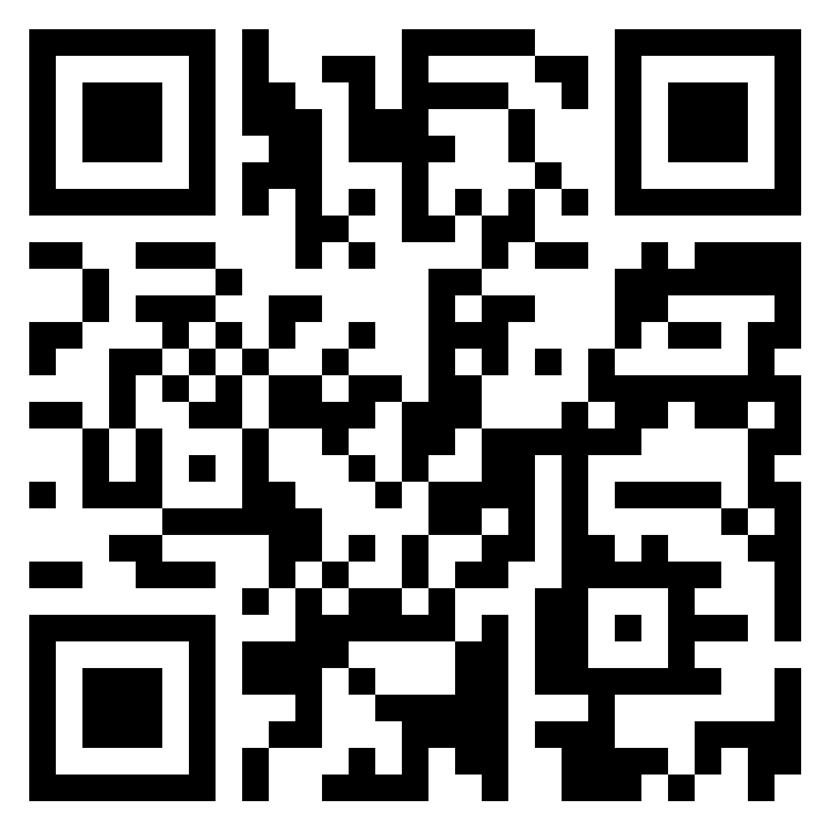
Break-out Rooms
VTSS & Special Ed
UDL
What “aha’s” did you have special education and VTSS alignment?
What questions do you still have about VTSS and special education?
How does UDL support high expectations for all students and promote collaboration between general and special educators?
What effective UDL examples can you share?

Slide 21
Evaluation
Please complete the evaluation!

Slide 22
See You This Summer
Advanced Tiers Summer Forum
for school teams
July 13-15,2021
9:00-3:00
Registration on the VTSS website

