Slide 1
Check-in, Check-out (CICO)
Fading and Self-Monitoring
Advanced Tiers Community of Practice
January 21, 2021

Slide 2
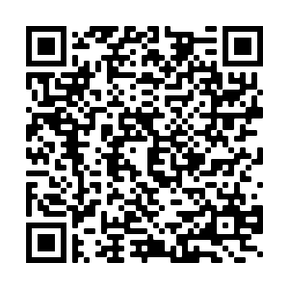
Attendance
Please register your attendance

Slide 3
Virtual Norms

Slide 4
Zoom Notes
Watch for the flashing orange alert which notifies you of a new chat
Closed captions are available
If you don’t see a full screen; some of the slide is cut off, choose display options” to change your screen display

Slide 5
Who is With Us?
District Administrators | Building Administrators | School Counselors
General and Special Education Elementary Teachers | General and Special Education Secondary Teachers | Other…Tell us in the Chat!

Slide 6
Current Learning Environment?
Face-to Face | Virtual | Hybrid

Slide 7
“Turn and Talk” in A Virtual World
Open “Chat” on your Screen
Click on the dropdown menu that says “everyone”
Select a name of someone you do NOT know to enable a private chat with this person
Introduce yourself
Name
School division
Implementing CICO?
Celebrate!
Share one positive school positive you experience from this week

Slide 8
Learning Intentions
Participants will:
increase understanding of decision rules for fading Check-in, Check-out and student self-monitoring strategies
Network with and learn from school division personnel effectively implementing CICO fading and self-monitoring strategies.
Consider data decision-making for advanced tier interventions in the current learning environment.

Slide 9
Success Criteria
School teams make data-informed decisions and follow a process for enrolling students and fading advanced tier interventions.

Slide 10
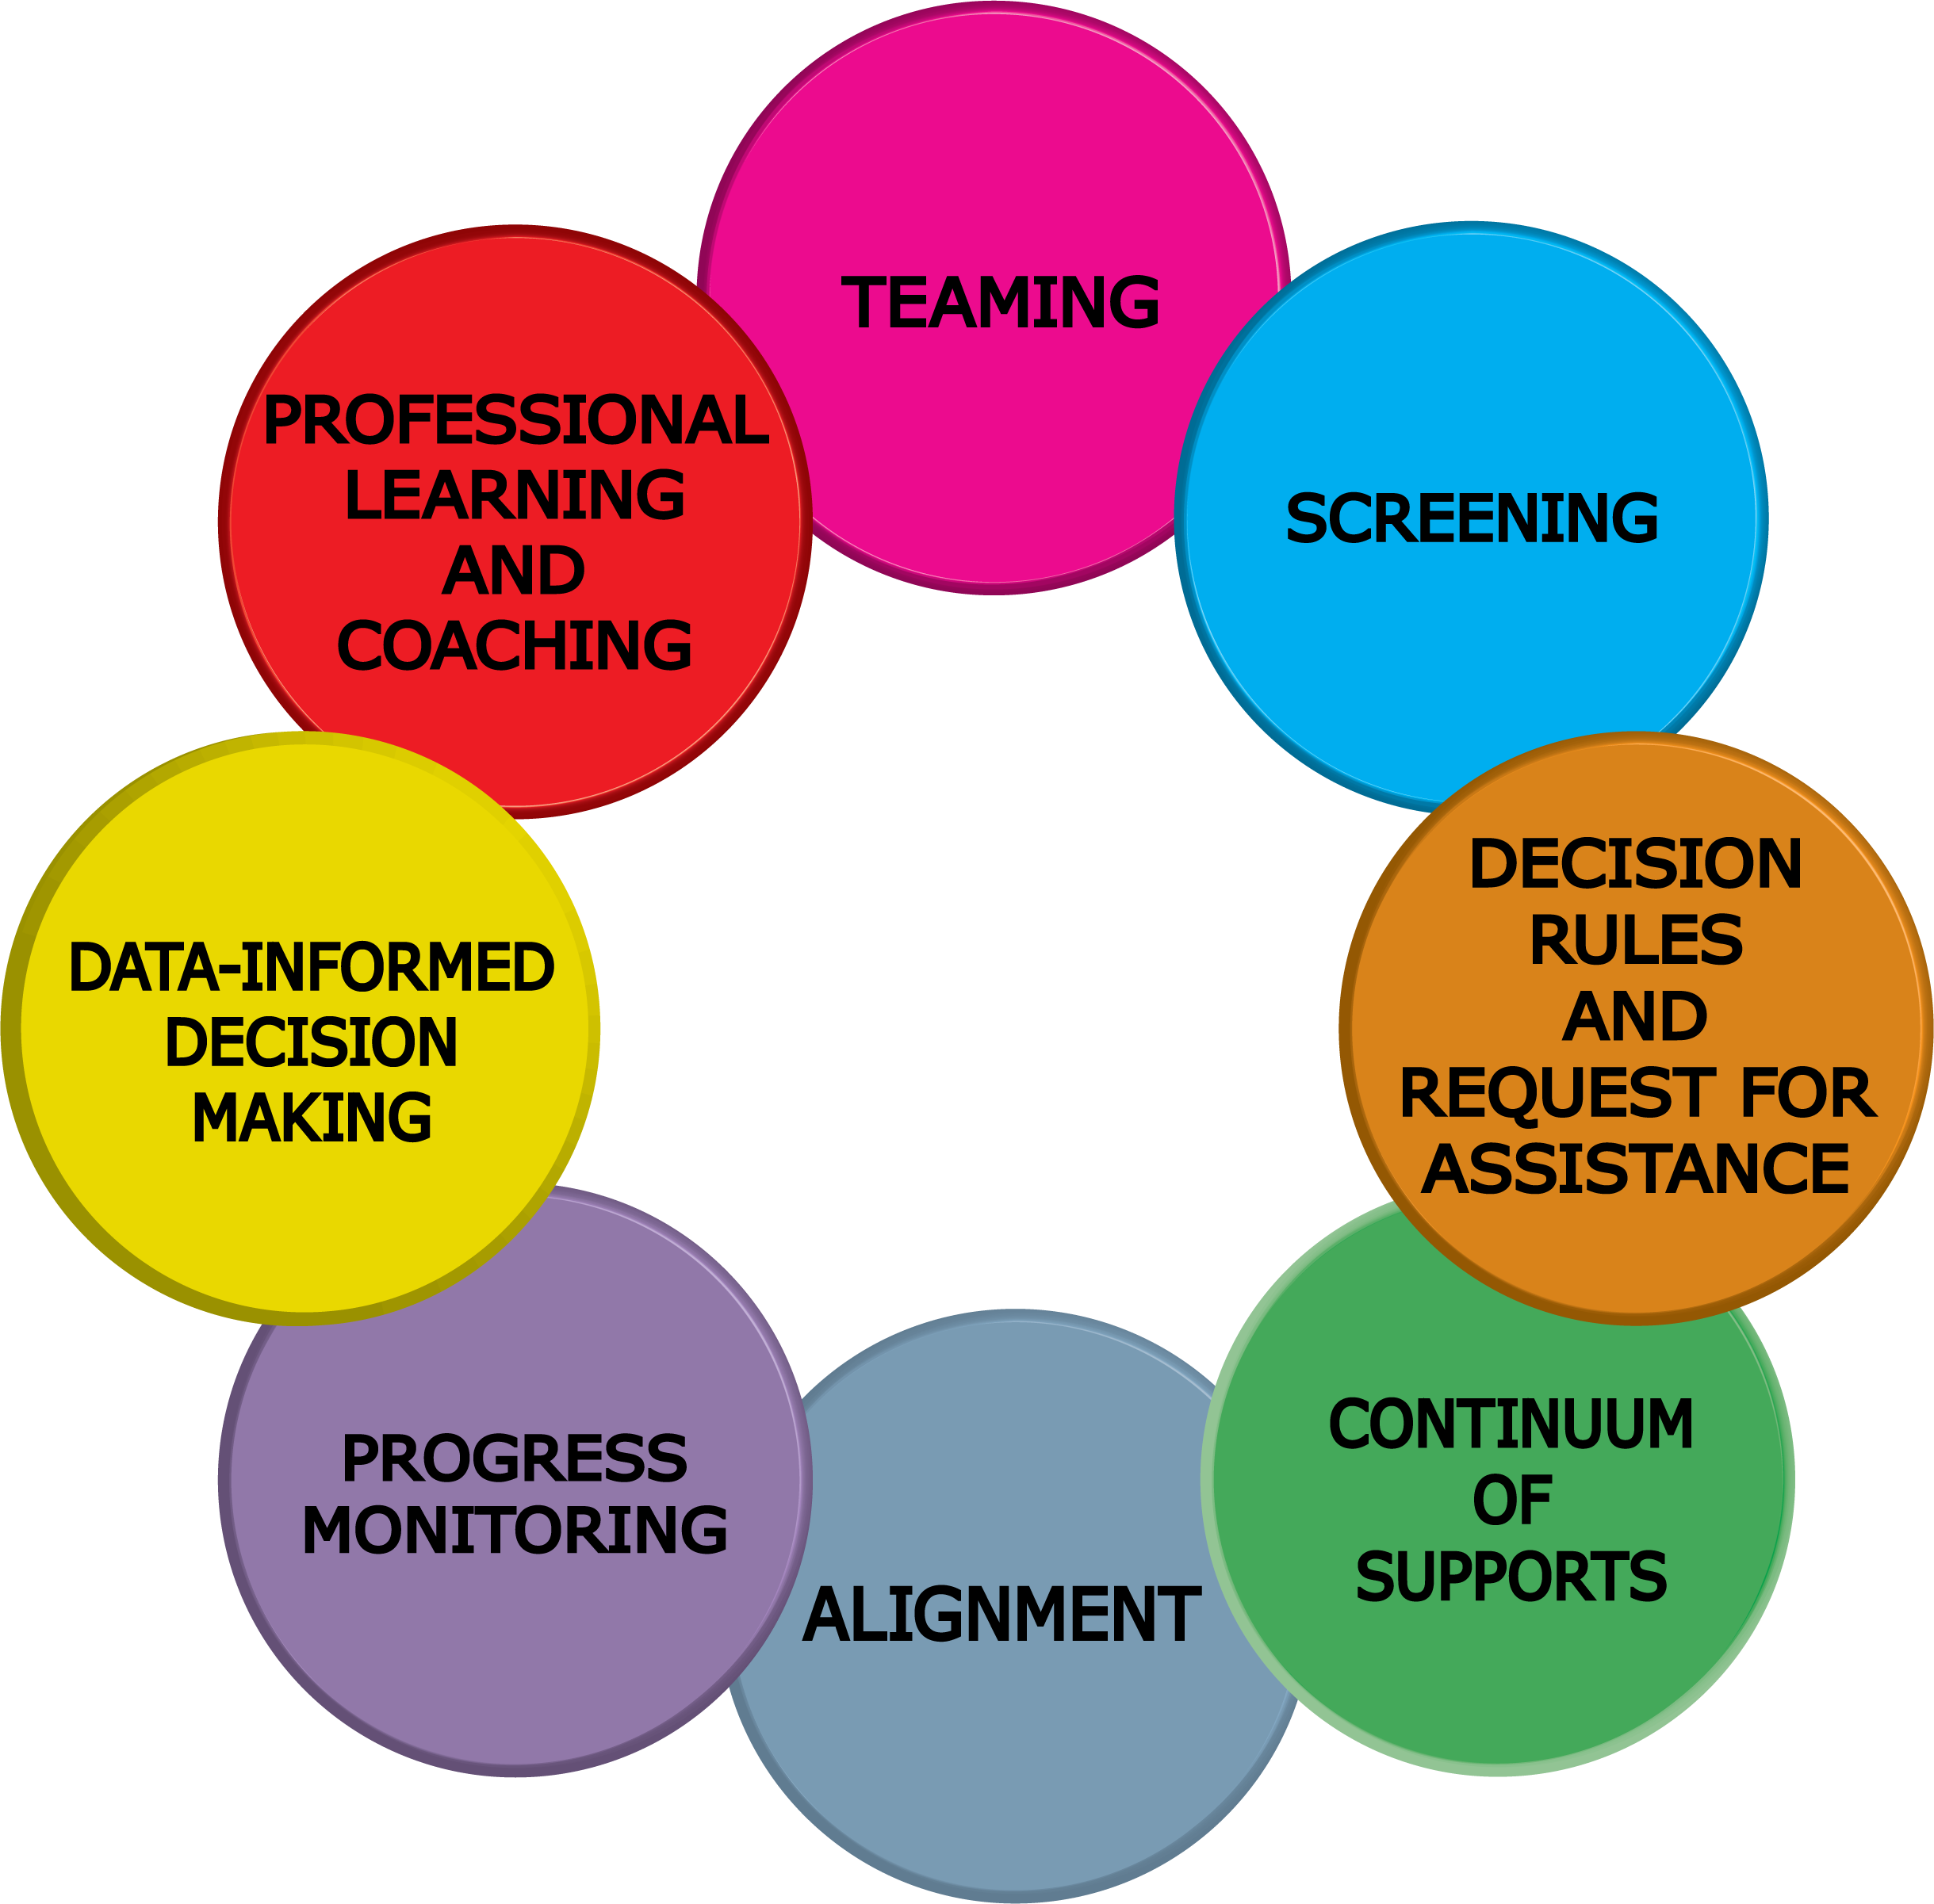
Advanced Tiers Foundations
“The Elite Eight”

Slide 11
STUDENT PERFORMANCE DATA
TFI 2.11

Slide 12
2.11b Student Performance Data
There are no headers, just single boxes
Tier II team uses Tier II intervention outcomes data and decision rules for progress monitoring and modification | Student progress data Daily/Weekly Progress Report sheets Family communication | 0 = Student data not monitored 1 = Student data monitored / no data decision rules 2 = Student data monitored at least monthly; use data decision rules to alter support

Slide 13
CICO Student Data Conversations
Entry
Enrolled
Exit
What qualifies a student to receive intervention
Frequent progress monitoring while enrolled in intervention
Evaluation to determine when to fade, graduate, or change

Slide 14
Exit: Fade to Graduate
“5 students have met and maintained their goals”
For two weeks, students will check in less frequently
Move to student self-monitoring
Participate as a student leader
Participate in a Graduation Celebration

Slide 15
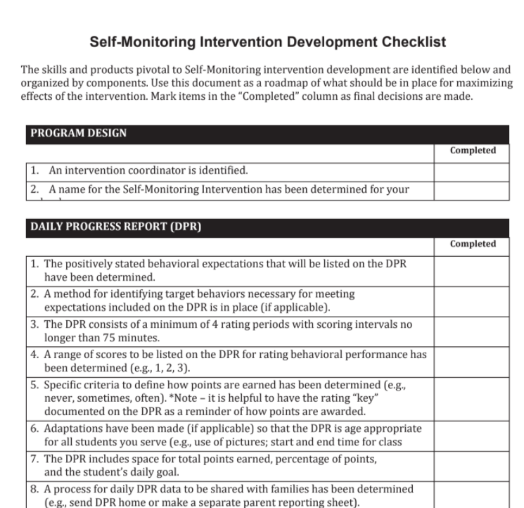
CICO Self-Monitoring
EBP
Sustains use of DPR and data collection
Shifts from teacher to student rating of own behavior
“I do, we do, you do”

Slide 16
Self-Monitoring Phase 1
Student learns to accurately self-assess
Teacher and student score DPR simultaneously
Compare ratings
Success = ratings match (even if low rating)
Teacher rating assumed accurate
If discrepancy in score, discuss and teach
Provide acknowledgement for accuracy

Slide 17
Initial Instruction
The initial goal when teaching self-monitoring is for the student rating to get closer and closer to the teacher rating until the student is reliable and accurate in rating his/her own behavior
(80% agreement between teacher and student for 5 consecutive days)
*Document % of agreement and continue to monitor daily progress scores

Slide 18
Fade Teacher Rating
Teacher Rating Removed
Begins once a student demonstrates consistency in accurately rating behavior for 5 consecutive days at 80%
Student continues to rate self for 2 weeks, checking in and out with facilitator

Slide 19
Fading Tips
Talk about fading during initial orientation
Provide weekly alumni check-outs
Small reinforcer for continuing to be successful after CICO intervention
Host quarterly alumni party
Establish criteria (no ODRs during quarter)

Slide 20
More Fading Tips
Provide other opportunities and experiences that access adult attention
Transfer enrollment to leadership roles
Alumni assistant to the CICO Coordinator
Help organize materials and reinforcers
Become an assistant to another adult in the building

Slide 21
Graduate!
Graduation is a time of celebration!

Slide 22
Experience from the Field!
Prince William County Public Schools:
Rebecca Yellets-Supervisor of Special Education (ED/LD) MTSS Division Coordinator
Richard Terillion-Administrative Coordinator, Office of Special Education
Rebecca Massey-MTSS Specialist
Molly Jensen-MTSS Specialist

Slide 23
Tips for Success!
Consistent data meeting structures
CICO is standing agenda item
Clearly defined tier definitions inclusive of entry/exit decision rules
Keep CICO light and fun!
Student voice
Clearly defined fading process
Differentiated support for successful transition to self-monitoring

Slide 24
2.10 Level of Use
There are no headers; just a row of cells
Team follows written process to track proportion of students participating in Tier II supports, and access is proportionate. | Tier II enrollment data Tier II team meeting minutes Progress monitoring tool | 0 = Team does not track Tier II data 1 = Student data monitored but no data decision rules established to alter (e.g., intensify or fade) support 2 = Team defines criteria and tracks proportion, with at least 5% of students receiving Tier II supports

Slide 25
What is your Data Story?

Slide 26
Entry Decision Rules
Student has:
2-5 ODR’s
1 Suspension
more than ? minutes out of instruction
Visits to clinic, counselor, administrator etc
misses more than ? days unexcused absences
? incomplete classwork/homework
? tardies

Slide 27
Break-Out Room Roles
Facilitator
Recorder
Time Keeper
Reporter

Slide 28
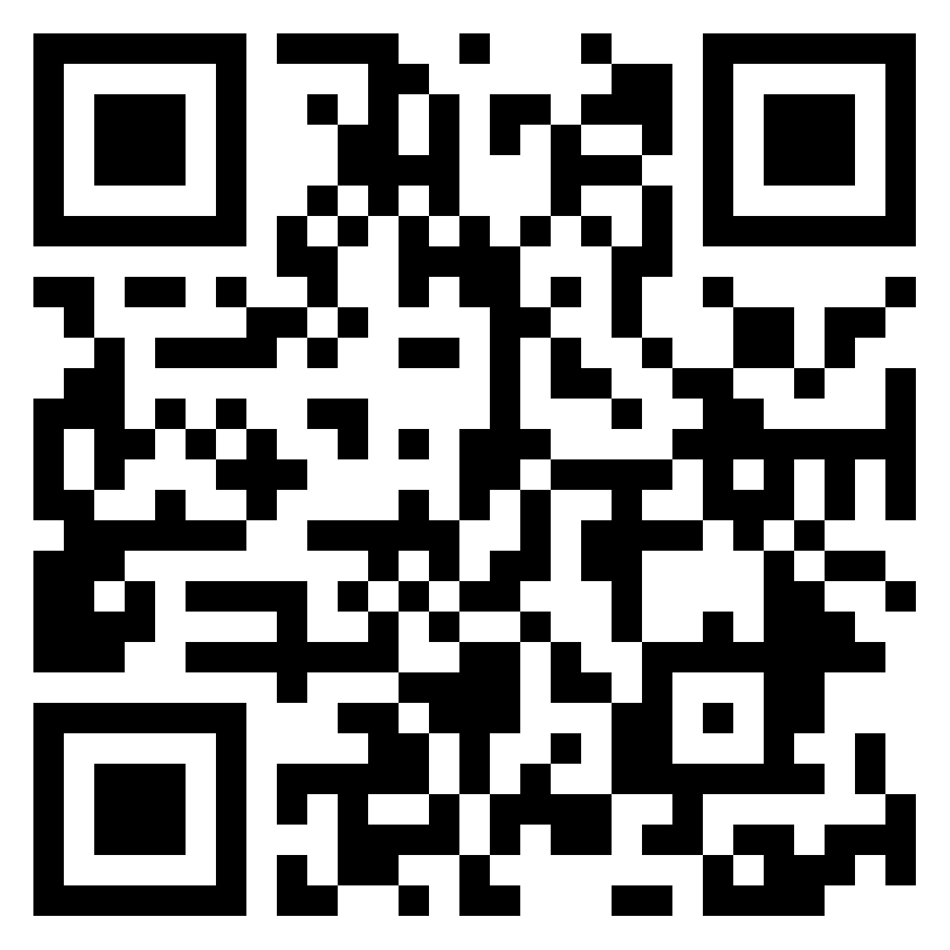
Break-out Rooms
Entry Decision Rules
What data is your team collecting and what are some of your decision rules for entry into advanced tier intervention within the current context?

Slide 29
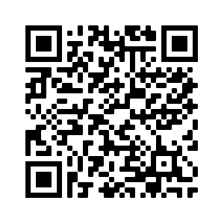
Evaluation
Please complete the evaluation!

Slide 30
Coming up Next!
Next Advanced Tiers Virtual Community of Practice
Advanced Tiers and Special Education!
March 9, 2021
3:00-4:00 PM

Slide 31
For More Information
•Visit VTSS-RIC and PBIS for more CICO resources
•Contact your VTSS Systems Coach
Thank you for completing the evaluation.

