Slide 1
VTSS
Advanced Tiers COP
Modifying and Intensifying CICO in Virtual and Hybrid Settings

Slide 2
Where are We with CICO?
Use annotate tool to stamp any box that is true for you.
Implementing CICO as an advanced tier intervention for 10-15% of students in our school | Used CICO as intervention before pandemic, but not currently implementing | Implementing CICO in virtual learning environment
Implementing CICO in face-to-face learning environment | Implementing CICO in hybrid learning environment | Implementing CICO in any learning environment with 70% of students responding

Slide 3
Navigating ZOOM!
CHAT
MUTE YOUR MICROPHONE
HIDE YOUR VIDEO CAMERA
SHARE YOUR SCREEN

Slide 4
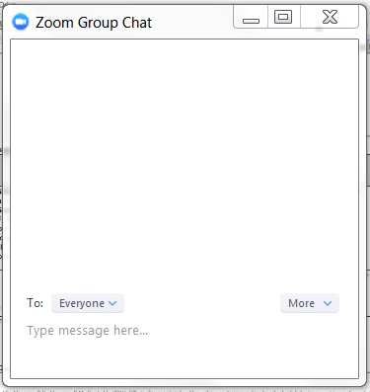
Chat Box Feature

Slide 5
Virtual Community Norms
Goal | Instructions
Be Engaged | Unmute to share ideas/ questions Participate in virtual activities
Be Respectful | Eliminate distractions like cell phones, email, social media and background noise. Give others time to talk and share. Be committed to attend all three days
Be Prepared | Download materials prior to the session. Set dates/times with your team to continue action planning after professional learning.

Slide 6
Today’s Agenda
3:00 - 3:05 Welcome and Introductions
3:05 - 3:15 CICO Virtual Modifications
3:15 - 3:30 Waynesboro Implementation and questions
3:30 - 3:45 DPR and data decisions
3:45 - 3:55 Break-out room discussions
3:55 - 4:00 Resources and Evaluation

Slide 7
Learning Intentions
Participants will:
Increase understanding of how to adapt CICO to virtual and hybrid learning environments
Use data-informed decision making to modify or intensify CICO for students not making adequate progress in the intervention

Slide 8
Success Criteria
Through participation in today’s COP, I will use resources and information to successfully:
Adapt school CICO implementation with fidelity to a virtual or hybrid learning environment
Use data-informed decision making to modify or intensify feedback for students not making adequate progress in CICO intervention

Slide 9
Determine Student Need
For CICO
Assess before you adapt
Behaviors seen at school may not manifest during distance learning
Behaviors in distant learning may not be same as in school setting
Role of Coordinator in adaptation
Notes:
Before adapting a child’s CICO, assess to determine if the student has a need while doing distance learning. Behaviors at school may not be an issue in a distant learning environment and often behaviors may manifest in the distance learning setting that did not exist in school setting. It is the role of the coordinator to ensure CICO is adapted to meet the students’ needs whether in an actual school setting or in a distant learning setting.

Slide 10
Student Need and Criteria
The Advanced Tiers Team sets Intervention Criteria for both settings
Considerations for Criteria
Preparing for transitioning from distance learning to in school setting
Notes:
The Advanced Tiers Team must be proactive in preparing for a virtual CICO process adaptation. Think about how the team can determine the need students may have for a distance learning CICO. Considerations for criteria include: lack of independent work completion, inappropriate language during virtual settings, lack of attention, organization skills, lack of some computer literacy. Some students may spend time playing on devices but may not know how to apply their skills to zoom, submitting work electronically, using annotation, and etc. Students will need support as they transition back into the actual school setting. Assess what skills may need supported as students return to school: time management for getting up earlier, going to bed earlier, setting time for homework in afternoons, etc.

Slide 11
Adapting CICO Routine to
Fall 2020 Learning Environments
As much as possible:
Continue scheduled, daily contact with the student.
Modify as needed:
Schedule
How connection is made

Slide 12
Modifying the Schedule
Remember:
Check in daily whenever possible!
If necessary, check in/check out:
2 – 3 times per week
May be aligned with live sessions or asynchronous sessions
“At the Very Least” (not recommended):
Check in on Monday before first session/class
Check out on Friday after last session/class

Slide 13
Modifying the Routine
Time: Tailor to student’s needs
beginning /end of their instructional day
Best Practice: Video/Phone Call
*Can be modified to text/email if student is responding well to virtual environment and logging on regularly
Platform: Be consistent
Connect how student connects for classes (Zoom, Google Meet, etc.)

Slide 14
Suggestions During “Check-In”
Greet/praise student for checking in
Remind briefly – DPR expectations
Support student with learning environment at home and creating schedule for work and breaks during day
Remind student how/when to connect at end of day
Provide encouragement
Video Link: Example: Virtual Check In

Slide 15
Suggestions During “Check-Out”
Review day based on DPR
Focus on POSITIVES – encourage future success
Calculate daily % to determine if goal was met
Share DPR electronically with family/caregiver at end of the day
Video Link: Example: Virtual Check-Out

Slide 16
Waynesboro City Public Schools
Kate Collins Middle School Example
Modified DPR
Check-In form
Check-Out form

Slide 17
KCMS Tier II Adjustments for 2020-21
Slow start due to lack of data
Modifying Decision Rules
Failing 4 or more classes
Absences 10% or more
3 or more ODRs
Online Request for Assistance Form

Slide 18
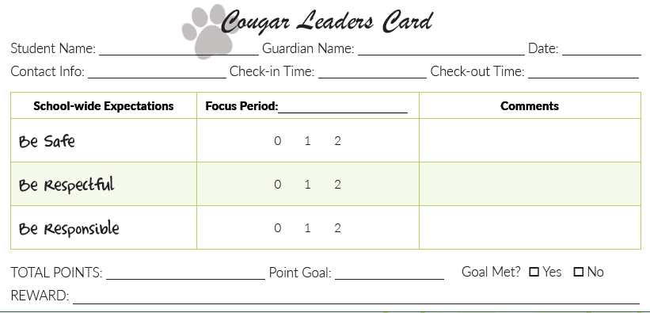
Synchronous DPR
Continue face-to-face practice of teacher providing feedback after a lesson
Notes:
Need to modify to fit student schedule and family schedule. May choose to use DPR for:
only the subject(s) CICO most needed
each activity that is part of learning at home schedule
student’s full daily schedule including home activities
Need to modify rating process
Maintain student privacy
breakout room, private chat, text message, shareable electronic form
Increased frequency of verbal and non-verbal feedback during instruction
Need to modify who gives the rating
family member
other school personnel (A?)
self-monitoring

Slide 19
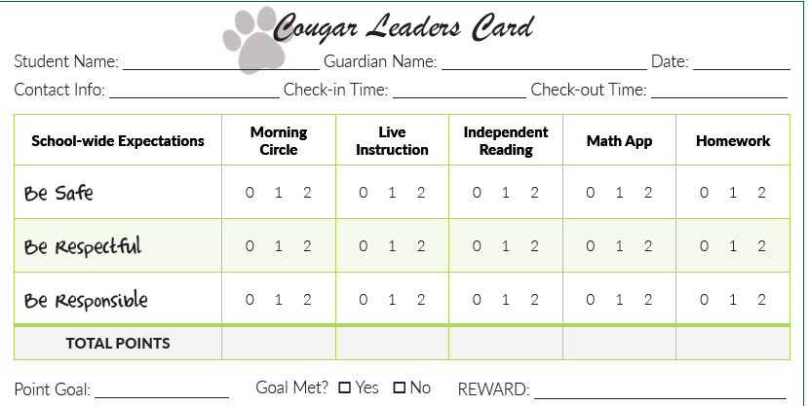
Multiple School Periods
Notes:
DPR agreed upon in consultation with families. What do students/families need? What is feasible?

Slide 20
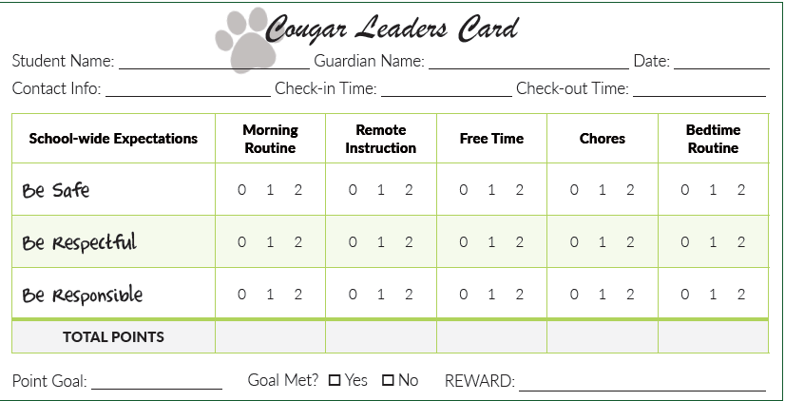
Home Activities Included
Notes:
Critical to partner with families and obtain agreement for whatever DPR is adopted. Consider family check-ins as well as student check-ins given increased family engagement in the intervention implementation
Only extend to family if you are assured you can provide orientation and feedback to family members providing feedback
Asynchronous remote instruction would be similar to home activities. Student behavior cannot be observed nor feedbc given directly by the teacher or staff during asynchronous learning. These situations require family/caregiver feedback or student self-monitoring.
In cases where student is not yet proficient with self-monitoring and an adult cannot provide interval feedback, maintain the practice of morning check-in and check-out with the coordinator.

Slide 21
Determine Reinforcement for CICO
Provide on a Daily or Weekly basis
Include Family/Caregivers
Align No-cost Rewards with Routines and Rituals
Notes:
Guidance on Adapting CICO for Distance Learning-Center on PBIS
Adapting Check-in Check-out (CICO) for Distance Learning (Michigan)
Image source: https://www.producthunt.com/posts/snap-camera
Increased Family/Caregiver participation in the process (attending check-ins and providing behavior ratings) may be too much to ask, therefore reduction to either daily or weekly check-ins may still provide the positive adult interactions to help students be successful.
Family/Caregivers have knowledge of student incentive preference
Family/Caregivers may need support in establishing the process such as establishing clear criteria and goals as well as no loss of rewards once earned

Slide 22
Virtual CICO Reinforcement
HOME
SCHOOL
Favorite:
Dinner
Movie
Game Night
Additional Time:
Break
Lunch
Activity
Screen Time
Video call from favorite extended family member
Virtual Media Selections
Time with Favorite:
Admin
Teacher
Staff
Choice of Activity
Additional Resources
Notes:
Virtual time with an adult from the educational community not only helps maintain bonding with school but may provide a bit of respite for the family/caregiver
Earned “breaks” from online learning or extended lunch time
Additional student sharing time online, such as telling a joke or story to the class, developing and sharing a video about a favorite topic, etc.
Have participants put symbols beside each reinforcement based on the age level they serve (e.g. heart for EC, circle for Elementary, star for Middle and diamond for High)

Slide 23
Data-Informed Decisions
Revisit Decision Rules?
Modify or intensify if...
below goal for 2 weeks?
Why might CICO not be successful?
Does the student know how CICO works?
Is the student interested in the rewards?
Is it implemented consistently and with fidelity?
Is the student receiving increased instruction and practice?
How frequent are the feedback intervals?
Notes:
Revisit decision rules for entry, fading, maintaining or intensifying

Slide 24
Which Disco Song Best Describes Your Current Virtual CICO?
“Good Times” by Chic
“Ain’t No Stoppin’ Us Now” by McFadden & Whitehead
“Got to Give It Up” by Marvin Gaye
“I Will Survive” by Gloria Gaynor

Slide 25
Break-Out Room Discussion
What adaptations will your team make to sustain CICO as an advanced tier intervention in the current context:
student identification
family involvement
CICO routine
DPR
Acknowledgement
Decision rule

Slide 26
How Did We Do?
Through participation in today’s COP, I will use resources and information to successfully:
Identify students for CICO
Create and sustain a structure for CICO feedback in a virtual or hybrid learning environment
Use data-informed decision making to modify or intensify feedback for students not making adequate progress

Slide 27
Evaluation
Please complete the evaluation at
and join us for our January 21, 2021 COP on “Fading and Self-Management”

Slide 28
Resources
Guidance on Adapting CICO for Distance Learning
Michigan’s MTSS Adapting CICO for Distance Learning

