Slide 1
How to prepare for the Division Capacity Assessment (DCA) & Tiered Fidelity Inventory (TFI)
Virtual Community of Practice
December 17, 3:30 - 4:30

Slide 2
PLEASE INTRODUCE YOURSELF AND
SIGN IN TO THE CHAT BOX WITH:
YOUR NAME, DIVISION, ROLE, EMAIL ADDRESS, AND HOW LONG HAVE YOU BEEN WORKING WITH VTSS
Welcome!

Slide 3
Share your division name, email and primary role

Slide 4
Navigating ZOOM!
CHAT
MUTE YOUR MICROPHONE
HIDE YOUR VIDEO CAMERA
SHARE YOUR SCREEN

Slide 5
Learning Outcomes
Clarify purpose and structure of the DCA & TFI
Provide ready access to tools and resources for conducting the DCA & TFI
Provide opportunity for Division and Building Level Coaches to get clarification on processes
Provide an opportunity for Division and Building Level Coaches to share insights and experiences using the DCA & TFI

Slide 6
What are the DCA and TFI?
Team Reflection Tools
Scoring will be product dependent
Implementation (Action) Drivers
Decisions regarding effectiveness
Decisions regarding current implementation
Decisions to drive on-going Action Planning
Progress Monitoring

Slide 7
Division Responsibility
Division Capacity Assessment (DCA)
The purpose of the DCA is to assist school divisions to implement effective innovations including VTSS that benefit students.

Slide 8
Division Responsibility (cont.)
Division Capacity Assessment (DCA)
Each Division Leadership Team (DLT) will complete a DCA
Required for VTSS divisions
Optional for PBIS divisions
One individual (typically the Division Coordinator) will submit the data to VTSS using their secure url

Slide 9
DCA Components
Division Capacity Assessment (DCA)
27 items
3 implementation drivers
9 subscales
Scoring criteria (2-, 1-, or 0-points)
Division Capacity Action Plan

Slide 10
School Responsibility
Tiered Fidelity Inventory (TFI)
The purpose of the TFI is to provide a valid, reliable, and efficient measure of the extent to which school personnel are applying the core features of school-wide positive behavioral interventions and supports (SWPBIS).

Slide 11
School Responsibility (cont.)
Tiered Fidelity Inventory (TFI)
Each School Leadership Team (SLT) will complete a TFI
Data will be entered by the registered school Point of Contact (POC) using their secure url
View the current POC or change the current POC at www.ttac-odu.org

Slide 12
TFI Components
Tiered Fidelity Inventory (TFI)
45 items
3 tiers
12 subscales
Scoring criteria (2-, 1-, or 0-points)
TFI Action Plan

Slide 13
View Full Instruments
Copies of the DCA and TFI along with supplemental documentation can be viewed at:
https://vtss-ric.org/data-collection/midyear-data-collection-instruments/

Slide 14
What is new with the DCA?
https://nirn.fpg.unc.edu/resources/district-capacity-assessment-dca

Slide 15
Midyear 2019
Opens: Monday, February 3rd
Deadline: Tuesday, March 31st
Email your VTSS State Coach or pbisva@odu.edu for questions.

Slide 16
Academic TFI

Slide 17
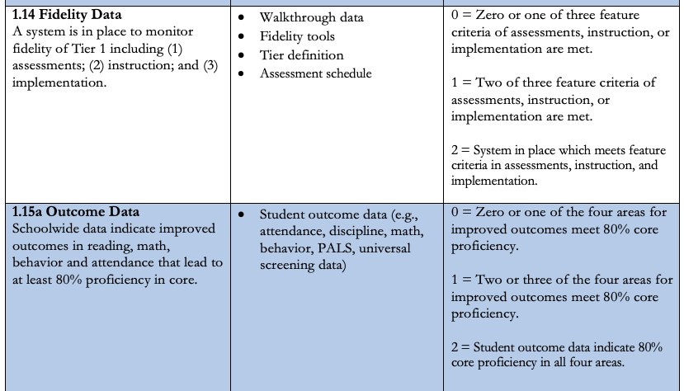
Academic TFI (cont.)

Slide 18
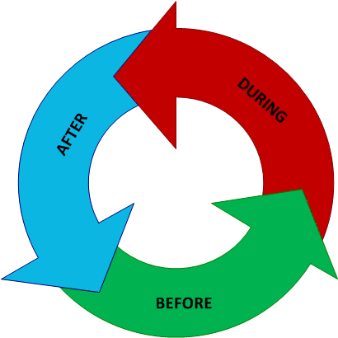
Tips and Tools
BEFORE administering the DCA & TFI
DURING administration of the DCA & TFI
AFTER administering the DCA
& TFI

Slide 19
Socrative
Copy of TFI (all 3 Tiers) and DCA (2020)
https://b.socrative.com/teacher/#import-quiz/43452916
Keep in Mind: State Coaches hold DCA Certification. The divison coordinator or division level coach must gain a DCA certification through NIRN before administering the DCA.
Keep in Mind: you will need to open a Socrative account (free) to make a copy.

Slide 20
Poll Question
How do you vote on your team?

Slide 21
Before Administering: DCA/TFI
Assure administrator has been trained prior to facilitating
Schedule carefully to ensure appropriate team members will be present
Gather artifacts for quick access during administration
Team meeting minutes, attendance, etc.
Summary from TFI walkthrough, interviews
Matrix, lesson plans, product book, etc.
Print scoring guide for all team members
DCA requires an external facilitator and an internal administrator
Determine how team members will “vote”

Slide 22
Documents to Have Available for the TFI
Discipline handbook (could be in the student, parent and/or faculty handbooks or Code of Conduct)
School improvement plan goals
Annual Action Plan for meeting school-wide behavior support goals
School wide matrix
Lesson plans for teaching the school-wide rules
Office discipline referral form(s)
Office discipline referral flow chart (what is class managed/office managed behavior)
List of PBIS team members
Artifacts, or evidence of the product (i.e. Google Drive)

Slide 23
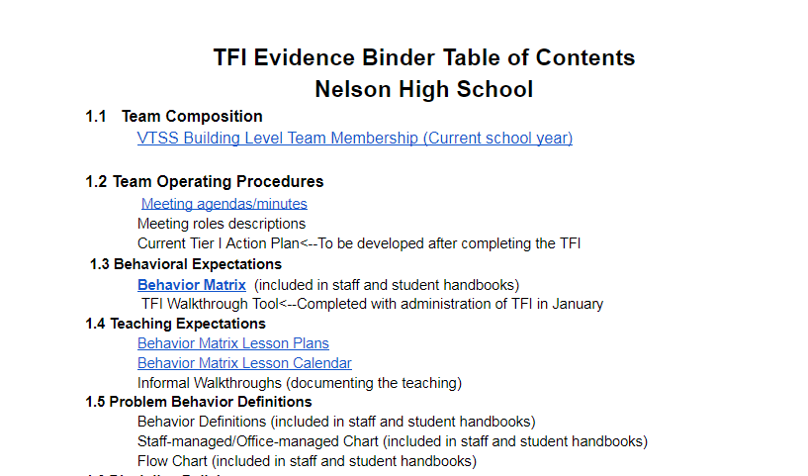
A Way to Organize the Work

Slide 24
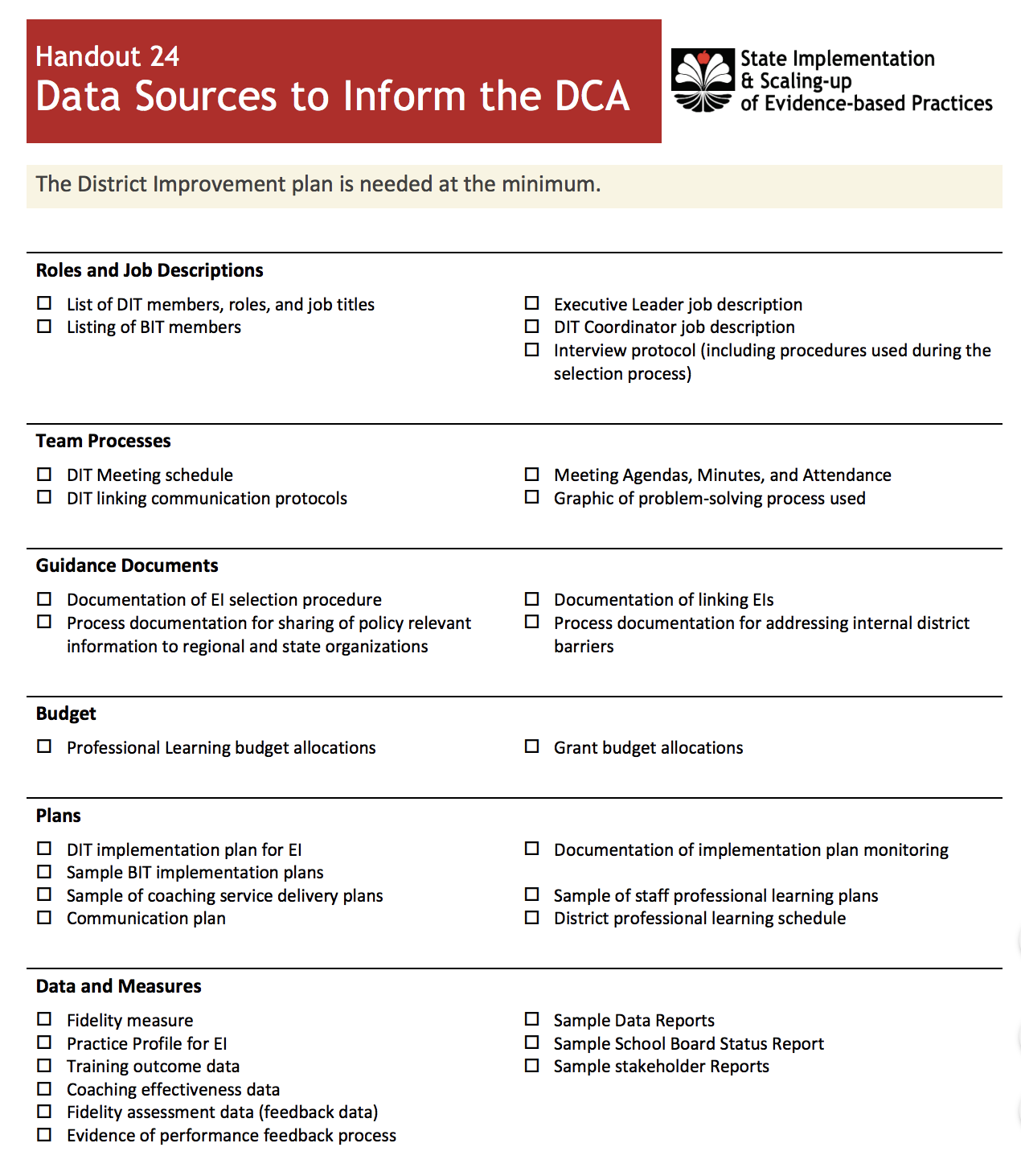
Documents to Have Available

Slide 25
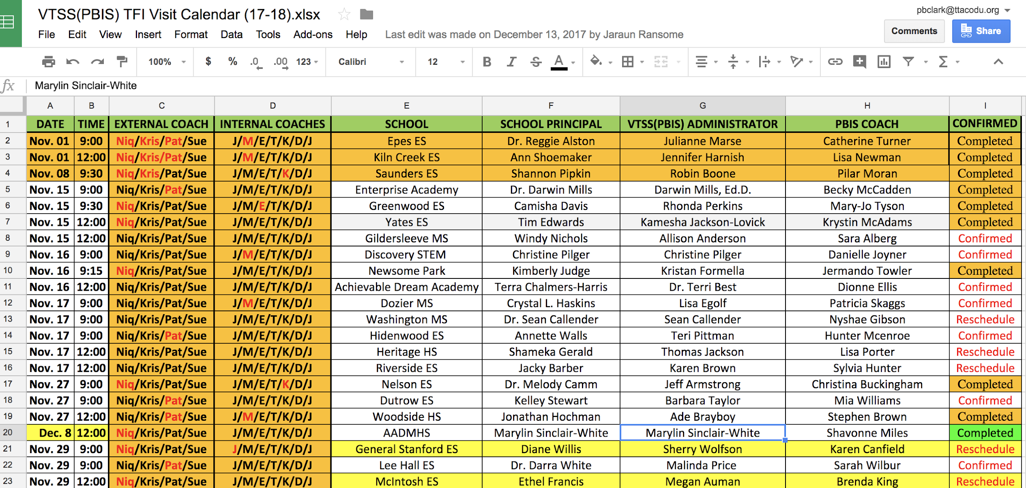
SAMPLE: Before TFI Scheduling Tool: Newport News

Slide 26
During Administration
of the DCA and TFI
Preserve the integrity and fidelity of the administration process to ensure that the DLT and school-based VTSS teams have accurate and objective results from which to plan.
Overview of purpose and administration protocol
Administrator
Facilitator
Note Taker
DCA glossary (pg. 31)
Treat as a formal process

Slide 27
During Administration
of the DCA and TFI (cont.)
Each team member has an independent voice/vote.
“What is our CURRENT status of implementation?”
Consider what your artifacts support.
Follow the established protocol for “brief” sharing of rationales when there is a split or no clear majority vote.
Embrace the “0”.
The DCA and TFI are NOT external evaluation tools.
The DCA and TFI are tools for your planning and decision-making purposes in developing your implementation (DCA)/ action (TFI) plans.

Slide 28
After Administration
of the DCA and TFI
Plan a time to meet and work on 1 - 3 obtainable goals including a few quick wins - things that could be accomplished within the remainder of the year.
Define a few long-term SMART goals.
Progress monitor action plan regularly. (i.e. add to your team meeting agenda for consistent review)

Slide 29
Welcome Suffolk
Dr. Suzanne Rice,
Asst. Supt. Student Services

Slide 30
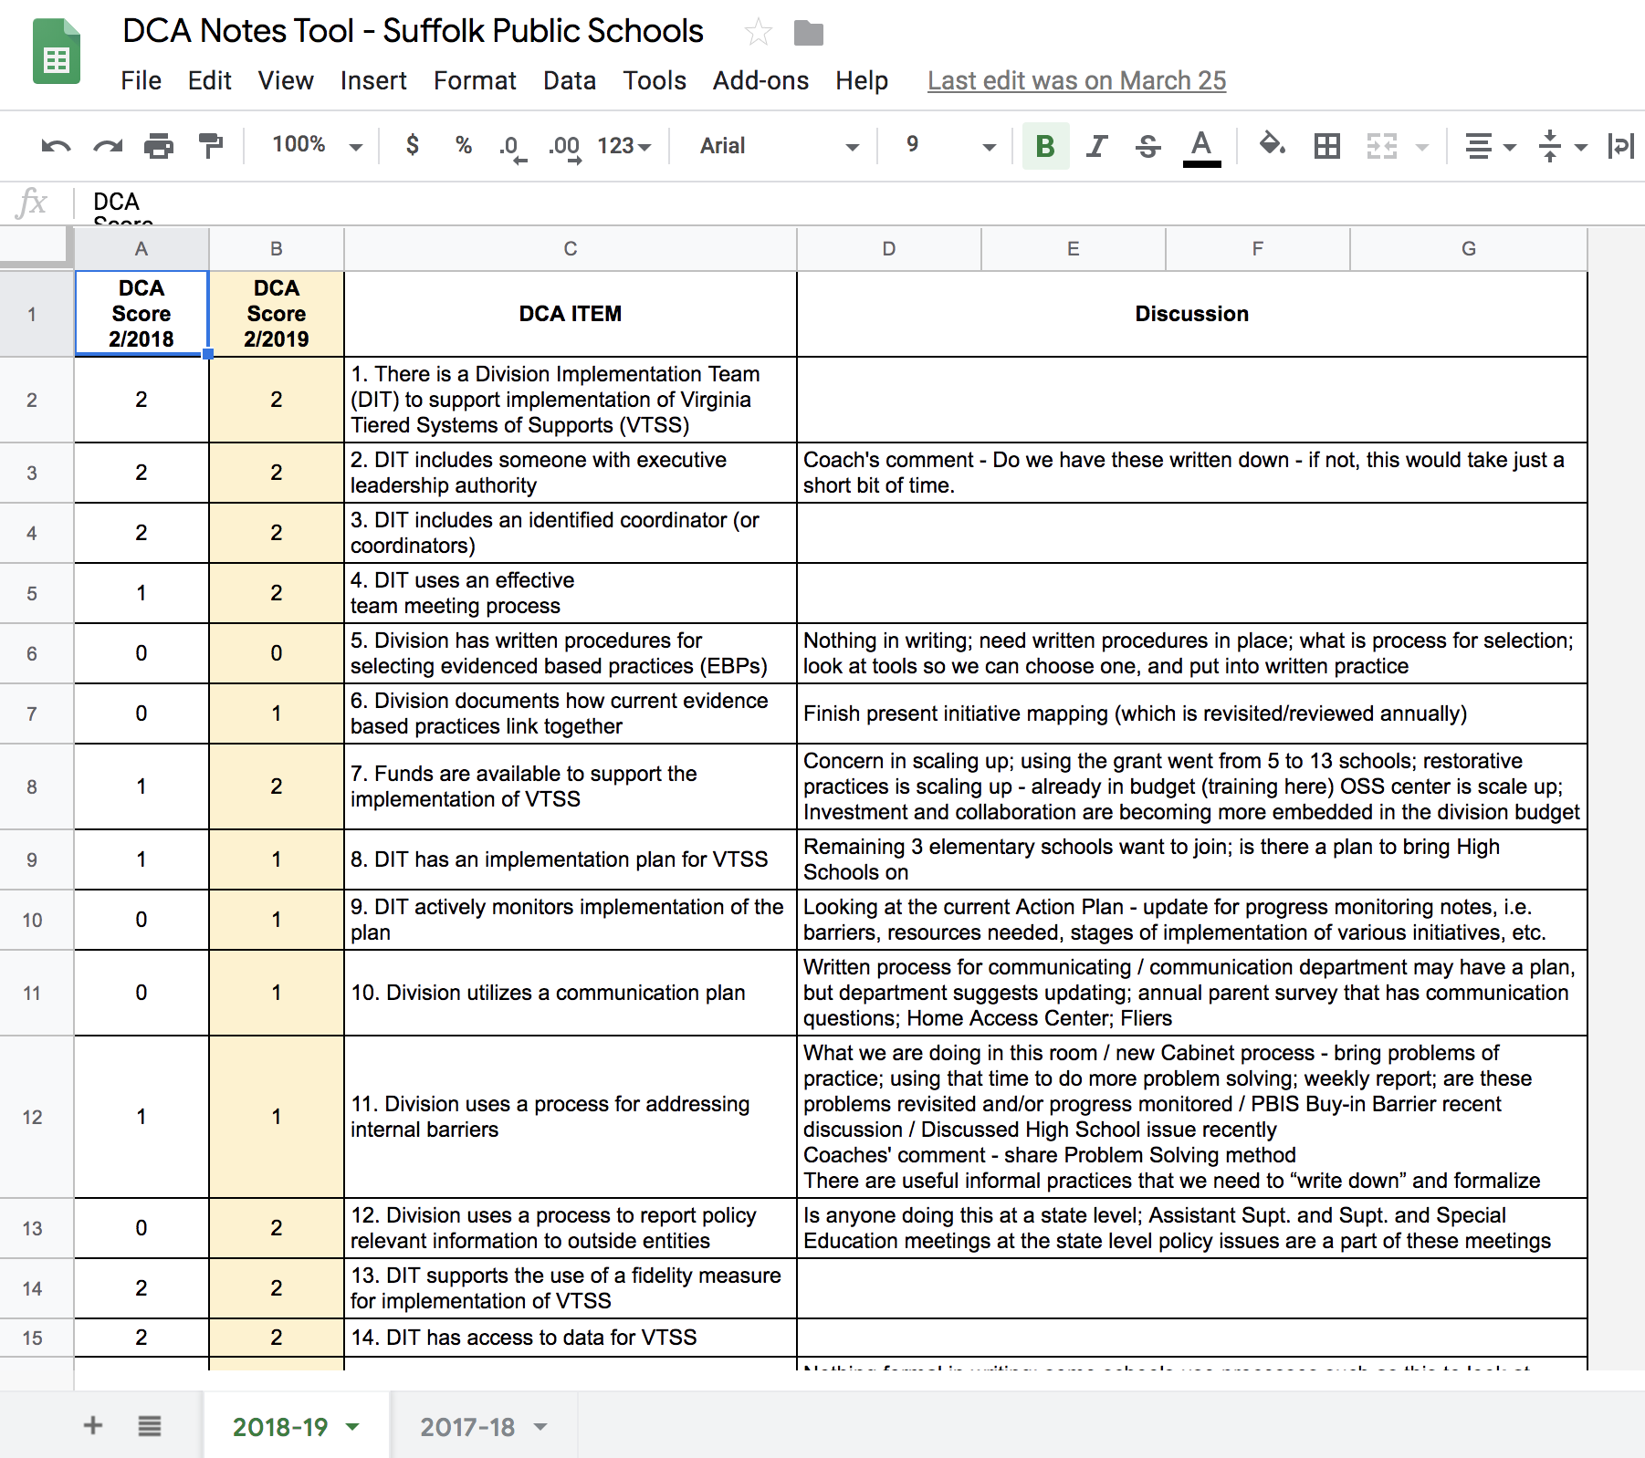
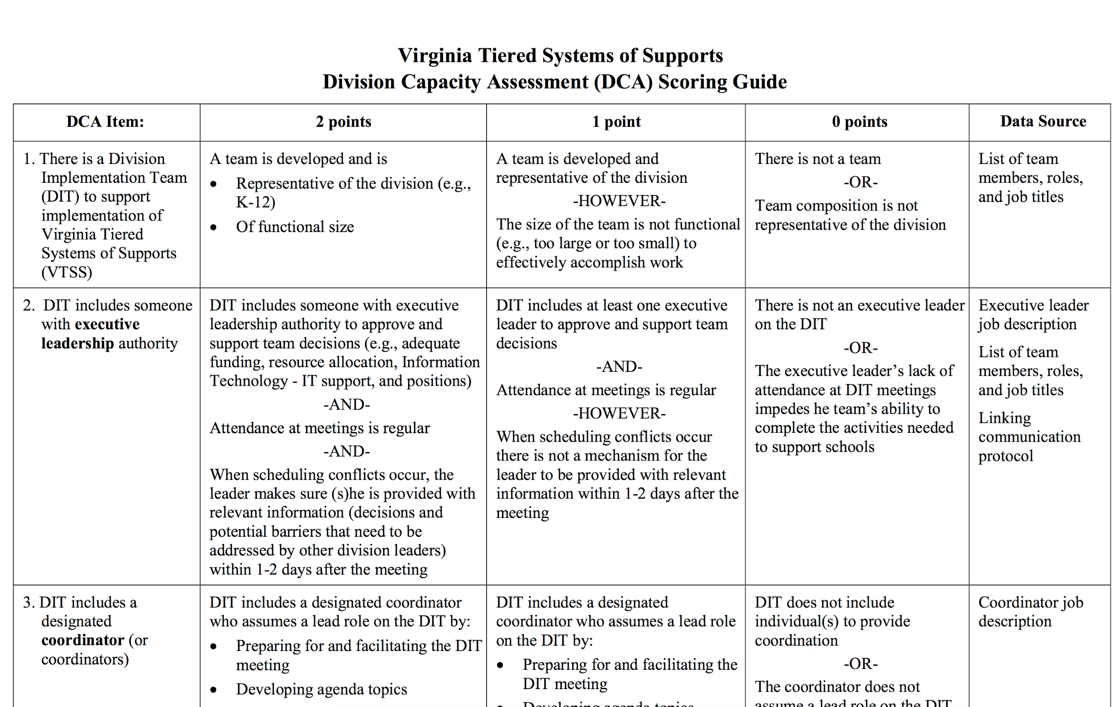
DCA Note-taking

Slide 31
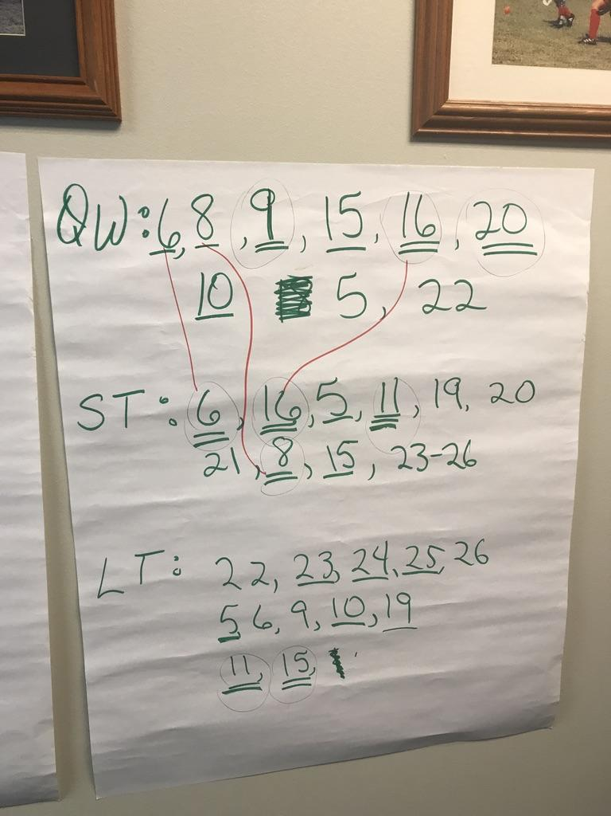
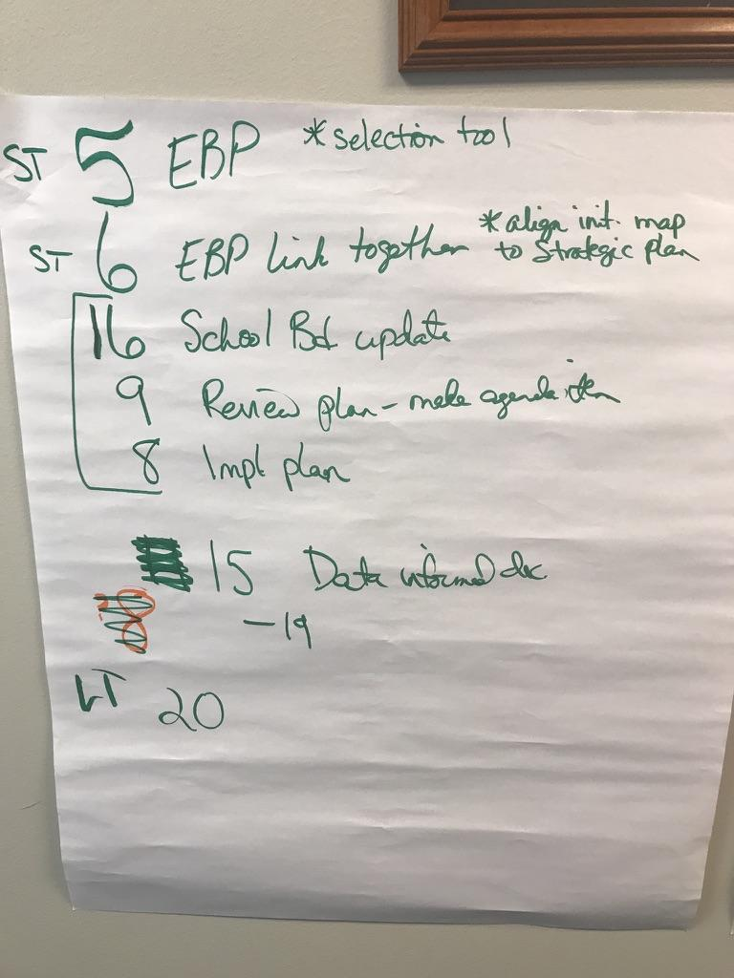
DCA Informed PRIORITIES

Slide 32
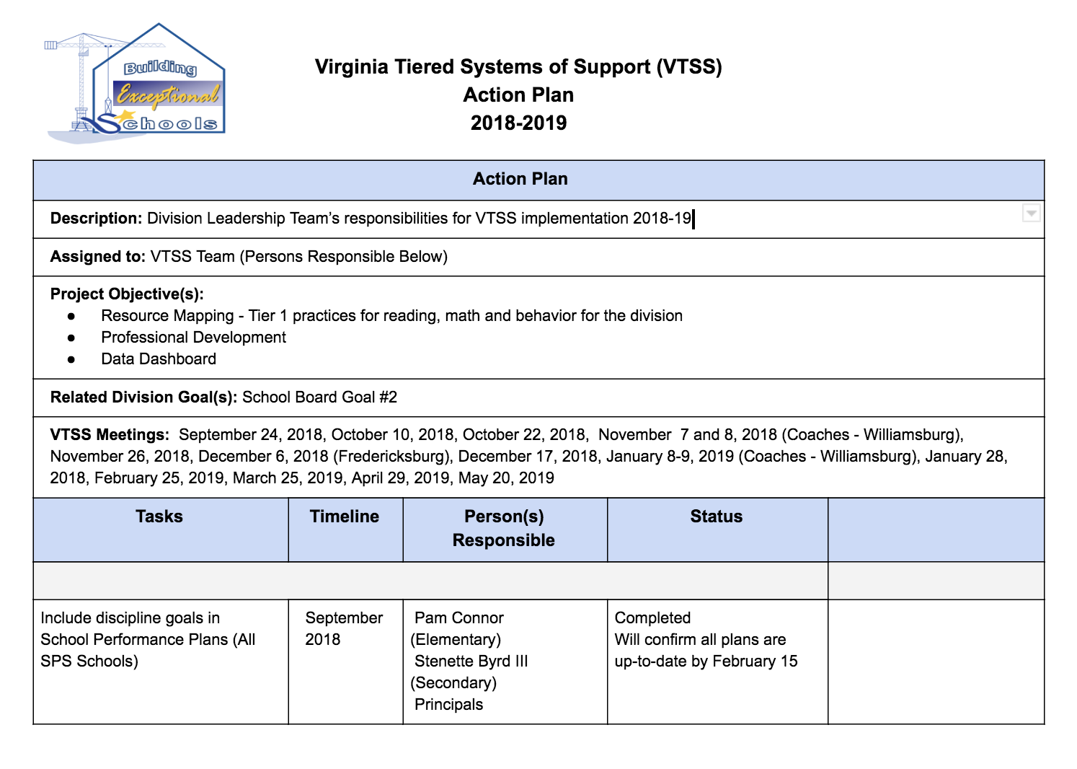
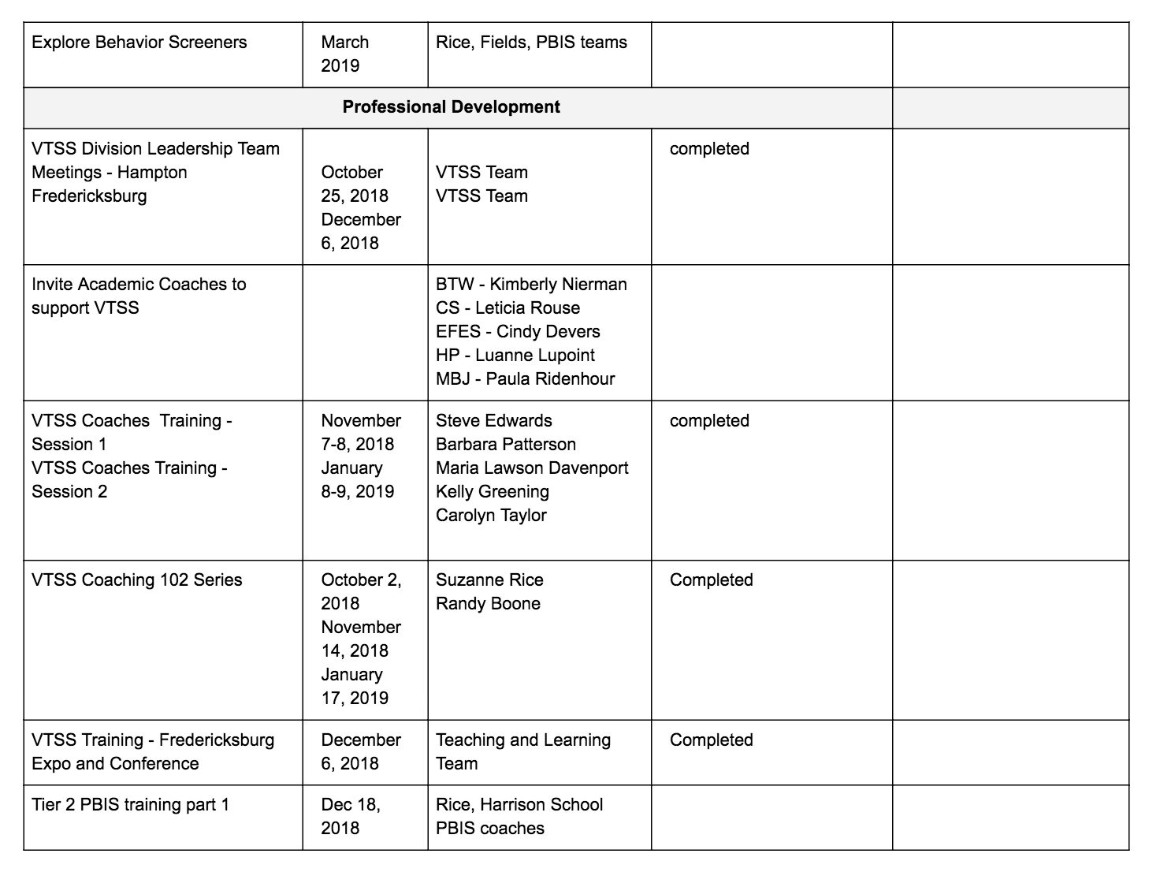
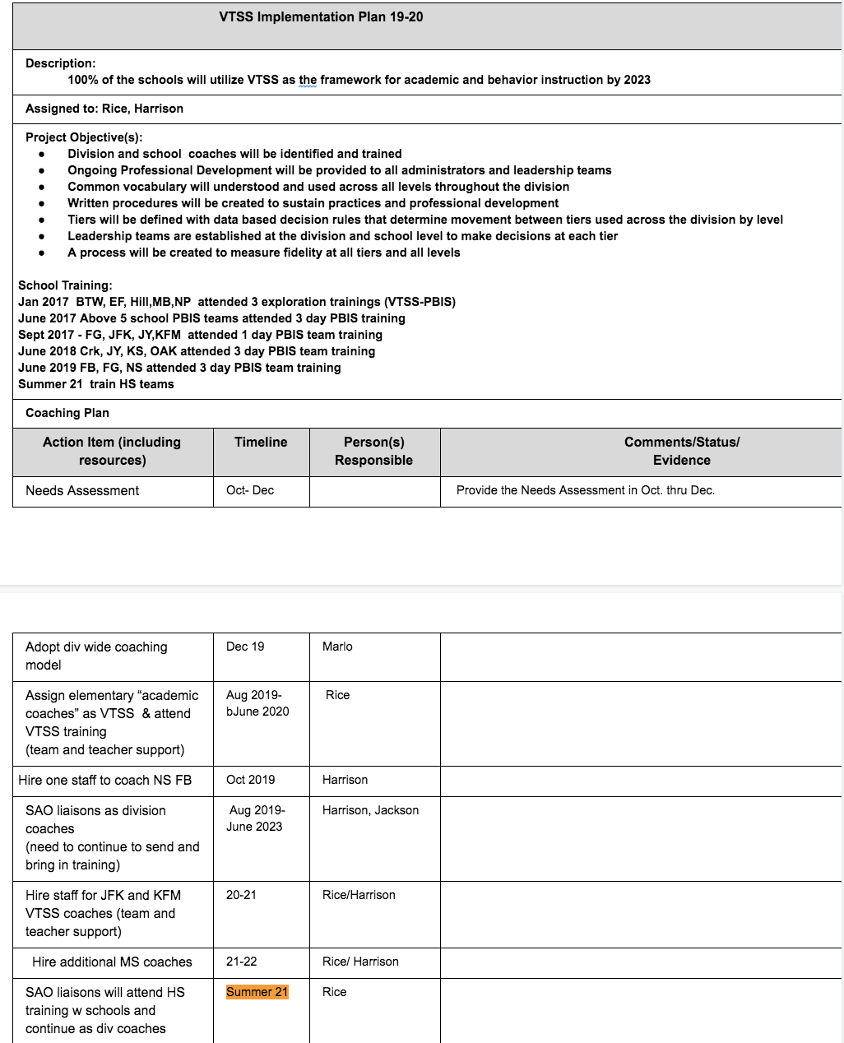
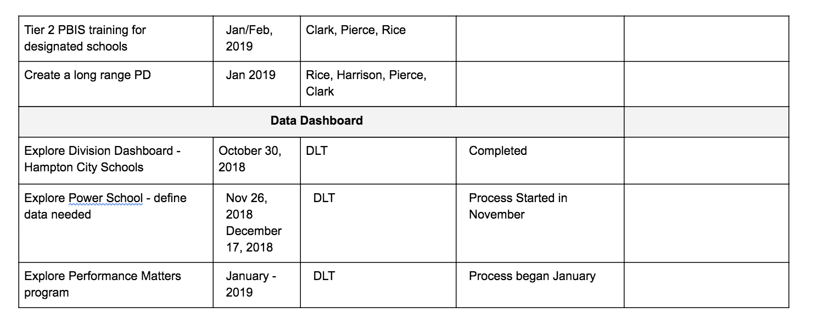
DCA Informed ACTION PLANNING

Slide 33
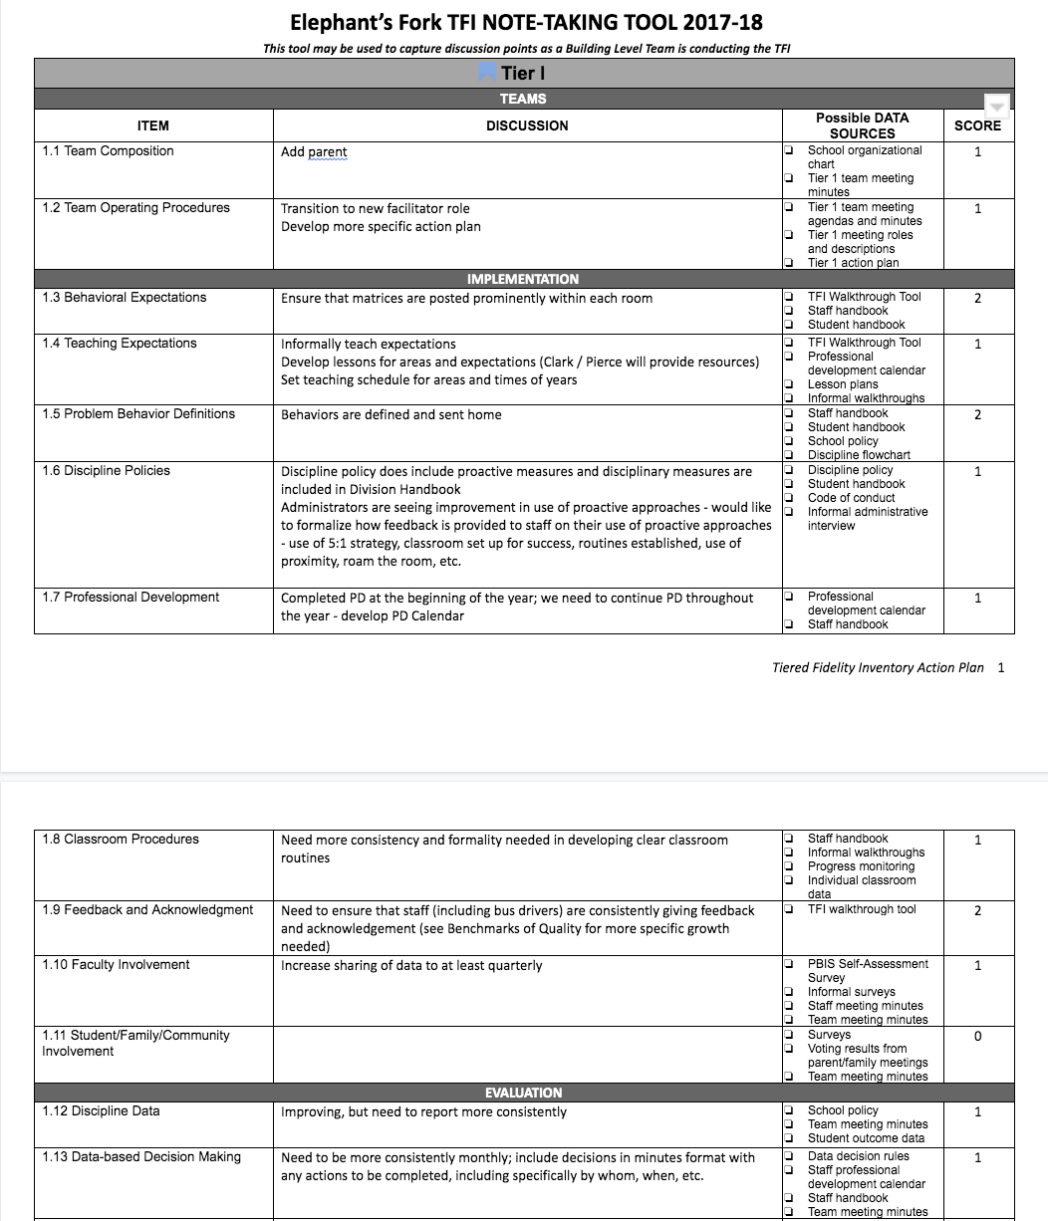
TFI Note-taking

Slide 34
Poll Question
Building trust takes time.
Where is your team on establishing trust to ensure everyone’s voice is heard through their vote and open honest discussion?

Slide 35
Discussion Questions
How well do you understand the purpose and structure of the DCA and TFI?
Do you have the necessary tools and resources for conducting the DCA and TFI?
Do you need any clarification on this process?
How can your VTSS Coach support you?
Please share a glow and grow from your experiences!
Take time now to schedule your DCA and TFI and gather the necessary materials.
Don’t forget a possible snow date.

Slide 36
Recordings networking events
available on the VTSS site under the Professional Learning tab https://vtss-ric.org/

Slide 37
Evaluation
Please complete a quick 3 question evaluation!
https://redcap.vcu.edu/surveys/?s=FMA79LYJTT
Notes:
.

