Slide 1
Module Introduction
Welcome to our on-line trauma learning modules for Virginia Tiered Systems of Supports. We believe that becoming a Trauma-Sensitive School is a journey. Throughout this journey will provide you tools to develop the systems to gain knowledge, to build practices, and to have the skills to support a Trauma-Sensitive School. Your professional journey includes engaging and practical learning modules. Within the learning modules you will interact with content that is focused on developing a Trauma Sensitive School. Supplemental activities, resources, and an action planner are included to help guide your implementation. Videos from experts and division staff implementers are also included with each module to enrich your experience.
Finally, our six modules are focused on the following topics: Module 1: Introduction to Trauma and Becoming a Trauma-Sensitive School; Module 2: Families and Communities as Partners; Module 3: How Trauma Impacts Learning; Module 4: Strategies and Classroom Practices (academic, social emotional learning, trauma-sensitive environments, regulation, cognitive problem solving, relationships, school wide discipline, self care); Module 5: Implementation and Systems (division, staff, administrators); Module 6: Resilience.

Slide 2
Hidden Slide #1
This Section of the Learning Module 1 was designed to be used in the following manner.
The audience for this Module is division and school teams, families, communities.
This Module is meant for whole staff presentations.
Following this training, participants should complete the Action Plan document to determine next steps.
There are two sections in this module. Teams are not required to complete all sections of the learning modules. Instead, participants will complete only those sections of the learning modules that fit the needs of their school.
Notes:
This section of Learning Module 1 is designed to be completed in 1 hour. Together both sections of Learning Module 1 can be completed within 2 hours.

Slide 3
Hidden Slide #2
In person training
Presenter notes and information
Notes:
In-person training suggestions
The Trauma Introduction Module in-person training should take about 2 hours in its entirety. Each section takes at maximum 1 hour.
This presentation provides the basics of trauma and trauma-sensitive schools. You may want to add or enhance portions with visuals and examples that will resonate with your audience. As a reminder, always be sure to include appropriate citations when adding resources. Also, you might look to the resources and activities sections for additions that may be helpful.
In summary
This module outlines the basics of trauma and trauma-sensitive schools
It can be adapted to individual contexts
The training should last about 2 hours for the entire module or 1 hour for each section
Presenter notes information
Presenter notes are included in the PowerPoint. Background information for the presenter is shown as “To Know.” Statements to be shared with participants are shown as “To Say.” In some instances, the “To Know/To Say” are combined.The presenter notes also include “To Do” prompts and cues for “Handouts”.
Additional activities, examples, videos, etc. are being developed. A presenter may add material from the resources and activities section on the website.
Breaks should be inserted at the discretion of the presenter based on the needs of participants.

Slide 4
Hidden Slide #3
Supplies needed
WIFI access for presenter and participants
Access to videos (through WIFI if available, but download to flash drive as a back-up)
Chart paper
Markers
Post-it-Notes
Notes:
To Know
These supplies are needed for the Trauma Professional Learning Modules.

Slide 5
Hidden Slide #4
Handouts for this Module
Action Planner
Resource Map Activity
Trauma-Sensitive School Checklist Activity
Managing Complex Change
Notes:
To Know
The Participant and Presenter Materials are located on the vtss-ric website.
References

Slide 6
Hidden Slide #5
Key Terms in This Module:
Virginia Tiered Systems of Supports (VTSS)
Multi-tiered Systems of Supports (MTSS)
Alignment
Resource Mapping
VTSS Implementation Logic and Framework
Data Dashboard
Trauma-Sensitive and Trauma Informed
Managing Complex Change
Readiness
Systems Change
Qualitative Changes and Outcome Measures
Notes:
To Know
These are the key terms used throughout the module.

Slide 7
Becoming a Trauma-Sensitive School
Notes:
To Know:
VTSS Professional Learning Modules are organized in the same manner. All schools can begin their journey with Module 1 which introduces the foundational knowledge around trauma and trauma-sensitive schools. This powerpoint shares key information on how we create trauma-sensitive, safe and supportive schools.
To Say:
Welcome to the learning module, “Becoming a Trauma-Sensitive School”. Let’s get started!

Slide 8
What We Will Know and Do
Use data to inform the importance of trauma-sensitive practices
Align trauma-sensitive practices into a multi-tiered systems of supports
Determine school readiness for implementation of trauma-sensitive practices
Notes:
To Know:
Go over the learning intentions targeted for this session
To Say:
During this module we hope you will begin to understand the importance of using data to inform the importance of trauma-sensitive practices and the importance of the alignment of trauma-sensitive practices into a multi-tiered systems of supports. Lastly, how will you know if your school is ready for implementation?

Slide 9
VTSS defined
Virginia Tiered Systems of Supports (VTSS) is a data-informed decision making framework for establishing the social culture and academic and behavioral supports needed for the school to be an effective learning environment (for academics, behavior and social-emotional wellbeing) for all students.
Notes:
To Know:
Definition of Virginia Tiered Systems of Supports (VTSS)
To Say:
The best place to start with this module is the definition of Virginia Tiered Systems of Supports, or VTSS. Virginia Tiered Systems of Supports is a data-informed decision making framework for establishing the social culture and academic and behavioral supports needed for the school to be an effective learning environment, for academics, behavior and social-emotional wellbeing, for all students. Notice the bolded words. Our data-informed decisions are key to establishing supports needed for all students. Also, we all tend to have a preference. Maybe you are a teacher skilled in high quality instruction. Maybe you are a school counselor who supports the division with social-emotional learning. Or, maybe you are a behavior specialist who is an expert in managing behaviors. Think of behavior, academics, and social-emotional wellbeing as a three-legged stool. All three are important to the success of the student. How do we work together to provide an effective learning environment?

Slide 10
Intersection of Trauma Sensitivity and VTSS
Multi-tiered Systems of Supports | Trauma-Sensitive
Tier 3: Functional Behavioral Assessments and individualized plans and supports. | Tier 3: Trauma-related factors are considered in individual assessments and plans. School provides or connects to trauma-specific mental health services.
Tier 2: Behavioral and academic skill development groups. | Tier 2: Group-level skill-building considers trauma and key factors for resilience-building.
Tier 1: Creating a positive school culture, teaching social skills, positively reinforcing prosocial behaviors, structuring the environment to prevent undesirable behaviors. | Tier 1: Training all staff on trauma and its impact. Identifying and minimizing trauma-related triggers. Upholding core principles of that support positive school culture. Teaching self-regulation
Notes:
To Know:
We use the words Trauma-Sensitive and Trauma Sensitivity. The term “trauma-sensitive” school describes a school in which all students feel safe, welcomed, and supported and where addressing trauma's impact on learning on a school-wide basis is at the center of its educational mission
To Say:
As you begin to understand the importance of trauma sensitivity, remember that you are not adding another initiative to your way of work. Take a look at the intersection of trauma sensitivity and VTSS. For example, creating a positive school culture with high quality instruction and positive behaviors interventions and supports (PBIS) upholds core principles within the work of trauma sensitivity. We will talk more about what that looks like in other modules.
Reference:
safesupportivelearning.ed.gov

Slide 11
A Blended Model
ACADEMIC COMPETENCIES | BEHAVIOR COMPETENCIES | SOCIAL EMOTIONAL COMPETENCIES
Activities are structured in predictable and emotionally safe ways and information is presented, learning assessed, using multiple modes. | Expected academic and social behaviors are taught directly to all students in classrooms and across other campus settings/locations. | Team uses community data and student and family perception data/focus groups to inform development of student expectations as well as staff expectations for the teaching matrix
Notes:
To Know/To Say:
You will see as we work together, the development of trauma-sensitive practices are based on overarching ideas gathered from a blended model. Please take the time to read this slide.

Slide 12
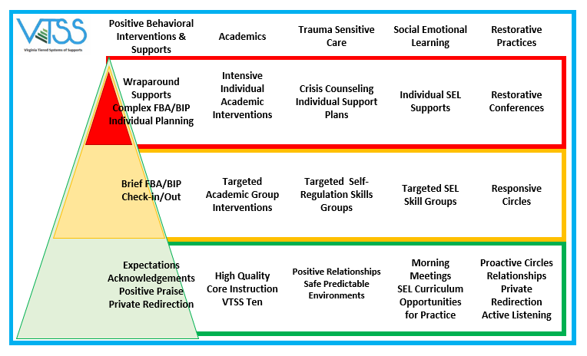
Sample Resource Map
Notes:
To Know: Have participants think about the commonalities that some of these universal components of each area.
To Say:
In just a moment, we will ask you to consider resource mapping your tiered systems of supports. First, we wanted to share an example of what that might look like. You’ll notice behavioral, academic, and social-emotional wellbeing supports are all a part of their tiered system that supports an effective learning environment. Also notice areas in which there are commonalities as you begin to explore this work.
Handout:
References:
Chesterfield County Public Schools

Slide 13
Becoming a Trauma-Sensitive School
Why?
What?
How?
Notes:
To Know/To Say:
Before we look at the what and the how, it is so important to understand the why. The why will help you work with others in your division and help with buy-in. When we are knowledgeable about the why, we often find that staff are motivated to engage in the work.

Slide 14
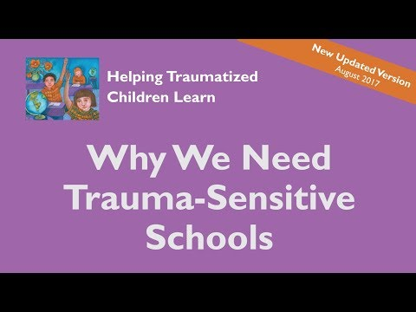
The Why
Notes:
To Know: Video is a little over 10 minutes
To Say: Study after study show that nearly every school have children who have been exposed to overwhelming experiences, such as violence, abuse, and poverty no matter what their background. We know that this exposure is common but may not always know who is impacted by trauma. A trauma sensitive school is one in which all children feel safe, supported, and welcomed and addressing the role that trauma plays in our students lives is at the center of its educational mission.
Resource: https://youtu.be/vyQdOLl6d2c

Slide 15
Trauma-Sensitive Schools
Trauma sensitivity is a universal, whole school approach
Trauma sensitivity helps students feel safe to learn
Trauma sensitivity involves systems change
Notes:
To Know/To Say:
In a trauma-sensitive school, all aspects of the educational environment are grounded in an understanding of the impact of trauma, and are designed to promote resilience for all. All includes staff, students, and families. Within a multitiered framework, trauma sensitivity is a universal approach. This universal support creates a solid foundation for all students regardless of your knowledge of the student’s background. We may not always know what is going on with everyone of your students, but when we approach all students with the lens of trauma sensitivity all students benefit. Along with the understand of the universal approach, we recognize that this works involves systems change. From the Superintendent to the teacher in the classroom, and all the supporting staff we are committed to the work and develop policies, practices, and a mindset that is trauma-sensitive.

Slide 16
VTSS Implementation Logic
OUTCOMES: Did we achieve our intended outcomes?
SYSTEMS
Promote adult wellness by creating a nurturing environment
DATA
Expand the data that teams use to identify which skills to teach
PRACTICES
Teach SEL Competencies using VTSS Instructional Systems
https://www.pbis.org/Common/Cms/files/pbisresources/TeachingSocialEmotionalCompetenciesWithinAPBISFramework.pdf
Notes:
To Know:
The circles represent our IMPLEMENTATION LOGIC. This is how we organize ourselves to affect systems change. Everything we do, we consider DATA, SYSTEMS and PRACTICES.
To Say:
Remember we shared the definition of VTSS at the beginning of the module. We highlighted the importance of data. Here you see our way of work or the implementation logic. As we implement, we can use the logic to help us in our systems work and alignment. For example, you can use data to understand and identify what social emotional skills you need to teach. Once you’ve identified the skill, you can use evidence based practices in the classroom to help students with skill acquisition. Sometimes, we stop there. We have a problem. Let’s do this practice. A big part of systems change is supporting your adults. In this example, we’ve decided to promote adult wellness by creating a nurturing environment. You would also consider resources, professional learning, or any supports the adult needs to carry out the practice with fidelity. Once we’ve considered data, practices, and our systems work, we examine our outcomes. Did we achieve our set forth outcomes? Has the data point improved? You can see how this would be a continuous way of work as you review your outcomes.

Slide 17
Urgency
As a staff, why is there an urgency and motivation to become trauma-sensitive in your school?
Notes:
To Know:
The process of creating a trauma-sensitive school often begins when an individual or small group of staff have a sense of urgency about the need to address an important school priority.
To Say:
Let’s imagine that you’ve looked at your data, and you can show staff evidence for the need to consider a trauma-sensitive school. The data can help you convey a sense of urgency. When we find a concern, we often develop a sense of urgency to respond. As a staff, why is there an urgency and motivation to become trauma-sensitive in your school? Is there an issue that the school is trying to address but seems to be missing the mark (attendance, low test scores, low graduation rates)? Take time to pause and reflect.

Slide 18
Starting with Data:
Integrated Data Dashboard
Common Data
Mental Wellness
Grades
Test scores
Universal screening for behavior and academics
Office Disciplinary Referrals
Suspensions
Graduation rates
Risk ratios
Absenteeism
Social Emotional Screeners
Nurse visits
Community Data (Community Data: statistics on prevalence of mental illnesses in the U.S. or your community, trends in the use of mental health services)
Notes:
To Know:
Nationally the data is there and we know that all schools and educators work with children who have experienced trauma. We need to look specifically at your population and your data to get your data story around trauma in your school. If we remember from the implementation logic we shared, we start with data. So our regular data tells us quite a bit – for example, attendance and absenteeism – how successful have we been at creating a culture where kids want to drop in instead of drop out? Is school a successful place for them?
To Say:
We start with data. Some of our data may show concerns with attendance, suspensions, or low test scores. To measure the impact of our trauma-sensitive work, we are considering other factors, too. Other sources of data can include: community demographics, screening information, attendance patterns, discipline patterns, climate surveys, family members deployed, family members impacted by drug use, domestic violence, and calls to crisis centers.

Slide 19
What Does Your Data Say?
What does your data say?
community demographics
screening information
attendance patterns
discipline patterns
climate surveys
family members deployed
family members impacted by drug use
domestic violence, calls to crisis centers
Notes:
To Know:
It is important to dig deeper. This slide is a good example of looking at different forms of data.
To Say:
What does your data say? Consider these data sources within your division. If you don’t have access to this data, how can you begin to find out how to gain access and have meaningful conversations?

Slide 20
In Your Division
Consider your existing data:
What data might you want to add to your existing data at this point?
How might you want to add to it?
Who do you need to include in order to add to it?
Notes:
To Say/To Do:
In your division consider your existing data. Consider these three questions. What data might you want to add to your existing data at this point? How might you want to add to it? Who do you need to include in order to add to it?
This is a good time to discuss as a group. Spend some time reviewing data.

Slide 21
Urgency - Activity
Based on your data story, why is there an urgency and motivation to become trauma-sensitive?
Fill this in under “Vision” on your Action Planning Sheet.
Notes:
To Say/To Do:
We’ve learned that data can help us with a sense of urgency. Pause and reflect on your data story. Why is there an urgency and motivation to become trauma-sensitive? Take a moment to fill this in under “vision” on your action planning sheet.
Handout:
Action Planner

Slide 22
Becoming a Trauma-Sensitive School
Why?
What?
How?
Notes:
To Say:
We will now review the “what” of becoming a trauma-sensitive school.

Slide 23
Trauma-informed Defined
"Trauma-informed" means an approach to childhood care and education that includes (i) an understanding of the impact childhood trauma has on a child's physical, emotional, and behavioral development and health; (ii) the ability to recognize signs that a child has experienced childhood trauma; (iii) the skills, knowledge, and resources to provide necessary and timely support to a child who has experienced childhood trauma; and (iv) the knowledge to facilitate a safe, stable, and trauma-sensitive classroom environment.
Virginia Senate Bill 1300 https://legiscan.com/VA/text/SB1300/id/2766879
Notes:
To Know:
Language matters so it is important to distinguish between the terms “trauma-sensitive” and “trauma-informed.” This definition is defined in Virginia State Senate Bill 1300.
To Say:
How is trauma-informed defined? "Trauma-informed" means an approach to childhood care and education that includes (i) an understanding of the impact childhood trauma has on a child's physical, emotional, and behavioral development and health; (ii) the ability to recognize signs that a child has experienced childhood trauma; (iii) the skills, knowledge, and resources to provide necessary and timely support to a child who has experienced childhood trauma; and (iv) the knowledge to facilitate a safe, stable, and trauma-sensitive classroom environment.
Reference: Virginia Senate Bill 1300 https://legiscan.com/VA/text/SB1300/id/2766879

Slide 24
Language Matters
Trauma-Sensitive
Trauma Informed
A framework which arose in the behavioral health field which recognizes all types of trauma and an awareness of the impact it can have across settings, services, and population.
https://traumasensitiveschools.org/about-tlpi/
A framework in which schools acknowledge the high prevalence of traumatic exposure for students, the importance of staff well-being and strives to meet the unique needs of all learners.
Black, P., Cook, E. & Daniel, S. 2017
Notes:
To Know:
Language matters so it is important to distinguish between the terms “trauma-sensitive” and “trauma-informed” in order to recognize the roles of schools and that of our behavioral health providers.
To Say:
What do you think about the two definitions shared on this slide? Language matters. Trauma-sensitive is a framework in which schools acknowledge the high prevalence of traumatic exposure for students, the importance of staff well-being and strives to meet the unique needs of all learners. Trauma informed arose in the behavioral field which recognizes all types of trauma and an awareness of the impact it can have across settings, services, and population. As we are working with our educators it is important to emphasize that they are not expected to take on the role of a mental health provider.
Reference:
Helping Traumatized Children Learn: https://traumasensitiveschools.org/about-tlpi/

Slide 25
Trauma-Sensitive Foundation
Understanding trauma and its impact.
Believing that healing happens in relationship
Ensuring physical and emotional safety.
Supporting choice, control, and empowerment for all
Ensuring cultural awareness
Viewing students holistically
Using a collaborative approach
Notes:
To Know:
Foundations create an environment where educators and staff can engage in trauma-sensitive action planning.
To Say:
A Trauma-sensitive foundation includes the following components. As you review the components Understanding trauma and its impact, Believing that healing happens in relationship, Ensuring physical and emotional safety, Supporting choice, control, and empowerment for all, Ensuring cultural awareness, Viewing students holistically, and Using a collaborative approach, you may reflect on your school’s practices and the division’s way of work. You may have many of these foundational components within your school or division. This is the foundation in which you can begin to action plan. Take note of what you feel needs more attention, and celebrate what you are doing well.
References:
https://safesupportivelearning.ed.gov/sites/default/files/03%20P2_Integrating%20Trauma-Sensitive%20Practices%20in%20Schools_10.15.15_to%20ED.pdf

Slide 26
Trauma-Sensitive at the Universal Level
Trauma-Sensitive Environment | Social Emotional Learning
Emotional and Physical Regulation | Building Relationships
School-Wide Discipline | Academic Supports
Problem Solving (Cognitive) | Family and Community Engagement
Staff Self-Care
Notes:
To Know:
As you work through the modules, we will cover each of these strategies. Module 4 focuses on Trauma-Sensitive environments, regulation, SEL, problem solving, academic supports, school-wide discipline and self-care.
To Say:
Trauma-sensitive at the universal level encomposes a trauma-sensitive environment, emotional and physical regulation, problem solving, school-wide discipline, staff self-care, social emotional learning, building relationships, academic supports, and family/community engagement. Throughout the learning modules we will cover all of these components.
References:
https://safesupportivelearning.ed.gov/sites/default/files/03%20P2_Integrating%20Trauma-Sensitive%20Practices%20in%20Schools_10.15.15_to%20ED.pdf

Slide 27
Tier 1
SEL Curriculum
Relationship-Based Teaching and Learning, and Access to Rigorous, Differentiated, Core Content
Universal Screening and Data-Informed Decision Making
PBIS, Behavioral Expectations
Outreach to Community Partners
Staff Self-Care Plans
Restorative Practices
Family/Community Engagement
Culturally Responsive Approach to Student Need for Safety and Belonging
Notes:
To Know/To Say:
Let’s circle back. Remember we shared that you would begin to think about your “what” through examining your tiered systems of supports. We want to show you another example of tiered systems of supports. Here you see Tier 1 supports that support social-emotional wellbeing. Take a look! Which practices do you have in your school? Are there some practices you are curious about? Are you seeing any duplication in services with any of these universal practices? Remember that Tier 1 practices are for all students.

Slide 28
Tier 2
Student Mentoring Program
Check In Check Out
Small Groups for Specialized Instruction that Supports Behavioral, Social-Emotional, and/or Academic Success
Partnering with Community Organizations that Support Families Experiencing Domestic Violence, Homelessness, and Mental Health
Notes:
To Know/To Say:
Tier 2 practices are for some students. While the student is receiving tier 1 supports, they may also need tier 2 supports. This is where many practices start to really differ. Take a look at these examples.

Slide 29
Tier 3
Regular Communication with the Family
Wrap-Around Services: Child Services, Mental/Physical Health Specialists, Social Services, etc.
Individual Therapeutic Counseling
Notes:
To Know/To Say:
Finally, maybe that student who is receiving tier 1 and 2 supports, also needs tier 3 supports. Tier 3 is for a few students within your school. Take a look at these examples of tier 3 supports.

Slide 30
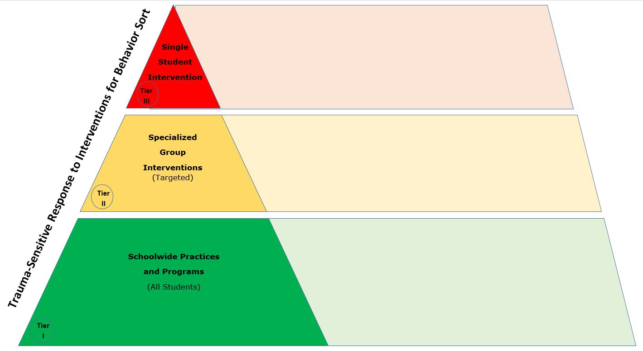
Resource Map Activity
Notes:
To Say/To Do:
Now it’s your turn. Pause and think about your resources within your school. You can use the handout we’ve provided, or you can simple write out on a piece of paper your initial thoughts. Be sure to share your work with others. It’s amazing all the practices that may be put in place that we are not aware of. That is one benefit of resource mapping. Getting everyone on the same page and examining our practices with common language and understanding.
Handouts

Slide 31
Becoming a Trauma-Sensitive School
Why?
What?
How?
Notes:
To Know/To Say:
Let’s talk about the initial steps, or the “how” of becoming a trauma-sensitive school.

Slide 32
Readiness for Change
The first step toward the “how” is to determine readiness
Notes:
To Know:
Readiness for change refers to organizational members' shared resolve to implement a change (change commitment) and shared belief in their collective capability to do so (change efficacy). When organizational readiness for change is high, organizational members are more likely to initiate change, exert greater effort, exhibit greater persistence, and display more cooperative behavior. The result is more effective implementation.
To Say:
Reflect back on your “why”. What is your data story? When you reviewed the foundations of trauma-sensitive schools, what were your initial thoughts about your school or division? All of this will help you determine readiness for change. Do you think most are ready to see a change in the school’s data story? Remember you don’t have to have all staff on board, but you do need a mighty crew to begin the work. There will always be some resistance to change, but a mighty crew can work on supporting staff and casting the vision.
References:
https://rdcu.be/b4AWO

Slide 33
6 Key Factors for Readiness
A commitment to a whole school approach and the need for a process for creating a trauma -sensitive school
A sense of urgency and motivation to become trauma-sensitive
Awareness of barriers and/or supports to implementation
Time to engage in the process
Alignment with other initiatives that support or compete with the work
Leadership commitment
Trauma Learning Policy Initiative, 2019
Notes:
To Know/To Say:
You’ve reviewed your data. You have a team. Let’s talk as a team about these 6 key factors for readiness.
A commitment to a whole school approach and the need for a process for creating a trauma-sensitive school
A sense of urgency and motivation to become trauma-sensitive
Awareness of barriers and/or supports to implementation
Time to engage in the process
Alignment with other initiatives that support or compete with the work, and
Leadership commitment
You may not have time to discuss these six key factors right now. Schedule a time to review and examine, Are we ready? What do you need to work on to increase readiness?

Slide 34
Evidence Based Selection Tool
Selection of Evidence Based Practices for Reading, Math, and Behavior: Is it the right thing to do? Do we think we can do it the right way?
DATA | PRACTICES | SYSTEMS
NEED | EVIDENCE | RESOURCES
Do we have data that supports the need? | Is there research to support its use? | Is there time and money for adequate training?
Have we considered parent and community support? | Is there research to support its use with a particular population? | Is the technology department able to support the EBP if needed?
Will this EBP support a school improvement or continuous improvement goal? | Is the effect size sufficient? | Is there time and money for adequate coaching?
Is there data specific to the EBP that can serve as a component of progress monitoring? | Is it cost-effective or is there something less expensive that yields similar results? | READINESS
Can the data be communicated to students (feedback) and parents? | Is there a fidelity checklist or tool? | Does the leadership support the EBP?
Notes:
To Know: At VTSS we use the Evidence Based Selection Tool to determine readiness and fit.
To Say:
As the team completes the exploratory phase of implementation, the next fit is to determine if this is a right fit for your school. VTSS developed the Evidence Based Selection Tool to help schools determine readiness to implement a new practice or initiative. This is an important part of the process to determine sustainability.
Handout: Tool

Slide 35
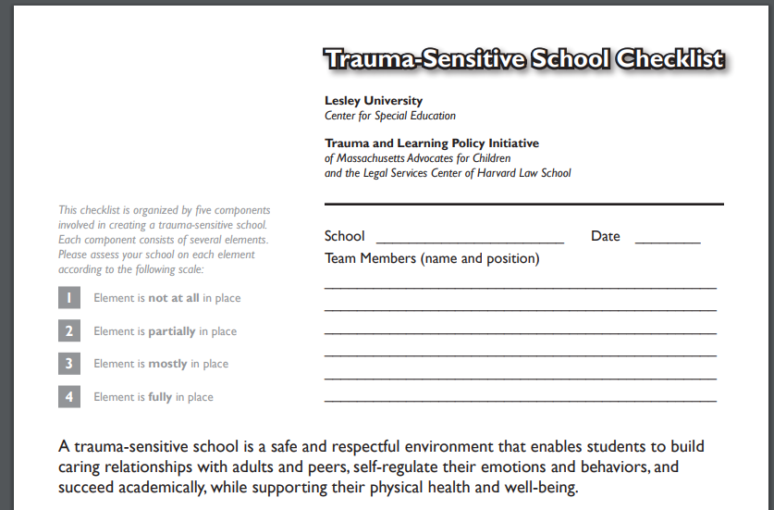
Trauma-Sensitive School Checklist Activity
Located in resources
Notes:
To Know:
We share this checklist with our schools in the trauma-sensitive training – there are many to pick from, and it's always good to explore what is currently out there and select what fits your context.
To Say:
This is another resource we’ve provided for you from Lesley University and found in your resources is the trauma-sensitive school checklist. Take the time now to locate this resource and review for readiness.
Handout:
References:
https://lesley.edu/sites/default/files/2017-06/trauma-sensitive-school-checklist.pdf

Slide 36
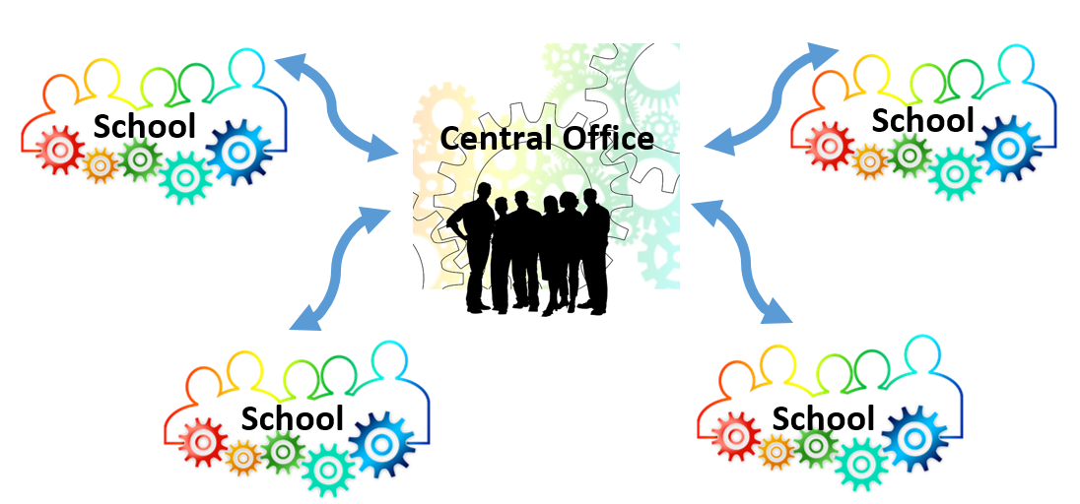
Trauma Sensitivity Involves Systems Change
Notes:
To Know/To Say:
Another big piece of the “how” is systems change. This is a simple picture to show the importance of full support from the top down and the bottom up. We, as a system, are dedicated to our practices, policies, and way of work to becoming trauma-sensitive.

Slide 37
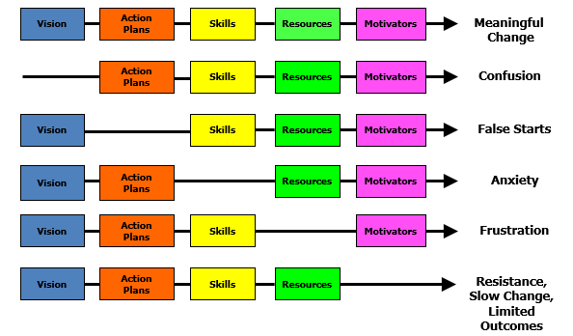
Managing Complex Change
Adapted from Knoster, T., Villa R., & Thousand, J. (2000). A framework for thinking about systems change. In R. villa & J. Thousand (Eds.), Restructuring for caring and effective education: Piecing the puzzle together (pp. 93-128). Baltimore: Paul H. Brookes Publishing Co.
Notes:
To Know/To Say:
Managing complex change can be hard. This diagram from the work of Knoster shows the importance of vision, action planning, skills, resources, and motivators for meaningful change. Remove one aspect of the change process and you will have confusion, false starts, anxiety, frustration, and resistence or limited outcomes. Let’s talk about skills. Suppose you discover with your data that students are struggling with social emotional skills. You research evidence based practices, select a practice to teach social emotional learning in the classroom during circle time. If your school does not support the staff through professional learning of the skills, modeling, feedback, and ongoing coaching and observations, you may have a staff with heightened anxiety. In turn, this will impact the fidelity of the practice in the classroom and staff morale.
Handout:
Reference: Adapted from Knoster, T., Villa R., & Thousand, J. (2000). A framework for thinking about systems change. In R. villa & J. Thousand (Eds.), Restructuring for caring and effective education: Piecing the puzzle together (pp. 93-128). Baltimore: Paul H. Brookes Publishing Co.

Slide 38
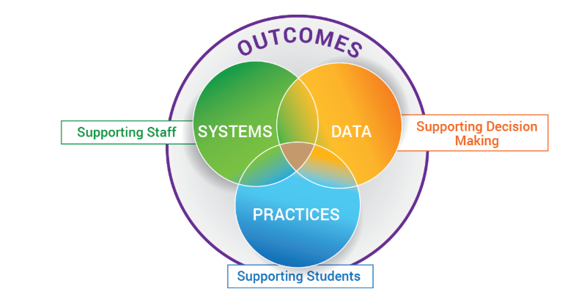
Remember Alignment:
Not another thing to add
Consider the intersection between:
trauma sensitivity and PBIS
trauma sensitivity and restorative practices
trauma sensitivity and academics
Notes:
To Know: The framework of data, practices, systems, and examining our outcomes supports the alignment of our work.
To Say:
Remember alignment within the framework of the implementation logic. Take the time upfront to align your work to all the great things you are already doing with behavior, social emotional wellbeing, and academics. The trauma-sensitive practices are embedded within the framework and become a way of work for your school and division.

Slide 39
Review Tier 1 Team Representation
Representatives from all grade levels, departments
Administrator is an active member of the team
Team should form around the data points you want to move and your “why.”
Student representatives/voice, especially with high school
Representative/voice of families
Representative/voice of your school community
Notes:
To Know:
It is always important to look at your team representation.
To Say:
Another important aspect of the “how” is to re-look at your tier 1 team. Consider these items, and what changes need to take place?
Representatives from all grade levels, departments
Administrator is an active member of the team
Team should form around the data points you want to move and your “why.”
Student representatives/voice, especially with high school
Representative/voice of families
Representative/voice of your school community

Slide 40
Other Service Providers
Is your School Psychologist, School Social Worker, School Counselor and/or School Nurse, School Resource Officers on the team?
Can community mental health providers be a member of the Tier 1 team?
Memorandum of Understanding (MOU)
Provide Tier 1 Instruction/Skills training for all students
Notes:
To Know: Consider other service providers that may have expertise in trauma and support staff, students, and families
To Say:
Remember that it can be challenging to be an expert in all areas of practice. When you consider your resources such as school psychologist, school social workers, school nurses, and your community mental health providers, how can they support the work of a trauma-sensitive school?

Slide 41
Educate: Professional Learning
Tier 1
Tier 2 & 3
Workforce knowledgeable about trauma and its impact on development
The development of skills and strategies that can prevent and reduce its effect on children
Personnel identify and understand the connection between a child’s presentation, behaviors and symptoms and exposure to trauma
Training for more intensive interventions and supports
Focus on the neurobiological impact of chronic stress
De-escalation strategies to avoid re-traumatization
Vicarious Trauma and staff self-care
Teacher coaching to increase effectiveness and sustainability of training
Notes:
To Know: Professional Learning is imperative and specialized. We also use data to inform the need for professional learning and designing of content
To Say:
We shared an example in managing complex change of the importance of professional learning. Let’s pause and take a look specifically at tier 1, 2, and 3 examples of professional learning. Take a moment to read. What are you curious about? Who on your staff can help with the professional learning? Do you need external supports or training?

Slide 42
How will we know we are a trauma-sensitive school?
Qualitative Changes
Outcome measures
Notes:
To Know: Using all data available to you will be important. We have to consider evidence that shows we are becoming more trauma-sensitive.
To Say:
How will you know your school has become trauma-sensitive? Let’s take a look at qualitative changes and outcome measures.

Slide 43
Qualitative Changes
Shifts in mindsets (moving away from reactive to proactive approaches)
Shifts in the way staff are talking about students and families
Shifts in the way it feels in the school (ex: our school feels calmer)
Increase opportunity for student voice
The use of problem solving more quickly after identifying a concern
Observable shifts in interaction between staff and students - more positive
Increase consistency across the building
The school’s goal to develop trauma-sensitive schools is reflected throughout their mission/vision statement, PBIS matrix, behavior reflection forms and family engagement activities.
Notes:
To Know: Qualitative changes are important to examine changes and outcomes
To Say:
Your team will want to always examine data. Qualitative data is often overlooked and is so important. These data items are often collected anecdotally or through surveys with open-ended questions. You can also collect data through focus groups and discussions.

Slide 44
Quantitative
Staff and student surveys
Decrease in crisis calls
Decrease in number of office referrals for students who are often sent for disciplinary purposes
Reductions in chronic attendance issues/improvement in attendance
Tracking data from student support meetings
Decreases in reports of bullying
Decrease in number of times students go to the nurse or clinic in your school
Notes:
To Know: Quantitative data will provide evidence of intended outcomes
To Say:
Here are examples of quantitative data. Take a look at the data you probably have access to if you were to consider collaboration. For example, collaborating with the school nurse to examine number of students coming to the clinic, and the reasons why they come.

Slide 45
Team Talk: Review the “How”
Are we ready to engage in the work?
How will we begin implementation of the work?
Fill this in on your Action Plan under “Objectives and Action Planning”
Notes:
To Know: Action planning supports engagement in the work and next steps
To Say:
We’ve now completed the module “Becoming a Trauma-Sensitive School”. This is your time to pause and reflect on the “how”. Are you ready to engage in the work? How will you begin implementation of the work? Please fill this in on your action plan under objectives and action planning.
Handout:

Slide 46
References
Integrating Trauma-Sensitive Practices in Schools
A theory of organizational readiness for change Bryan J Weiner
Trauma-Sensitive School Checklist
Managing Complex Change: Knoster, T., Villa R., & Thousand, J. (2000). A framework for thinking about systems change. In R. villa & J. Thousand (Eds.), Restructuring for caring and effective education: Piecing the puzzle together (pp. 93-128). Baltimore:
Paul H. Brookes Publishing Co.

