Slide 1
Hidden Slide #1
This Module was designed to be used in the following manner.
The audience for this Module is division and school teams, families, communities.
This Module is meant for whole staff presentations.
Following this training, participants should complete the Action Plan document to determine next steps.
There are two sections in this module. If time permits, they may be completed together. Teams are not required to complete all components of the Modules. Instead, participants will complete only those Modules that fit the needs of their school.
Notes:
This Module is designed to be completed in under 2 hours.

Slide 2
Hidden Slide #2
In person training
Presenter notes and information
Notes:
In-person training suggestions
The Trauma Introduction Module in-person training should take about 2 hours in its entirety. Each section takes at maximum 1 hour.
This presentation provides the basics of the impact of trauma on learning. You may want to add or enhance portions with visuals and examples that will resonate with your audience. As a reminder, always be sure to include appropriate citations when adding resources. Also, you might look to the resources and activities sections for additions that may be helpful.
In summary
This module outlines the basics of the impact of trauma on learning
It can be adapted to individual contexts
The training should last about 2 hours for the entire module or 1 hour for each section
Presenter notes information
Presenter notes are included in the PowerPoint. Background information for the presenter is shown as “To Know.” Statements to be shared with participants are shown as “To Say.” In some instances, the “To Know/To Say” are combined.The presenter notes also include “To Do” prompts and cues for “Handouts”.
Additional activities, examples, videos, etc. are being developed. A presenter may add material from the resources and activities section on the website.
Breaks should be inserted at the discretion of the presenter based on the needs of participants.

Slide 3
Hidden Slide #3
Supplies needed
WIFI access for presenter and participants
Access to videos (through WIFI if available, but download to flash drive as a back-up)
Chart paper
Markers
Post-it-Notes
Notes:
To Know
These supplies are needed for the Trauma Professional Learning Modules.

Slide 4
Hidden Slide #4
Handouts for this Module
Action Planner
Notes:
To Know
The Participant and Presenter Materials are located on the vtss-ric website.
References

Slide 5
Hidden Slide #5
Key Terms in This Module:
Executive Functioning
Learning Brain
Survival Brain
Hyperarousal
Notes:
To Know
These are the key terms used throughout the module.

Slide 6
Module 3: Trauma and the Classroom
Part A: Impact on Learning
Notes:
To Know:
VTSS Professional Learning Modules are organized in the same manner. All schools can begin their journey with Module 1 which introduces the foundational knowledge around trauma and trauma sensitive schools. This powerpoint shares key information on the impact of trauma in the classroom.
To Say:
Welcome to the learning module, “Trauma and the Classroom: Impact on Learning”. Let’s get started!

Slide 7
What We Will Know and Do
Recognize the impact of trauma in the classroom and how it affects learning, relationships and behavior
Notes:
To Know:
Go over the learning intentions targeted for this session
To Say:
During this module we will be learning to recognize the impact of trauma in the classroom. This module has been divided into two parts: Part A will focus on the impact on learning and Part B will explore the impact on relationships and behavior.
Note: The modules can be presented together at one time, or may be presented in two separate sessions.

Slide 8
Essential Role of Adults
“The adults in children’s lives must understand that a child’s challenging behaviors are normal, self-protective, and adaptive reactions to highly stressful situations, rather than viewing that child as intentionally misbehaving...It is essential that adults become aware of the prevalence and impact of trauma, and learn to apply a “trauma lens” (i.e., gain the capacity to view children’s difficulties in behavior, learning, and relationships as natural reactions to trauma that warrant understanding and sensitive care).”
--Bartlett, J.D. and Steber, K. 2019
Notes:
To Know: It is essential for adults to know challenging behaviors warrant understanding and sensitive care.
To Say: Adults play an essential role in the lives of children. This quote from an article by Bartlett and Steber highlights the importance of the way in which adults view a child’s challenging behavior. They point out that these challenging behaviors are actually normal, self-protective and adaptive reactions to highly stressful situations. As adults, we are responsible for becoming aware of the impact of trauma; and, applying that “trauma lens” in order to understand and provide sensitive care to the children’s difficulties.
References: Bartlett, J.D. and Steber, K. 2019

Slide 9
Video
Notes:
To Know: Video is 4.39 minutes. The brain reacts differently when it has been exposed to trauma.
To Say: When understanding the impact of trauma it is important to understand the impact of trauma on the brain. Take a moment to watch Allison Sampson Jackson explain the impact of trauma on the brain using the hand model of the brain.
To Do: Watch the video with the intent of being able to explain the hand model of the brain yourself.
Resource: https://vimeo.com/109042767

Slide 10
Survival Brain
Increased
Decreased
Emotional instability
Anxiety
Irritability
Anger
Frustration
Impulsivity with regards to language or actions
Problem solving
Communication skills
Emotional regulation
Ability to retrieve previously learned information
Decision making
Notes:
To Know: When in survival brain emotional instability and impulsivity increase, while problem solving, communication, emotional regulation, learning retrieval, and decision making decrease.
To Say: As a reminder: When we are working with children who have experienced trauma it is also important to remember that their experiences can impact the way they view the world around them. Children who are have experienced typical development often believe they live in a predictable and benevolent world. They usually view themselves positively and are hopeful and optimistic about the future. They usually feel empowered and have a sense of stability about what is happening around them.
In contrast, children who have experienced trauma often develop a basic mistrust of others and can view the world as unsafe. Remember that they are often functioning in their survival brain so they may be constantly on the alert for danger or threat. They may have a negative self-worth and feel fear and pessimism about the future. Additionally, there may be feelings of hopelessness and they may feel powerless within their environment.

Slide 11
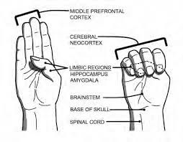
Small Group Discussion
Image source: Heart-Mind Community Hub
Notes:
To Know: How trauma impacts the brain using the hand model.
To Say: You have just learned about the hand model of the brain and what happens when a person is in their survival brain. Take a moment to pause and practice explaining the hand model of the brain to a partner.
To Do: Partners take turns explaining the hand model of the brain to each other.

Slide 12
Adverse Childhood Experiences and School Performance, Part 1
Difficulties with attention
Lower test scores
More absences
Higher suspension and expulsion rates
Internalizing behaviors (depression, anxiety)
Difficulty regulating emotions
National Child Traumatic Stress Network 2008
Notes:
To Know: Adverse Childhood Experiences (ACEs) can have multiple negative impacts on a child’s educational experience through academics, relationships and behavior.
To Say:
Children who have experienced Adverse Childhood experiences also experience the following:
Pause and read this extensive list. What are some of the items that you see in your context, and what things are missing? Add to the list! This is why becoming a Trauma Sensitive School is so important.
References: National Child Traumatic Stress Network 2008 (https://www.nctsn.org/)

Slide 13
Adverse Childhood Experiences and School Performance, Part 2
2.5 times more likely to be retained
More discipline referrals
Externalizing behaviors (Defiance, hyper activity)
More frequently placed in special education
More likely to have struggles in receptive & expressive language
National Child Traumatic Stress Network 2008
Notes:
To Know: Adverse Childhood Experiences (ACEs) can have multiple negative impacts on a child’s educational experience through academics, relationships and behavior.
To Say:
Children who have experienced Adverse Childhood experiences also experience the following:
Pause and read this extensive list. What are some of the items that you see in your context, and what things are missing? Add to the list! This is why becoming a Trauma Sensitive School is so important.
References: National Child Traumatic Stress Network 2008 (https://www.nctsn.org/)

Slide 14
Impact of Trauma: Learning
Learning
Relationships
Behavior
Notes:
To Know: Trauma can significantly impact learning, relationships and behavior.
To Say: We will first look at the impact trauma can have on learning. Remember the effects of trauma vary significantly from student to student.

Slide 15
How Does Trauma Impact Learning?
Executive Functioning
Language and Communication Skills
Memory
Ability to see Cause and Effect
Organizational Ability
Concentration and Attention
Descriptions that follow largely based on Rodenbush, K. (2015). The effects of trauma on behavior in the classroom included in Education Northwest “A Practitioner’s Guide to Educating Traumatized Children”
Notes:
To Know: Trauma impacts learning in multiple ways.
To Say:
The impact of trauma on learning presents in multiple ways including impacting executive functioning, language and communication skills, memory, the ability to see cause and effect, organization ability, and concentration and attention. We will learn more about the way trauma impacts the areas as we move through this module.
References: Rodenbush, K. (2015). The effects of trauma on behavior in the classroom included in Education Northwest “A Practitioner’s Guide to Educating Traumatized Children”

Slide 16
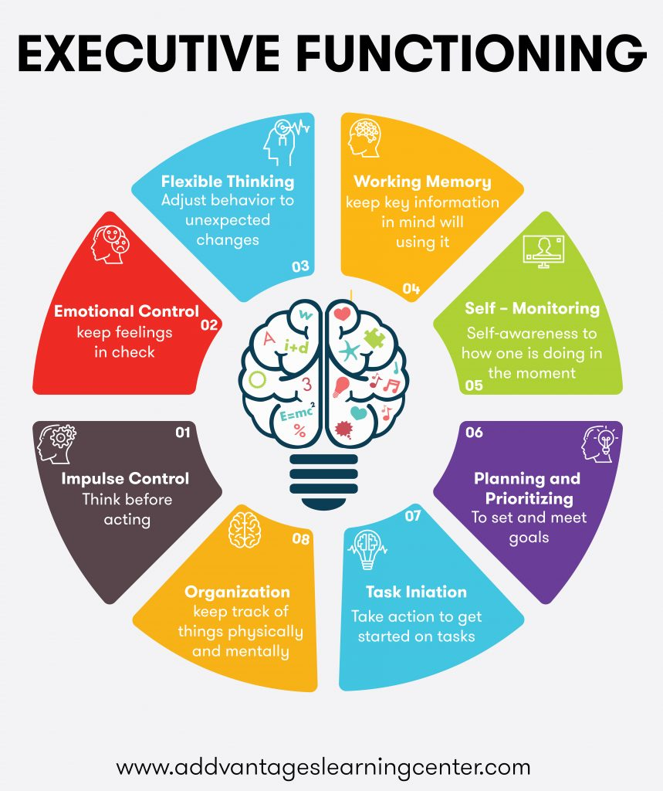
Executive Functioning
Executive Functioning
Impulse Control – think before acting
Emotional Control – keep feelings in check
Flexible Thinking – adjust behavior to unexpected changes
Working Memory – keep key information in mind will using it
Self-monitoring – self-awareness to how one is doing in the moment
Planning and Prioritizing – to set and meet goals
Task Initiation – take action to get started on tasks
Organization – keep track of things physically and mentally
Notes:
To Know: Because trauma impacts the brain it can interfere with brain functioning in many ways. It can adversely affect executive brain function which is one of the most critical areas for learning.
To Say: First, let’s focus on the impact on executive functioning. Executive functioning, the “CEO of the brain” is in charge of a set of mental skills that include goal setting, anticipating consequences, initiating and carrying out plans, and evaluating outcomes. It is very important for achieving academic and social success and in establishing life goals. Trauma damages the prefrontal cortex portion of the brain, which is responsible for executive functioning. Traumatized child can develop a bleak perspective on life, expect failure, have a low sense of self-worth, and a foreshortened view of the future, all of which disrupt the ability to plan, anticipate, and hope. Trouble with executive function as a result of trauma can make it hard to focus, follow directions, and handle emotions. Traumatized children have deficits in related skills required for academic success, including:
Working memory
Problem solving
Planning
Reasoning
Flexibility
Goal setting
Anticipating consequences
Initiating and carrying out plans
Evaluating outcomes
References: www.advantageslearningcenter.com

Slide 17
Language and Communication Skills
Language
Communication
Notes:
To Know: Language and communication skills can be negatively affected by trauma.
To Say: Trauma impacts Language Ability and communication skills. A dysregulated brain is not conducive for language and effective communication. When in a state of hyperarousal, a traumatized student cannot attend to or process information. In survival mode, language becomes a tool for getting things accomplished or needs met—not for articulating thoughts and expressing feelings. Students may have difficulty focusing on the content of language because they are too busy monitoring nonverbal messages. Additionally, traumatized students may have had little exposure to adults who encourage expressing ideas or feelings, as well as limited experience tending to complex communications.
References: Rodenbush, K. (2015). The effects of trauma on behavior in the classroom included in Education Northwest “A Practitioner’s Guide to Educating Traumatized Children”

Slide 18
Memory
Notes:
To Know: Because trauma impacts the brain it can interfere with brain functioning in many ways. It can adversely affect all forms of memory. Memory is an essential skills for learning.
To Say: Memory is an essential skill for learning. Because trauma impacts the brain it can interfere with brain functioning as it relates to memory. Due to the chaotic and unpredictable environment of many who have experienced trauma, they may not have moved to a more sequential ordering of the world, impacting their development of sequential memory. Trauma can:
Prevent information from different parts of the brain from combining to make a semantic memory
Shutdown episodic memory and fragment the sequence of events
Trigger emotions often without context
Change the pattern of procedural memory

Slide 19
Ability to See Cause and Effect
Children living with trauma may suffer from physical restriction and unrealistic parental expectations that inhibit their exploration of the world. Therefore they are often deprived of the opportunity to develop age appropriate ability to see cause and effect
Trauma damages children’s sense of object constancy, causing them to lack a sense of predictability in their environment
Notes:
To Know: Because braining function and their environment is adversely impacted by trauma and these, students are often deprived of age appropriate learning opportunities, their ability to see cause and effect relationships may be limited.
To Say:
Students affected by trauma may have limited ability to see cause and effect. Children living with trauma may suffer from physical restriction and unrealistic parental expectations that inhibit their exploration of the world. Therefore they are often deprived of the opportunity to develop age appropriate ability to see cause and effect. Trauma damages children’s sense of object constancy, causing them to lack a sense of predictability in their environment

Slide 20
Organizational Ability
Notes:
To Know: Due to the chaotic lives students may experience as well as the cognitive effects of trauma, age appropriate organizational skills may be difficult
To Say: Students exposed to trauma may have more difficulty organizing and processing the content of academic lessons for efficient retrieval and application. Organization requires the ability to utilize sequential memory. If the development of sequential memory is delayed and the ability to learn information sequentially is impaired, traumatized children will have difficulty with organizing information in a sequence.
Due to the unpredictability in their lives, children aren’t exposed to a rhythm in their lives. So during their developmental years, if rules and routines are the the whim of a caretaker depending on mood, mental health, or substance abuse, then, they may not have the foundation necessary to organize academic materials. Therefore, if a traumatized student is living in chaos, it significantly affects his or her ability to bring linear order to narrative material. Bringing coherence to a collection of random events is most easily accomplished in an environment marked by consistent, predictable routines and reliable caregivers which is lacking for these students.

Slide 21
Concentration and Attention
Concentration and Attention get interrupted by:
Anxiety
Focusing on the teacher mood rather than content
Dessociating and not processing information
Hypervigilance to perceived danger
Notes:
To Know: Concentration and attentional skills can be negatively affected by trauma for a variety of reasons.
To Say:
Children who have experienced trauma may seem to be distracted and lack focus. Responses to traumatic stress may range from being hyper-aroused (vigilantly taking in everything/being unable to distinguish between relevant and non-relevant information/seeing everything as a potential threat) to dissociating (tuning out and taking in nothing at all). Both responses look like attention problems in the classroom.
As you can imagine, when students are dealing with trauma in their lives it is not easy for them to focus in the classroom. Their concentration and attention may be interrupted by:
Anxiety about his or her own safety, as well as others’ safety, which chronically occupies his or her thoughts adversely affecting attention
Focusing on “interpreting the teacher’s mood” rather than the academic content
Dissociating from the immediate environment and not process the information the teacher is presenting
Symptoms of anxiety and hypervigilance to danger for those students who are diagnosed with attention-deficit/hyperactivity disorder

Slide 22
Turn and Talk--Learning
You have just been given an impromptu writing assignment about how you spent your spring vacation. Turn to the person next to you and explain how trauma could impact your ability to complete this task.
Notes:
To Know: Ways in which a child’s learning could be impacted by trauma.
To Say: Take a moment to pause and consider the following scenario: “You have just been given an impromptu writing assignment about how you spent your spring vacation.” Turn to the person next to you and explain how trauma could impact your ability to complete this task.
To Do: Use the what you have learned about how trauma impacts learning to explain to a partner how trauma could influence a person's ability to complete an impromptu writing assignment about how you spent your spring vacation.

Slide 23
Team Talk: Review the “How”
How will you adjust your practices to support learning for students who have experienced trauma?
Fill this in on your Action Plan under “Objectives and Action Planning”
Notes:
To Know: Action planning supports engagement in the work and next steps
To Say:
We’ve now completed the module “Trauma and the Classroom Part 1”. This your time to pause and reflect on the “how”. How will you adjust your practices to support learning for students who have experienced trauma? Please fill this in on your action plan under objectives and action planning.
Handout: Action Planner

Slide 24
References
Bartlett, J.D. and Steber, K. (2019). Retrieved from: How to Implement Trauma-informed Care to Build Resilience to Childhood Trauma
National Child Traumatic Stress Network 2008
Rodenbush, K. (2015). The effects of trauma on behavior in the classroom included in Education Northwest “A Practitioner’s Guide to Educating Traumatized Children”
National Child Traumatic Stress Network

