Slide 1
Hidden Slide #1
This Module was designed to be used in the following manner.
The audience for this Module is division and school teams, families, communities.
This Module is meant for whole staff presentations.
Following this training, participants should complete the Action Plan document to determine next steps.
There are two sections in this module. Teams are not required to complete all components of the Modules. Instead, participants will complete only those Modules that fit the needs of their school.
Notes:
This Module is designed to be completed in under 2 hours.

Slide 2
Hidden Slide #2
In person training
Presenter notes and information
Notes:
In-person training suggestions
The Trauma Introduction Module in-person training should take about 2 hours in its entirety. Each section takes at maximum 1 hour.
This presentation provides the basics of trauma and trauma sensitive schools. You may want to add or enhance portions with visuals and examples that will resonate with your audience. As a reminder, always be sure to include appropriate citations when adding resources. Also, you might look to the resources and activities sections for additions that may be helpful.
In summary
This module outlines the basics of trauma and trauma sensitive schools
It can be adapted to individual contexts
The training should last about 2 hours for the entire module or 1 hour for each section
Presenter notes information
Presenter notes are included in the PowerPoint. Background information for the presenter is shown as “To Know.” Statements to be shared with participants are shown as “To Say.” In some instances, the “To Know/To Say” are combined.The presenter notes also include “To Do” prompts and cues for “Handouts”.
Additional activities, examples, videos, etc. are being developed. A presenter may add material from the resources and activities section on the website.
Breaks should be inserted at the discretion of the presenter based on the needs of participants.

Slide 3
Hidden Slide #3
Supplies needed
WIFI access for presenter and participants
Access to videos (through WIFI if available, but download to flash drive as a back-up)
Chart paper
Markers
Post-it-Notes
Notes:
To Know
These supplies are needed for the Trauma Professional Learning Modules.

Slide 4
Hidden Slide #4
Handouts for this Module
Fight, Flight, Freeze, Appease
Common responses to high stress trauma
Action Planner
Notes:
To Know
The Participant and Presenter Materials are located on the vtss-ric website.
References

Slide 5
Hidden Slide #5
Key Terms in This Module:
Survival brain
Fight, flight, freeze, appease
Emotional dysregulation
Notes:
To Know
These are the key terms used throughout the module.

Slide 6
Module 3: Trauma and the Classroom
Part B: Impact on Relationships and Behavior
Notes:
To Know:
VTSS Professional Learning Modules are organized in the same manner. All schools can begin their journey with Module 1 which introduces the foundational knowledge around trauma and trauma sensitive schools. This powerpoint shares key information on the impact of trauma in the classroom.
To Say:
Welcome to the learning module, “Trauma and the Classroom Part B: Relationships and Behavior”. Let’s get started!

Slide 7
What We Will Know and Do
Recognize the impact of trauma in the classroom and how it affects learning, relationships and behavior
Notes:
To Know: Go over the learning intentions targeted for this session
To Say: During this module we will continue learning to recognize the impact of trauma in the classroom. Previously, Part A of this module focused on the impact on learning. In Part B, we will focus on the impact on relationships and behavior. We will be covering specific strategies to address the impact on the classroom in later modules.
Note: The modules can be presented together at one time, or may be presented in two separate sessions.

Slide 8
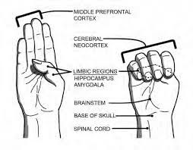
Trauma Changes the Brain
Image source: Heart-Mind Community Hub
Notes:
To Know: Trauma changes the brain, therefore, it has an impact on learning through its influence on academics, behavior, and social emotional skills.
To Say: Let’s review what we have learned in previous modules. When a person experiences trauma or stress there are changes in their brain that can impact their learning, relationships and behavior. The video we watched in the last module explained how these changes can cause the limbic system, or the survival brain, to take over and not allow the frontal lobe, or learning brain, to function as we need it to. When students are in the classroom, they need to be able to retrieve previously learned information, regulate their emotions, interact with their peers and adults appropriately, and problem solve. Unfortunately, students who have experienced trauma may not have access to those skills because are focused on survival and the perceived threat around them.

Slide 9
Survival Brain
Increased
Decreased
Emotional instability
Anxiety
Irritability
Anger
Frustration
Impulsivity with regards to language or actions
Problem solving
Communication skills
Emotional regulation
Ability to retrieve previously learned information
Decision making
Notes:
To Know: When in survival brain emotional instability and impulsivity increase, while problem solving, communication, emotional regulation, learning retrieval, and decision making decrease.
To Say: As a reminder: When we are working with children who have experienced trauma it is also important to remember that their experiences can impact the way they view the world around them. Children who are have experienced typical development often believe they live in a predictable and benevolent world. They usually view themselves positively and are hopeful and optimistic about the future. They usually feel empowered and have a sense of stability about what is happening around them.
In contrast, children who have experienced trauma often develop a basic mistrust of others and can view the world as unsafe. Remember that they are often functioning in their survival brain so they may be constantly on the alert for danger or threat. They may have a negative self-worth and feel fear and pessimism about the future. Additionally, there may be feelings of hopelessness and they may feel powerless within their environment.

Slide 10
Essential Role of Adults
“The adults in children’s lives must understand that a child’s challenging behaviors are normal, self-protective, and adaptive reactions to highly stressful situations, rather than viewing that child as intentionally misbehaving...It is essential that adults become aware of the prevalence and impact of trauma, and learn to apply a “trauma lens” (i.e., gain the capacity to view children’s difficulties in behavior, learning, and relationships as natural reactions to trauma that warrant understanding and sensitive care).”
--Bartlett, J.D. and Steber, K. 2019
Notes:
To Know: It is essential for adults to know challenging behaviors warrant understanding and sensitive care.
To Say: Adults play an essential role in the lives of children. This quote from an article by Bartlett and Steber highlights the importance of the way in which adults view a child’s challenging behavior. They point out that these challenging behaviors are actually normal, self-protective and adaptive reactions to highly stressful situations. As adults, we are responsible for becoming aware of the impact of trauma; and, applying that “trauma lens” in order to understand and provide sensitive care to the children’s difficulties.
References: Bartlett, J.D. and Steber, K. 2019

Slide 11
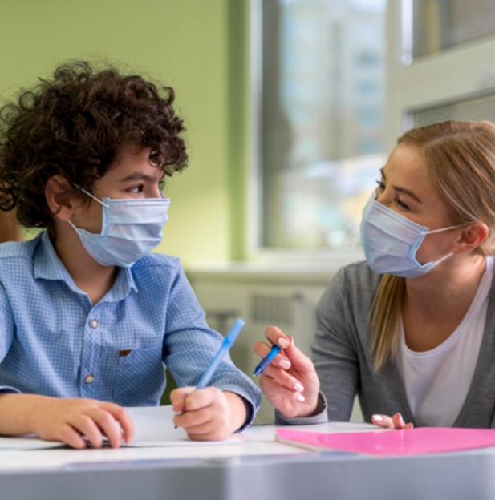
Impact of Trauma:Relationships
Learning
Relationships
Behavior
Notes:
To Know: The challenges that trauma can present in forming and maintaining relationships with others.
To Say: In the previous sections you learned how trauma impacts the brain. We also discussed how those changes to the brain can impact a person’s ability to learn. In the upcoming section we are going to learn about the potential impact of trauma on forming and maintaining relationships.

Slide 12
Importance of Relationships
“Building relationships with students is by far the most important thing a teacher can do. Without a solid foundation and relationships built on trust and respect, no quality learning will happen.”
Timothy Hilton, Teacher, Education Week
Notes:
To Know: The building of relationships is essential for quality learning to occur.
To Say: As we begin to explore the impact of trauma on relationships, it is important to first recognize the critical role relationships play in enabling quality learning to occur. Take a moment to read this quote from Timothy Hilton on the importance of relationships.
Reference: Timothy Hilton, Teacher, Education Week

Slide 13
How Does Trauma Impact Relationships?
The caregiver may be the source of trauma
The availability, reliability, and predictability of the caregiver may be limited
The child may not learn to regulate his emotions or calm himself down when experiencing intense emotions
The child’s ability to learn through exploration of his environment may “take a back seat” to his/her need for protection and safety
The child begins to perceive the world as dangerous, leading to a sense of vulnerability and distrust of others.
Notes:
To Know: Ways in which a child’s traumatic experiences may influence the formation of relationships.
To Say:
The template for relationships is developed through the emotional bond between a child and their primary caregiver. The caregiver serves as the source of the child’s safety, provides for the child’s needs, and guides her in understanding herself and others. In turn, the child meets the caregiver’s need to provide nourishment and guidance. Healthy attachments provide the building blocks for later relationships and a child’s ability to master developmental tasks by:
Regulating emotions and self-soothing
Developing trust in others
Encouraging children to freely explore their environment
Helping children to understand themselves and others
Helping children understand they can have an impact on their world
In contrast, traumatized children may experience:
The caregiver may be the source of trauma
The availability, reliability, and predictability of the caregiver may be limited
The child may not learn to regulate his emotions or calm himself down when experiencing intense emotions
The child’s ability to learn through exploration of his environment may “take a back seat” to his/her need for protection and safety
The child begins to perceive the world as dangerous, leading to a sense of vulnerability and distrust of others.

Slide 14
Trauma Impacts Perceptions
Based on traumatic experiences with their caregivers students may develop the following beliefs:
Adults are inconsistent and untrustworthy
Caregivers fail to protect me, I must protect myself
Caregivers leave me, so I keep myself at a distance
Kaiser, B. 2020. Understanding the Impact of Trauma on Behavior.
Notes:
To Know: When a caregiver is the source of a traumatic experience it can negatively influence how the child perceives relationships with others.
To Say: If a caregiver is the source of a traumatic experience it can negatively influence how the child perceives relationships with others. The child may begin to see ALL adults as inconsistent and untrustworthy. They may feel the need to take on the responsibility to protect themselves due to their caregivers failure to effectively protect them. Also, those that have experienced trauma from a caregiver leaving them, may fear abandonment by others. As a result of that fear of abandonment, they my keep others at a distance perceiving that the distance will help to protect them. Since consistency and trust, are foundational to a healthy relationship, it is easy to understand how these perceptions of relationships could have a negative impact on the ability to form and maintain relationships with others.
Reference: Kaiser, B. 2020. Understanding the Impact of Trauma on Behavior.

Slide 15
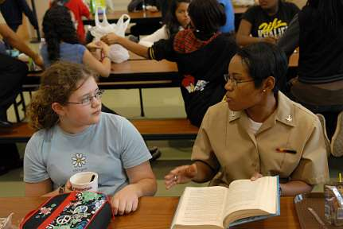
Teacher Student Relationships
Due to the traumatic experience with their caregiver, students may transfer to their beliefs about their caregiver to their relationships with their teachers. As a result students may:
Be distrustful
Push away adults
Be guarded
Withdraw
Be impulsive/reactionary
Unconsciously connect similarities between adults present during the traumatic experience and other adults
Notes:
To Know: Negative perceptions of relationships can be transferred onto teachers.
To Say: In the quote earlier we heard about the importance of healthy relationships in order for meaningful learning to occur. We also just discussed how a student who has experienced trauma may perceive relationships negatively as a result of that trauma. That negative perception of relationships often also carries over to the relationship with their teacher. Students may transfer their beliefs about their caregiver onto their teacher. They may, therefore, be distrustful of their teacher, push them away, remain guarded, withdraw, be impulsive/reactionary, or unconsciously transfer negative feelings for their caregivers onto their teachers due to similarities between the two. Since a positive relationship between the teacher and the student plays such a critical role in order for learning to occur, it is necessary for the teacher to be aware of the potential challenges trauma can create for their relationship and develop strategies to help build that relationship. We will discuss these strategies in a later module.

Slide 16
The Impact of Trauma on Attachment
Distorted | Absent
Attention seeking Clinging Craves Approval Promiscuity Gang Involvement | Alienated Withdrawn Affectionless Rejected Suspicious
2019. STARR.ORG. Resetting for Resilience.
Notes:
To Know: Trauma can impact attachment in ways with seem quite opposite.
To Say: When an attachment is formed in a relationship it can look different for a child who has experienced trauma. For children who have experienced trauma their attachment may be distorted or even absent. Often times we are familiar with the characteristics of students who display a absence of attachment. These students are frequently withdrawn, affectionless, rejected, and suspicious. Yet for other children with a distorted attachment the child may seek attention, be clingy, and/or crave approval. In older students, he or she may engage in promiscuity and/or become involved with gangs.
References: 2019. STARR.ORG. Resetting for Resilience.

Slide 17
Peer Relationships
Students with traumatic experiences may have poor peer relationships due to:
Misinterpretation of other students actions
Recurrent conflicts with classmates
Being impulsive/reactionary
Distrust
Notes:
To Know: Trauma also impacts students’ relationships with peers.
To Say: Students having experienced trauma may also have poor peer relationships. The characteristics mentioned in the previous slide including their tendency to be withdrawn or overly clingy can result in peers keeping their distance. In addition to this, students with trauma often misinterpret the actions of others, are distrustful, and can be impulsive/reactionary. These characteristics can lead to conflicts with their classmates. As a teacher who often has to intervene in peer conflicts, it is helpful to understand the way trauma can plan a role in those peer interactions.

Slide 18
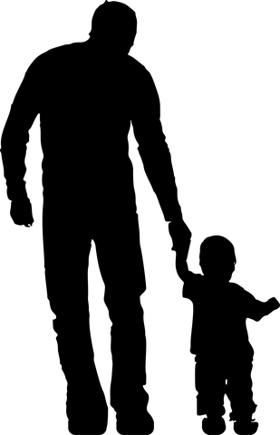
Relationships with Families
Trauma often impacts families differently
Trauma impacts families' ability to build relationships due to
distrust
miscommunication
disconnection
shame
Partnering with families on equal terms is key to fostering trust and positive relationships.

Slide 19
Relationships
Notes:
To Know: Significant relationships are required for significant learning.
To Say:
While developing positive relationships with students who have experienced trauma may be challenging, the development of those relationships is critical to these students’ resilience. We will learn more about strategies for building relationships in a later module.
As you read this quote from James Comer, think of a teacher with whom you had a positive relationship, how did having a relationship with that teacher impact your learning experience? Share your experience with a partner.
To Do: Share with a partner how a positive relationship with a teacher impacted your learning experience.
Reference: James Comer

Slide 20
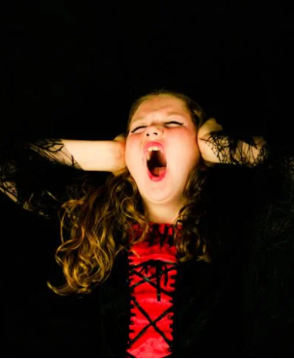
Impact of Trauma on the Child: Behavior
Learning
Relationships
Behavior
Notes:
To Know: Trauma impacts behavior of a child.
To Say: Many of the effects of trauma within the context of classroom behavior originate from the same problems that create academic difficulties. The impact that trauma has on the way a child’s brain develops can manifest itself in all aspects of their day and certainly on the behavior they demonstrate.

Slide 21
Small Group Discussion 1
“For many children who have experienced traumatic events, the school setting can feel like a battleground in which their assumptions of the world as a dangerous place sabotage their ability to remain calm and regulate their behavior in the classroom.”
Helping Traumatized Children Learn - The Problem: Impact
Notes:
To Say: Read the following quote. After reading consider the following questions: Have you seen this play out in your classrooms, playgrounds, buses, cafeterias, hallways etc.? What does that look like?
To Do: Have participants discuss the following questions in small groups:Have you seen this play out in your classrooms, playgrounds, buses, cafeterias, hallways etc.? What does that look like?
References: https://traumasensitiveschools.org/trauma-and-learning/the-problem-impact/

Slide 22
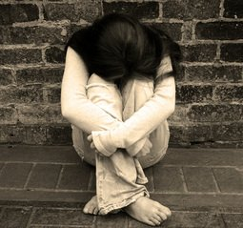
Fight, Flight, Freeze, Appease
Notes:
To Say: When a child in functioning in survival brain or is faced with a situation that causes them fear or stress, they will have one of four reactions. They will fight, flee (flight), freeze or appease. You have likely heard of fight, flight or freeze but there is an additional category, called appease that we are going to explain in a moment. When a child is in fight, they will demonstrate behaviors that could be labeled as aggressive. They may take something out of another student’s hand, they may yell or run at you, or cry and throw themselves on the floor. A child who is experiencing flight will usually be looking for a way to escape. They may attempt to run out of the classroom, hide under a desk or cover their ears. A student who is experiencing freeze may become quiet, they may look around the room or stumble over their words. You may not see any behavior at all but they may still be functioning in survival brain. The last category is appease. This is also referred to as fawn or submit. Children who are experiencing appease may simply go along or comply with the request given because they see that as the only safe alternative. It is important for us, as educators, to remember that even though they may seem calm and compliant, they may actually be functioning in survival brain. We wanted to take a few minutes to let you explore these concepts. Please refer to the handout on these four reactions. Take note of the the columns as told from the students perspective. Look through the chart and identify behaviors you may have seen your students exhibit. Pay close attention to the last column which highlights ways you can support students when they are in survival brain.
To Do: Have participants read through the handout and identify behaviors they have seen in their classrooms. Have them highlight strategies they would be willing to try in order to support student when they are in survival brain.
Handout: Fight, Flight, Freeze, Appease

Slide 23
How Does Trauma Impact Behaviors?
Emotional Dysregulation
Reactivity/Impulsivity
Aggression
Defiance
Withdrawal
Perfectionism
Notes:
To Know: Trauma can impact behavior in a number of ways.
To Say: We’ve spent some time identifying what behavior students may demonstrate when they are in survival brain. Let’s take a few minutes to dive deeper into the impact trauma can have on behavior. Being able to self-regulate or modulate emotions is a key predictor to academic, behavioral and social success; yet, unfortunately emotional dysregulation is one of the most striking features of chronically traumatized children. Children who have experienced trauma may feel fear, worry, sadness, anger, loneliness, low self-worth, or the feeling of not being able to trust others. They may become withdrawn, anxious, or depressed. There may be issues of shame, guilt, and body image. Children may fail to recognize their feelings and be able to manage them appropriately.
Children who have experienced trauma may also be triggered if they feel they are being provoked or if something reminds them of the trauma. An incident or remark that might seem minor to some may be perceived as threatening to a child who has experienced trauma, who may then respond in a disproportionate way.
Children who develop in the context of a traumatic or chaotic household may have underdeveloped verbal skills and lack experience with verbal problem solving. They may have had physical aggression modeled as a way of problem solving or how emotions are dealt with at home. Aggression may rise from a distorted perception of the intentions of others, interpreting them as hostile or aggressive; thus, their actions are self-protective (fight response).
Children who enter the classroom in a state of fear at any level may refuse to respond to the teacher. They may attempt to take control of a situation through actively defiant behavior or through being passive (freeze). Either way, the child is not receptive or responsive to the teacher or the expectations.
In addition to that, feelings of being vulnerable may foster a reluctance to engage in the classroom…these children may be easily overlooked. Finally, children exposed to violence at home are subject to the arbitrary will of the caregivers who have unrealistic expectations for childhood behaviors. They become afraid to disappoint their caregivers and incur their explosive response, so they try but often fail to meet the unreasonable expectations. In their desire for approval and success, they become perfectionists. If they meet with frustration, they may give up or become despondent when they encounter difficulty mastering a task.

Slide 24
Small Group Discussion 2
How might a student’s school day be impacted if they are unable to manage the intensity or duration of negative emotions?
Notes:
To Say: Let’s consider how a child’s school day might be impacted by those factors. If a student is unable to manage the intensity or duration of negative emotions, how might their day be impacted? What would that look like as they arrive, walk down the hallway, enter into the classroom, engage with their peers and adults? Take some time in your small group to discuss.
To Do: Have small groups discuss the above questions. De-brief after if possible.

Slide 25
Behavior is the language of trauma
“Many children develop behavior coping mechanisms in an effort to feel safe and in control, yet these behaviors can frustrate educators and evoke exasperated reprisals, reactions that both strengthen the child’s expectations of confrontation and danger and reinforce a negative self-image.”
Helping Traumatized Children Learn - The Problem: Impact
Notes:
To Know: Behavior is the language of trauma and it is important for educators to respond to behavior in a way that reinforces the desired behavior.
To Say: Remember that behavior is the language for trauma. A child’s behavioral response to traumatic events can lead to lost learning time and strained relationships with teachers and peers. For many children who have experienced traumatic events, the school setting can feel like a battleground in which their assumptions of the world as a dangerous place sabotage their ability to remain calm and regulate their behavior in the classroom.
It is extremely important to consider our responses. Module 4 focuses on various strategies to respond to learning and behavior challenges in the classroom. Before selecting specific strategies, it is important to consider your own response to stressful situations. It is our response that will determine the outcome of the situation. We can either respond in a way that reinforces the very behavior we do not want or, we can break the cycle, and allow the student to demonstrate a new skill that will lead us to our desired outcomes.
References: https://traumasensitiveschools.org/trauma-and-learning/the-problem-impact/

Slide 26
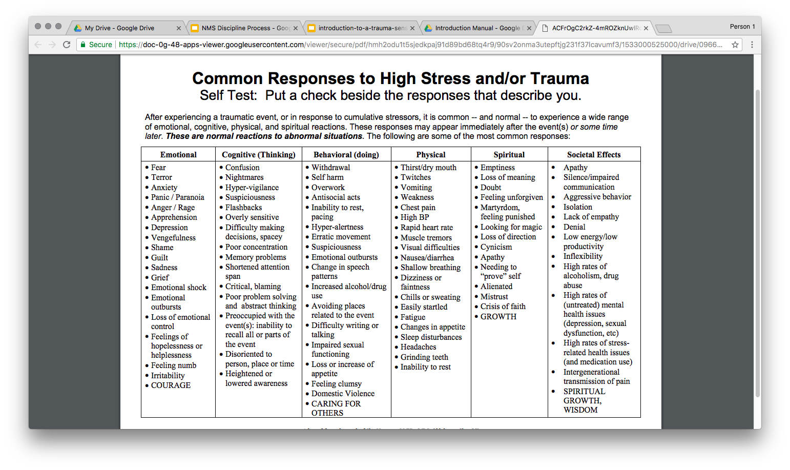
Common Responses to High Stress of Trauma
Adapted from the work of Jim Norman, M.ED, C.T.S Oklahoma City, OK
Copyright © 2016 Eastern Mennonite University, http://www.emu.edu/star
Notes:
To Say: In order to respond to student needs in your classroom effectively, you will first need to be able to recognize your own response to stress. The following activity will allow you to begin those conversations. The directions are as follows: Complete this self-assessment showing common responses to high stress of trauma. Put a check beside the responses that typically you engage in when faced with an event that overwhelms you or cause stress.
To Do: Consider having participants complete and discuss in small groups or complete prior to beginning Module 4.
Handout: Common Responses to High Stress

Slide 27
Team Talk: Review the “How”
What adjustments will we make to our practices in order to address the impact trauma has on:
Relationships
Behavior
Fill this in on your Action Plan under “Objectives and Action Planning”
Notes:
To Know: Action planning supports engagement in the work and next steps
To Say:
We’ve now completed the module “Trauma and the Classroom”. This your time to pause and reflect on the “how”. What adjustments will we make to our practices in order to address the impact trauma has on relationships and behavior. Please fill this in on your action plan under objectives and action planning. A reminder that specific strategies to address the impact on the classroom will be covered in later modules.
Handout: Action Planner

Slide 28
References
Bartlett, J.D. and Steber, K. (2019). Retrieved from: How to Implement Trauma-informed Care to Build Resilience to Childhood Trauma
Helping Traumatized Children Learn - The Problem: Impact
Kaiser, B. 2020. Understanding the Impact of Trauma on Behavior.
Norman, J. (2016) Common Responses to High Stress and Trauma Self Test. Retrieved from: Eastern Mennonite University
STARR.ORG (2019) Resetting for Resilience.

