Slide 1
Hidden Slide #1
This Module was designed to be used in the following manner.
The audience for this Module is division and school teams.
This Module is meant for whole staff, team, and division presentations.
Following this training, participants should complete the Action Plan document to determine next steps.
There are eight sections in this module. Teams are not required to complete all components of the Modules. Instead, participants will complete only those Modules that fit the needs of their school.
Notes:
Module 1 is divided into several sections. Each section can be completed in 30 minutes or less.

Slide 2
Hidden Slide #2
In person training
Presenter notes and information
Notes:
In-person training suggestions
The Building Relationships Module in-person training should take about 30 minutes, but could be longer, depending on how you choose to use the activities embedded in the powerpoint.
This presentation provides research about the importance of relationships, strategies to build relationships (with examples through the use of videos and articles), and how to repair relationships. Additionally, the module includes a section on building relationships with students. You may want to add or enhance portions with visuals and examples that will resonate with your audience. As a reminder, always be sure to include appropriate citations when adding resources. Also, you might look to the resources and activities sections for additions that may be helpful.
In summary
This module outlines the basics of building relationships and includes multiple examples of strategies that can be used to connect with students and families.
It can be adapted to individual contexts
The training should last about 30 - 60 minutes, depending on the activities you choose to use.
Presenter notes information
Presenter notes are included in the PowerPoint. Background information for the presenter is shown as “To Know.” Statements to be shared with participants are shown as “To Say.” In some instances, the “To Know/To Say” are combined.The presenter notes also include “To Do” prompts and cues for “Handouts”.
Additional activities, examples, videos, etc. are being developed. A presenter may add material from the resources and activities section on the website.
Breaks should be inserted at the discretion of the presenter based on the needs of participants.

Slide 3
Hidden Slide #3
Supplies needed
WIFI access for presenter and participants
Access to videos (through WIFI if available, but download to flash drive as a back-up)
Chart paper
Markers
Post-it-Notes
Notes:
To Know
These supplies are needed for the Trauma Professional Learning Modules.

Slide 4
Hidden Slide #4
Handouts for this Module
Action Planner
Notes:
To Know
The Participant and Presenter Materials are located on the vtss-ric website.
References

Slide 5
Building Relationships
Notes:
To Know:
VTSS Professional Learning Modules are organized in the same manner. All schools can begin their journey with Module 1 which introduces the foundational knowledge around trauma and trauma sensitive schools. This powerpoint is part of Module 4 that shares strategies on how we create trauma-sensitive, safe and supportive schools.
To Say:
Welcome to the learning module, “Building Relationships”. Let’s get started!

Slide 6
What We Will Know and Do
Understand the importance of relationships
Gain strategies that can be used in the classroom to develop relationships with students
Explore practices to connect with families
Notes:
To Know:
Go over the learning intentions targeted for this session
To Say:
During this module we hope you will discuss the importance of relationships, as well as provide strategies to build relationships with your students and their families.

Slide 7
What this looks like
When there is a positive teacher-student relationship, students feel safe and there is a strong bond of trust within the classroom. Students are not afraid to take risks and understand that making errors are all part of the learning process. Students are more likely to feel positive about school and have a greater chance of developing a true love for learning.
https://meteoreducation.com/teacher-student-relationships/
Notes:
To Know: Students who experienced trauma seek safety and trust from other (2 of the care values discussed in the Trauma Sensitive Environments module).
To Say: Positive teacher-student relationships provide students with a sense of safety and trust. Once relationships are established, students can thrive in the classroom or school environment. It only takes one caring adult to be the bridge to success for children who have experienced trauma.

Slide 8
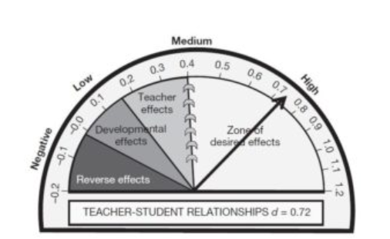
Why this matters
“It is teachers who have created positive teacher student relationships that are more likely to have the above average effects on student achievement.” John Hattie (2009)
Notes:
To Know: Most effective educators turn to data-driven research when creating a plan of action. In John Hattie’s book, Visible Learning, A Synthesis of Over 800 Meta-analysis Relating to Achievement, he synthesizes over 800 meta-analyses. Therefore, what indicators make the greatest impact on student achievement?
Scores ranged from -0.51 to 1.30. In his summary of Hattie’s book, Gerry Miller states, “An effect size of d=1.0 indicates an increase of one standard deviation on the student achievement. A one standard deviation increase is typically associated with advancing a student’s achievement by 2 to 3 years or improving the rate of learning by 50%. Research shows that these can be expected to have an average effect size of 0.4 (the ‘hinge point’).” Anything below 0.40 won’t have much of an impact on student achievement, while anything above 0.40 will have a direct correlation to student success (Miller, G. p.1).
To Say: John Hattie conducted research on over 800 meta-analyses to look at which factors impact student achievement. Research show that an average effect size is 0.4. Anything below 0.4 won’t have much of an impact, while anything about .4 has been demonstrated to have a direct correlation with student success. Positive teacher-student relationships has an effect size of 0.72, which indicates how much a strong relationship can impact a student’s success.

Slide 9
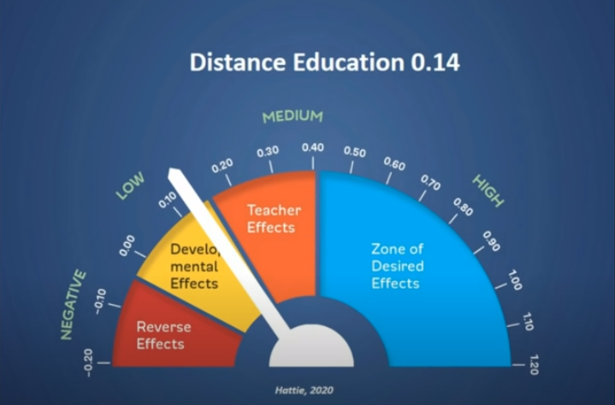
Distance Learning
Notes:
To Know: Hattie asserts that time away from school does not result in devastating learning outcomes, he cautions that equity is a far more concerning factor. Hattie highlights that the effect size of technology has been low for the last 50 years, and remains so. “The effect of distance learning is small (.14) but that does not mean it is NOT effective – it means it does not matter whether teachers undertake teaching in situ or from a distance over the internet (or, like when I started in my first university, via the post office)," he says.
To Say: It is not the median that matters it is the message we use that matters. There are different ways to get to student outcomes in distance learning. Hattie emphasises several key points:
Optimising social interaction between peers and teachers
Listen to student feedback carefully as you do not have the usual classroom cues to look out for
Balance “precious knowledge with deep learning”
Understand what it is to be a learner online
Question how you can know your impact as an educator from afar
Collaborate more with other teachers to share ideas, observations and tips

Slide 10
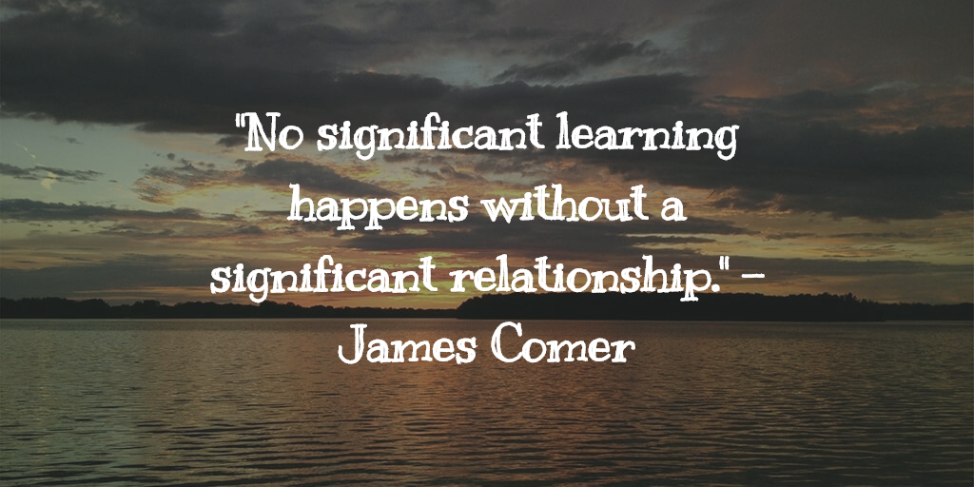
Relationships
Notes:
To Know and Say: This quote sums up the importance of relationships. Pause for a moment and reflect on when you were in school and relationships you had with teachers. Are there teachers that stand out? Why? Most of us likely will think of teachers who made us either feel really successful or really bad! Think about the type of relationship you had with that teacher and did that affect your attitude and performance the his/her class?

Slide 11
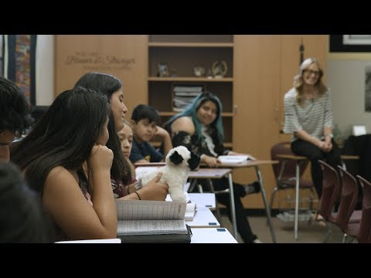
Video: Building Relationships
Notes:
To Know: Short video with some examples of teachers building relationships with students. Video is 3:17 - https://youtu.be/Zzvd3VpNCXE
To Say: We are going to watch a brief video with some examples of teachers building relationships with their students.

Slide 12
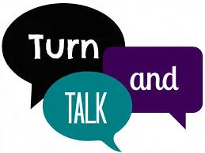
Discussion
What strategies have you used to successfully build relationships?
What challenges have you faced with to building relationships?
Notes:
To Know and Say: Reflect on the video and think about some strategies that you have used to build relationships with students. (Give opportunity to share if in group.) What are some challenges that you have faced in trying to build relationships? (Again, share with others, either in pairs or whole group, depending on setting/staff).

Slide 13
Key Considerations
be intentional about getting to know your students
interact in a responsive & respectful manner
be authentic with students
Notes:
To Know: For some teachers, building relationships come naturally; however, that is not the case for all teachers.
To Say: Relationships with students sometimes occur naturally; however, for some teachers and some students, it can be more of a challenge to develop a relationship. We want to ensure that we are intentional in getting to know about ALL students, and we may need to plan classroom activities to learn about others. It is critical that as adults, we interact in a responsive and respectful manner to our students (even when they may not be demonstrating those same behavior to us). This becomes even more important with older students. Also, remember that students know if you are faking it! Be authentic when engaging with your students.

Slide 14
Building Relationships from a Distance
Dynamism - Look and sound passionate and prepared
Immediacy - Accessibility and relatability
Connection
Teacher clarity
Engagement
Feedback
Notes:
To Know/To Say: When you are building relationships from a distance it is more difficult to connect so therefore teachers need to spend time engaging in different ways with their students. Come to your online classroom looking professional and prepared. Show your students that you are excited and passionate about what they are about to learn. When practicing immediacy make sure you are gesturing when talking, looking at your students (pay attention to your facial expressions), calling your students by name, make sure you can pronounce each students name properly, have students provide feedback using different tools. Connection is very important which we highlight in strategies.

Slide 15
Strategies to Build Relationships
Notes:
To Know: Transition Slide

Slide 16
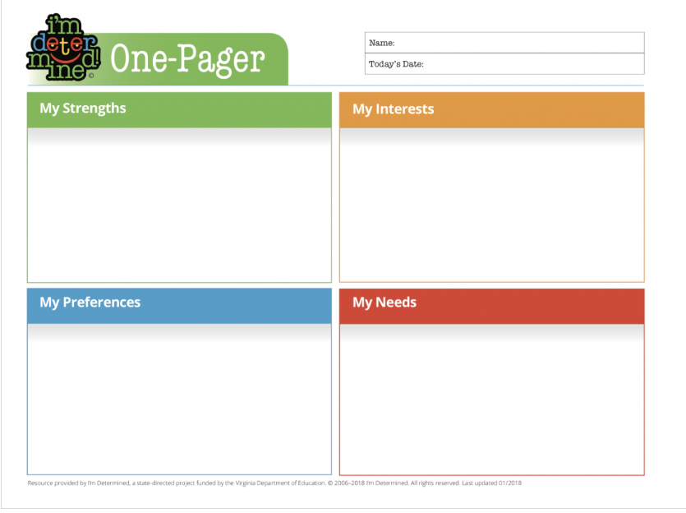
Get To Know Your Students
Surveys
Questionnaires
Letters
Projects
Student of the
week
https://www.imdetermined.org/quick-links/one-pager
Notes:
To Know: There are multiple strategies that can be used to build relationships. This module is only sharing a few, easy to implement strategies. The next several slides provide different ways to build relationships, depending on your audience.
To Say: The first step in building relationships with your students is to get to know them. There are a number of ways to do this including: student surveys and questionnaires, student letters about themselves, get to know you projects, and ongoing structures such as student of the week. Consider the One Pager resource from the I’m Determined project. This resource invites students to identify individual strengths, interests, preferences, and needs.

Slide 17
The “Take Care of Me List”
ask students to fill a page with specific things you can do to take care of them as learners.
model this by having your own “Take Care of Me List” that highlights things you need from them as students
read them all and write a short response
Link to article: The Take Care of Me List
Notes:
To Know: The “Take Care of Me List” is a specific strategy to get to know your students needs.
To Say: One specific strategy to help you get to know your students is the “Take Care of Me List.” With this strategy you can ask your students to fill a page with specific things that you can do to take care of them as learners. Have them think back to a previous experience that made them happy to learn and describe what the teacher did to support them. Model this by having your own “Take Care of Me List” that highlights things you need from them as students. Once you collect these it will be important to read them all and write a response to validate and affirm their feedback.

Slide 18
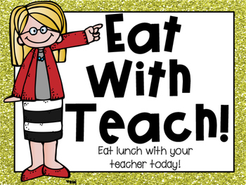
Strategies to Connect with Students
take the first five minutes of class to engage students in casual conversations
gaming, music, tv shows, sports, movies, etc.
set up times for “office hours”
or lunch groups
attend extra-curricular
activities
set up community building structures like class meetings or cooperative group activities
Notes:
To Know: There are multiple strategies that can be used to build relationships. This module is only sharing a few, easy to implement strategies. The next several slides provide different ways to build relationships, depending on your audience.
To Say: Let's consider some easy ways to begin to build relationships with our students. Any time an adult spends time with a student and tries to get to know more about them, especially around things other than academics and behavior, you begin to create a relationship. Consider taking the first five minutes of class to engage students in casual conversations. Talk to them about various topics such as sports, TV, or movies to get to know their specific interests. You can also talk to students individually to learn more about them. This can be done by setting up times that students can visit with you before or after class or at lunch. Also, students love when they see teachers outside of the school setting! Making an effort to attend some of the extra-curricular events to support students can also be very powerful. It is also important to set up various community building structures within your classroom. Consider the use of class meetings and cooperative groups. These practices are a good way for students to learn about each other and find common interests.

Slide 19
Connection in a Virtual Session
Send messages to families
Ask intriguing questions in advance of instruction
Post photos of students and assignments to your LMS
Customize directions for assignments in a short video
Personalize feedback on assignment using Google Voice comments
Notes:
To Know/To Say: There are many tools that you can use to connect with students in a virtual session. These are just a few.

Slide 20
More Suggestions
Strategies for Building Rapport With Students
Advisory: 22 Ways to Build Relationships
Notes:
To Know: Two articles with lists of strategies to build relationships. Determine how you would like to engage your staff with these resources.
Strategies for Building Rapport With Students: This article provides a list of 30 strategies to build and maintain relationships with students
Advisory: 22 Ways to Build Relationships: Nashville Big Picture High School shares strategies to build intentional relationships with students
To Say: Let’s discuss strategies that were shared in the article.

Slide 21
Strategies to Repair Relationships
Notes:
To Know: Transition Slide

Slide 22
Reconnect with Student
Practice open and positive communication
Be mindful of your non-verbal language
Provide opportunities for student success
Provide behavior specific praise
Engage in conversations about their interests without discussing school expectations
Notes:
To Know/To Say: There will be times when the student/teacher relationship is in need of repair and it is important to reconnect with students during this time. To begin with, practice open and positive communication. Be mindful of your non-verbal language as students are watching and listening to more than your words. When reconnecting with students, provide numerous opportunities for them to experience success and provide immediate behavior specific praise in order to establish a pattern of positive interactions. Finally, continue to engage students in conversations about their individual interests. Refrain from talking about your academic expectations during these conversations and instead focus on engaging them in topics of interest.

Slide 23
Videos for Discussion
The following videos provide additional considerations and discussion points to use with your team or faculty:
Strengthening Relationships with Diverse Learners
From Gang Member to Graduate
The Power of Relationships in Schools
Notes:
To Know: Three very good videos to engage staff in discussion about relationships. Choose one video to use with your staff and engage in discussions. Many staff like the Gang Member to Graduate video, but if this has been used in other trainings, there are two other choices. Watch the video as a group and then discuss key points.
Strengthening Relationships with Diverse Learners: At North Salem High School, one of the most diverse high schools in Oregon, teachers and school leaders have made building positive relationships with students a school priority. In this video by REL Northwest, two teachers share successful strategies they have used to connect to students and build authentic relationships. (9:04)
From Gang Member to Graduate: This the story of DJ Batiste. At the age of four he was kicked out of Head Start. At the age of thirteen he was in Juvenile Detention and still leading a large violent gang in Mississippi. At the age of 17 he was introduced to Conscious Discipline. Now, he leads and teaches from a different point of view and in turn inspires hundreds around the country with the message of Connection instead of Correction. Video shares DJ and the teacher’s points of view regarding behavior. (7:36)
The Power of Relationships in School: Learning environments and importance of building relationships. (3:40)
To Say: Lead the group in a discussion about the video. Takeaways? How to incorporate these strategies with teachers and students?

Slide 24
Articles for Discussion
Creating a Learning Environment Where All Kids Feel Valued
Relationships Matter More Than Rules
The Power of Positive Communication
Notes:
To Know: Three articles that can be used with staff. Divide up in groups and assign one article to each group or choose one article to use with the whole group, depending on you needs.
Creating a Learning Environment Where All Kids Feel Valued: A five-step exercise on identity and belonging helps middle school students appreciate differences—in themselves and in their peers.
Relationships Matter More Than Rules: Community building in the classroom starts on day one. Try these strategies to begin forging strong relationships.
The Power of Positive Communication: Setting a goal of positive contact with every student’s family helped a middle school teacher deepen relationships and boost her own morale.
To Say: Lead a discussion about chosen article(s).

Slide 25
Connect with Families
Engage families within your school
Invite them into the classroom
Have them involved in projects
Honor their accomplishments and contributions
Host a parent tea or coffee
Practice consistent communication
Be proactive and positive
Positive phone calls home
Notes:
To Know/To Say: It is important to connect with families as they are an essential support for your students. Engage family members within your school through a variety of strategies such as inviting families into the classroom. Incorporate projects that can highlight family strengths and customs and have families come in to share in the presentation of those. Host parent speakers to honor accomplishments and contributions or invite parents in to engage through a tea or coffee event. In addition to inviting them in, it is important to practice consistent communication. Be proactive and positive with the communication and schedule consistent positive phone calls home.

Slide 26
Team Talk: Review the “How”
How will you adjust your practices to support learning for students who have experienced trauma?
How will you involve families and students in practices?
Fill this in on your Action Plan under “Objectives and Action Planning”
Notes:
To Know: Action planning supports engagement in the work and next steps
To Say:
We’ve now completed the module “Building Relationships”. This your time to pause and reflect on the “how”. Make a list of several practices that you can easily incorporate into your class/role to develop positive relationships with students. Commit to using at least one strategy with all of the students in your class(es). Please fill this in on your action plan under objectives and action planning.
Handout: Action Planner

Slide 27
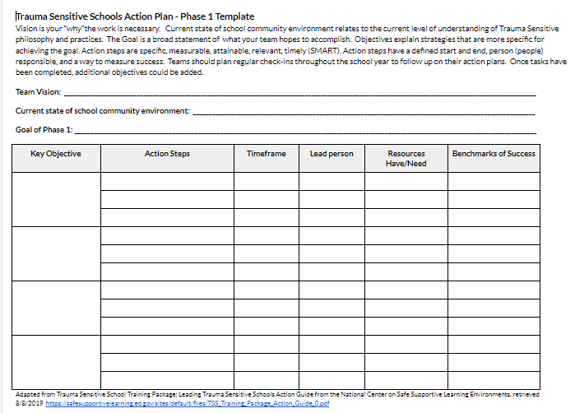
Action Planning
Notes:
To Know: Action planning supports engagement in the work and next steps
To Say: We’ve now completed the module “Building Relationships” . This your time to pause and reflect on the “how”. Are you ready to engage in the work? How will you begin implementation of the work? Please fill this in on your action plan under objectives and action planning.

Slide 28
Resources/References
https://meteoreducation.com/teacher-student-relationships/
https://visible-learning.org/
https://www.youtube.com/watch?v=Zzvd3VpNCXE
https://www.imdetermined.org/quick-links/one-pager
https://www.edutopia.org/article/take-care-me-list
https://www.thoughtco.com/strategies-for-building-rapport-with-students-3194262
https://www.edutopia.org/practice/advisory-22-ways-build-relationships-educational-success

Slide 29
More Resources/References
https://www.youtube.com/watch?v=AWliHzJVVeQ&feature=youtu.be
https://www.youtube.com/watch?v=DRJYJrs7Fso&feature=youtu.be
https://www.edutopia.org/video/power-relationships-schools
https://www.edutopia.org/article/creating-learning-environment-where-all-kids-feel-valued
https://www.edutopia.org/article/relationships-matter-more-rules
https://www.edutopia.org/article/power-positive-communication

