Slide 1
Hidden Slide #1
This Module was designed to be used in the following manner.
The audience for this Module is division and school teams.
This Module is meant for whole staff, team, and division presentations.
Following this training, participants should complete the Action Plan document to determine next steps.
There are eight sections in this module. Teams are not required to complete all components of the Modules. Instead, participants will complete only those Modules that fit the needs of their school.
Notes:
Module 1 is divided into several sections. Each section can be completed in 30 minutes or less.

Slide 2
Hidden Slide #2
In person training
Presenter notes and information
Notes:
In-person training suggestions
This module can be broken down into sections. Each section of Module 4 should be about 30 minutes to complete. This modules provides strategies that can be used for staff and students in trauma sensitive schools. You may want to add or enhance portions with visuals and examples that will resonate with your audience. As a reminder, always be sure to include appropriate citations when adding resources. Also, you might look to the resources and activities sections for additions that may be helpful.
In summary
This module outlines strategies that can be used in trauma sensitive schools
It can be adapted to individual contexts
The training should last about 4 hours for the entire module or 30 minutes for each section.
Presenter notes information
Presenter notes are included in the PowerPoint. Background information for the presenter is shown as “To Know.” Statements to be shared with participants are shown as “To Say.” In some instances, the “To Know/To Say” are combined.The presenter notes also include “To Do” prompts and cues for “Handouts”.
Additional activities, examples, videos, etc. are being developed. A presenter may add material from the resources and activities section on the website.
Breaks should be inserted at the discretion of the presenter based on the needs of participants.

Slide 3
Hidden Slide #3
Supplies needed
WIFI access for presenter and participants
Access to videos (through WIFI if available, but download to flash drive as a back-up)
Chart paper
Markers
Post-it-Notes
Notes:
To Know
These supplies are needed for the Trauma Professional Learning Modules.

Slide 4
Hidden Slide #4
Handouts for this Module
Action Planner
Notes:
To Know
The Participant and Presenter Materials are located on the vtss-ric website.
References

Slide 5
Hidden Slide #5
Key Terms in This Module:
Social Emotional Learning
CASEL
Self-Awareness
Social-Awareness
Self-Management
Responsible Decision Making
Relationship Skills
Notes:
To Know
These are the key terms used throughout the module.

Slide 6
An Introduction to SEL
What is social emotional learning and why is it important?
Notes:
To Know:
VTSS Professional Learning Modules are organized in the same manner. All schools can begin their journey with Module 1 which introduces the foundational knowledge around trauma and trauma sensitive schools. This powerpoint is part of Module 4 that shares strategies on how we create trauma-sensitive, safe and supportive schools.
To Say:
Welcome to the learning module, “Introduction to Social Emotional Learning”. Let’s get started!

Slide 7
What We Will Know and Do
Build an understanding of the importance of social emotional learning.
Explore how we are organized to implement VTSS with SEL practices to support trauma sensitive schools.
Notes:
To Know:
Go over the learning intentions targeted for this session
To Say:
During this module we hope you will gain an understanding of the importance of social emotional learning and how it connects to our work.

Slide 8
What is SEL?
Social Emotional Learning is the process through which children and adults acquire and effectively apply the knowledge, attitudes, and skills necessary to understand and manage emotions, set and achieve positive goals, feel and show empathy for others, establish and maintain positive relationships and make responsible decisions.
Notes:
To Know: CASEL (Collaborative for Academic, Social and Emotional Learning) defines SEL above.
To Say: “Social and emotional learning (SEL) is an integral part of education and human development. SEL advances educational equity and excellence through authentic school-family-community partnerships to establish learning environments and experiences that feature trusting and collaborative relationships, rigorous and meaningful curriculum and instruction, and ongoing evaluation. SEL can help address various forms of inequity and empower young people and adults to co-create thriving schools and contribute to safe, healthy, and just communities.”
Reference: This comes directly from https://casel.org/what-is-sel/

Slide 9
Quick Review of Definitions
SELF-
AWARENESS
SELF-
MANAGEMENT
SOCIAL AWARENESS
RELATIONSHIP
SKILLS
RESPONSIBLE DECISION MAKING
The abilities to understand one’s own emotions, thoughts, and values and how they influence behavior across context.
The abilities to manage one’s emotions, thoughts, and behaviors effectively in different situations and to achieve goals and aspirations.
The abilities to understand the perspectives of and empathize with others, including those from diverse backgrounds, cultures, and contexts.
The abilities to establish and maintain healthy and supportive relationships and to effectively navigate settings with diverse individuals and groups.
The abilities to make caring and constructive choices about personal behavior and social interactions across diverse situations.
CASEL 2020
Notes:
To Know: CASEL’s five areas of competence have served as the foundation for the VDOE social emotional standards and competencies. This is a video that you can show about the reintroduction to SEL.
To Say: CASEL articulates five areas of competence: self awareness, self-management, social awareness, relationship skills, and responsible decision making. Social Emotional Learning is about how we understand ourselves, make good decisions, work with others, and set goals. SEL enhances student learning by helping students develop the knowledge, skills, and attitudes needed to successfully navigate their schooling experience. For example, SEL helps students understand their own strengths and limitations, develop their communication skills, manage their own learning, collaborate with others, apply real world problems, engage in respectful dialogue, resolve conflicts peacefully, and advocate for themselves and others when confronted with difficult situations. All of these social and emotional competencies help facilitate students’ deeper engagement in school, thus enhancing their learning.
Reference: https://casel.org/wp-content/uploads/2020/12/CASEL-SEL-Framework-11.2020.pdf

Slide 10
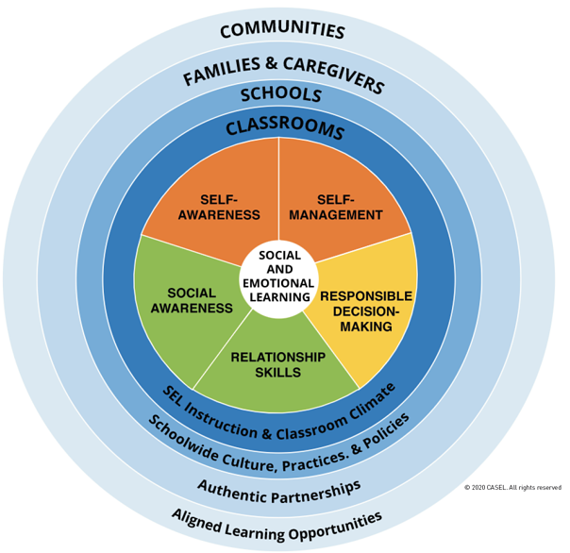
Social Emotional Learning
Self Awareness:
Identifying personal, cultural, and linguistic assets
Identifying one’s emotions
Linking feelings, values, and thoughts
Examining prejudices and biases
Having a growth mindset
Self Management:
Managing one’s emotions
Setting personal and collective goals
Using planning and organizational skills
Showing the courage to take initiative
Responsible Decision Making:
Demonstrating curiosity and open-mindedness
Identifying solutions for personal and social problems
Learning to make a reasoned judgment after analyzing information, data, facts
Reflecting on one’s role to promote personal, family, and community well-being
Social Awareness:
Taking others’ perspectives
Showing concern for the feelings of others
Identifying diverse social norms, including unjust ones
Understanding the influences of organizations/systems on behavior
Relationship Skills:
Communicating effectively
Developing positive relationships
Demonstrating cultural competency
Practicing teamwork and collaborative problem-solving
Resolving conflicts constructively
Notes:
To Know/To Say: This slide breaks down the CASEL 5 into how you can see these areas across 5 competencies. Take some time with this slide and see where you can see connections in your classroom, at home, and school-wide.
To Do: Have teams spend time with this slide. Do an activity that connects them to this and everyday life. Where would they use these skills?
Reference: https://casel.org/wp-content/uploads/2020/12/CASEL-SEL-Framework-11.2020.pdf

Slide 11
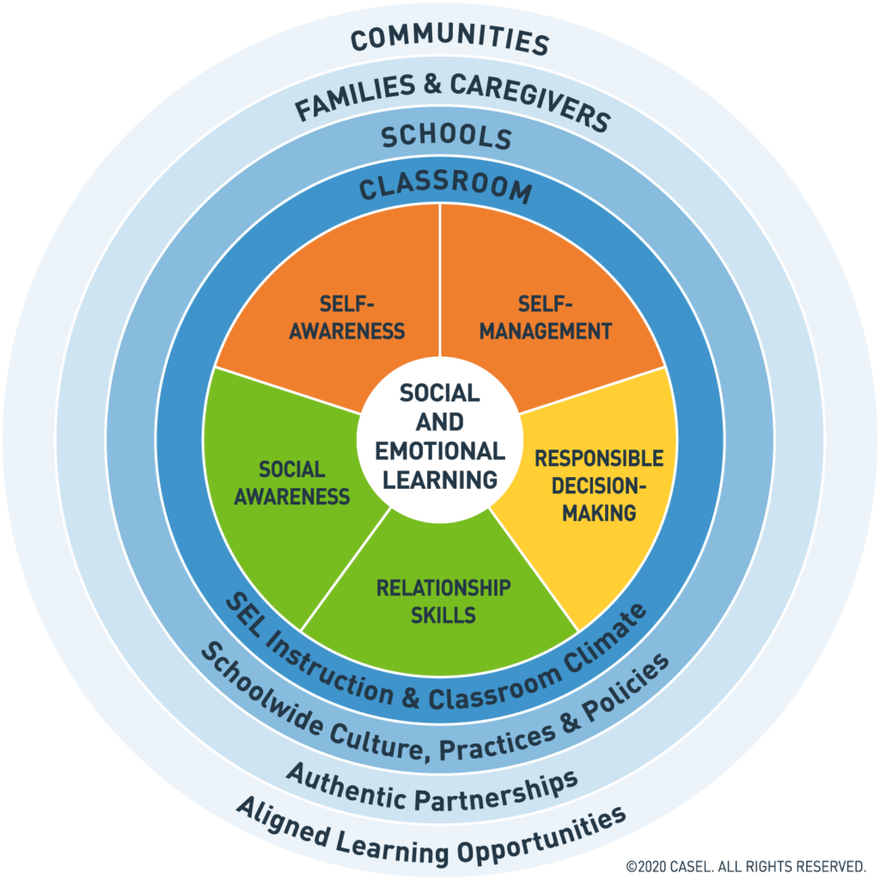
Where? SEL in School, Classroom, Families, and Communities
Notes:
To Know: This figure depicts the CASEL framework.
To Say: Systemic SEL is promoted across multiple contexts, every day. This framework and slide emphasize the importance of establishing equitable learning environments and coordinating practices across key settings. The classrooms, schools, families, and communities work together to enhance all students social emotional and academic learning. This includes policies, how we are incorporating SEL into daily instruction, how we are connecting with our families and communities.

Slide 12
Why SEL?
Science links SEL to Student Gains:
Better social emotional skills
Improved attitudes towards self, others, and school
Positive classroom behavior
11 percentile gain on standardized achievement tests
Fewer conduct problems
Less emotional stress
Lower drug use
Notes:
To Know: An overview slide for those who want only one slide, with research highlights. The next few slides are great for buy-in to the data on why SEL works. Depending on your audience you may want to emphasize certain points. Also important to note and point out: reductions in conduct problems is an important finding, but once again, it’s important to be wary of folks who think of SEL as behavior management and are looking to “fix broken kids.” Reductions in emotional distress warrants significant emphasis. We’re living in a time when emotional distress, depression, anxiety, and suicide are at an all-time high. Understanding that SEL can have an impact here is important, but with a word of caution: SEL should not be viewed as a solution for mental illness or students who demonstrate significant emotional or behavioral issues.
To Say: This slide shows student gains on the most cited and compelling research on SEL, the 2011 meta-analysis. Through this student we learned many things about SEL programming and improved SEL skills. (Read through bullet points)
Resources:
Meta-analysis source: Durlak, J.A., Weissberg, R.P., Dymnicki, A.B., Taylor, R.D., & Schellinger, K. (2011). The impact of enhancing students’ social and emotional learning: A meta-analysis of school-based universal interventions. Child Development: 82 (1), 405-432.
Early Social-Emotional Functioning and Public Health: The Relationship Between Kindergarten Social Competence and Future Wellness," published on October 09, 2015, in American Journal of Public Health.
Teacher burnout : Jennings, P.A. & Greenberg, M.T. (2009). The prosocial classroom: Teacher social and emotional competence in relation to student and classroom outcomes. American Educational Research Association.
Adult outcomes : Jones, D.E., Greenberg, M., & Crowley, M. (2015) Early social-emotional functioning and public health: The relationship between kindergarten social competence and future wellness. American Journal of Public Health 105 (11), 2283-2290.

Slide 13
Long-Lasting Gains
According to research by the Robert Wood Johnson Foundation, social-emotional learning helps young people to be "twice as likely to attain a college degree in early adulthood; 54% more likely to earn a high school diploma; and 46% more likely to have a full-time job at the age of 25."
Notes:
To Know/To Say: Preparing students for success after high school is critical to their success.
Resource: Research from "Early Social-Emotional Functioning and Public Health: The Relationship Between Kindergarten Social Competence and Future Wellness," published on October 09, 2015, in American Journal of Public Health.

Slide 14
Adult Gains
Adults Benefit from SEL:
Teachers who possess social and emotional competencies are more likely to stay in the classroom longer. because they’re able to work more effectively with challenging students
Research shows significant associations between social emotional skills in kindergarten and key young adult outcomes across multiple domains of education, employment, criminal activity, substance abuse, and mental health
Notes:
To Know: Research highlights.
To Say: Teachers with high levels of social competence are better able to protect themselves from burnout by:developing and managing nurturing relationships with their students, managing behavior in their classrooms, serving as behavioral role models for children, regulating their own emotions,
Resources:
Meta-analysis source: Durlak, J.A., Weissberg, R.P., Dymnicki, A.B., Taylor, R.D., & Schellinger, K. (2011). The impact of enhancing students’ social and emotional learning: A meta-analysis of school-based universal interventions. Child Development: 82 (1), 405-432.
Early Social-Emotional Functioning and Public Health: The Relationship Between Kindergarten Social Competence and Future Wellness," published on October 09, 2015, in American Journal of Public Health.
Teacher burnout : Jennings, P.A. & Greenberg, M.T. (2009). The prosocial classroom: Teacher social and emotional competence in relation to student and classroom outcomes. American Educational Research Association.
Adult outcomes : Jones, D.E., Greenberg, M., & Crowley, M. (2015) Early social-emotional functioning and public health: The relationship between kindergarten social competence and future wellness. American Journal of Public Health 105 (11), 2283-2290.

Slide 15
Employers Value SEL
Top 10 skills employers value:
Complex problem solving
Critical thinking
Creativity
People management
Coordinating with others
Emotional intelligence
Judgement and decision making
Service orientation
Negotiation
Cognitive flexibility
Notes:
To Know: This is a great slide to show the connection between SEL and real world skills. All of the skills listed involve social emotional competence.
To Say: The World Economic Forum identified the top 10 skills that are important to employers. All of these skills involve social emotional competence.
Reference: Future of Jobs Report, World Economic Forum

Slide 16
Administrators, Families, and Teachers Value SEL
According to a report released by McGraw Hill in 2018, the findings indicated that the overwhelming majority of administrators (96%), teachers (93%) and parents (81%) believe that social and emotional learning is just as important as academic learning.
Notes:
To Know/To Say: More recently, a new report from McGraw Hill was released in 2018 sharing findings from a survey conducted by Morning Consult from September 6-11, 2018. The findings represent a national sample of 1,140 teachers, administrators and parents. Overall, administrators, teachers and parents agree: SEL is crucial.
Reference: https://www.mheducation.com/prek-12/explore/sel-survey.html

Slide 17
Indicators of School-Wide SEL
How?
Why?
What and Where?
Implementation Focus Areas
Build Foundational Support and Plan
Strengthen Adult SEL Competencies and Capacity
Promote SEL for Students
Practice Continuous Improvement
Student Outcomes
Improved attitudes about self and others
Academic Success
College and Career Readiness
Healthy Relationships
Notes:
To Know/To Say: Whenever we are looking at systems we do the how, what (SEL competencies), where (schools, communities and families), why (buy-in), and the how (implementation)
Reference: https://casel.org/wp-content/uploads/2020/08/CASEL-Equity-Insights-Report.pdf

Slide 18
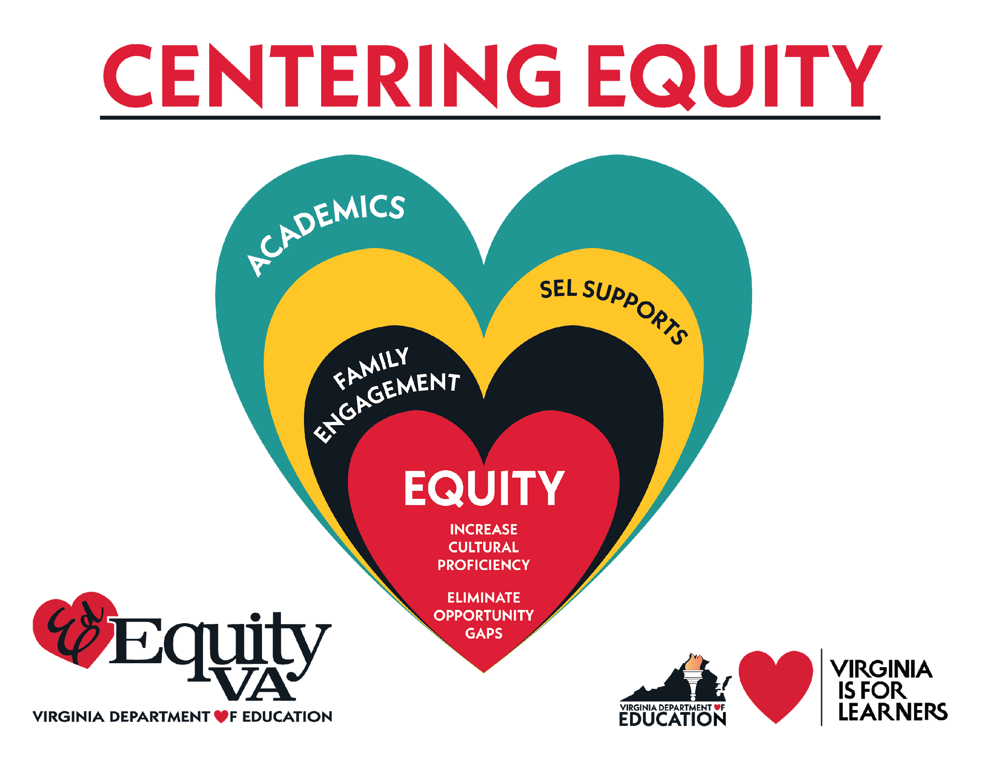
SEL in Virginia
The 2020 General Assembly (HB 753) required the VDOE to develop a uniform definition of Social Emotional Learning and to create K-12 SEL standards (and deliver to schools by July 1, 2021).
Notes:
To Know/To Say: VDOE was tasked in 2020 by the General Assembly to develop a uniform definition of Social Emotional Learning as well as create standards for SEL. A group of statewide contributors were tasked with this and informed by CASEL.

Slide 19
VDOE SEL for Virginia
VIRGINIA’S VISION FOR SOCIAL EMOTIONAL LEARNING
“The vision of social emotional learning in Virginia is to maximize the potential of all students and staff to become responsible, caring, and reflective members of our diverse society by advancing equity, uplifting student voice, and infusing SEL into every part of the school experience.”
VIRGINIA’S DEFINITION OF SOCIAL EMOTIONAL LEARNING
Virginia defines social emotional learning as:
“the process through which all young people and adults acquire and apply the knowledge, skills, and attitudes to develop healthy identities, manage emotions and achieve personal and collective goals, feel and show empathy for others, establish and maintain supportive relationships, and make responsible and caring decisions.”
Notes:
To Know/To Say: VDOE adopted the definition from CASEL.
Reference: https://www.doe.virginia.gov/support/prevention/social-emotional/index.shtml

Slide 20
Group Discussion
Review and discuss the VDOE vision and definition as a team.
What resonates with you?
What are you still curious about?
Notes:
To Do: Get teams to engage with the VDOE vision and definition for SEL.

Slide 21
VTSS Implementation Logic
OUTCOMES
SYSTEMS
Promote adult wellness by creating a nurturing environment
DATA
Expand the data that teams use to identify which skills to teach
PRACTICES
Teach SEL Competencies using VTSS Instructional Systems
https://www.pbis.org/Common/Cms/files/pbisresources/TeachingSocialEmotionalCompetenciesWithinAPBISFramework.pdf
Notes:
To Know/To Say: Using this common framework across all initiatives helps to keep us from being siloed. SEL should be anchored to your data, practices and systems.
First, at the top, we always consider student outcomes. It's all fluff if we don’t see improvement here.
Our data tells us where we need to focus and how to set goals. Teams review data to answer questions such as What are our key indicators, what data suggests student needs – this tells us where to teach and how to set goals. Since SEL is a trauma sensitive practice. Let’s look at SEL programs. Clearly it would be a big mistake to buy into an SEL program or approach without carefully considering the data, involving stakeholders, and identifying site specific needs and goals. Without data analysis, a school risks blindly selecting a program with little evidence of need. A failure to involve stakeholders will guarantee that this initiative will be doomed by limited buy in from teachers, students and families. It will be perceived as one more thing to do. Goals should be aligned to identified needs. This provides staff with ways to monitor and adjust our practices.
Our practices support the students. For example, if many students are impacted by poverty and trauma, we may need to explicitly teach social emotional competencies or expand our positive behavioral instruction. Invest in your division’s selection process for decisions based on need and fit before deciding on one SEL curriculum or prepackaged curriculum.
Our systems supports our most valued resource-our staff! The practices won’t sustain without supporting the adults working with the students and helping them to understand why it is important to review and work towards changing adult behavior. When we are talking about SEL we want to make sure that we put supports in place to support their own social emotional competency development.

Slide 22
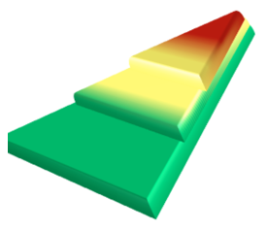
SEL is for EVERYONE
Tier 3 for a Few: Intensive, Individualized
Tier 2 for Some: Targeted for Small Groups
Tier I for All: Core/Universal
Notes:
To Know/To Say:For this slide, I have a hunch most of you have this burned in your brain. The important point to remember is that for many of our students, we don’t always know what happens. But we do know that the every student comes from a different environment and that environment will impact all students, so we start there – at Tier 1. Our data tells us that MANY students have an enhanced need for very positive behavioral instruction and support so we build that first and THEN we add our trauma sensitive school training with some parallel structures of ensuring academic success.
MTSS helps organize supports in a multilevel prevention system so that all students have what they need, academically, behaviorally, and emotionally. SEL supports equity by providing that Tier 1 foundation for all students because everyone needs well-developed social and emotional skills to successfully navigate their daily lives.
When we help students develop and apply social emotional skills, we are also helping to foster a positive and supportive school climate. Foundational SEL practices are aligned and integrated into academic instruction as well as connected to school wide academic and behavioral expectations.

Slide 23
Integrated SEL and Trauma
Equity focused
Builds individual and collective agency and resilience
Supports systems change to transform structures of injustice amd to promote robust equity
Supports and benefits from positive school climate, conditions for learning, and restorative practices
Notes:
To Know/To Say: It is important to emphasize the importance of school climate and integration of SEL and trauma sensitivity into daily practice, along with an expanding focus on issues of equity, both approaches are guided by common principles, such as safety, supportive relationships, youth and family empowerment, cultural competence, and focus on well-being.
With a clear understanding of complementarity, educators, in partnership with students and families, can work to articulate a shared vision for their schools and classrooms that includes a commitment to integrating both approaches to further their goal of creating safe, equitable, and engaging learning environments.
We want to develop a shared understanding and integrated vision for this work.
Reference: https://www.prevention.psu.edu/uploads/files/TSS-SEL-Brief-Final-June2021R.pdf

Slide 24
Focus on Adult SEL
Adults reflect on their own SEL skills
Support staff on developing capacity for supporting SEL (example: self-care)
Set up structures to support staff’s professional development
Model SEL competencies throughout school community with students, families, and community partners
Notes:
To Know/To Say: We start with our adults. Sometimes this may include a shift in mindsets. We need to focus on the social-emotional development of adults in order for those adults to have positive outcomes on our students. The same skills that help students succeed in life can benefit our school staff. A study from the Yale Center for Emotional Intelligence found that teachers who were mandated to teach SEL but not cultivate their own skills worsened their students SEL skills but the teachers who developed their SEL skills not only improved their well being but also improved the social emotional and academic development of their students. Adults who recognize, understand, label, and regulate their own emotions are less likely to report burnout, demonstrate higher levels of patience and empathy, encourage healthy communication, and create safe student learning environments.

Slide 25
School-wide Approach
We want to move from a small number of staff delivering lessons to all staff providing opportunities to teach in all settings, all day.
Notes:
To Know/To Say: Many assume that SEL is only instituted at the beginning of the school year, or that it only needs to be used with students who demonstrate emotional or behavioral issues. However, everyone benefits from developing strategies to help manage stress, build more meaningful relationships with others, and solve problems in a responsible way. It is important for all educators — teachers, support staff, and administration — to work together to support all students at a Tier 1, or universal, level.
There are many ways to teach social emotional learning to our students but which is right for your school? How will these practices become part of the fabric of the school and not just something that is taught every Monday morning during classroom meetings? How can home and community strengths be fully leveraged so that this is a fully integrated approach?
The research is conclusive: SEL principles taught to students will not gain traction unless adults in the school can integrate them into their daily practice and capitalize on real life situations that demand their application (Jones et al, 2017).
School wide SEL is a systemic approach to infusing SEL into students educational experiences - across all classrooms, during all parts of the school day.

Slide 26
Culturally Responsive SEL Instruction
Teaching and learning practices recognize that there are multiple viewpoints and multiple constructive ways to reach various situations.
Does not over-simplify what "appropriate" social and emotional responses are without exploring the complexities of social interactions.
Empowers students to constructively question inequitable treatment and make decisions that will move them towards growth and change.
Notes:
To Know/To Say: We have learned that when students have 4 or more adverse childhood experiences that one of the interventions we use to reduce symptoms are teaching emotion regulation skills but that rarely includes cultural integration. In order to do this our interventions need to be resilience focused. This looks at identifying and applying individual strengths, maximizing relationships and fostering community support. It is critical to monitor the impact of SEL instruction to ensure equitable outcomes across groups, meaning that no one group will benefit at the expense of another group as a result of SEL assessment and instructional practices.
Although individuals develop a broad array of social and emotional competencies, the ways in which individuals demonstrate or use the competencies and related skills may vary by culture and by the cultural norms that are created within a school. Thus, it is important to ensure that, as you implement SEL programs and practices, notions of cultural variation and adaptation are referenced and discussed with students and with your colleagues.
To support cultural variation in SEL, Gregory and Fergus suggest that educators consider the ecological conditions that affect education equity in general and affect whether students have equitable access to SEL programs and practices. Ecological conditions include such classroom aspects as the quality of instruction, types of behavior management strategies used, and overall context in which the student learns.
For example, emotions play a critical role in influencing students’ perceptions of themselves and, also, how others perceive them. When and how students experience and demonstrate various emotions can vary depending on their culture, previous experiences, societal norms, race, ethnicity, and gender.
Reference: https://ice.aasb.org/wp-content/uploads/Checklist-for-Culturally-Responsive-and-Embedded-Social-and-Emotional-Learning.pdf
Gregory, A. & Fergus E., (2017). Social-Emotional Learning and Equity in School Discipline. In S. M. Jones, E. Doolittle, & S. McLanahan (Eds.) The Future of Children, 27, special issue on Social-Emotional Learning, 117-136.

Slide 27
How? …Same Process
DEFINE
(TELL)
Simplify
ADJUST
(RETEACH)
For
efficiency
MODEL
(SHOW)
BE CONSISTENT
MONITOR
PRACTICE
In setting
Notes:
To Know/To Say: Just like academics, SEL instruction requires teachers to preplan the key elements of what to teach. So when teaching a lesson you always start by defining whatever it is you're going to teach. What is the skill that students need to succeed? What will that look like in action? How can we break this skill down so we can teach it well? In order for you to define the skills that students need to be successful you are going to look at your data. Your data such as school climate or students outcome data (minors) will help you define these skills.
Another practice that applies to both academics and SEL instruction is modeling. You're going to model it for your students and you're going to show them. The same steps we might use to model a new math problem can be used to model how to follow group norms during a social studies debate or your matrix has active listening under respect. We model skills so students can see this done effectively. Then we give students an opportunity to try this skill by practicing.
They will need time to practice these skills.
As they're practicing, you're going over and monitor and acknowledge how students are doing; so you're either providing useful corrections if they're misusing a strategy or you are providing positive feedback when they have it right, pointing out what they do right and then also giving them tips and prompts and redirecting them when they need it. And then as students go on we adjust for efficiency and effectiveness. Maybe you have some students who learn first time you modeled and practiced and monitor in they've got it. There's some other students that might need some different strategies. You may need to use manipulatives or another approach. That process for teaching a lesson is familiar with teachers.
Again, the main point is that teaching social emotional skills and teaching academics are fundamentally the same. It doesn't matter if you're teaching reading, math, physics, music, etc., it's all the same process.
Reference: http://www.nationalresilienceresource.com/Education/Educators_social_and_emotional_skills.pdf

Slide 28
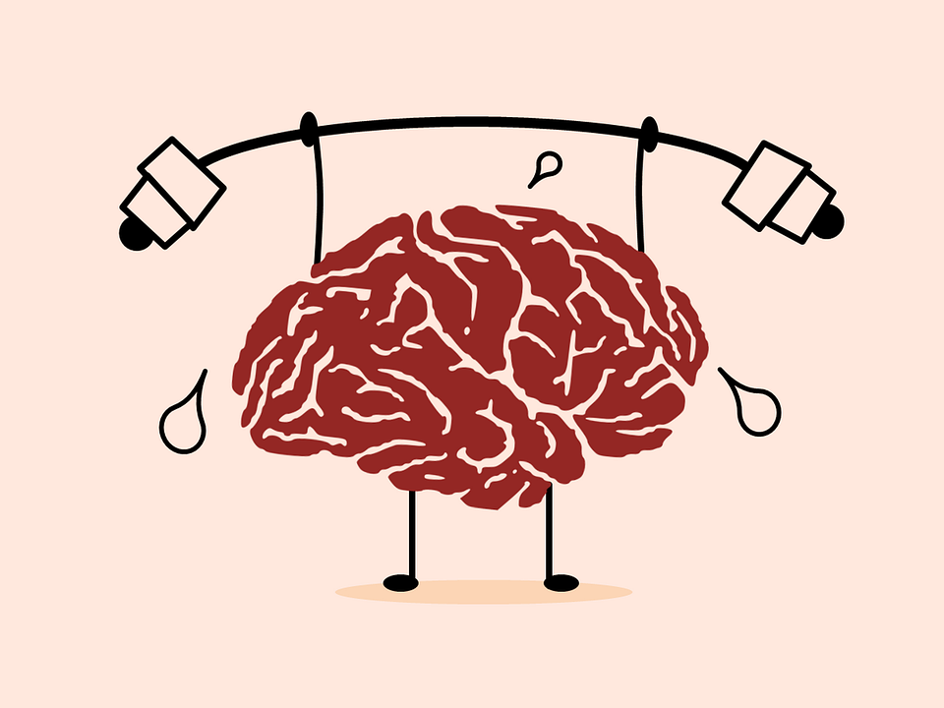
Student Voice
Notes:
To Know/To Say: A reminder about the brain and the importance of student voice. When students are learning new skills, that learning typically takes place when they are calm, engaged in learning, and have access to their frontal lobe. If we want students to be able to access those learned skills during times of stress or elevated emotions, we need to make sure they see value in the skills they are learning. When a student attaches value to information, it is more easily accessed during times of need. The best way to make sure a student values the information you are providing is to capture their voice. When you engage youth voice you are supporting the development of their identities and belonging.

Slide 29
Implementing SEL
Explicit skills instruction
Direct
Linked to real life experiences (social and cultural environment)
Curriculum integration
Teacher instructional practices
Programming beyond the classroom
Notes:
To Know/To Say: There are multiple ways to implement SEL in a classroom. Generally, there are three classroom-based approaches to SEL, which can be implemented either through SEL programs or through general SEL practices. First, you can provide instruction targeting specific social and emotional competencies, focusing on the underlying knowledge, attitudes, and skills that constitute each competency. For example, you could set aside time in class to specifically teach your students how to communicate effectively with their peers.
You can also integrate SEL instruction into core academic content. For example, a language arts teacher can teach empathy through a story being read and discussed in class, and, to build social awareness, emotional competencies through general teaching practices that encourage a safe and supportive learning environment. For example, you might teach students how to resolve interpersonal conflicts as they work in cooperative groups.

Slide 30
Resource Map
Self Awareness:
Identifying personal, cultural, and linguistic assets
Identifying one’s emotions
Linking feelings, values, and thoughts
Examining prejudices and biases
Having a growth mindset
Self Management:
Managing one’s emotions
Setting personal and collective goals
Using planning and organizational skills
Showing the courage to take initiative
Responsible Decision Making:
Demonstrating curiosity and open-mindedness
Identifying solutions for personal and social problems
Learning to make a reasoned judgment after analyzing information, data, facts
Reflecting on one’s role to promote personal, family, and community well-being
Social Awareness:
Taking others’ perspectives
Showing concern for the feelings of others
Identifying diverse social norms, including unjust ones
Understanding the influences of organizations/systems on behavior
Relationship Skills:
Communicating effectively
Developing positive relationships
Demonstrating cultural competency
Practicing teamwork and collaborative problem-solving
Resolving conflicts constructively
Notes:
To Know/To Say: This is an activity
To Do: Have teams spend time with this slide. Resource map what you are already doing in your school to address these competencies. Where can you incorporate these skills in your classrooms?

Slide 31
Discussion
How can supporting SEL in your classroom impact you specifically?
Could development of social and emotional competencies — your own and your students’ — and SEL practices in general, create a more equitable learning environment for your students?
Notes:
To Do: Wrap up slide

Slide 32
References/Resources
https://casel.org/what-is-sel/
https://casel.org/wp-content/uploads/2020/12/CASEL-SEL-Framework-11.2020.pdf
https://youtu.be/0N_Y34tjQm8
https://ice.aasb.org/wp-content/uploads/Checklist-for-Culturally-Responsive-and-Embedded-Social-and-Emotional-Learning.pdf
https://www.prevention.psu.edu/uploads/files/TSS-SEL-Brief-Final-June2021R.pdf

Slide 33
References/Resources
https://www.ycei.org/
http://www.nationalresilienceresource.com/Education/Educators_social_and_emotional_skills.pdf
https://www.doe.virginia.gov/support/prevention/social-emotional/index.shtml
Durlak, J.A., Weissberg, R.P., Dymnicki, A.B., Taylor, R.D., & Schellinger, K. (2011). The impact of enhancing students’ social and emotional learning: A meta-analysis of school-based universal interventions. Child Development: 82 (1), 405-432.

Slide 34
References/Resources
The Relationship Between Kindergarten Social Competence and Future Wellness," published on October 09, 2015, in American Journal of Public Health.
Jennings, P.A. & Greenberg, M.T. (2009). The prosocial classroom: Teacher social and emotional competence in relation to student and classroom outcomes. American Educational Research Association.
https://www.mheducation.com/prek-12/explore/sel-survey.html

Slide 35
References/Resources
Research from "Early Social-Emotional Functioning and Public Health: The Relationship Between Kindergarten Social Competence and Future Wellness," published on October 09, 2015, in American Journal of Public Health.
Future of Jobs Report, World Economic Forum
Jones, D.E., Greenberg, M., & Crowley, M. (2015) Early social-emotional functioning and public health: The relationship between kindergarten social competence and future wellness. American Journal of Public Health 105 (11), 2283-2290.

Slide 36
References/Resources
Gregory, A. & Fergus E., (2017). Social-Emotional Learning and Equity in School Discipline. In S. M. Jones, E. Doolittle, & S. McLanahan (Eds.) The Future of Children, 27, special issue on Social-Emotional Learning, 117-136.

