Slide 1
Hidden Slide #1
This Module was designed to be used in the following manner.
The audience for this Module is division and school teams.
This Module is meant for whole staff, team, and division presentations.
Following this training, participants should complete the Action Plan document to determine next steps.
There are eight sections in this module. Teams are not required to complete all components of the Modules. Instead, participants will complete only those Modules that fit the needs of their school.
Notes:
Module 1 is divided into several sections. Each section can be completed in 30 minutes or less.

Slide 2
Hidden Slide #2
In person training
Presenter notes and information
Notes:
In-person training suggestions
This module can be broken down into sections. Each section of Module 4 should be about 30 minutes to complete. This modules provides strategies that can be used for staff and students in trauma sensitive schools. You may want to add or enhance portions with visuals and examples that will resonate with your audience. As a reminder, always be sure to include appropriate citations when adding resources. Also, you might look to the resources and activities sections for additions that may be helpful.
In summary
This module outlines strategies that can be used in trauma sensitive schools
It can be adapted to individual contexts
The training should last about 4 hours for the entire module or 30 minutes for each section.
Presenter notes information
Presenter notes are included in the PowerPoint. Background information for the presenter is shown as “To Know.” Statements to be shared with participants are shown as “To Say.” In some instances, the “To Know/To Say” are combined.The presenter notes also include “To Do” prompts and cues for “Handouts”.
Additional activities, examples, videos, etc. are being developed. A presenter may add material from the resources and activities section on the website.
Breaks should be inserted at the discretion of the presenter based on the needs of participants.

Slide 3
Hidden Slide #3
Supplies needed
WIFI access for presenter and participants
Access to videos (through WIFI if available, but download to flash drive as a back-up)
Chart paper
Markers
Post-it-Notes
Notes:
To Know
These supplies are needed for the Trauma Professional Learning Modules.

Slide 4
Hidden Slide #4
Handouts for this Module
Action Planner
Notes:
To Know
The Participant and Presenter Materials are located on the vtss-ric website.
References

Slide 5
Hidden Slide #5
Key Terms in This Module:
Relationships
Empathy
Conflict Resolution
Active Listening
Notes:
To Know
These are the key terms used throughout the module.

Slide 6
Relationship Skills
Notes:
To Know:
VTSS Professional Learning Modules are organized in the same manner. All schools can begin their journey with Module 1 which introduces the foundational knowledge around trauma and trauma sensitive schools. This powerpoint is part of Module 4 that shares strategies on how we create trauma-sensitive, safe and supportive schools.
To Say:
Welcome to the learning module, “Relationship Skills”. Let’s get started!

Slide 7
What We Will Know and Do
Build an understanding of the importance of relationship skills
Leave with some strategies or techniques that you could try in the classroom to support your students in developing relationship skills
Notes:
To Know:
Go over the learning intentions targeted for this session
To Say:
During this module we hope you will gain an understanding of the importance of relationships, as well as provide strategies develop relationship skills.

Slide 8
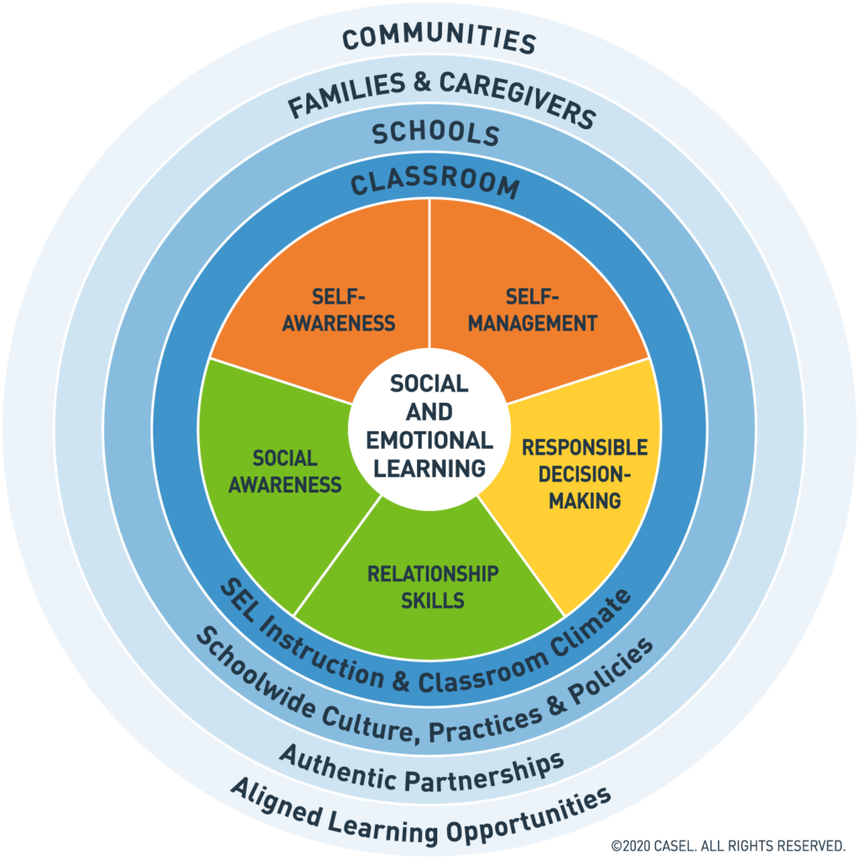
Social Emotional Competencies
Notes:
To Know: Social and emotional learning (SEL) enhances students’ capacity to integrate skills, attitudes, and behaviors to deal effectively and ethically with daily tasks and challenges. Like many similar frameworks, CASEL’s integrated framework promotes intrapersonal, interpersonal, and cognitive competence. There are five core competencies that can be taught in many ways across many settings.
To Say: In VTSS, we use CASEL’s five core competencies: Self-Awareness, Self-Management, Social-Awareness, Relationship Skills, and Responsible Decision Making. These five competencies can be taught in many ways across many settings. They provide a solid foundation for social relationships and achievement. Today we will focus on Relationship Skills.
References: https://casel.org/core-competencies/

Slide 9
The Power of Relationships
Notes:
To Know/To Say: This is a powerful statement about relationships and pedagogical strategies. Relationships are at the center of any trauma-sensitive approach.

Slide 10
Relationship Skills
The ability to establish and maintain healthy and rewarding relationships with diverse individuals and groups.
The ability to communicate clearly, listen well, cooperate with others, resist inappropriate social pressure, negotiate conflict constructively, and seek and offer help when needed
Notes:
To Know/To Say: Interventions that foster supportive relationships help students make more connections with peers, feel more safe in school, and achieve greater success. In Zaretta Hammond book, Culturally Responsive Learning and the Brain, she explains that many teachers may not be fully aware of their interactions with students.
Resource: https://casel.org/core-competencies/
Reference: Culturally Responsive Learning and the Brain, Zaretta Hammond

Slide 11
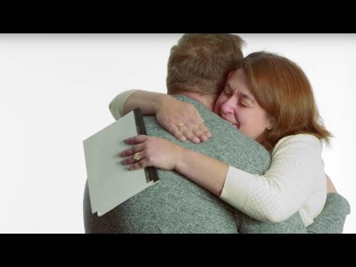
Why This Matters
Notes:
To Know: This video is 2.41 minutes long.
To Say: Trauma sensitive schools work to value and foster relationships at all levels - between adults and students, among student to student, among staff to staff, and with our families and communities.
Reference: https://youtu.be/gANeGBBoSBs

Slide 12
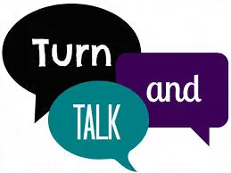
Reflection
How would students and families describe their experience with staff in your school?
Notes:
To Do: Have people reflect on this question.

Slide 13
What Does That Look Like?
Relationship Skills Include:
Listening
Keeping confidences
Empathy
Honesty/Trust
Respect
Resolving conflicts
Notes:
To Know: This section will focus on the things highlighted in yellow.
To Say: When we are working with students on developing relationship skills we want to make sure we include; listening, trust, empathy, respect, resolving conflicts, and keeping confidences. As teachers, we want to model and coach these skills for our students. This will help students learn to regulate their emotions and connect better with their peers, family members, and others.

Slide 14
How Do You Rate?
Rate yourself on the following:
Listening Skills
Empathy Towards Others
Honesty
Trust
Resolving Conflicts
Notes:
To Know: You can do this activity with staff in many different ways. If teachers are going to be models and coaches on helping students they need to be honest about their own skills in these areas. As the presenter, feel free to use any rating scale that works for you.
To Do: Please rate yourself on the following list of skills.

Slide 15
Building Relationships with Families
“No meaningful family engagement can be established until relationships of trust and respect are established between home and school. A focus on relationship building is especially important in circumstances where there has been a history of mistrust between families and school.., or where negative past experiences or feelings of intimidation hamper the building of partnerships.” -U.S. Dept. of Education
Notes:
To Know: Throughout this section we add areas in which families can be engaged in each strategy.
To Say: A 2017 research literature review found the following strategies to be most related to student achievement:
Engaging parents (or caregivers) in their children’s learning through social networks
Empowering parents with leadership roles in the school environment
Providing parents with classes to help with their own education or their child’s education
Providing families with opportunities to engage with their children’s education at home and at school. Schools that build strong family-school relationships were found to have a positive impact on students’ academic outcomes and well-being.

Slide 16
Strategies to Promote Relationship Skills
Notes:
To Know: Transition Slide

Slide 17
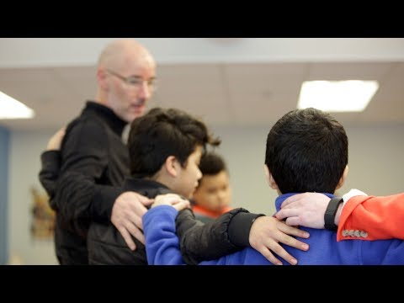
Building Community
Notes:
To Know: Video is 5 minutes https://youtu.be/QjVI-1XDX_Y
To Say: This video is a great example of building trust and helping students to feel safe through community circles. Morning circles can be done face to face or virtually. It is always important to make sure you are sharing with your families on how they can help support this work at home.

Slide 18
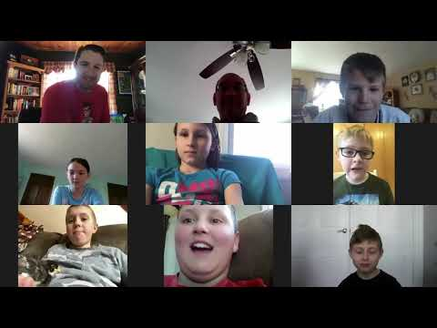
Building Community Virtually
Notes:
To Know: This video is over 2 minutes. https://youtu.be/-Riygoz2u4w
To Say: This video shares some examples of how you can connect with your students online. When you are building connections virtually be sure to include your families. It is also important to note some things when using ZOOM that can alienate students. Be careful on how you are using the mute button. If you are constantly muting the same students and can make them feel isolated and not connected to you are the class. It is always a best practice to have all students mute unless they are participating. The more you practice this with your students the better they will understand your expectations.
Resources: https://teacherrebootcamp.com/2020/05/virtualcheckins/

Slide 19
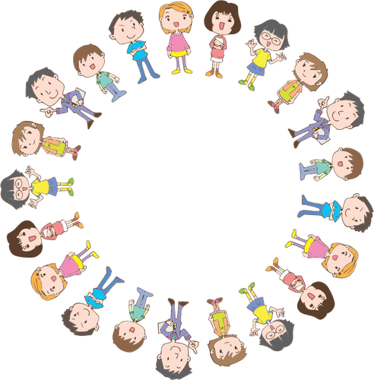
Active Listening Activity
Notes:
To Know: When discussing emotionally charged topics, it’s important to have guidelines to foster a safe space.
To Say: To encourage active listening, create small groups. Have your students position their chairs in a circle so everyone can make eye contact. To strengthen empathy, you can facilitate deeper discussion around what a student shares by asking, “Why did that student share what they did?” or “What perspective is that student coming from?” You can also set this structure up in your online environment.
Resource:://www.nctsn.org/sites/default/files/resources/fact-sheet/pfdl_recommendations_for_holding_a_virtual_community_circle_to_build_connection_during_covid-19.pdf

Slide 20
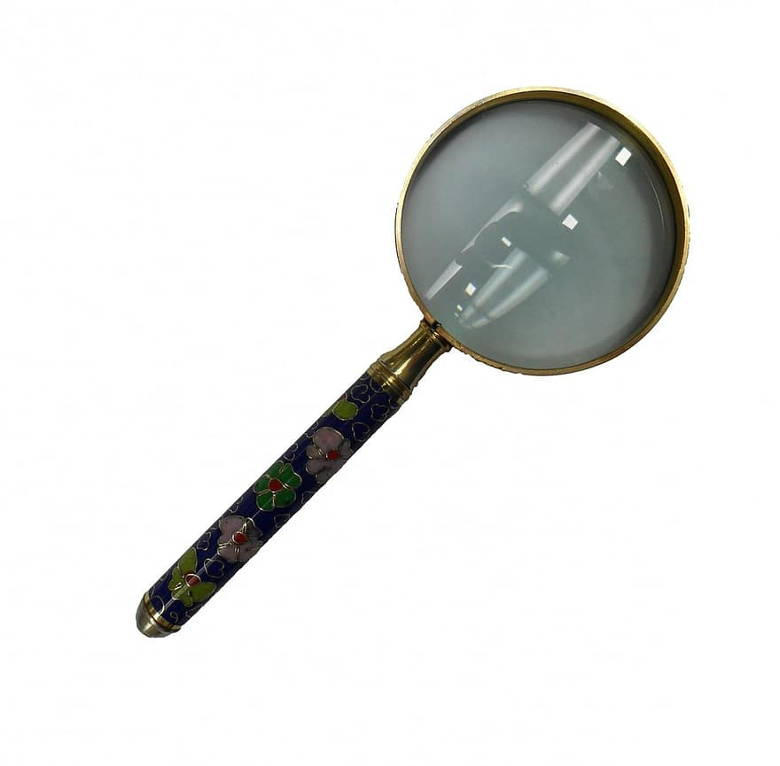
Live Show and Tell
Notes:
To Know/To Say: You can use Google Meet or Zoom as well as in person. Ask everyone to bring an object from their house to share that represent them in some way or remind them of someone. This is a great way for students to get to know each other and for the teacher to know what things your students connect with.

Slide 21
Building Connections
Two Minute Talks
Student Introductions
Class Song Playlist
Notes:
To Know/To Say: Icebreakers are a great way to get students to build relationships with one another.
Two minute talks can be done in person and virtually. Virtually you can ask students to write in the chat something like “What is your favorite food?”. If you are doing this in the classroom you can set it up as four corners. Give students choices such as dogs, cats, none, both. Let them go to where they fit and have them connect with the others for two minutes.
Student Introductions are a great way for students to get to know each other on day one. You can do this many different ways. If students are virtual they can do a flip grid in their Learning Management System and others can comment on it. In the classroom you can do discussion starters.
Class Playlist is a fun activity that you can do both in person and virtual. In both scenarios you have the class create a class song playlist. You can randomly select which you will play during certain times of your class. They can use an app in class to assemble the list and get to know one another.

Slide 22
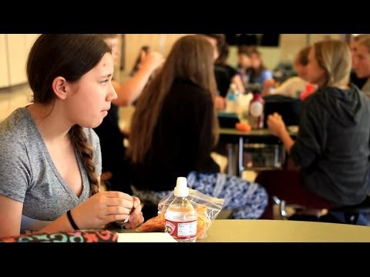
A Lesson on Empathy
Notes:
To Know: This video is 2.21 minutes https://youtu.be/aU3QfyqvHk8
To Say: You can do a lesson like this in the classroom or have students create this through flipgrid. This lesson on empathy was done by 8th grade students from Kalispell Middle School. Great example of having students creating lessons.

Slide 23
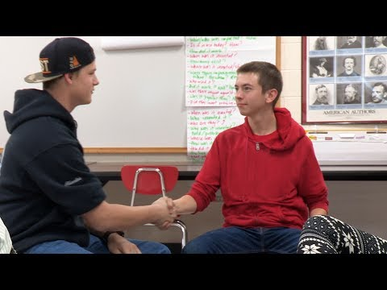
Conflict Resolution
Notes:
To Know: This video is 4.19 minutes.
To Say: The video shows the Justice Committee at Pittsfield Middle High School—a group of students trained in conflict resolution skills to be able to address conflict at the school in a restorative way. Instead of getting suspensions or detentions, students at the school can turn to the Justice Committee, which offers them an alternative way to resolve conflicts, with each other or a teacher. The video shows students new to the committee, being trained as mediators, as they role play a mediation and reflect on the various steps of that mediation in detail.
Reference: https://youtu.be/zgw7gY9fbz8

Slide 24
Practice
Instructions: Identify one of the strategies we have discussed (or one of your own ideas) that you would like to try. Pick something that will take relatively little effort to implement.
–Think about particular students you would like to use the strategy with
Why did you pick the strategy you did?
How would you put it in place or get started?
How would you practice it? Or how would your students practice it?
What will your immediate next steps be?
Notes:
To Say/To Do: Have participants practice a strategy that we shared or even share one that they have used that worked well for them.

Slide 25
Team Talk: Review the “How”
How will you adjust your practices to support learning for students who have experienced trauma?
How will you involve families and students in practices?
Fill this in on your Action Plan under “Objectives and Action Planning”
Notes:
To Know: Action planning supports engagement in the work and next steps
To Say:
We’ve now completed the module “Relationships”. This your time to pause and reflect on the “how”. How will you adjust your practices to support learning for students who have experienced trauma? Please fill this in on your action plan under objectives and action planning.
Handout: Action Planner

Slide 26
References/Resources
https://casel.org/core-competencies/
Hammond, Zaretta L. Culturally Responsive Teaching and the Brain. Corwin Press, 2015.
https://teacherrebootcamp.com/2020/05/virtualcheckins/
U.S. Department of Education (2017).

Slide 27
References/Resources
https://youtu.be/gANeGBBoSBs
https://youtu.be/QjVI-1XDX_Y
https://youtu.be/-Riygoz2u4w
https://youtu.be/aU3QfyqvHk8
https://youtu.be/zgw7gY9fbz8

