Slide 1
Hidden Slide #1
This Module was designed to be used in the following manner.
The audience for this Module is division and school teams.
This Module is meant for whole staff, team, and division presentations.
Following this training, participants should complete the Action Plan document to determine next steps.
There are eight sections in this module. Teams are not required to complete all components of the Modules. Instead, participants will complete only those Modules that fit the needs of their school.
Notes:
Module 1 is divided into several sections. Each section can be completed in 30 minutes or less.

Slide 2
Hidden Slide #2
In person training
Presenter notes and information
Notes:
In-person training suggestions
This module can be broken down into sections. Each section of Module 4 should be about 30 minutes to complete. This modules provides strategies that can be used for staff and students in trauma sensitive schools. You may want to add or enhance portions with visuals and examples that will resonate with your audience. As a reminder, always be sure to include appropriate citations when adding resources. Also, you might look to the resources and activities sections for additions that may be helpful.
In summary
This module outlines strategies that can be used in trauma sensitive schools
It can be adapted to individual contexts
The training should last about 4 hours for the entire module or 30 minutes for each section.
Presenter notes information
Presenter notes are included in the PowerPoint. Background information for the presenter is shown as “To Know.” Statements to be shared with participants are shown as “To Say.” In some instances, the “To Know/To Say” are combined.The presenter notes also include “To Do” prompts and cues for “Handouts”.
Additional activities, examples, videos, etc. are being developed. A presenter may add material from the resources and activities section on the website.
Breaks should be inserted at the discretion of the presenter based on the needs of participants.

Slide 3
Hidden Slide #3
Supplies needed
WIFI access for presenter and participants
Access to videos (through WIFI if available, but download to flash drive as a back-up)
Chart paper
Markers
Post-it-Notes
Notes:
To Know
These supplies are needed for the Trauma Professional Learning Modules.

Slide 4
Hidden Slide #4
Handouts for this Module
Action Planner
Notes:
To Know
The Participant and Presenter Materials are located on the vtss-ric website.
References

Slide 5
Hidden Slide #5
Key Terms in This Module:
Responsible Decision Making
Social Emotional Learning
Equity
Role Play
Notes:
To Know
These are the key terms used throughout the module.

Slide 6
Responsible Decision Making
Notes:
To Know:
VTSS Professional Learning Modules are organized in the same manner. All schools can begin their journey with Module 1 which introduces the foundational knowledge around trauma and trauma sensitive schools. This powerpoint is part of Module 4 that shares strategies on how we create trauma-sensitive, safe and supportive schools.
To Say:
Welcome to the learning module, “Responsible Decision Making”. Let’s get started!

Slide 7
What We Will Know and Do
Build an understanding of the importance of responsible decision making.
Leave with some strategies or techniques that you could try in the classroom to support your students in developing responsible decision making skills
Notes:
To Know:
Go over the learning intentions targeted for this session
To Say:
During this module we hope you will gain an understanding of the importance of responsible decision making, as well as provide strategies develop responsible making skills.

Slide 8
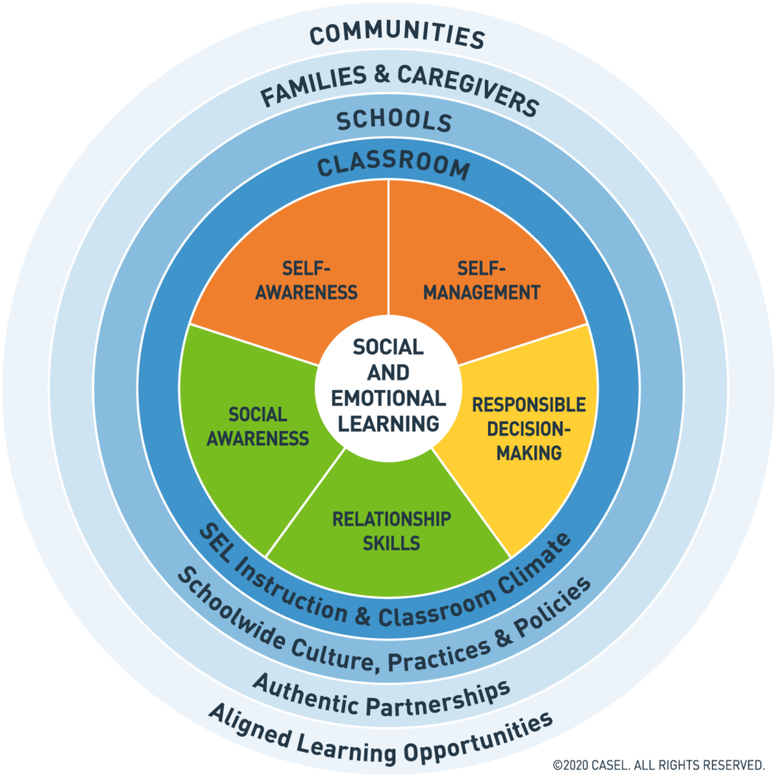
Social Emotional Competencies
Notes:
To Know: Social and emotional learning (SEL) enhances students’ capacity to integrate skills, attitudes, and behaviors to deal effectively and ethically with daily tasks and challenges. Like many similar frameworks, CASEL’s integrated framework promotes intrapersonal, interpersonal, and cognitive competence. There are five core competencies that can be taught in many ways across many settings. Many educators and researchers are also exploring how best to assess these competencies.
To Say: In VTSS, we use CASEL’s five core competencies: Self-Awareness, Self-Management, Social-Awareness, Relationship Skills, and Responsible Decision Making. These five competencies can be taught in many ways across many settings.They provide a solid foundation for social relationships and achievement. Today we will focus on Responsible Decision Making.
References: https://casel.org/core-competencies/

Slide 9
Responsible Decision Making
Responsible decision-making is the ability to make constructive choices about personal behavior and social interactions based on ethical standards, safety concerns, and social norms.
Notes:
To Know: Have participants read definition.
To Say: Through an equity lens, responsible decision-making skills can help adults and students make decisions that are inclusive and equitable, understand the systemic implications of different outcomes, and reflect on how actions and decisions can impact equity.
Resource: https://casel.org/core-competencies/

Slide 10
Decision Making Skills
Skills include:
Problem identification and situation analysis
Problem solving
Evaluation and reflection
Personal, moral, and ethical responsibility
Notes:
To Know/To Say: Everyday we ask students to problem solve in our schools.

Slide 11
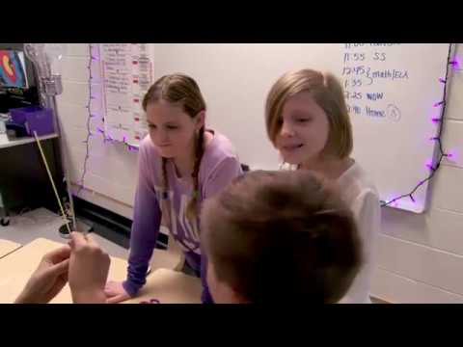
What Does it Look Like?
Notes:
To Know: Video is 3.54 minutes -https://youtu.be/yWSSPnTB6OY
To Say: This video outlines what responsible decision making looks like. When thinking about what this may sound like it could involve questions such as: How will this impact others? Is it worth it? Why do I want to make this choice? Will this help me?

Slide 12
Strategies to Promote Responsible Decision Making Skills
Notes:
To Know: Transition Slide

Slide 13
Responsible Decision Making Strategies
Responsible Decision Making strategies involve:
Articulating differences and connections
Identifying emotions behind actions
Brainstorming different approaches or solutions to a task
Exploring possible consequences
Modeling and articulating decision making process
Reflecting on past experiences
Evaluating actions
Role playing a task
Notes:
To Know/To Say: These are the many ways in which we can infuse problem solving thinking and reflection in our classrooms.
Reference: http://actforyouth.net/youth_development/professionals/sel/decision_making.cfm

Slide 14
Elementary Activity - Stop, Think, Act
Notes:
To Know/To Say: “Stop, Think, Act” is an activity you can use with elementary students for making decisions. Show students a stop sign (you can even keep it posted in the classroom as a reminder), explain what the stop sign means and discuss how the stop sign can be used in the classroom - it can be used as a prompt to stop and think about their behaviors before taking action. Routinely encourage your students to use this strategy anytime they face a choice or decision. Provide feedback when you observe students making good decisions.
Resource: https://education.mn.gov/mdeprod/groups/communications/documents/hiddencontent/bwrl/mdcz/~edisp/mde073493.pdf

Slide 15
Middle School Role Playing Activity
Notes:
To Know/To Say: Middle school is a time when students start to realize the challenges that are presented when making responsible decisions on how to balance many things. Role-playing different outcomes of a decision can let students experience how choices affect other people. This activity can be done with elementary students and high school students.
Create a fictional scenario involving a big decision and write four different outcomes on slips of paper. After reading the scenario story to the class, have students work in groups to randomly select one outcome and put together a skit showing what happens. Once all the groups have performed their skits, discuss which of the outcomes was the best solution, which was the poorest choice and how these decisions affected everyone involved.This activity can be done in a virtual setting using breakout rooms and flipgrid.

Slide 16
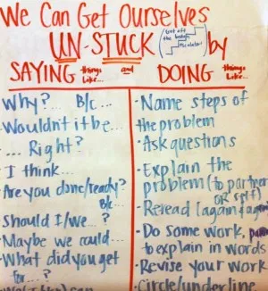
Don’t Be Stuck On the Escalator
What does this look like?
Notes:
To Know: This video is 2 minutes - https://youtu.be/47rQkTPWW2I
To Say/To Do: This video is one of the reasons it is important to teach students how to problem solve. In the classroom you can give students a problem that makes them feel “stuck”. Their job is to get “unstuck”. As students work through this process you work with them to name the process: “How did you get yourself unstuck” or “What was your first step? How did it feel when you were stuck?” What are you doing now?” What might you try new?”
Video: 2 minutes https://youtu.be/47rQkTPWW2I

Slide 17
Discussion
We problem solve around academics dailey, how can we continue to support our students using decision making skills socially?
Notes:
To Know: To make progress on equity and inclusion we need to lead and teach with the understanding that all learning is social and emotional for all students.
To Say/To Do: Everyday we ask students to problem solve around academics. How can we continue to support our students not just academically but socially as well? It is important to remember that mistakes become learning opportunities and we can help students by encouraging them to talk about their choices, possible consequences, and the best solutions for helping them to become their best selves.

Slide 18
Practice
Instructions: Identify one of the strategies we have discussed (or one of your own ideas) that you would like to try. Pick something that will take relatively little effort to implement.
–Think about particular students you would like to use the strategy with
Why did you pick the strategy you did?
How would you put it in place or get started?
How would you practice it? Or how would your students practice it?
What will your immediate next steps be?
Notes:
To Say/To Do:

Slide 19
Team Talk: Review the “How”
How will you adjust your practices to support learning for students who have experienced trauma?
How will you involve families and students in practices?
Fill this in on your Action Plan under “Objectives and Action Planning”
Notes:
To Know: Action planning supports engagement in the work and next steps
To Say:
We’ve now completed the module “Responsible Decision Making”. This your time to pause and reflect on the “how”. How will you adjust your practices to support learning for students who have experienced trauma?Please fill this in on your action plan under objectives and action planning.
Handout: Action Planner

Slide 20
References/Resources
https://casel.org/core-competencies/
http://actforyouth.net/youth_development/professionals/sel/decision_making.cfm
https://youtu.be/yWSSPnTB6OY
https://education.mn.gov/mdeprod/groups/communications/documents/hiddencontent/bwrl/mdcz/~edisp/mde073493.pdf
https://youtu.be/47rQkTPWW2I

