Slide 1
Hidden Slide #1
This Module was designed to be used in the following manner.
The audience for this Module is division and school teams.
This Module is meant for whole staff, team, and division presentations.
Following this training, participants should complete the Action Plan document to determine next steps.
There are eight sections in this module. Teams are not required to complete all components of the Modules. Instead, participants will complete only those Modules that fit the needs of their school.
Notes:
Module 1 is divided into several sections. Each section can be completed in 30 minutes or less.

Slide 2
Hidden Slide #2
In person training
Presenter notes and information
Notes:
In-person training suggestions
This module can be broken down into sections. Each section of Module 4 should be about 30 minutes to complete.
This modules provides strategies that can be used for staff and students in trauma sensitive schools. You may want to add or enhance portions with visuals and examples that will resonate with your audience. As a reminder, always be sure to include appropriate citations when adding resources. Also, you might look to the resources and activities sections for additions that may be helpful.
In summary
This module outlines strategies that can be used in trauma sensitive schools
It can be adapted to individual contexts
The training should last about 4 hours for the entire module or 30 minutes for each section.
Presenter notes information
Presenter notes are included in the PowerPoint. Background information for the presenter is shown as “To Know.” Statements to be shared with participants are shown as “To Say.” In some instances, the “To Know/To Say” are combined.The presenter notes also include “To Do” prompts and cues for “Handouts”.
Additional activities, examples, videos, etc. are being developed. A presenter may add material from the resources and activities section on the website.
Breaks should be inserted at the discretion of the presenter based on the needs of participants.
Additional activities, examples, videos, etc. are being developed. A presenter may add material from the resources and activities section on the website.
Breaks should be inserted at the discretion of the presenter based on the needs of participants.

Slide 3
Hidden Slide #3
Supplies needed
WIFI access for presenter and participants
Access to videos (through WIFI if available, but download to flash drive as a back-up)
Chart paper
Markers
Post-it-Notes
Notes:
To Know
These supplies are needed for the Trauma Professional Learning Modules.

Slide 4
Hidden Slide #4
Handouts for this Module
Action Planner
Notes:
To Know
The Participant and Presenter Materials are located on the vtss-ric website.

Slide 5
Hidden Slide #5
Key Terms in This Module:
Affirmation
Behavior Specific Praise
Mantra
Value Based Affirmations
Self-efficacy
Self-perception
Self-confidence
Notes:
To Know
These are the key terms used throughout the module.

Slide 6
Self-Awareness
Notes:
To Know:
VTSS Professional Learning Modules are organized in the same manner. All schools can begin their journey with Module 1 which introduces the foundational knowledge around trauma and trauma sensitive schools. This powerpoint is part of Module 4 that shares strategies on how we create trauma-sensitive, safe and supportive schools.
To Say:
Welcome to the learning module, “Self-Awareness”. Let’s get started!

Slide 7
What We Will Know and Do
Build an understanding of self-awareness
Leave with some strategies or techniques that you could try in the classroom to support your students in developing self-awareness skills
Notes:
To Know:
Go over the learning intentions targeted for this session
To Say:
During this module we hope you will gain an understanding of the importance of self-awareness, as well as provide strategies develop self-awareness skills.

Slide 8
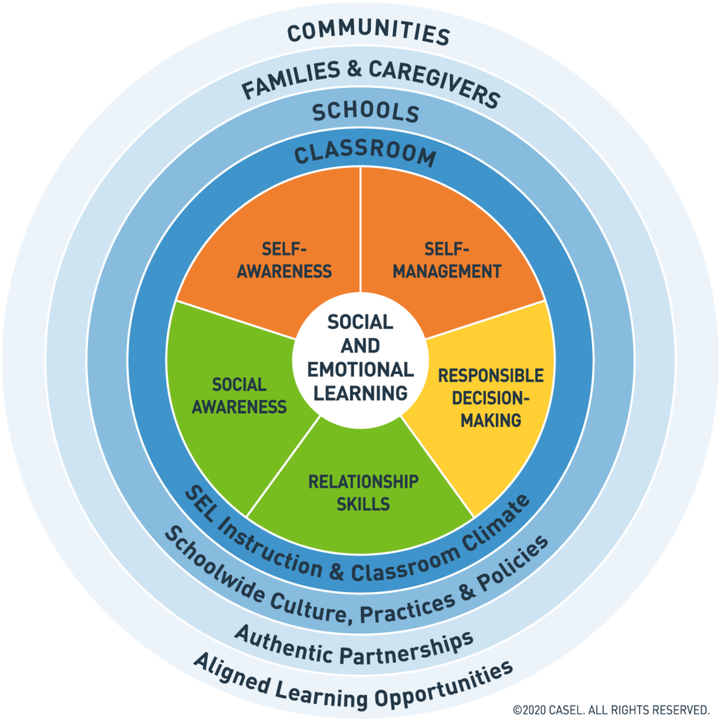
Social Emotional Competencies
Notes:
To Know: Social and emotional learning (SEL) enhances students’ capacity to integrate skills, attitudes, and behaviors to deal effectively and ethically with daily tasks and challenges. Like many similar frameworks, CASEL’s integrated framework promotes intrapersonal, interpersonal, and cognitive competence. There are five core competencies that can be taught in many ways across many settings. Many educators and researchers are also exploring how best to assess these competencies.
To Say: In VTSS, we use CASEL’s five core competencies: Self-Awareness, Self-Management, Social-Awareness, Relationship Skills, and Responsible Decision Making. These five competencies can be taught in many ways across many settings.They provide a solid foundation for social relationships and achievement. Today we will focus on Self-Awareness.
References: https://casel.org/core-competencies/

Slide 9
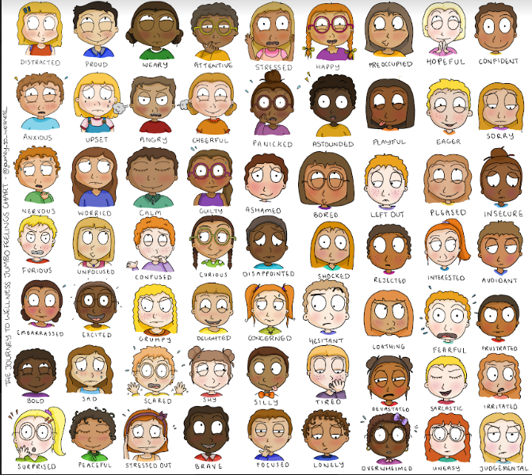
How Do You Feel?
Notes:
To Say/To Do: Let’s start by asking How do You feel? If you are doing this virtual you can have them annotate on the powerpoint.

Slide 10
Self-Awareness
Self-awareness is:
The ability to accurately recognize one’s own emotions, thoughts, and values and how they influence behavior. The ability to accurately assess one’s strengths and limitations, with a well-grounded sense of confidence, optimism, and a “growth mindset.”
Notes:
To Know/To Say: Self-awareness is the ability to tune into your thoughts, feelings, and actions. When you are self-aware that means you are also able to recognize how other people see you and how you act impacts yourself and others. This is not just an important skill for kids, but for adults as well. There are two kinds of self-awareness: Private and public. Private self-awareness is when kids are aware of something about themselves and others may not be. For example, some kids may get anxious feelings when first meeting someone. They may be nervous but others may not notice this about them. Public self-awareness develops later once kids understand that other people have thoughts, feelings and perspectives different from theirs. Public-self awareness is when kids are aware of how people see them.
We have all worked with students who do not seem to pick up on social cues. It is important to realize that it may not be that they don’t care about others feelings but they may not notice or understand people’s feelings. We can help that student by helping them to recognize other people's feelings and responses.
Reference: https://www.edutopia.org/sites/default/files/pdfs/stw/edutopia-stw-school21-well-being-progression.pdf
https://www.understood.org/en/friends-feelings/empowering-your-child/self-awareness/the-importance-of-self-awareness

Slide 11
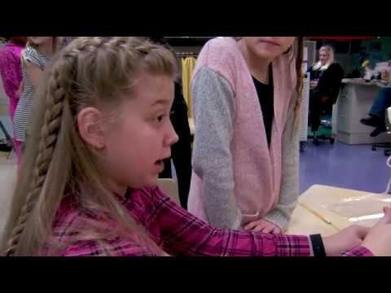
Self Awareness
Notes:
To Know: Video is 4.10 minutes. https://youtu.be/dZL2eZBe4Ew
To Say: This video outlines what self-awareness looks like.

Slide 12
Why This Matters
Self-awareness plays a critical role in how students learn and grow.
Students impacted by trauma lack self-awareness to understand how their actions are related to their thoughts or feelings and how they influence one another.
Difficulty identifying, expressing, and managing emotions.
Notes:
To Know: Self-Awareness develops over time. It is a process.
To Say: When individuals are self-aware, they build upon their strengths while efficiently focusing on areas they need to improve upon – a key step to setting and achieving goals.
We know that students who can recognize their feelings and thoughts and how they connect with our actions are better able to regulate their emotions and attend to academics with more confidence and success.
Research shows us that thoughts have a direct impact on emotions and feelings. Those emotions trigger a corresponding release of chemicals in our brain. Using positive affirmations may allow students to harness and manipulate the release of chemicals that will serve them in constructive ways. Just by virtue of drawing attention to their thoughts, students become more self-aware.
References: https://www.connectinglink.com/blog/social_and_emotional_learning_self-awareness_strategies_in_the_classroom
https://www.kirstenskaboodle.com/benefits-of-using-positive-affirmations-in-the-classroom/

Slide 13
What Does this Look Like?
the ability to identify emotions
have an accurate self-perception
recognize your strengths
possess self-confidence
demonstrate self-efficacy
Notes:
To Know/To Say: As we discussed earlier, self-awareness takes times. The great thing is that these skills can be taught and practiced on a regular basis. Learning these skills takes practice. When a student has developed these skills then they are able to identify their emotions, have an accurate self-perception, recognize their strength, have confidence, and demonstrate self-efficacy.

Slide 14
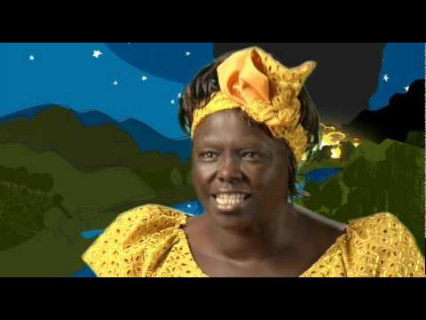
Be a Hummingbird
Notes:
To Know: Video is 2 minutes - https://youtu.be/IGMW6YWjMxw
To Say/To Do: Discussion: What does this video have to do about self-awareness? Does the hummingbird possess any of these skills in the video?
the ability to identify emotions
have an accurate self-perception
recognize your strengths
possess self-confidence
demonstrate self-efficacy

Slide 15
Strategies to Promote Self-Awareness Skills
Notes:
To Know: Transition Slide

Slide 16
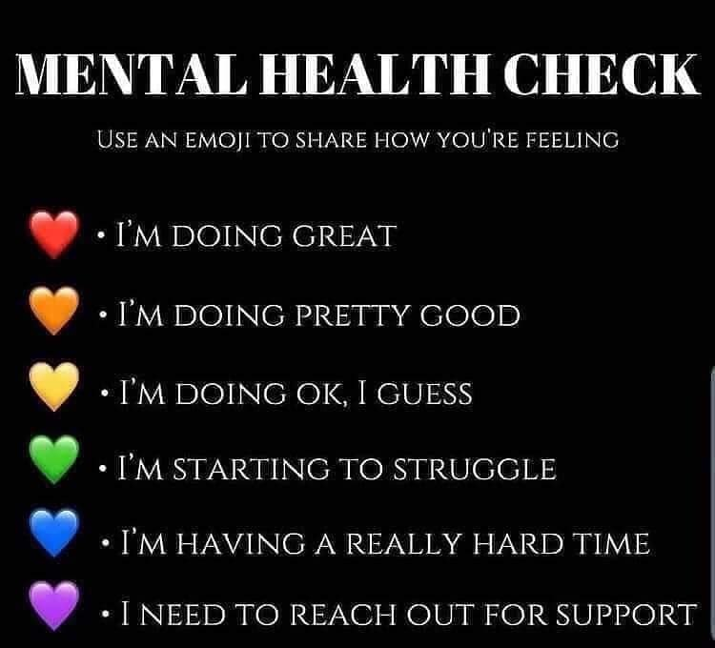
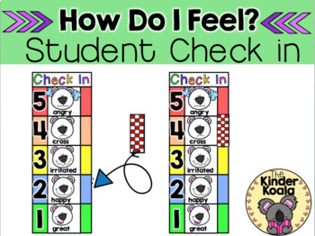
Emotional Check-ins
Notes:
To Know/To Say: An emotional check-in is a time when students and teachers come together to connect and reflect on how things are going. Students are encouraged to share how they feel with the group or maybe a partner. If you have a Feelings Word Wall in the classroom, encourage students to use different words to describe their emotions. In many cases, we feel more than one emotion at a time! Share yours as well. Modeling is an important part of increasing students’ social and emotional skills.
When we teach students how to identify their emotions they are able to correctly label them, recognize that emotions are temporary and can change, recognize how it affects their behavior, and how they can have a physical effect on their bodies.
Some teachers have found great success checking in first thing with students as they are coming through the door. Using tools that show emotions, and they know they can quickly point, or privately share. Teachers find knowing ahead of time will help them support the student during class time.
It is always good at an early age to acknowledge students physical and emotional cues. For example: “I can see you are really excited right now by that happy smile on your face.”
You can also do an activity like this online.

Slide 17
Teaching Students to Believe in Themselves
Meet them where they are
Set realistic expectations
Encouragement
Notes:
To Know: Relate this back to the hummingbird video. The hummingbird believed that it could do what it was doing.
To Say: Helping students believe in themselves helps them to identify their strengths and sense of self-efficacy. It also helps give them hope.

Slide 18
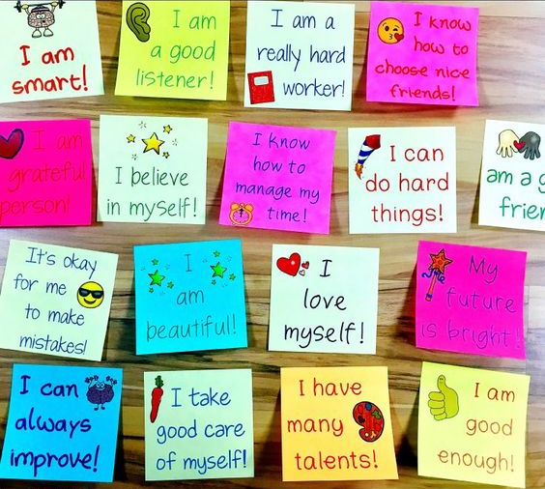
Self-Confidence and Affirmations
Affirmation: a positive assertion
To affirm anything is to state that it is so, and to maintain this as being true in the face of all evidence to the contrary. Repeating an affirmation is leading the mind to that state of consciousness where it accepts that which it wishes to believe.
–Ernest Holmes
Notes:
To Know/To Say: When students have confidence in themselves it gives them the ability to be able to handle daily tasks and challenges effectively and maintain optimism about their future.
Resource for Positive Affirmation Sticky Notes:
Kirstens Kaboodle
https://www.kirstenskaboodle.com/product/stick-it-to-make-it-stick-positive-affirmations-for-lower-grades/?utm_medium=social&utm_source=pinterest&utm_campaign=tailwind_smartloop&utm_content=smartloop&utm_term=18678490

Slide 19
Mantra: High School Setting
Notes:
To Know: This video is under 1 minute. https://www.youtube.com/watch?v=G0LQxRp0Rxw
To Say: Mantras are community or classroom beliefs that can be said together or as a class each day, or in moments that behaviors arise. For example, if you have a mantra around your expectation of safety and a behavior occurs in the classroom that impacts safety, you would pause and say the mantra together. Mantras can change each month to incorporate social emotional learning. Here you see a video of a teacher using a mantra in the high school setting.

Slide 20
Mantra Elementary Setting
Teacher: “Who’s safe?”
Child: “I am safe.”
Teacher: “Who can help when you don’t feel safe?”
Child: “You ________ (teacher’s name) help us feel safe.”
*You can personalize your mantra to include how they ask for help.
Notes:
To Know/To Say: Here is an example of a mantra you could use in the elementary setting. Notice how you can personalize to you classroom expectations and routines.

Slide 21
Discussion
How could you begin to use Mantras (community building) and Affirmations (individual) in the classroom?
Notes:
To Say/To Do: Have participants discuss this question.

Slide 22
Why Behavior Specific Praise Supports Students
Positive specific praise is a powerful tool for building a student’s self-esteem and positive sense of self.
Teaches new skills and the predictability of Behavior Specific Praise allows for a sense of control and promotes brain development.
The recommended ratio of Behavior Specific Praise to error correction is even higher for students impacted by trauma, due to the predictability it creates.
Notes:
To Know/To Say: Before we discuss why praise might not work at first for some students who have experienced trauma, let’s take a look at why the practice might support the student.
It can be a powerful tool for building a sense of self--”Wow, my teacher noticed that I was paying attention!”
It can be a way to teach new skills, and when you engage in the practice consistently you are literally promoting brain development!
We also remember that we may need to increase the 5 to 1 to 13 to 1 due to the predictability this will create, and someone who may be living in the chaos of trauma needs predictability.

Slide 23
Why Praise Does not Work for Some
Our belief system is our reality and begins in the womb.
Your belief is your reality.
If I believe I’m bad, stupid, or unworthy, I will respond in this way.
Notes:
To Know: When we apply the understanding hat trauma impacts our belief system, we can offer alternative ways of connecting with our students.
To Say: We often hear from teachers that share that praise actually causes the student to act out. If I believe I’m bad, and you tell me that I just did a great job on an assignment or expectation, then I may show you just how bad I am so my belief system, my reality, is not threatened. I also may have a belief that praise makes me look weak and I have to “save face”.

Slide 24
Alternatives
Provide positive feedback on a sticky note and share privately
Ask the student how they like to receive feedback/praise
Work with the student to develop affirmations to begin to work on changing their self-concept
Example:
“I refuse to believe I’m stupid any longer. I am smart and I accept that now.”
They can have this affirmation at their desk to remind them daily.
Notes:
To Know/To Say: Here are some alternatives to public praise.

Slide 25
Cultural Responsiveness: Value-Based Affirmations
When we engage in individually examining our values and learning to become self-aware within this recognition, research has found we do a better job at regulating our emotions, problem solving, and dealing with stress. It also helps with self-identity and a sense of belonging.
Improves social/emotional wellness
Improves academic achievement
Please see resources for a Value-Based Activity
https://ed.stanford.edu/sites/default/files/annurev-psych-psychology_of_change_final_e2.pdf
https://www.cmu.edu/homepage/health/2013/summer/benefits-of-self-affirmation.shtml
Notes:
To Know/To Say: Another activity to consider is value-based affirmations. When we engage in individually examining our values and learning to become self-aware within this recognition, research has found we do a better job at regulating our emotions, problem solving, and dealing with stress. It also helps with self-identity and a sense of belonging. As we discussed before, we must consider our classroom, the context and culture of our classroom, and knowing ahead of time that some students may need extra support with this exercise.
Students completed several structured reflection value-based exercises in their class throughout the year. The results were dramatic: Latino American students who completed the affirmation exercises had higher grades than those in the control group. Moreover, the effects of the affirmation intervention persisted for three years, remaining stable even as students transitioned from middle school to high school.
Reference: https://ed.stanford.edu/sites/default/files/annurev-psych-psychology_of_change_final_e2.pdf
(research led by Geoffrey Cohen, a professor at Stanford Graduate School of Education and the Department of Psychology, and David Sherman, a professor at the Department of Psychological and Brain Sciences at the University of California, Santa Barbara. )
(https://www.cmu.edu/homepage/health/2013/summer/benefits-of-self-affirmation.shtml)

Slide 26
Practice
Instructions: Identify one of the strategies we have discussed (or one of your own ideas) that you would like to try. Pick something that will take relatively little effort to implement.
–Think about particular students you would like to use the strategy with
Why did you pick the strategy you did?
How would you put it in place or get started?
How would you practice it? Or how would your students practice it?
What will your immediate next steps be?
Notes:
To Say/To Do:

Slide 27
Team Talk: Review the “How”
How will you adjust your practices to support learning for students who have experienced trauma?
How will you involve families and students in practices?
Fill this in on your Action Plan under “Objectives and Action Planning”
Notes:
To Know: Action planning supports engagement in the work and next steps
To Say:
We’ve now completed the module “Self-Awareness”. This your time to pause and reflect on the “how”. How will you adjust your practices to support learning for students who have experienced trauma?Please fill this in on your action plan under objectives and action planning.
Handout: Action Planner

Slide 28
References/Resources
Casel Core Competencies
What does Self-Awareness Look Like?
Be a Hummingbird
Post-it Affirmations
High School Mantra Example
Benefits of Self Affirmation
Mantra and Affirmation Resource
Value-Based Affirmation-Please see adapted resource included in this module.

