Slide 1
Hidden Slide #1
This Module was designed to be used in the following manner.
The audience for this Module is division and school teams.
This Module is meant for whole staff, teams, divisions, and family/community presentations.
Following this training, participants should complete the Action Plan document to determine next steps.
There are eight sections in this module. Teams are not required to complete all components of the Modules. Instead, participants will complete only those Modules that fit the needs of their school.
Notes:
Module 1 is divided into several sections. Each section can be completed in 30 minutes or less.

Slide 2
Hidden Slide #2
In person training
Presenter notes and information
Notes:
In-person training suggestions
This module can be broken down into sections. Each section of Module 4 should be about 30 minutes to complete.
This modules provides strategies that can be used for staff and students in trauma sensitive schools. You may want to add or enhance portions with visuals and examples that will resonate with your audience. As a reminder, always be sure to include appropriate citations when adding resources. Also, you might look to the resources and activities sections for additions that may be helpful.
In summary
This module outlines strategies that can be used in trauma sensitive schools
It can be adapted to individual contexts
The training should last about 4 hours for the entire module or 30 minutes for each section.
Presenter notes information
Presenter notes are included in the PowerPoint. Background information for the presenter is shown as “To Know.” Statements to be shared with participants are shown as “To Say.” In some instances, the “To Know/To Say” are combined.The presenter notes also include “To Do” prompts and cues for “Handouts”.
Additional activities, examples, videos, etc. are being developed. A presenter may add material from the resources and activities section on the website.
Breaks should be inserted at the discretion of the presenter based on the needs of participants.

Slide 3
Hidden Slide #3
Supplies needed
WIFI access for presenter and participants
Access to videos (through WIFI if available, but download to flash drive as a back-up)
Chart paper
Markers
Post-it-Notes
Notes:
To Know
These supplies are needed for the Trauma Professional Learning Modules.

Slide 4
Hidden Slide #4
Handouts for this Module
Action Planner
Notes:
To Know
The Participant and Presenter Materials are located on the vtss-ric website.
References

Slide 5
Hidden Slide #5
Key Terms in This Module:
Self-Care
Self-Compassion
Mindfulness
Gratitude
Analysis Paralysis
Stress
Notes:
To Know
These are the key terms used throughout the module.

Slide 6
Self-Care for Adults
Notes:
To Know:
VTSS Professional Learning Modules are organized in the same manner. All schools can begin their journey with Module 1 which introduces the foundational knowledge around trauma and trauma sensitive schools. This powerpoint is part of Module 4 that shares strategies on how we create trauma-sensitive, safe and supportive schools.
To Say:
Welcome to a practical session on self-care for adults and building resilience. Focusing on resilience and self care provides an understanding of what enables teachers to persist in the face of challenges.

Slide 7
What We Will Know and Do
Understand the importance of self-care for educators
Demonstrate self-care practices
Notes:
To Know:
Go over the learning intentions targeted for this session
To Say:
During this module we hope you will begin to understand the importance of self-care for educators.We also hope to demonstrate some self-care practices to help build resilience.

Slide 8
System: Supporting Staff
Self-care is a priority and necessity
-not a luxury-
in the work that we do.
Notes:
To Know/To Say: Self-care in relationship to trauma work is an essential practice when working with schools and systems. Staff need more than the technical skills to succeed. Think of supporting staff as promoting well-being that helps during difficult situations. Brunetti, 2006, discovered that resilient teachers tend to maintain job satisfaction and commitment to their profession. Self-care is a priority and necessity, not a luxury, in the work that we do.

Slide 9
Self-Care
The definition of self-care is any action that you use to improve your health and well-being. According to the National Institute of Mental Illness (NAMI), there are six elements to self-care:
Physical
Psychological
Emotional
Spiritual
Social
Professional
Notes:
To Know/To Say: Let’s start with a good working definition of self-care. Self-care is any action that you use to improve your health and well-being. According to the National Institute of Mental Illness there are six elements to self care. They include physical, psychological, emotional, spiritual, social , and professional. Later in this session, we will encourage you to develop a self-care plan that includes these important elements.

Slide 10
THE WHY: Global View
Today’s educators are working directly, and over extended periods of time with students and families who deal with significant hardships.
Educators are prone to developing compassion fatigue, which can lead to burnout or secondary trauma.
To protect yourself, it’s important to understand its impact, recognize its symptoms, and develop strategies to take care of yourself.
Notes:
To Know/To Say:Teachers who experience higher levels of stress are more likely to be burnt out, less effective in teaching and classroom management, less connected to their students, and less satisfied with their work. To protect yourself, it’s important to understand the impact of compassion fatigue, which can lead to burnout or secondary trauma. Developing strategies to take care of yourself is paramount to maintaining well-being.

Slide 11
THE WHY: Impact in the classroom
78% of teachers express overwhelming levels of stress in a survey.
Impacts relationships and connection
Impacts classroom instruction and student achievement
Notes:
To Know: In 2017, the American Federation of Teachers conducted an educator quality of work life survey that revealed the majority of teachers experience poor mental health, high levels of stress, and both mental and emotional exhaustion.
Resources:https://www.aft.org/sites/default/files/2017_eqwl_survey_web.pdf
https://eab.com/insights/blogs/district-leadership/improve-teacher-wellbeing/
To Say: If teachers are stressed out and unhappy, they will possibly struggle with providing instruction to students—regardless of whether the teacher has created a lesson that is differentiated, cross-curricular, and standards-aligned.

Slide 12
Why do teachers struggle with self-care?
We think busy is normal
We put self-care off--”I will start taking better care of myself when…“
It’s hard to say no to things we care about
Can you relate to any of these reasons? What would you add to the list?
Notes:
To Know/To Say: Jennifer Gonzalez in her podcast, Cult of Pedagogy,interviewed Angela Watson, someone who is committed to helping educators take care of themselves. In the interview Angela shared a few reasons why teachers struggle with self-care. Can you relate to any of these reasons? What would you add to the list?
To Do: Have staff answer the questions: Can you relate to any of these reasons? What would you add to the list?
Reference: https://www.cultofpedagogy.com/teacher-self-care/

Slide 13
What’s the point of self-care?
●Increased enjoyment in life
●Cope with stressful events & sadness
●Achieve goals and potential
●Maintain positive connections with others
●To benefit ourselves, our families, and those in our care
*We will be better equipped to support the mental health & wellbeing of each child in our service
Notes:
To Know/To Say: What’s the point of self-care? Let’s think about it! Increased enjoyment in life, cope with stressful events & sadness, achieve goals and potential, maintain positive connections with others, and to benefit ourselves, our families, and those in our care. It’s important to take care of ourselves so we can be in the best possible place to serve others and to create a life worth living that continuously builds the capacity for freedom and joy. No matter what you may be facing in life or going through right now you deserve to make the time to care for yourself.
We all do.

Slide 14
Building a Self-Care Plan
Step 1: Evaluate your coping skills
“You are not a machine. You can’t just program yourself to perform at optimal levels 24 hours a day. You have to have rest in there, and it doesn’t necessarily mean this hour-long nap in the afternoon. It could just be turning off the lights in your classroom for a few minutes after dismissal.” Angela Watson
Notes:
To Know/To Say: Take a step back from your current situation. Imagine yourself looking into your life and way of work. Some things we can’t change. You may be in a season of life that requires a lot of your energy emotionally and physically. You can develop a self-care plan that is right for you, and we first start with evaluating how we cope. What are we doing to care for ourselves right now.
To Do: Go to https://schools.au.reachout.com/articles/developing-a-self-care-plan and take the self-care assessement. Spend time celebrating the areas you are doing well.

Slide 15
What are coping skills?
Constantly changing cognitive and behavioral efforts to manage specific external and/or internal demands that are appraised as taxing or exceeding the resources of the person. (Lazarus and Folkman, 1984)
Examples:
Seeking support
Humor
Problem solving
Physical activity
Setting goals
Expressing emotions through writing, painting, music
Notes:
To Know/To Say
Lazarus and Folkman define coping skills as “constantly changing cognitive and behavioral efforts to manage specific external and/or internal demands that are appraised as taxing or exceeding the resources of the person”. Some examples of coping skills are listed. Take a look at some of these positive examples. What coping skills do you use during difficult times? What would you add to the list?
Reference: Lazarus and Folkman, 1984

Slide 16
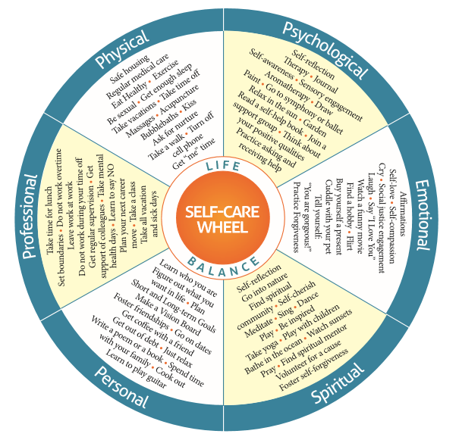
Step 2: Identify your self care needs
Notes:
To Know/To Say: Using the self care wheel, we can identify our self-care needs which includes physical, psychological, emotional, spiritual, personal, and professional.
Handout: http://www.olgaphoenix.com/wp-content/uploads/2015/05/SelfCare-Wheel-Final.pdf
Reference: http://www.olgaphoenix.com/wp-content/uploads/2015/05/SelfCare-Wheel-Final.pdf

Slide 17
Step 3: Look at barriers and areas for
improvement
Reflect - What's working? What’s not working?
Examine - Are there barriers to maintaining your self-care?
Replace - Work on reducing, and then eliminating, negative coping strategies
Notes:
To Know/To Say: Step 3: After we celebrate areas you are doing well, look at barriers and areas for improvement. Reflect on what is working and what is not working. Examine the barriers to maintaining your self-care. Replace negative coping strategies with positive. Maybe you start with reducing the negative and trying a positive strategy to see if it makes a difference. Think about your “why”. I enjoy my profession because_______. I want to take care of myself because___________.

Slide 18
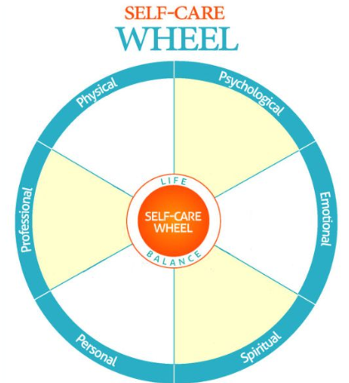
Step 4: Develop Self-Care Plan
http://www.olgaphoenix.com/wp-content/uploads/2015/05/SelfCare-Wheel-Final.pdf
Notes:
To Know/To Say: Step 4: Create your personal self-care plan. We would encourage you to pause the learning module to create your plan! Take the time to pause and reflect. Creating your plan will help you get started ! This template can be found in your resources. Consider using the feedback from the online assessment to create or revise your self-care plan. Putting your self care plan in writing helps to keep us accountable. Feel free to share your plan with someone who knows how special you are.
Handout: http://www.olgaphoenix.com/wp-content/uploads/2015/05/SelfCare-Wheel-Final.pdf
Reference: http://www.olgaphoenix.com/wp-content/uploads/2015/05/SelfCare-Wheel-Final.pdf

Slide 19
Step 5: Make the Time
Self-care just doesn’t happen because we wish to take better care of ourselves.
Look at your calendar and notice what you’ve deliberately planned.
How can you make the time for your self-care plan?
Notes:
To Know/To Say: Self-care happens when you make the time for your plan. Look at your calendar and notice what you deliberately schedule. How can you make the time for your the items on your plan?

Slide 20
Self-Care Toolkit: YOU decide what goes in your toolbox!
Notes:
To Know: Self-care is an individual choice. Offering a variety of choices provides the opportunity to select what works for the person reviewing this module.
To Say: You will now be taken through resources and self-care strategies. If you are in leadership, remember to promote choice. As you go through the module select what works for you. Throughout the module you will see a combination of collective self-care and individual self-care strategies. Let’s get started!

Slide 21
Strategies to Promote Self-Care
Notes:
To Know: Transition Slide

Slide 22
Pause and Reflect
What are some self-care strategies you have used?
Notes:
To Know/To Say: Now that we understand the importance of self-care, let’s take the time to discuss a few strategies. Remember self-care is personal. Every self-care plan will be different. What are some of the strategies you have used?
To Do: Have participants talk to each other using the self-care wheel, or do a gallery walk around the room in each category of the self-care wheel and have individuals add their items to the category.

Slide 23
What is collective self-care?
Collective self-care is the intentional practices we do together in community to create a sense of belonging and community wellbeing.
How does your division promote a culture of wellness?
Meaningful school rituals (school chant, celebrations, secret-pals, gratitude boards, self-care bingo)
After-school exercise classes, like yoga or walking
Practicing self-care strategies together and sharing tips with each other
Space to share (begin staff meetings in a dialogue circle that includes a question posed and a process
Notes:
To Know/To Say: Many of the strategies we will share with you today will be for individuals to consider for their self-care plan. We also know that communities benefit from collective self-care. When we have meaningful school rituals and practices that we share together, we can create a positive school culture for the staff. Consider how you can share some of the strategies in community, too. Here are some examples on collective self-care. A link is provided on proactive circles. It’s a classroom example that can also be used with adults with a few changes. This can also serve as a model for teachers to potentially take back to the classroom to support students.

Slide 24
Self-Care Bingo
Create a simple bingo card for staff to write in items from their self-care plan.
Decide as a staff if you have to fill the entire card or a row in order to receive recognition or a small incentive from leadership.
This activity incorporates self-care for individuals with collective care.
*A bingo card template can be found in your resources.
Notes:
To Know/To Say: Administrators need to create and maintain a school climate and culture that is physically, mentally, and emotionally safe for all staff, students and families. Self-Care Bingo is a great activity to support collective self care and individual self care.

Slide 25
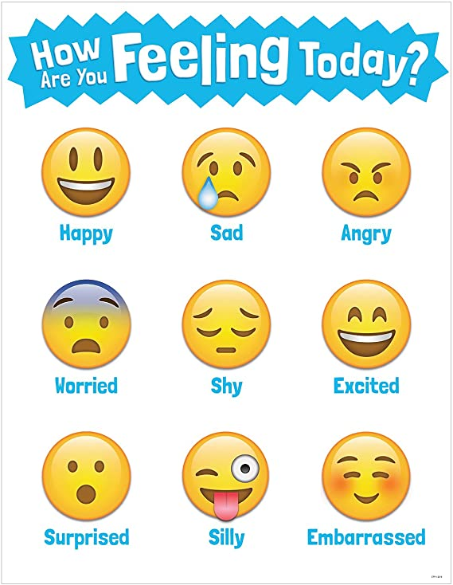
How are you feeling?
Pick 1-2 words that describe how you are feeling.
This activity can be done at any time. The purpose is to notice our thoughts, practice mindfulness, and re-connect to the present.
Notes:
To Know: Beginning the day or activity acknowledging our feelings helps us to move forward and put the “now” in perspective.
To Say: When we name our feelings and practice mindfulness, we potentially provide a way to examine our thoughts and actions. It’s okay to take breaks and say no. As educators we often work beyond the call of duty because we are helpers. Instead of “I have to”, could you consider “not now”, or “I can do this later when I’m feeling better”? How are you feeling can be used as a self-reflection or in community with your staff. Start a meeting off with this activity so there is space to process and re-connect to the present.
You can also use different tools using any online format with your staff, families, and students.

Slide 26
B.A.R.
Breathe--Take a deep breath, breathe in for 4 counts, hold for 4 counts, breathe out for 4 counts
Acknowledge-- Acknowledge what you are feeling, and actively listen or observe what is going on
Respond-- Instead of reacting, your deep breath and pause will help you to ask more questions, to consider solutions, or to table the situation for later if needed
Notes:
To Know/To Say: There are many breathing meditations available. This one, B.A.R., combines breathing along with acknowledging your feelings, and responding. So often we leave out the last two steps which can be critical when we are in a difficult situation. With any of these strategies, we hope you will pause and practice. Taking the time to practice strategies before the event will ensure that you are ready when the event occurs. The strategy becomes automatic.

Slide 27
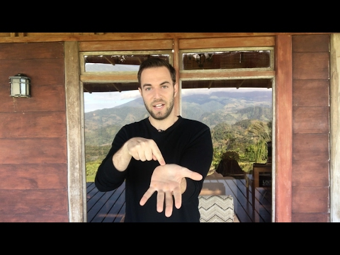
Take 5
Notes:
To Know: This video is 2.45 minutes https://youtu.be/MqariSXiSvs
To Say: Take 5 is a quick video for you to use as an individual, and we would also like to recommend using the video in professional learning activities or staff meetings. A quick, simple strategy to practice together.

Slide 28
Mindful Music
Choose a playlist or a song that relaxes or inspires you.
Notice the thoughts, memories, sensations, and emotions you have during the song.
Notes:
To Know/To Say: Cell phones and computers have so many possibilities for us to access our favorite music. We can make a playlist, or a single song that inspires you. Take the time to notice your thoughts, memories and sensations during the song. Remember to incorporate your deep breathing with mindful music.

Slide 29
Tap in, Tap Out
Notes:
To Know: This video is under 2 minutes. https://youtu.be/qPtsP7pBo
To Say: Sometimes teachers need a minute to take a breath and refocus. A tap-in, tap-out strategy allows them to call in support so they can step out of their room. This video explains how to do tap in, tap out by Fall-Hamilton Elementary School, in Nashville, Tennessee.

Slide 30
Practice Self-Compassion
Self Kindness: Be loving towards ourselves instead of self critical. What would you say to a friend who is hurting? Say the same things to yourself.
Common Humanity: Everyone suffers. You are not alone, and no one is perfect. We can support each other.
Mindfulness: Notice our struggle. Avoid self-judgement or overreaction.
Kristin Neff
Notes:
To Know/To Say: Kristin Neff is a pioneer in the work of self-compassion. Self-care, in a way, starts with self-compassion--a place of self-worth. A practice of self-forgiveness and being kind to ourselves verses self critical supports a sense of personal wellbeing and the space to make mistakes. Mistakes can be opportunities. Self-compassion includes the knowledge that everyone suffers in some way. We all have our battles we face every day. How can we support each other and find commonality and validation. We are not alone. Lastly, self-compassion includes mindfulness. We acknowledge the struggle in the context of self-kindness and common humanity along with purposeful actions, like, writing a letter to yourself of self-compassion. What would you say to a friend who is struggling? Write the same letter to yourself.
Reference: https://self-compassion.org/

Slide 31
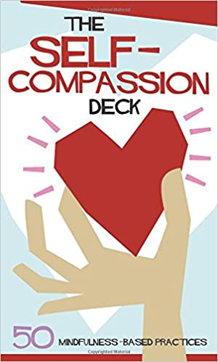
Investing in you...
The Self-Compassion Deck offers 50 mindfulness-based practices for use at home or in the classroom.
The practice of self-compassion has been proven to:
- Improve well-being
- Regulate emotions
- Reduce depression and anxiety
Christopher Willard, Mitch Abblett, and Tim Desmond
Notes:
To Know/To Say: If this is an area you struggle in, invest in you! Here is a self-compassion deck that offers 50 mindfulness-based practices. This deck was created by Christopher Willard, Mitch Abblett and Tim Desmond.
Reference/Resource: https://www.amazon.com/Self-Compassion-Deck-50-Mindfulness-Based-Practices/dp/1683730380

Slide 32
Apps for your phone
Ten Percent Happier Meditation 4+
Find calm, insight, and sleep
10% Happier Inc.
Notes:
To Know/To Say: There are many apps out there that support mindfulness. Here is one example.
Resource: https://www.tenpercent.com/

Slide 33
Gratitude
“Brene Brown, researcher and author, emphasizes that maintaining an ‘attitude of gratitude’ is insufficient to cultivate joy unless it translates to a behavior--a tangible practice of gratitude.”
Article, Nick Jankel
Notes:
To Know: One of the findings that emerged from the research of Brene Brown is that the people who described themselves as joyful all had one thing in common: an active gratitude practice.
To Say: The relationship between joy and gratitude actually surprised Brown. While she expected to find that joyful people were grateful for what they had in their lives, the data indicated that it’s in fact gratitude that comes first. In the words of Brother David Steindl-Rast: It is not happiness that makes us grateful, but gratefulness that makes us happy. Brown emphasizes that maintaining an ‘attitude of gratitude’ is insufficient to cultivate joy unless it translates to a behavior. The wholehearted folk whom she interviewed all had a tangible practice of gratitude, whether that was journaling, meditation, or saying grace.
Reference: https://switchonnow.com/magazine/brene-browns-surprising-findings-on-gratitude-and-joy/

Slide 34
How to practice gratitude
Notice your surroundings: nature, play music, comforting smells and sounds
Keep a gratitude journal: Write down things
Recall how you overcame past experiences and be grateful for what you learned
Practice thankful words like abundance, blessings, gifts
Write a letter of gratitude to a friend or loved one; text someone an encouraging message (Doing this at the end of the workday helps you leave on a positive note!)
Notes:
To Know/To Say: Here are some ideas to practice gratitude! How can you develop a self-care plan that incorporates gratitude? How can you build gratitude practices into your collective self-care as a school? Some teachers have created a space or board for staff to share “shout outs”. Students have created opportunities for other students to write thank you notes to teachers. This is usually done by a club, or group of students, who organize the materials and time, for example, during lunch.
Reference: “A Surprising Way to Reduce Stress”, Elizabeth Bernstein

Slide 35
Stress and Analysis Paralysis
When all decisions are equal and all require lots of careful thought. We worry, awfulize, and make a list of all the “what if’s?” We become anxious and can’t make a decision.
What to do?
Recognize when it’s setting in
Practice making a decision quickly
Employ one of your self-care strategies
Seek support
Practice self compassion--It’s okay to not be perfect
Notes:
To Know: Self-care can be intrinsic practices, too. Over the last decade, our educational system and the world around us have faced many changes. Some of the changes are positive, and others have been collective trauma experiences in which we have had to adjust significantly.
To Say: We all face stress and change differently. You may find that it creates a sense of urgency, and you are overworking. For others, stress can paralyze decision making. When you find yourself in analysis paralysis, recognize it, and normalize it. It’s okay. Here are some tips to consider. Recognition and seeking support are key. Thinking of collective self-care--How could leadership send the message of support during high stress times, and a process to gain that support when needed? Do you have an open-door policy, or times during the day you schedule for teachers? Consider department meetings. How can we include time to seek support while also getting our tasks accomplished?

Slide 36
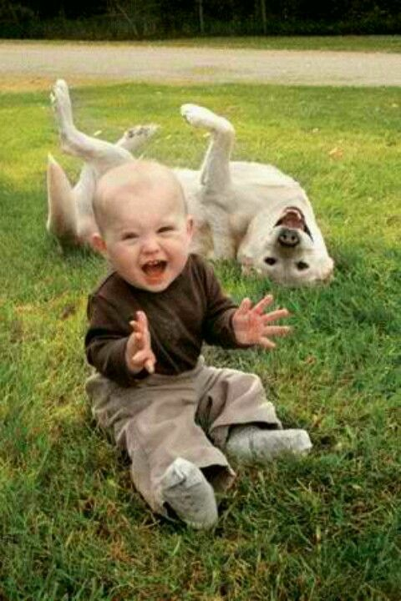
The power of laughter
Listen to comedy podcast
Read a joke book
Listen to music that makes you smile/laugh
There’s even evidence from one study on the replenishing effects of watching animal videos, and videos of children laughing
Daniel Pink
Picture source: https://www.pinterest.com/pin/216595063301787978/?autologin=true
Notes:
To Know/To Say: In Daniel Pink’s book, When: The Scientific Secrets of Perfect Timing, he writes about the research behind laughter. Here are some ideas to get the laughter going! How can you include humor and laughter into staff events? Can you open with a quick humorous cartoon? A funny question to respond to using polling apps? Maybe a “joke of the day” that highlights the struggles of educators.
Picture source: https://www.pinterest.com/pin/216595063301787978/?autologin=true

Slide 37
Quick Tips for the Workplace
Micro-breaks
20-20-20
Hydrate
Wiggle your body to reset your mind (shake arms and legs, flex your muscles)
Yoga in the moment
Create your quick time-out checklist
and practice them daily
Notes:
To Know/To Say: Continuing with Daniel Pink. Here are some researched based strategies for the workplace. He suggests to create your “quick time-out checklist” and practice them daily. Micro breaks would be a replenishing break that does not need to be lengthy or complex. For 20-20-20 every 20 minutes, look at something 20 feet away, for 20 seconds. Make sure you hydrate often to help your brain and energy. When you are sitting for long periods of time move your body.
Reference: Daniel Pink

Slide 38
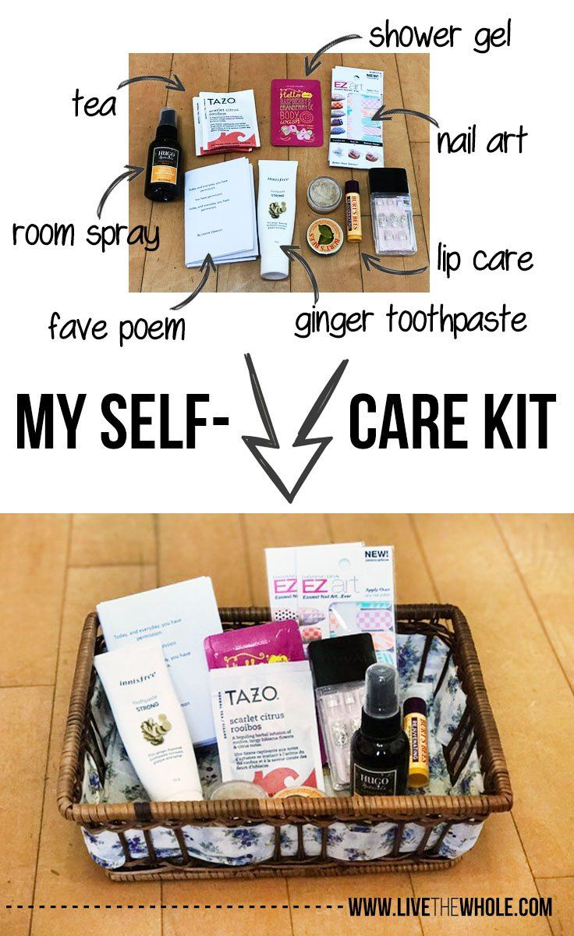
Make a self-care kit
Intentionally place items that bring you comfort in a box (remember your 5 senses)
Choose a theme song to calm and have it at the ready on your phone to play
Remember the many self-care and mindful apps that are available to you to download
Notes:
To Know/To Say: How about a self-care kit? Many educators are creating a self-care kit with items that bring them comfort. What would be in your self-care kit?
To Do: Have participants talk about what they would put in their self-care kit.

Slide 39
Action Plan
Instructions: Identify one of the strategies we have discussed (or one of your own ideas) that you would like to try. Pick something that will take relatively little effort to implement.
–Think about particular students you would like to use the strategy with
Why did you pick the strategy you did?
How would you put it in place or get started?
How would you practice it? Or, how would your students practice it?
What will your immediate next steps be?
Notes:
To Say/To Do:

Slide 40
Resources
Self-Care Plan: www.OlgaPhoenix.com
NAMI: https://www.nami.org/Home
Take 5 Video Cory Muscara: https://www.youtube.com/watch?v=MqariSXiSvs
Survey shows need for national focus on workplace stress:
https://www.aft.org/news/survey-shows-need-national-focus-workplace-stress
Self-Compassion Deck: Christopher Willard, Mitch Abblett and Tim Desmond

Slide 41
Resources Continued
Compassion Resilience Toolkit: https://compassionresiliencetoolkit.org/
Resilience Toolkit: https://www.winona.edu/resilience/toolkit.asp
Why is it so hard for teachers to take care of themselves (and 4 Ways to Start):
https://www.cultofpedagogy.com/teacher-self-care/
Edutopia: https://www.edutopia.org/
Pink, D. (2018). When: The scientific secrets of perfect timing. New York, New York: Riverhead Books.
Dialogue Circles: https://www.edutopia.org/practice/stw-glenview-practice-dialogue-circles-video

Slide 42
Resources Continued
Brunetti, G. J. (2006). Resilience under fire: Perspectives on the work of experienced, inner city high school teachers in the United States. Teaching and Teacher Education, 22(7), 812-825.
Research on teacher stress
Teacher stress with resources

