Slide 1
Hidden Slide #1
This Module was designed to be used in the following manner.
The audience for this Module is division and school teams.
This Module is meant for whole staff, team, and division presentations.
Following this training, participants should complete the Action Plan document to determine next steps.
There are eight sections in this module. Teams are not required to complete all components of the Modules. Instead, participants will complete only those Modules that fit the needs of their school.
Notes:
Module 1 is divided into several sections. Each section can be completed in 30 minutes or less.

Slide 2
Hidden Slide #2
In person training
Presenter notes and information
Notes:
In-person training suggestions
This module can be broken down into sections. Each section of Module 4 should be about 30 minutes to complete.
This modules provides strategies that can be used for staff and students in trauma sensitive schools. You may want to add or enhance portions with visuals and examples that will resonate with your audience. As a reminder, always be sure to include appropriate citations when adding resources. Also, you might look to the resources and activities sections for additions that may be helpful.
In summary
This module outlines strategies that can be used in trauma sensitive schools
It can be adapted to individual contexts
The training should last about 4 hours for the entire module or 30 minutes for each section.
Presenter notes information
Presenter notes are included in the PowerPoint. Background information for the presenter is shown as “To Know.” Statements to be shared with participants are shown as “To Say.” In some instances, the “To Know/To Say” are combined.The presenter notes also include “To Do” prompts and cues for “Handouts”.
Additional activities, examples, videos, etc. are being developed. A presenter may add material from the resources and activities section on the website.
Breaks should be inserted at the discretion of the presenter based on the needs of participants.

Slide 3
Hidden Slide #3
Supplies needed
WIFI access for presenter and participants
Access to videos (through WIFI if available, but download to flash drive as a back-up)
Chart paper
Markers
Post-it-Notes
Notes:
To Know
These supplies are needed for the Trauma Professional Learning Modules.

Slide 4
Hidden Slide #4
Handouts for this Module
Action Planner
Notes:
To Know
The Participant and Presenter Materials are located on the vtss-ric website.
References

Slide 5
Hidden Slide #5
Key Terms in This Module:
Self Management
Social Emotional Learning
Notes:
To Know
These are the key terms used throughout the module.

Slide 6
Self Management
Notes:
To Know:
VTSS Professional Learning Modules are organized in the same manner. All schools can begin their journey with Module 1 which introduces the foundational knowledge around trauma and trauma sensitive schools. This powerpoint is part of Module 4 that shares strategies on how we create trauma-sensitive, safe and supportive schools.
To Say:
Welcome to the learning module, “Self-Management”. Let’s get started!

Slide 7
What We Will Know and Do
Build an understanding of self-management
Leave with some strategies or techniques that you could try in the classroom to support your students in developing self-management skills
Notes:
To Know:
Go over the learning intentions targeted for this session
To Say:
During this module we hope you will gain an understanding of the importance of self-management, as well as provide strategies develop self-management skills.

Slide 8
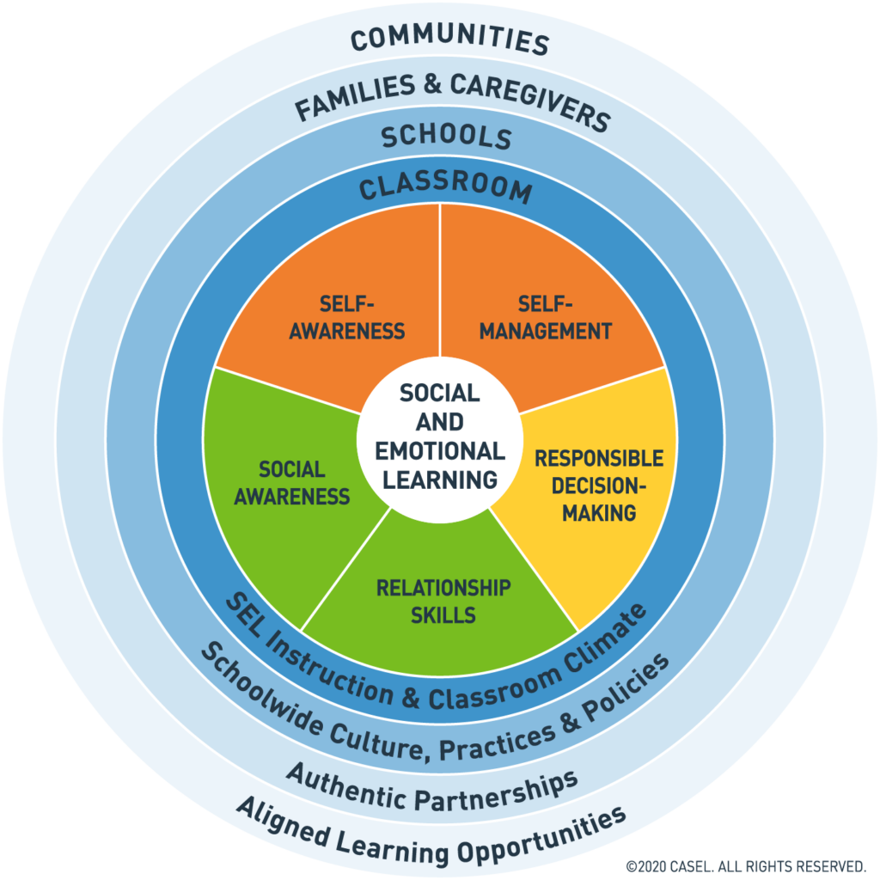
Social Emotional Competencies
Notes:
To Know: Social and emotional learning (SEL) enhances students’ capacity to integrate skills, attitudes, and behaviors to deal effectively and ethically with daily tasks and challenges. Like many similar frameworks, CASEL’s integrated framework promotes intrapersonal, interpersonal, and cognitive competence. There are five core competencies that can be taught in many ways across many settings. Many educators and researchers are also exploring how best to assess these competencies.
To Say: In VTSS, we use CASEL’s five core competencies: Self-Awareness, Self-Management, Social-Awareness, Relationship Skills, and Responsible Decision Making. These five competencies can be taught in many ways across many settings. They provide a solid foundation for social relationships and achievement. Today we will focus on Self-Management.
References: https://casel.org/core-competencies/

Slide 9
Self-Management
Self-Management is the ability to manage your emotions, thoughts, and behaviors in different situations.
Notes:
To Know/To Say: Self-management is an essential component of social emotional learning. Teaching students how to manage their behaviors allows teachers more time to focus on teaching and less time focusing on challenging behaviors. The ability to self-manage is a skill that teaches students healthy ways to navigate and shift their thoughts, emotions and behaviors in order to make better decisions and reach their goals.

Slide 10
What Does this Look Like?
Managing your emotions
Delaying gratification
Motivating yourself
Focusing attention
Setting and working towards goals
Notes:
To Know: Self-management is a key enabler for all learning.
To Say: Self-management refers to a variety of behaviors that focus on how people manage themselves at school and in life. These skills include: managing your emotions, delaying gratification, motivating yourself, focusing your attention, and setting and working towards goals.

Slide 11
Why This Matters
Higher self-management in young children is correlated with positive outcomes such as high school completion and higher income levels later in life. Lower self-management is correlated with chronic health problems, financial difficulties, substance abuse, and criminal involvement.
Notes:
To Know/To Say: Strong self-management skills may contribute to better outcomes in school and beyond. One report demonstrated that, controlling for academic achievement, children with better self-management at age 4 were almost 40% more like to complete college by 25. a landmark study showed that children’s self-management between ages 3-11 predicted key adult outcomes, such as physical health, substance dependence, personal finances, and criminal offenses.
Reference: https://www.transformingeducation.org/wp-content/uploads/2019/04/Introduction_to_Self-Management_Handout_Final_CC.pdf
Moffitt, T. E., Arseneault, L., Belsky, D., Dickson, N., Hancox, R. J., Harrington, H., Houtes, R., Poulton, R., Roberts, B., Ross, S., Sears, M., Thomson, W.M., & Caspi, A. (2011). A gradient of childhood self-control predicts health, wealth, and public safety. Proceedings of the National Academy of Sciences, 108(7), 2693-2698.); Knudsen, E. I., Heckman, J. J., Cameron, J. L., & Shonkoff, J. P. (2006). Economic, neurobiological, and behavioral perspectives on building America’s future workforce. Proceedings of the National Academy of Sciences, 103(27), 10155-10162
McClelland, Piccinin, Acock & Stallings (2011) Relations between preschool attention and later school achievement and educational outcomes

Slide 12
Video Example
Notes:
To Know: Video is 3 minutes - https://youtu.be/4p5286T_kn0
To Say: This is a great example of moving towards seeing students as solutions and not problems.

Slide 13
Discussion
What resonated with you in the video?
What strategies have worked with your students in helping them build self-management skills?
Notes:
To Say/To Do: Have groups discuss the following questions.

Slide 14
Strategies to Promote Self-Management Skills
Notes:
To Know: Transition Slide

Slide 15
Self-Management Strategies
The most effective strategies are proactive.
They involve action long before the distraction or decision point occurs.
They can be practiced repeatedly long before they are needed.
Notes:
To Know/To Say: Behavioral problems can be prevented through appropriate design of your settings, programs, and systems. If we can predict it, we can prevent it. An good example of this would be effective school-wide expectations and classroom management strategies.

Slide 16
Create Self-Management Expectations
Provide opportunities for students to track their own progress towards goals over time.
Readiness to Learn: Create a checklist and set aside time at the beginning of class for students to assess their readiness to learn. Track their results so students can see their progress over time
Classroom Behavior: Have students track classroom expectations. At the end of each class, have students rate themselves and record their results.
Notes:
To Know/To Say: These are a couple of ways in which we can infuse self-management in our classrooms.

Slide 17
Cognitive Strategies
Notes:
To Know: video is a little over 3 minutes. Walter Mischel’s “Marshmallow Test” showed that ability to delay gratification at age 4 predicts academic and social competence as well as ability to cope with stress later in life. Ten years after the experiment, those who had delayed gratification were rated by their parents as more academically and socially competent, verbally fluent, rational, attentive, planful, and able to deal with frustration and stress. Several years later, the group that had delayed gratification at age 4 also had higher SAT scores than their peers who had not.
To Say:
This is comparison to teachers telling a student “stop fidgeting” , You are basically telling the student to stop and figure out how to do it putting this all on the kiddo. Maybe the child doesn't know how. You need to provide the student with a tool to help support their need to fidget. Squeeze a ball, doodle.
To Do: https://youtu.be/QX_oy9614HQ
Reference:
Mischel, W., Shoda, Y., & Rodriguez, M. L. (1989). Delay of gratification in children. Science, 244, 933-938; Y. Shoda, W. Mischel, & P.K. Peake (1990). Predicting adolescent cognitive and self‐regulatory competencies from preschool delay of gratification. Developmental psychology, 26(6), 978‐86

Slide 18
Discussion #2
What strategies did some of the kids use to resist temptation or increase their focus on the goal of getting 2 marshmallows?
Notes:
To Say/To Do: Have participants discuss the question above.

Slide 19
The WOOP Method
The WOOP Method The WOOP strategy, which is positive thinking plus a dose of reality, contains four steps:
Wish: Students name an important but feasible wish or goal that they want to fulfill.
Outcome: Students imagine, as vividly as possible, what the future will be like once they fulfill this wish or reach the goal.
Obstacle: Students imagine the most critical personal obstacle that stands in the way of fulfilling that wish or reaching the goal.
Plan: Students name an effective behavior to overcome the obstacle and create a specific plan using an if-then statement: “If X happens, then I will Y.”
Notes:
To Know/To Say: WOOP is a scientifically proven tool that helps us change our behaviors for the better and achieve our goals. It stands for Wish, Outcome, Obstacle, and Plan. And it's basically the combination of two tools called mental contrasting and implementation intentions.
Reference: https://www.psychbytes.com/woop-goal-setting/

Slide 20
Practice
Instructions: Identify one of the strategies we have discussed (or one of your own ideas) that you would like to try. Pick something that will take relatively little effort to implement.
–Think about particular students you would like to use the strategy with
Why did you pick the strategy you did?
How would you put it in place or get started?
How would you practice it? Or how would your students practice it?
What will your immediate next steps be?
Notes:
To Say/To Do:

Slide 21
Team Talk: Review the “How”
How will you adjust your practices to support learning for students who have experienced trauma?
How will you involve families and students in practices?
Fill this in on your Action Plan under “Objectives and Action Planning”
Notes:
To Know: Action planning supports engagement in the work and next steps
To Say:
We’ve now completed the module “Self Management”. This your time to pause and reflect on the “how”. How will you adjust your practices to support learning for students who have experienced trauma?Please fill this in on your action plan under objectives and action planning.
Handout: Action Planner

Slide 22
References/Resources
Moffitt, T. E., Arseneault, L., Belsky, D., Dickson, N., Hancox, R. J., Harrington, H., Houtes, R., Poulton, R., Roberts, B., Ross, S., Sears, M., Thomson, W.M., & Caspi, A. (2011). A gradient of childhood self-control predicts health, wealth, and public safety. Proceedings of the National Academy of Sciences, 108(7), 2693-2698.)
Knudsen, E. I., Heckman, J. J., Cameron, J. L., & Shonkoff, J. P. (2006). Economic, neurobiological, and behavioral perspectives on building America’s future workforce. Proceedings of the National Academy of Sciences, 103(27), 10155-10162
McClelland, M., A. Piccinin, Acock, A. & Stallings, M. (2011) Relations between preschool attention and later school achievement and educational outcomes. doi: 10.1016/j.ecresq.2012.07.008

Slide 23
References/Resources
Mischel, W., Shoda, Y., & Rodriguez, M. L. (1989). Delay of gratification in children. Science, 244, 933-938; Y.
Shoda, W. Mischel, & P.K. Peake (1990). Predicting adolescent cognitive and self‐regulatory competencies from preschool delay of gratification. Developmental psychology, 26(6), 978‐86
https://www.psychbytes.com/woop-goal-setting/
https://www.transformingeducation.org/wp-content/uploads/2019/04/Introduction_to_Self-Management_Handout_Final_CC.pdf
https://youtu.be/4p5286T_kn0
https://youtu.be/QX_oy9614HQ

Slide 24
References/Resources
https://youtu.be/4p5286T_kn0
https://youtu.be/QX_oy9614HQ

