Slide 1
Hidden Slide #1
This Module was designed to be used in the following manner.
The audience for this Module is division and school teams.
This Module is meant for whole staff, team, and division presentations.
Following this training, participants should complete the Action Plan document to determine next steps.
There are eight sections in this module. Teams are not required to complete all components of the Modules. Instead, participants will complete only those Modules that fit the needs of their school.
Notes:
Module 1 is divided into several sections. Each section can be completed in 30 minutes or less.

Slide 2
Hidden Slide #2
In person training
Presenter notes and information
Notes:
In-person training suggestions
This module can be broken down into sections. Each section of Module 4 should be about 30 minutes to complete.
This modules provides strategies that can be used for staff and students in trauma sensitive schools. You may want to add or enhance portions with visuals and examples that will resonate with your audience. As a reminder, always be sure to include appropriate citations when adding resources. Also, you might look to the resources and activities sections for additions that may be helpful.
In summary
This module outlines strategies that can be used in trauma sensitive schools
It can be adapted to individual contexts
The training should last about 4 hours for the entire module or 30 minutes for each section.
Presenter notes information
Presenter notes are included in the PowerPoint. Background information for the presenter is shown as “To Know.” Statements to be shared with participants are shown as “To Say.” In some instances, the “To Know/To Say” are combined.The presenter notes also include “To Do” prompts and cues for “Handouts”.
Additional activities, examples, videos, etc. are being developed. A presenter may add material from the resources and activities section on the website.
Breaks should be inserted at the discretion of the presenter based on the needs of participants.

Slide 3
Hidden Slide #3
Supplies needed
WIFI access for presenter and participants
Access to videos (through WIFI if available, but download to flash drive as a back-up)
Chart paper
Markers
Post-it-Notes
Notes:
To Know
These supplies are needed for the Trauma Professional Learning Modules.

Slide 4
Hidden Slide #4
Handouts for this Module
Action Planner
Notes:
To Know
The Participant and Presenter Materials are located on the vtss-ric website.
References

Slide 5
Social Awareness
Notes:
To Know:
VTSS Professional Learning Modules are organized in the same manner. All schools can begin their journey with Module 1 which introduces the foundational knowledge around trauma and trauma sensitive schools. This powerpoint is part of Module 4 that shares strategies on how we create trauma-sensitive, safe and supportive schools.
To Say:
Welcome to the learning module, “Social Awareness”. Let’s get started!

Slide 6
What We Will Know and Do
Build an understanding of social awareness
Leave with some strategies or techniques that you could try in the classroom to support your students in developing social awareness skills
Notes:
To Know:
Go over the learning intentions targeted for this session
To Say:
During this module we hope you will gain an understanding of the importance of social-awareness, as well as provide strategies develop social-awareness skills.

Slide 7
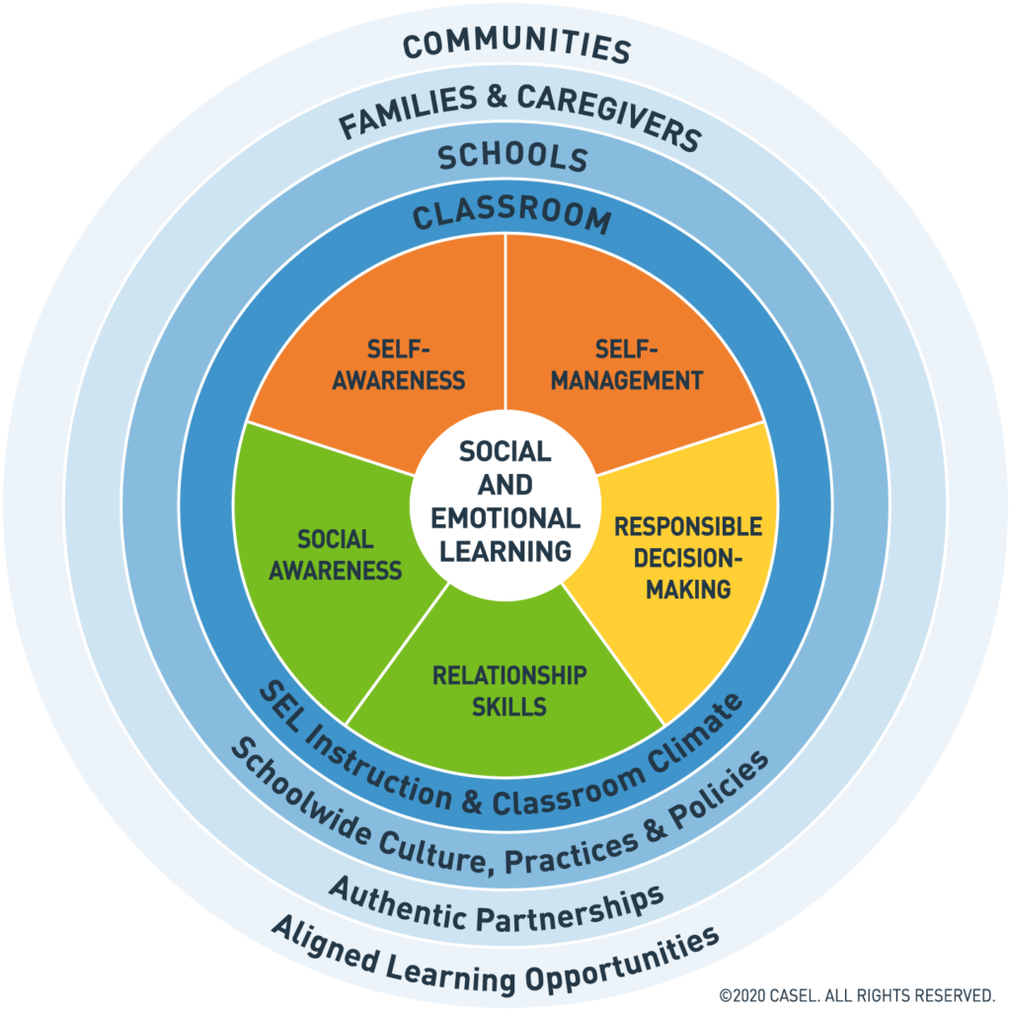
Social Emotional Competencies
Notes:
To Know: Social and emotional learning (SEL) enhances students’ capacity to integrate skills, attitudes, and behaviors to deal effectively and ethically with daily tasks and challenges. Like many similar frameworks, CASEL’s integrated framework promotes intrapersonal, interpersonal, and cognitive competence. There are five core competencies that can be taught in many ways across many settings. Many educators and researchers are also exploring how best to assess these competencies.
To Say: In VTSS, we use CASEL’s five core competencies: Self-Awareness, Self-Management, Social-Awareness, Relationship Skills, and Responsible Decision Making. These five competencies can be taught in many ways across many settings.They provide a solid foundation for social relationships and achievement. Today we will focus on Social-Awareness.
References: https://casel.org/core-competencies/

Slide 8
Social Awareness Defined
Social-Awareness is the ability to take the perspective of and emphasize with others from diverse backgrounds and cultures; to understand social and ethical norms for behavior; and to recognize family, school, and community resources and supports.
Notes:
To Know/To Say: Social awareness is the ability to take the perspective of and empathize with others, as well as learning social and ethical behavior.
Resource: https://casel.org/core-competencies/

Slide 9
Social Awareness
recognize one’s own emotions and other people’s emotions
use information about emotions to guide thinking and behavior
discern the thoughts, feelings, and motivations of others
understand how others view a particular situation
understand social and ethical norms for behavior
recognize and use family, school, and community resources and support
be aware of one’s own cultural identity and views about differences of culture
Notes:
To Know/To Say: When you are socially aware you are able to recognize one’s own emotions and the emotions of others and use this information to guide our own thinking and behavior. When we can do this we are able to understand and communicate with people in a far better way. We are better able to feel what they are feeling and say the words that are the best fit for the situation. Being able to have a realistic and accurate sense of what others are feeling or thinking when they are verbalizing their thoughts and feelings will help us to see the situation from the standpoint of the other person. We let go of the desire to be right and we are better able to show empathy. This is a skill that we not only need to teach our students but many adults need to practice and reflect on their ability to be socially aware.

Slide 10
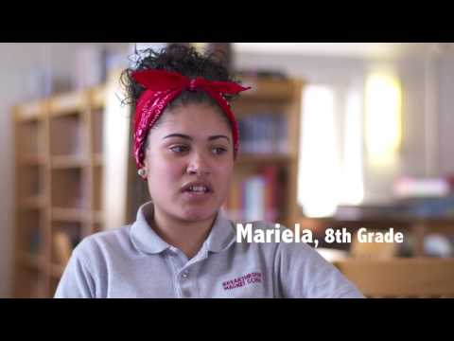
What Does it Look Like?
Notes:
To Know: video is 2.25 minutes. https://youtu.be/d75gxU6Nyq0
To Say: This is a great video from the lens of our students.
Resources: https://youtu.be/d75gxU6Nyq0h
https://www.transformingeducation.org/social-awareness-toolkit/

Slide 11
Discussion
What does social awareness look like in your classroom?
When do students use social awareness?
In what ways do your students excel in this area?
In what ways do your students struggle with social awareness?
How does this impact the classroom climate? What about student learning?
Notes:
To Say/To Do: Group discussion or activity on their own.

Slide 12
Strategies to Promote Social Awareness Skills
Notes:
To Know: Transition Slide

Slide 13
Classroom Strategies
Building Positive Relationships
Emotional Intelligence
Recognizing emotions
Understanding emotions
Labeling emotions
Expressing emotions
Regulating emotions
Cooperative Learning
Social Perspective Taking
Notes:
To Know/To Say: There are a variety of practices for improving students social awareness at every level. We will share a few of these strategies but when working with students strategies should include elements of building positive relationships, emotional intelligence, cooperative learning, and social perspective taking.

Slide 14
Wise Critical Feedback
To provide “wise, critical feedback,” teachers must reinforce their high expectations and their belief in a student’s potential through every instance of feedback. When providing written or verbal feedback to students, be sure to communicate:
that you are providing this feedback because you have high standards for the student, and
that you believe in the student's ability to meet those standards
Notes:
To Know/To Say: “Wise critical feedback” has been shown to improve students academic outcomes. Research finds this strategy especially effective in grades 7-12, particularly with students of color and students from low income communities. It is also important for students to be able to recognize their strengths and opportunities for growth.
Reference: Yeager, D., Garcia, J., Brzustoski, P., Hessert, W., Purdie-Vaughns, V., Apfel, N., Master, A., Williams, M. (2014). Breaking the cycle of mistrust: Wise interventions to provide critical feedback across the racial divide. Journal of Experimental Psychology (143).

Slide 15
Example of Wise Feedback
Feedback on a student paper:
Feedback: Your paper met the basic expectations of the assignment but needs improvement. Please review my comments.
High standards: I have provided detailed feedback. In this course I expect that you will take your writing to a level suitable for college work.
Assurance of student ability: I know that you have the skills and motivation, based on your past assignments, to use my feedback for revisions.
Notes:
To Know/To Say: This is an example of Wise Feedback. Where else can you provide this in your classroom?
Reference: Wright, J. (2016). How to help students accept constructive criticism: ‘Wise’ feedback. https://www.interventioncentral.org/sites/default/files/pdfs/pdfs_blog/student_motivation_wise_feedback.pdf
https://ggie.berkeley.edu/wp-content/uploads/2020/06/GGIE_Giving_Wise_Feedback.pdf

Slide 16
Examples of Strategies for Labeling Emotions
Use media - students can analyze commercials or social media and how they relate to emotions (example: snapchat or tiktok)
Journaling - have students record their reflections after working on a group project (example: how do you feel about the groups effort of completing the assignment? How did it feel to work in this group?)
Notes:
To Know/To Say: Talking about emotions is important and it is how we build empathy. The more we do this at school and at home the more our students will build empathy for how others may be feeling. It is important that we discuss emotions in the classroom and at home that are free from judgement. Stay away from labeling emotions as “good” or “bad”. There is no right and wrong when it comes to how someone is feeling. There are appropriate ways to express emotions depending on the setting or circumstances.

Slide 17
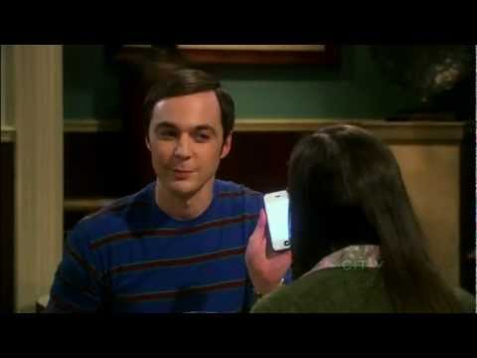
Non-Example of Empathy
Notes:
To Know: Video is just over 2 minutes https://youtu.be/ClvpNWU0A8Q
To Say: It is important to note that empathy is a skill that can be learned and developed. When we can understand another person’s emotions then we are better prepared to listen for their needs and concerns. The simple act of teaching our students to listen to what other people have to say and appreciating their differences can demonstrate you respect them for their ideas. Teach students to be ready and listen. This is a non-example of how not to listen to another person. When a person tells you something, listen carefully. Do not interrupt or share your personal experience. Focus on them. This is a critical skill for not just students but for adults as well.

Slide 18
The Jigsaw Classroom
In the jigsaw approach, students are divided into diverse groups and assigned distinct tasks under a common topic. Students become independent experts on their subtopic and work with leaders of the same task from other groups. Then, each person returns and teaches their original group about their area of expertise.
https://www.jigsaw.org/
Notes:
To Know/To Say: The Jigsaw classroom is a research based cooperative learning technique for group work. While this strategy applies to all grades, research has shown it has the strongest effect in elementary grades. This strategy has been shown to reduce racial conflict and improve educational outcomes including test scores, reduced absenteeism, and greater interest in school.
Reference: https://www.jigsaw.org/
Walker, I. (1998). Academic performance, prejudice, and the jigsaw classroom: new pieces to the puzzle. Journal of Community & Applied Social Psychology.

Slide 19
Perspective Taking
Gallery Walk Activity:
Students create text and visuals or other creative expressions that convey the unique experiences of the person featured in the biography. Student then conduct a “gallery walk”, spending time at each student’s station to learn about a new person and their experiences.
Students must understand their chosen person sufficiently in order to answer questions from their peers.
Notes:
To Know/To Say: Helping students become immersed in another person’s perspective and experience can build empathy, strengthen peer relationships and enhance prosocial behaviors.

Slide 20
Practice
Instructions: Identify one of the strategies we have discussed (or one of your own ideas) that you would like to try. Pick something that will take relatively little effort to implement.
What planning is required?
How do you plan to address anticipated challenges?
How might this strategy be integrated into your existing practices, strategies, or lesson planning?

Slide 21
Team Talk: Review the “How”
How will you adjust your practices to support learning for students who have experienced trauma?
How will you involve families and students in practices?
Fill this in on your Action Plan under “Objectives and Action Planning”
Notes:
To Know: Action planning supports engagement in the work and next steps
To Say:
We’ve now completed the module “Social Awareness”. This your time to pause and reflect on the “how”. How will you adjust your practices to support learning for students who have experienced trauma?Please fill this in on your action plan under objectives and action planning.
Handout: Action Planner

Slide 22
References/Resources
https://casel.org/core-competencies/
https://www.transformingeducation.org/social-awareness-toolkit/
https://youtu.be/d75gxU6Nyq0h
https://youtu.be/ClvpNWU0A8Q
Yeager, D., Garcia, J., Brzustoski, P., Hessert, W., Purdie-Vaughns, V., Apfel, N., Master, A., Williams, M. (2014). Breaking the cycle of mistrust: Wise interventions to provide critical feedback across the racial divide. Journal of Experimental Psychology (143).
Notes:
http://www.actforyouth.net/youth_development/professionals/sel/social_awareness.cfm

Slide 23
References/Resources
Wright, J. (2016). How to help students accept constructive criticism: ‘Wise’ feedback. https://www.interventioncentral.org/sites/default/files/pdfs/pdfs_blog/student_motivation_wise_feedback.pdf
https://ggie.berkeley.edu/wp-content/uploads/2020/06/GGIE_Giving_Wise_Feedback.pdf
https://www.jigsaw.org/
Walker, I. (1998). Academic performance, prejudice, and the jigsaw classroom: new pieces to the puzzle. Journal of Community & Applied Social Psychology.

