Slide 1
Hidden Slide #1
This Module was designed to be used in the following manner.
The audience for this Module is division and school teams.
This Module is meant for whole staff, team, and division presentations.
Following this training, participants should complete the Action Plan document to determine next steps.
There are eight sections in this module. Teams are not required to complete all components of the Modules. Instead, participants will complete only those Modules that fit the needs of their school.
Notes:
Module 1 is divided into several sections. Each section can be completed in 30 minutes or less.

Slide 2
Hidden Slide #2
In person training
Presenter notes and information
Notes:
In-person training suggestions
This module can be broken down into sections. Each section of Module 4 should be about 30 minutes to complete.
This modules provides strategies that can be used for staff and students in trauma sensitive schools. You may want to add or enhance portions with visuals and examples that will resonate with your audience. As a reminder, always be sure to include appropriate citations when adding resources. Also, you might look to the resources and activities sections for additions that may be helpful.
In summary
This module outlines strategies that can be used in trauma sensitive schools
It can be adapted to individual contexts
The training should last about 4 hours for the entire module or 30 minutes for each section.
Presenter notes information
Presenter notes are included in the PowerPoint. Background information for the presenter is shown as “To Know.” Statements to be shared with participants are shown as “To Say.” In some instances, the “To Know/To Say” are combined.The presenter notes also include “To Do” prompts and cues for “Handouts”.
Additional activities, examples, videos, etc. are being developed. A presenter may add material from the resources and activities section on the website.
Breaks should be inserted at the discretion of the presenter based on the needs of participants.

Slide 3
Hidden Slide #3
Supplies needed
WIFI access for presenter and participants
Access to videos (through WIFI if available, but download to flash drive as a back-up)
Chart paper
Markers
Post-it-Notes
Notes:
To Know
These supplies are needed for the Trauma Professional Learning Modules.

Slide 4
Hidden Slide #4
Handouts for this Module
Action Planner
Notes:
To Know
The Participant and Presenter Materials are located on the vtss-ric website.
References

Slide 5
Hidden Slide #5
Key Terms in This Module:
Self-care
Mindfulness
Brain Breaks
Self-reflection
Notes:
To Know
These are the key terms used throughout the module.

Slide 6
Strategies for Self-Care in the Classroom
Notes:
To Know:
VTSS Professional Learning Modules are organized in the same manner. All schools can begin their journey with Module 1 which introduces the foundational knowledge around trauma and trauma sensitive schools. This powerpoint is part of Module 4 that shares strategies for self-care in the classroom.
To Say:
Welcome to the learning module, “Strategies for Self-Care in the Classroom”. Let’s get started!

Slide 7
What We Will Know and Do
Build an understanding of what is is self-care and why is it important for students
Leave with some strategies or techniques that you can try in your classroom to support student self care
Notes:
To Know:
Go over the learning intentions targeted for this session
To Say:
During this module we hope you will begin to understand the importance of teaching students self-care. The earlier they learn to practice self-care the better they will be able to take care of themselves.

Slide 8
Self Care for Students
What is self care for students?
It is a set of activities that you can use in your classroom that maintains physical, mental, and emotional well-being of your students.
Notes:
To Know/To Say: We hear a lot today about self care for educators but not as much for our students. We want to help our students maintain physical, mental, and emotions well-being. Teaching them self-care will help support this.

Slide 9
Why Teach Self-Care to Students?
Teaching students how to take care of themselves can lead to more critical life skills later on.
A 2018 survey of over 80,000 U.S. postsecondary students shows that anxiety, stress, trouble sleeping, and depression are the top factors affecting academic performance among students.
Notes:
To Know/To Say: Teaching students how to take care of themselves will lead to them being better prepared for more critical life skills later on. This survey from 2018 shows the top factors affecting academic performance in postsecondary education. 80,000 students showed signs of anxiety, stress, trouble sleeping and depression is very alarming.
Reference: https://time.com/5190291/anxiety-depression-college-university-students/

Slide 10
Pause and Reflect
Why do you think students need self-care practices in the classroom?
What practices have you shared with your students to support their wellbeing?
Notes:
To Say: Let’s take a moment to reflect on what we just discussed.
To Do: Have groups work together or individually. Share out.

Slide 11
Strategies to Promote Self- Care
Notes:
To Know: Transition Slide

Slide 12
Strategies for the Classroom
We are hopeful that you will engage in each of the strategies as they are presented.
Consider learning the strategy then pause to practice the strategy and reflect on how you will use in the classroom.
Notes:
To Know: There are many strategies you can use with students.
To Say: We will engage in several strategies to help students practice self-care.

Slide 13
Introducing Mindfulness and Self-Care
Take time to introduce the how and the why of activities
Take time to share ideas with students’ families so they can practice at home and give input
Remember that some students may not want to practice--give them a choice with expectations
Notes:
To Know/To Say: It is always important to talk about the why behind what you are doing. It is also hard to teach something to students that you have never practiced. We want to focus on giving our students the skills to develop their awareness of their inner and outer experiences and to understand how their emotions can manifest in their bodies. Self-care and mindfulness are simple strategy that can be taught anywhere. Involving families in these strategies will help to give them some tools at home.

Slide 14
Voice and Choice
Take time to get to know your students. Self-care practices should be a choice, and they should have voice in what they want to try.
Closing your eyes or meditation can be anxiety producing for some. You can give choice by asking them to focus on something in the room, or sit quietly.
Ask them to speak to you privately if they have any concerns or a negative experience.
Notes:
To Know/To Say: There is not one right way to practice self-care. It really is what works best for you and what makes you feel good. Allowing students to have voice and choice in what they want to try will help them to find something that works best for them. Meditation does not always have to be about closing your eyes and sitting still. Some people meditate in different ways. An example could be walking through a forest and talking in your surroundings.

Slide 15
Pause and Reflect #2
Why is it so important to have voice and choice in self-care practices?
How will you incorporate voice and choice?
Notes:
To Say: Let’s reflect on voice and choice.
To Do: Have participants answer the questions together or as individuals.

Slide 16
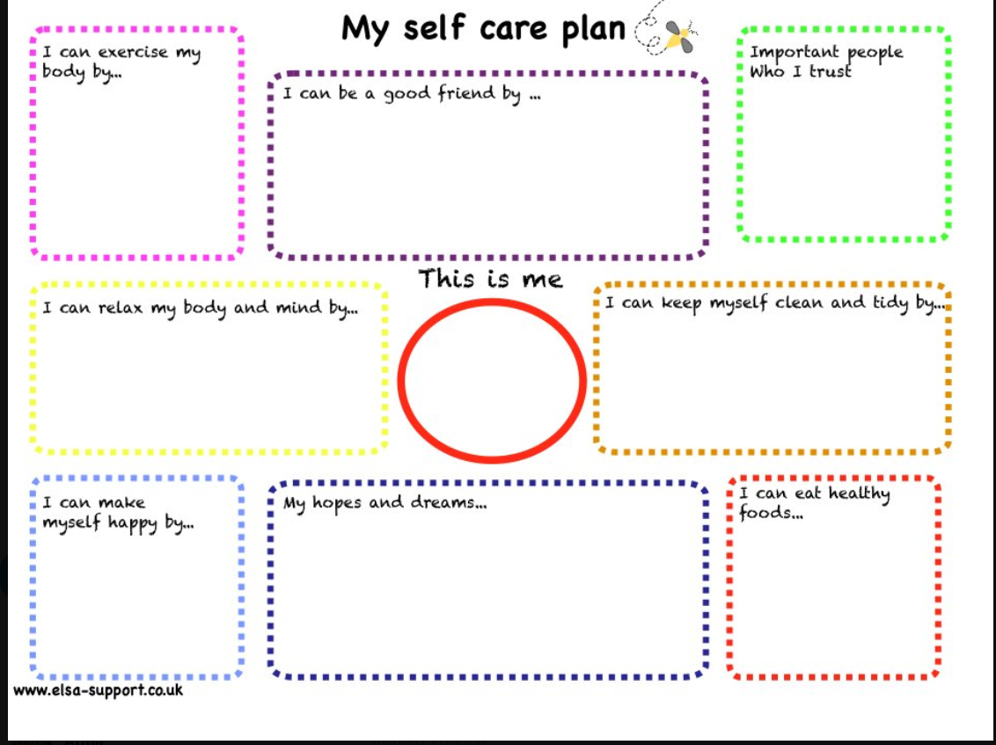
Help Students Create Their Self-Care Plan
Notes:
To Know and To Say: Help students create their self-care plan. If we don’t write it down and plan for it, we probably will not follow through. Make sure you incorporate into your classroom schedule a check in and discussion on how it is going! Here is one example you could use at the elementary setting. The self-care wheel in the adult self-care module can be used with secondary.

Slide 17
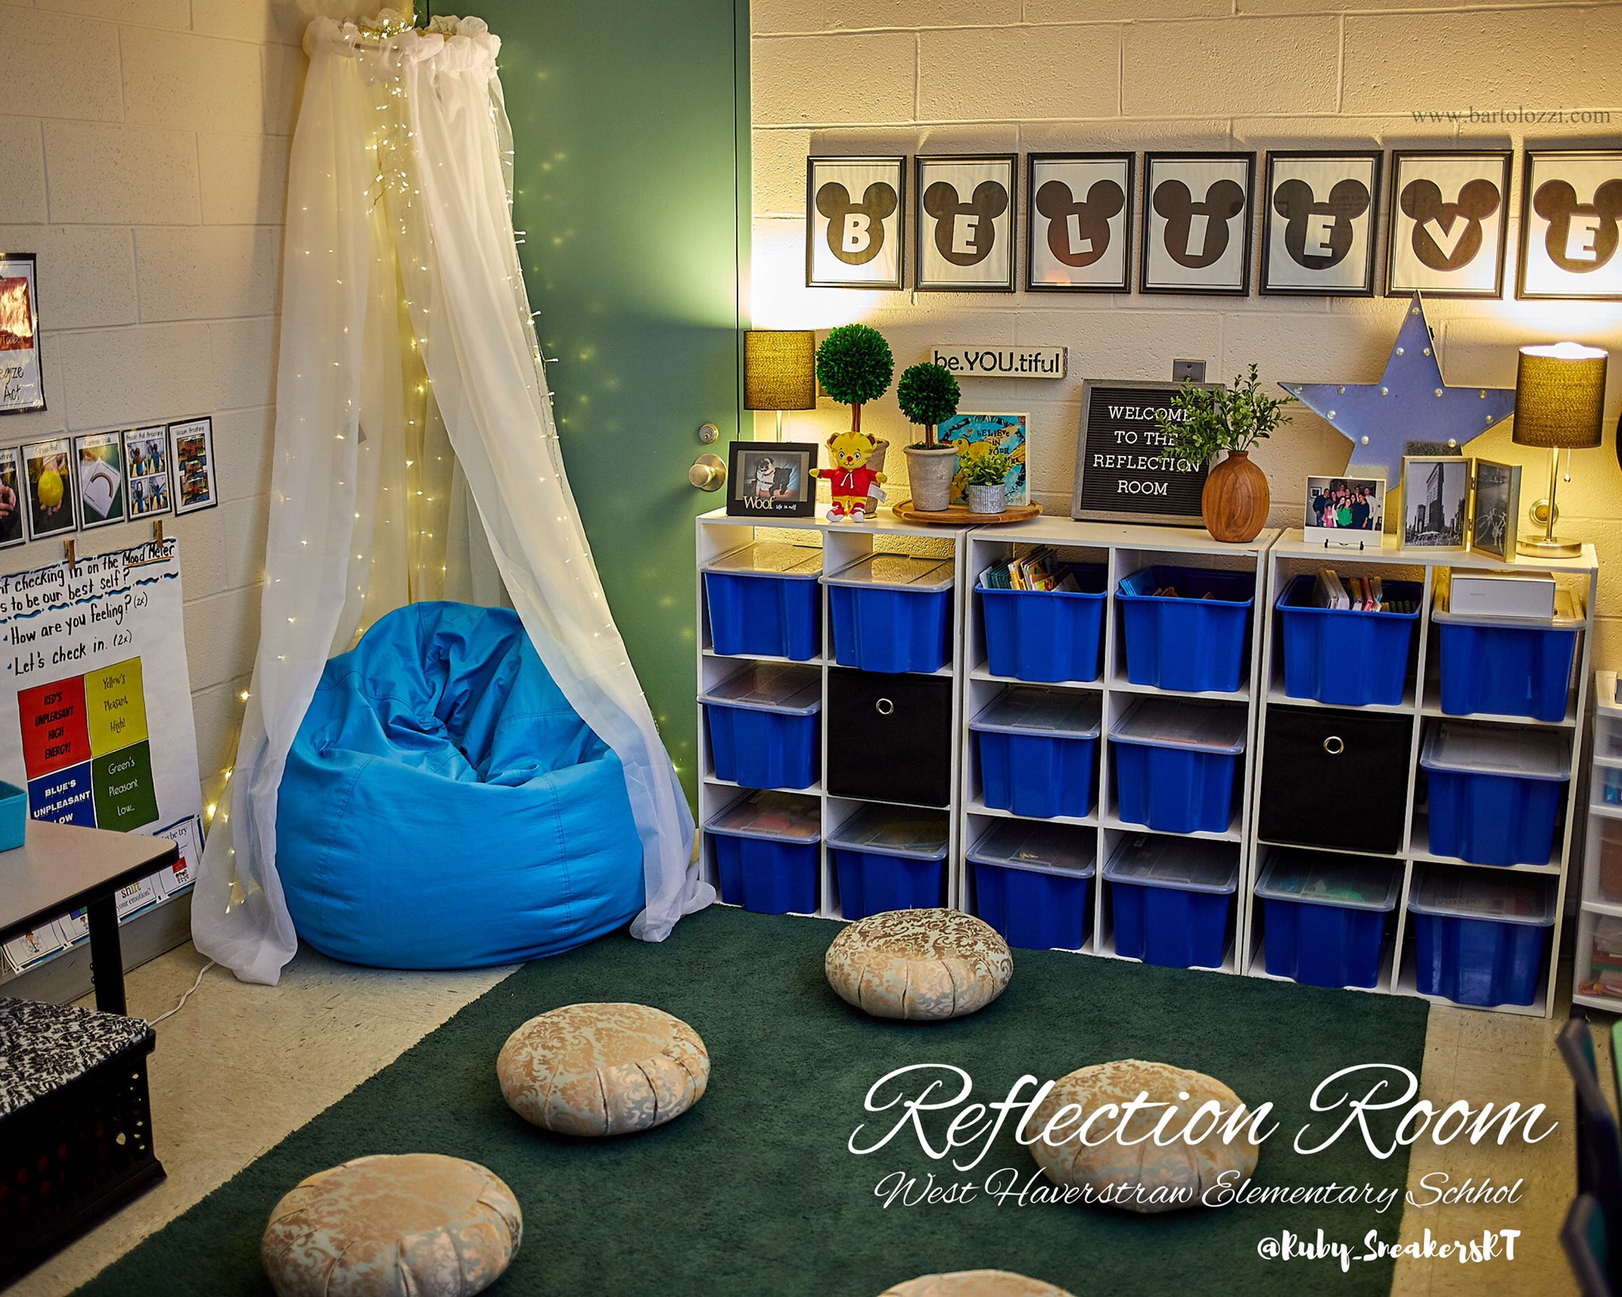
Self-Care Spaces
Peace corners
Talk it out tables
Don’t get mad, get glad cubbies
Chill corners
Notes:
To Know: There are many creative ideas on how to create self-care spaces. Use some of your own classrooms as examples for this.
To Say: Having a space in your room for self-care can help students with self-reflection and calming down when they are feeling stressed. Students corners can have fidgets, calming activities, strategy posters.

Slide 18
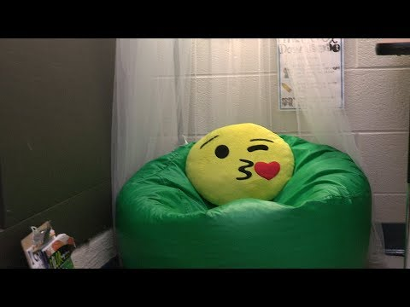
Elementary Example
https://www.youtube.com/watch?time_continue=11&v=dxBv1w4SQyw&feature=emb_logo
Notes:
To Know: This video is a little over 2 minutes
To Say/To Do: This is an elementary example of a peace corner. https://www.youtube.com/watch?time_continue=11&v=dxBv1w4SQyw&feature=emb_logo.
Resource: https://www.youtube.com/watch?time_continue=11&v=dxBv1w4SQyw&feature=emb_logo

Slide 19
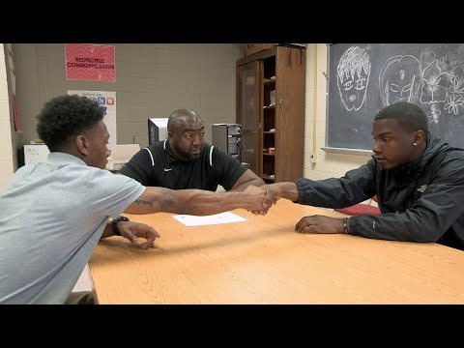
Secondary Example
https://www.youtube.com/watch?time_continue=1&v=YxC_Q8zE0SU&feature=emb_logo
Notes:
To Know: This video is a little over 3 minutes
To Say/To Do: This is an secondary example of a safe spaces.
Resource: https://www.youtube.com/watch?time_continue=1&v=YxC_Q8zE0SU&feature=emb_logo

Slide 20
Successful Use of Space
It’s important to introduce the space, model how to use it, and create a process on when and how to access.
Make sure you review how to access in your classroom, the routines and procedures, and remember to review/practice.
Notes:
To Know/To Say: We never want to create a space and just let our students use it without teaching them the importance of the space and how to use it by modeling and practicing. This can become part of your routines and procedures in the classroom. Having a sheet in the space for students to sign in can help to collect data on how often students are accessing it and if it is helping.

Slide 21
Brain Breaks
“A brain break is a short period of time when we change up the dull routine of incoming information that arrives via predictable, tedious, well-worn roadways. Our brains are wired for novelty. We know this because we pay attention to every stimulus in our environment that feels threatening or out of the ordinary. This has always been a wonderful advantage. In fact, our survival as a species depended on this aspect of brain development.” Lori Desautels
Notes:
To Know/To Say: Brain breaks are just what they sound like - a break from whatever it is that the student is focusing on. Short brain breaks can reduce stress and frustration and increase attention and productivity.
Reference: https://www.edutopia.org/profile/lori-desautels

Slide 22
Brain Breaks Continued
Link to Article
Invisible Pictures: Have a student draw a picture in the air while their partner guesses what it is. You could give them categories such as foods or places, or other ways to narrow the guessing.
Opposite Sides: Movement is critical to learning. Have students stand and blink with the right eye while snapping the fingers of their left hand. Repeat this with the left eye and right hand. Students could also face one another and tap the right foot once, left foot twice, and right foot three times, building speed they alternate toe tapping with their partner.
Notes:
To Know/To Say: The next two slides will give you several strategies on how to use brain breaks with your students.
Reference:https://www.edutopia.org/blog/brain-breaks-focused-attention-practices-lori-desautels

Slide 23
Brain Breaks Continued
Sound: The use of sound is very powerful for engaging a calm response. In the three classrooms where I teach, we use rain sticks, bells, chimes, and music. There are many websites that provide music for focus, relaxation, and visualization.
Free Apps: Research free mindfulness apps you can use in the classroom. One example is InsightTimer. There are websites like Go Noodle.
Notes:
To Know/To Say: These are additional strategies on how to use brain breaks with your students.
Reference:https://www.edutopia.org/blog/brain-breaks-focused-attention-practices-lori-desautels
Resources: https://insighttimer.com/
https://www.gonoodle.com/

Slide 24
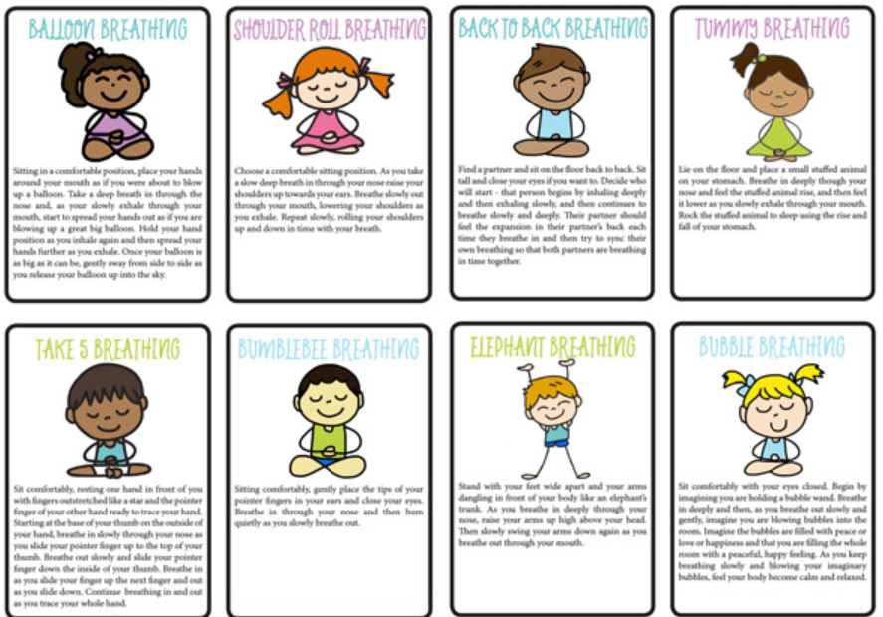
Breathing
Breathing cards, https://childhood101.com/fun-breathing-exercises-for-kids
Take 5, Video in Adult Self-Care Module
Fingertip Breathing, Video demonstration on next slide
Notes:
To Know/To Say: Your breath goes everywhere you go, so breathing is one of the easiest tools we can teach our students. Teaching different ways to breathe can help students slow down, relax, and take notice of how they are feeling.
Reference:
Resources: https://childhood101.com/fun-breathing-exercises-for-kids/

Slide 25
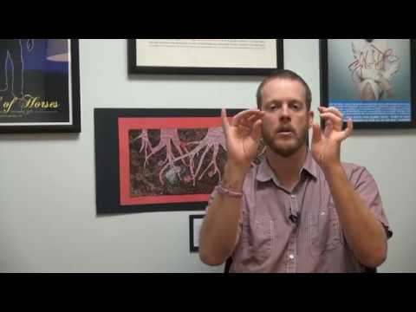
Let’s Practice
Example: Fingertip Breathing
https://www.youtube.com/watch?time_continue=16&v=biynm5sqEI4&feature=emb_logo
Notes:
To Know: This video is 2 minutes
To Say/To Do: This is an example that you can do with any age student. Practice this with your audience.
Resource: https://www.youtube.com/watch?time_continue=16&v=biynm5sqEI4&feature=emb_logo

Slide 26
Fidgets
https://www.youtube.com/watch?v=TsFY8sEA-Po&feature=emb_logo
Notes:
To Know: This video is under 2 minutes
To Say/To Do: Many people function under different circumstances. Fidgets are great way to get in the right frame of mind in order to stay focused or calm. Fidgets have been known to help students who suffer from anxiety to have something to play with keeps the focus off their anxious feelings. Even adults like to fidget. Next time you are in a staff meeting, look around, I am sure you will seem some creative fidgeters.
Resource: https://www.youtube.com/watch?v=TsFY8sEA-Po&feature=emb_logo

Slide 27
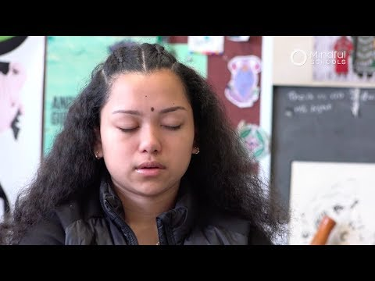
Meditation
https://www.youtube.com/watch?time_continue=1&v=u3jBjSs_cpk&feature=emb_logo
Notes:
To Know: This video is under 2 minutes
To Say/To Do: Watch this video and see how the teacher brought a quick medication practice into her classroom with her secondary students.
Resource: Meditation is a great way to build self-awareness and develop a strategy to manage stressors
https://www.youtube.com/watch?time_continue=1&v=u3jBjSs_cpk&feature=emb_logo

Slide 28
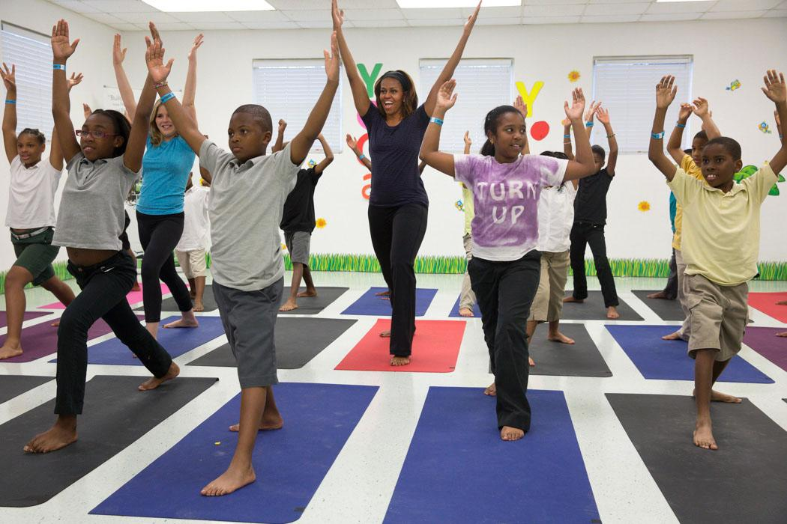
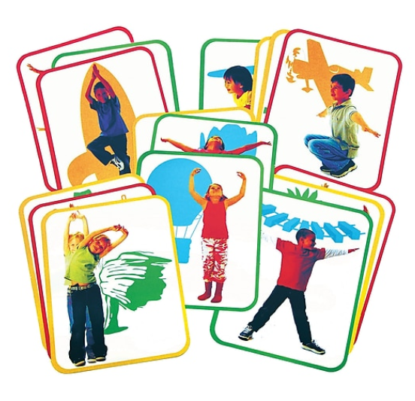
Trauma-Sensitive Yoga
Chair Yoga - quick stretches in the chair
Yoga Sequence - choose a few poses that students can do after a transition
Yoga posters or yoga cards
Notes:
To Say/To Do: : Research on school-based mindful yoga is still in its infancy. One study randomly assigned 112 high school students to participate in either yoga or PE twice per week for 45 minutes across the entire academic year. Among students who had high levels of participation, the yoga group ended up with a significantly higher grade point average (GPA) than the PE group. These are many ways you can practice yoga in the classroom. Remember to practice first before doing this with your students.
Resource: https://www.kidsyogastories.com/yoga-in-the-classroom/
Yoga Cards:https://www.amazon.com/Roylco-Poetry-Illustrated-Cards-Instructions/dp/B0017T2OJS

Slide 29
Self-reflection
Examples of self-reflective assessments:
Prompts: An inclusive prompt - students receive a question that is inclusive of everyone and evokes thought, but also connects to the lesson taught
Journals: Students submit entries in the form of a selfie video, or vlog, that can be uploaded to Canvas or another learning management system
A “gallery walk”: Students walk around the room observing and exploring the work of their fellow students.
Notes:
To Know/To Say: Journaling is a great way to write out your thoughts and feelings. You can also create a gratitude list in your journal to write out the things you are thankful for. This will help to shift your mind to think positive even during stressful moments

Slide 30
The Take Care of Me List
Students must fill a page with a list of specific things I could do as their teacher to take care of them as learners. I ask them to explain each item with a few sentences. I purposely don’t restrict the types of responses so that each list will give me the true flavor of each student’s personality.
Link to Article
Notes:
To Know: It’s important to get to know your students. This will help you understand what calms and relaxes them.
To Say: Here is an example of how you can get to know your students.
Reference: https://www.edutopia.org/article/take-care-me-list

Slide 31
Practice
Instructions: Identify one of the strategies we have discussed (or one of your own ideas) that you would like to try. Pick something that will take relatively little effort to implement.
–Think about particular students you would like to use the strategy with
Why did you pick the strategy you did?
How would you put it in place or get started?
How would you practice it? Or how would your students practice it?
What will your immediate next steps be?

Slide 32
Team Talk: Review the “How”
How will you adjust your practices to support learning for students who have experienced trauma?
How will you involve families and students in practices?
Fill this in on your Action Plan under “Objectives and Action Planning”
Notes:
To Know: Action planning supports engagement in the work and next steps
To Say:
We’ve now completed the module “Self Care in the Classroom”. This your time to pause and reflect on the “how”. How will you adjust your practices to support learning for students who have experienced trauma?Please fill this in on your action plan under objectives and action planning.
Handout: Action Planner

Slide 33
Resources: Hyperlinks Available
Take Care of Me Article
Go Noodle
InsightTimer
Edutopia Resources
Record Numbers of College Students Are Seeking Treatment for Depression and Anxiety — But Schools Can't Keep Up
Mindfulness in High School
Video: Peace Corner: Creating Safe Space for Reflection
Video: De-Escalation Spaces: Helping Students Manage Emotions

Slide 34
Resources Continued
Energy and Calm: Brain Breaks and Focused-Attention Practices
Video: Mindful Breathing: Fingertip Breathing Exercise
Video: Rosa Parks Elementary Receives Classroom Fidgets
Video: "Arrive" - A Mindful Minute Helps Students Arrive in the Classroom
How to Get Started with Yoga in the Classroom
Roylco Body Poetry Illustrated Yoga Cards with Instructions - 8 1/2 x 11 inch - Set of 16

