Slide 1
Hidden Slide #1
This Module was designed to be used in the following manner.
The audience for this Module is division and school teams.
This Module is meant for whole staff, team, and division presentations.
Following this training, participants should complete the Action Plan document to determine next steps.
There are eight sections in this module. Teams are not required to complete all components of the Modules. Instead, participants will complete only those Modules that fit the needs of their school.
Notes:
Module 1 is divided into several sections. Each section can be completed in 30 minutes or less.

Slide 2
Hidden Slide #2
In person training
Presenter notes and information
Notes:
In-person training suggestions
The Trauma Sensitive Environments Module in-person training should take about 30 - 60 minutes in its entirety.
This presentation provides the basics of trauma and trauma sensitive schools. You may want to add or enhance portions with visuals and examples that will resonate with your audience. As a reminder, always be sure to include appropriate citations when adding resources. Also, you might look to the resources and activities sections for additions that may be helpful.
In summary
This module outlines the basics of trauma and trauma sensitive schools
It can be adapted to individual contexts
The training should last about 30- 60 minutes.
Presenter notes information
Presenter notes are included in the PowerPoint. Background information for the presenter is shown as “To Know.” Statements to be shared with participants are shown as “To Say.” In some instances, the “To Know/To Say” are combined.The presenter notes also include “To Do” prompts and cues for “Handouts”.
Additional activities, examples, videos, etc. are being developed. A presenter may add material from the resources and activities section on the website.
Breaks should be inserted at the discretion of the presenter based on the needs of participants.

Slide 3
Hidden Slide #3
Supplies needed
WIFI access for presenter and participants
Access to videos (through WIFI if available, but download to flash drive as a back-up)
Chart paper
Markers
Post-it-Notes
Notes:
To Know
These supplies are needed for the Trauma Professional Learning Modules.

Slide 4
Hidden Slide #4
Handouts for this Module
Action Planner
Notes:
To Know
The Participant and Presenter Materials are located on the vtss-ric website.
References

Slide 5
Trauma Sensitive Environments
Notes:
To Know:
VTSS Professional Learning Modules are organized in the same manner. All schools can begin their journey with Module 1 which introduces the foundational knowledge around trauma and trauma sensitive schools. This powerpoint is part of Module 4 that shares strategies on how we create trauma-sensitive, safe and supportive schools.
To Say:
Welcome to the learning module, “Trauma Sensitive Environments”. Let’s get started!

Slide 6
What We Will Know and Do
Understand what a trauma sensitive classroom/school looks like
Explore some strategies to make your classroom/school trauma sensitive
Discuss discipline strategies that support students who have been impacted by trauma
Notes:
To Know:
Go over the learning intentions targeted for this session
To Say:
During this module we hope you will begin to understand what a trauma sensitive classroom or school looks like. We are going to share a few strategies that can be implemented to make your classroom or school trauma-sensitive.

Slide 7
What this look like
“A trauma-sensitive school is a safe and respectful environment that enables students to build caring relationships with adults and peers, self-regulate their emotions and behaviors, and succeed academically, while supporting their physical health and well-being.”
(from the Trauma Sensitive Checklist)
Notes:
To Know: We want all individuals, students, teachers, staff and family members, to feel safe and welcomed, as well as supported in our classrooms/schools.
To Say: Trauma sensitive schools help all students to feel safe to learn. The environment is described as welcoming and respectful and provides social-emotional supports so that students can be successful in the classroom setting.

Slide 8
Why this matters
In Virginia, 19% of children
have experienced two or
more ACES (Voices of
Virginia Fact Sheet)
Trauma-sensitive environments are best practice for all students
Notes:
To Know/Say: There is a high incidence of students who experience trauma in our schools. Trauma sensitive environments are beneficial for all students.

Slide 9
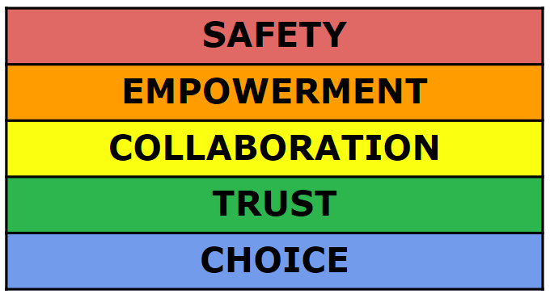
Trauma Sensitive Care Values
Notes:
To Know: There are five guiding principles associated with trauma-sensitive environments.
To Say: These five principles are important to consider when creating a trauma-sensitive environment:
SAFETY: This includes creating spaces where people feel culturally, emotionally, and physically safe as well as an awareness of individual’s discomfort or unease.
Going back to Maslow’s work, we are not going to get anywhere with a child’s education when they don’t feel safe.
Despite what we may like to believe, we have to remember that we do not get trust by default, we have to earn it.
This is especially relevant in education when working with children who have experienced terrible things at the hands of the adults that were supposed to protect them from harm.
EMPOWERMENT-This includes the recognition of an individual’s strengths. These strengths are built on and validated.
To what extent do our activities and setting provide opportunity for skill building and the opportunity to practice those skills?
How often do we give children and school staff a chance to practice those things we tell them they should be doing and hopefully have been teaching/coaching them through?
COLLABORATION: This includes the recognition that collaboration happens in relationships and partnerships with shared decision-making.
We spend way too much time as adults coming to solutions that are ill informed because they do not involve the major players in the approach…the child, the family and the community as a whole in addition to school professionals.
Use student voice: student led, vocabulary/comprehension/native language
We should not wait until we see challenging behavior.
One, because that isn’t proactive, and
Two because some of the kids that need our help fall under the radar because they don’t display challenging behavior (which we will continue to learn about throughout our modules.
TRUST-This includes the recognition of the need for an approach that honors the individual’s dignity.
Despite what we may like to believe, we have to remember that we do not get trust by default, we have to earn it.
This is especially relevant in education when working with children who have experienced terrible things at the hands of the adults that were supposed to protect them from harm.
In order to gain trust, the people and the environment must be predictable.
As adults, we do as we say we are going to do.
If we say we will keep the child (in many cases this is true also of our colleagues working with these students) safe and treat them with dignity and respect, we do that.
Our interventions for when things are not going as well have to reflect this as well.
This also speaks to the importance of the approach being school wide, not just with certain adults or classrooms.
CHOICE-This includes the meaningful sharing of power and decision-making. Transparent operations and decisions maintain trust. Ensure trustworthiness through clarity and consistency in all actions.
In a trauma sensitive school, we want to embed choice whenever we can.
Choice and collaboration tie in together as both emphasize the significance of student involvement and voice.
Often, the more intense and challenging that the behavior gets, the more decisions adults tend to make for the child.
this tends to intensify the challenging behavior because this is something that has been stripped from the lives of children who have experienced developmental trauma.
Additional Resources:
https://www.acesconnection.com/blog/values-for-a-trauma-informed-care-culture-in-your-classroom-and-school

Slide 10
Create safe learning environments
encourage and value student voice
make learning fun and rigorous
share fun facts and anecdotal info
have students create plays, songs/raps, etc. around content
communicate mistakes are okay; learning through trial and error
share with students when you make mistakes
Notes:
To Know/To Say: As we move forward, we will begin to explore strategies to make your classroom/school trauma sensitive. Many of these strategies may already be used, but sometimes we might need to be more intentional about the consistency in which they are implemented. We create safe learning environments through student voice and engagement. Also, it is important to be open and honest with students, sharing that adults are human and sometimes struggle and make mistakes too, and that it is okay.

Slide 11
Develop Relationships
Share who you are and your goals for working with students
Get to know student’s interests, dreams, and gifts by having 1:1 conferences with students.
use bulletin board space
to share student’s work,
dreams or something
about them
Notes:
To Know: Building relationships is one of the most important things staff can do to create trauma sensitive environments. There is a module that expands on relationships.
To Say: Developing relationships with your students is a great way to build a warm and welcoming classroom environment. When students feel connected it builds safety and trust. There are many ways in which we can build relationships with our students. We can start by sharing information about ourselves! With some students, building relationships will be easy, but with others, you may need to be more intentional. Students who have experienced trauma often do not trust adults, and might push you away. It is important that you continue to try to connect with all students.

Slide 12
Empower Students
use language that gives students a sense of accomplishment
use growth mindset…”not yet”
have high expectations for all students
make yourself available to help students reach their goals
give students responsibilities/”jobs”
Notes:
To Know/Say: We want to have high expectations for all of our students, and approach learning with a growth mindset. Individuals with a growth mindset believe they are capable of learning nearly anything if they work hard and accept failures and challenges as opportunities to grow. Encourage students, provide support and praise students for their effort. Be cognizant of the language we are using with our students so that we are acknowledging their progress towards the end goals.

Slide 13
Use Positive Language
communicate by telling
students what you want
them to do
reframe student’s negative language
When a student says “I can’t”, ask “what have you done so far?” or “Let’s hear what you are thinking, maybe that is where you are stuck.”
Praise for effort and perseverance
Notes:
To Know: Words are powerful and can have a huge impact on developing relationships and a trusting environment for the students.
To Say: How we use language can have a huge impact on others. The use of positive language, telling students what you want them to do, helps them to understand the end goal. Going back to growth mindset, we want to praise for effort and perseverance. It is also important to reframe student’s negative comments to a more positive phrase, which communicates a tone of trust and caring.

Slide 14
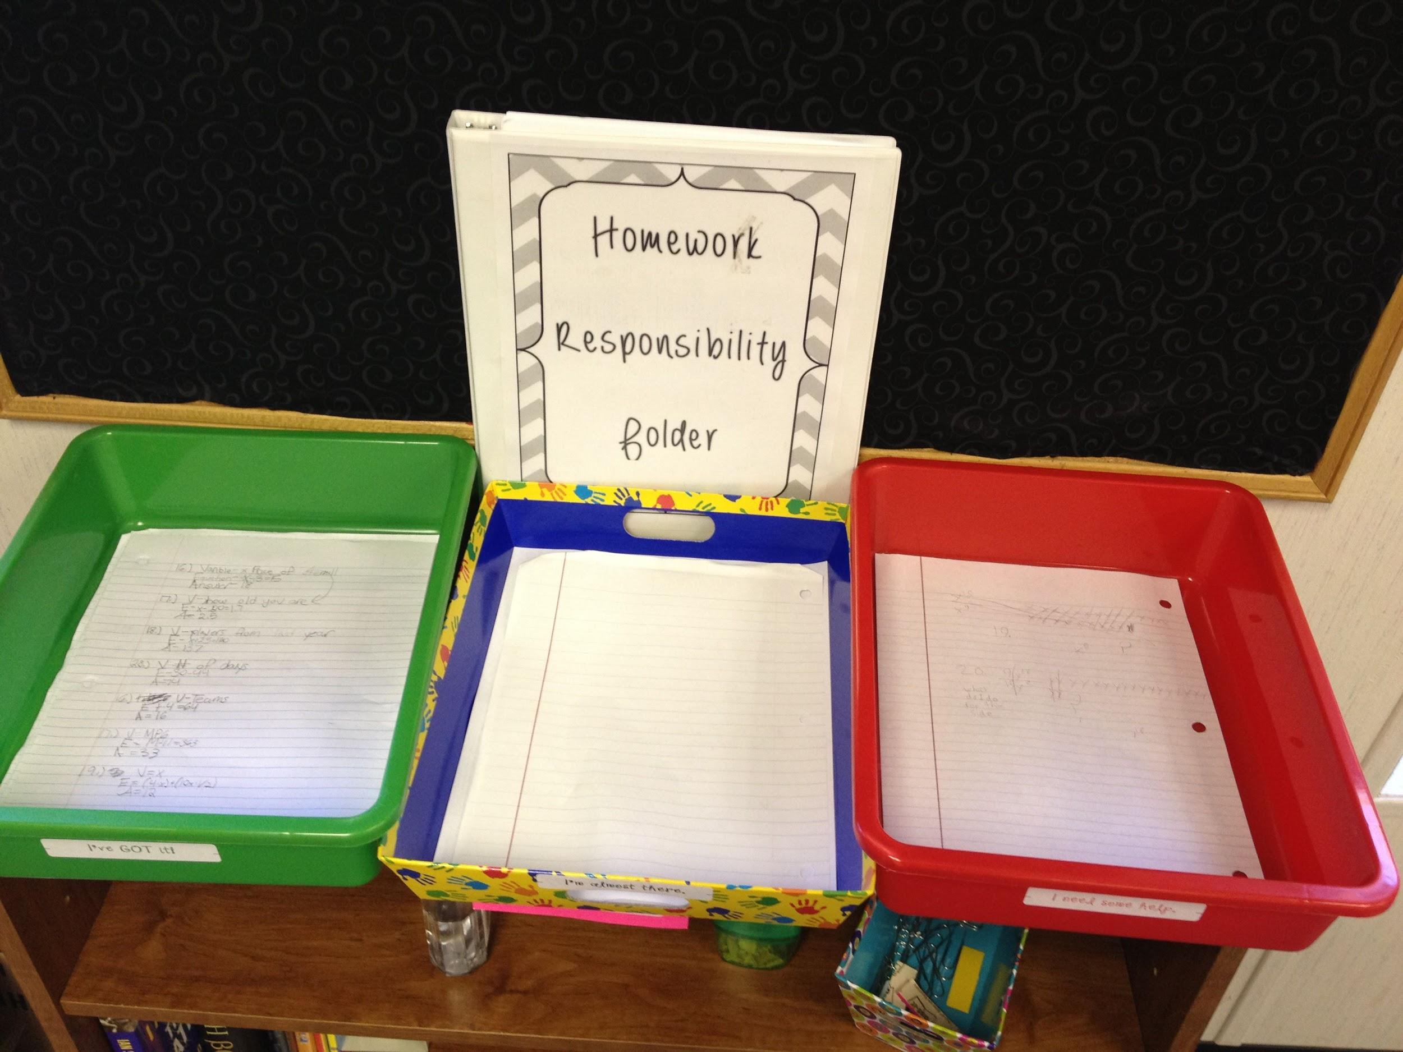
Establish Routines and Procedures
post daily agendas
teach students procedures around sharpening pencils, collecting homework, transitioning to activities, etc.
create “call backs” or
signals to gain class
attention
Notes:
To Know: Routines and procedures create predictability and safety for students who have experienced trauma.
To Say: Routines and procedures create predictability and safety for students who have experienced trauma.When we provide clearly defined routines and procedures, students know what to expect. Reducing the stress of the unknown helps students to operate in a state of calm. Strategies to support students include posting daily agendas, using visual cues, establishing routines for classroom activities and transitions, and using signals to gain the attention of the class.

Slide 15
Be Consistent
consequences for inappropriate behavior are clearly communicated and applied fairly
students are encouraged
to share if they feel they
are not treated fairly
Notes:
To Know: Consistency is important in establishing safety and trust with individuals.
To Say: When things are consistent, students do not need to worry about what will happen. It is important to have clear consequences for inappropriate behavior which are clearly communicated to the class. Thus, the consequence isn’t person, it becomes the standard for the class. It is important to establish open communication with the students so that they are able to speak up if they do not feel that they are treated fairly. Staff should be aware of the perceptions of the students and have conversations with them, to increase the level of trust within the classroom.

Slide 16
Discussion
Think about what you already do to create trauma sensitive environments.
What you can be more intentional about doing so that all students feel safe and supported?
Notes:
To Know: Teachers are already implementing many strategies which are trauma sensitive. They may want to evaluate their current practices and determine if there are areas for improvement.
To Say: Take a few minutes to think about what you are already doing in your classroom or school to create trauma sensitive environments. There are likely many things that you do every day, but are you consistent? Think about what strategies you can be more intentional about implementing to make sure that all students feel safe and supported.

Slide 17
School-wide Discipline
School discipline practices are positive, respectful, and restorative
Retraumatizing practices are avoided (e.g., harsh, punitive approaches, isolation and disconnection from the community)
Communication procedures include respecting confidentiality, being aware of triggers for students and caregivers, focusing on how issues are addressed information is shared
Notes:
To Know: Many students who have experienced trauma display challenging behaviors in the school setting. There are strategies that can help to support students
To Say: A safe and supportive school environment, that emphasizes relationships, is the key to addressing behavioral challenges. When schools are trauma sensitive, their discipline practices are positive, respectful and restorative. It is important that we respect the privacy of any information that is shared about a student, and work to avoid triggers. We want to ensure that we do not retraumatize the student by the use of punitive and exclusionary practices.

Slide 18
Negative Effects of Suspension
“Frequent out-of-school suspension does not produce better learning environments, deter future misbehavior, or stimulate effective parental involvement.”
https://all4ed.org/reports-factsheets/climatechange2/
Notes:
To Know/Say: Research has shown that out of school suspension is not effective in changing behavior. Instead, suspension and expulsion:
place students at risk for dropping out;
are being applied disproportionately to students with disabilities and African American students;
fail to address the underlying reasons for the behavior;
do not consider the social-emotional development or environmental influences;
decrease academic engagement;
decrease academic achievement; and
for some, create a pathway to prison rather than to college and a career.

Slide 19
Policies and Practices that Work for Students
School-wide Positive Behavior Intervention and Supports (SWPBIS)
Restorative Justice
Social-Emotional Learning
Using Early-Warning Indicator Systems to Identify and Respond to Discipline Issues
Notes:
https://all4ed.org/reports-factsheets/climatechange2/
To Know/Say: There are several practices that benefit all students and provide a more equitable and supportive system of school discipline, all while keeping at-risk students engaged and in school. These include Positive Behavior Intervention and Supports (PBIS), Restorative Justice, Social-Emotional Learning and the use of Early Warning Systems. All of these practices can be used within a singular framework to support student.

Slide 20
Creating a school-wide system
Proactive with clearly stated expectations
Expectations are understood by all
Expectations are taught and retaught
Acknowledgement for meeting expectations at a 5:1 ratio
Supports are increased when student doesn’t respond
Data is monitored and decisions are based on data
Notes:
To Know/Say: School discipline policies are trauma-informed when they: Balance accountability with an understanding of traumatic behavior; Teach students the school and classroom rules while reinforcing that school is not a violent place and abusive discipline (which students who have experienced trauma may be accustomed to) is not allowed at school; Minimize disruptions to education with an emphasis on positive behavioral supports and behavioral intervention plans; Create consistent rules and consequences; Model respectful, nonviolent relationships. Communication procedures and protocols are trauma-informed when they: Respect confidentiality; Involve open communication and relationship-building with families; Ensure ongoing monitoring of new policies, practices and training.

Slide 21
Focus Prevention
look for patterns of behavior
identify triggers
identify early warning signs of escalation
develop a plan to support the student
Notes:
To Know/Say: We can focus on prevention by using data to determine patterns and identify triggers and early signs of escalation. Be proactive in providing supports for students who may be experiencing problems. Many times changing the environment will have a positive impact on student’s behavior. For some students, it may be necessary to develop a formal support plan.

Slide 22
Change Mindset
“what happened to you” instead of “what’s wrong with you”
assume students are doing the best they can
avoid “criminalizing” children
Notes:
To Know/Say: One of the most important changes that can be made is to switch mindset and instead of asking/thinking “what’s wrong with you”, ask/think “what happened to you?” This thinking sets us up to investigate what is actually going on with the student.

Slide 23
Avoid Exclusionary Discipline
Implement restorative practices
Utilize ISS as an opportunity to work with the student to identify supports and alternative responses/behaviors
Notes:
https://www.elc-pa.org/wp-content/uploads/2015/06/Trauma-Informed-in-Schools-Classrooms-FINAL-December2014-2.pdf
To Know/To Say: School discipline policies are trauma-informed when they: Balance accountability with an understanding of traumatic behavior; Teach students the school and classroom rules while reinforcing that school is not a violent place and abusive discipline (which students who have experienced trauma may be accustomed to) is not allowed at school; Minimize disruptions to education with an emphasis on positive behavioral supports and behavioral intervention plans; Create consistent rules and consequences; Model respectful, nonviolent relationships. Communication procedures and protocols are trauma-informed when they: Respect confidentiality; Involve open communication and relationship-building with families; Ensure ongoing monitoring of new policies, practices and training.

Slide 24
Link to Mental Health Professionals
Refer to School Psychologist, School Counselor or School Social Worker for support
Refer to community providers to provide therapy and wrap-around services
Notes:
To Know/Say: Some students who have experienced trauma will require additional supports from specialists. Link students to school staff, such as school counselors, school psychologists or school social workers. Many schools also work closely with community agencies who can provide additional support to students.

Slide 25
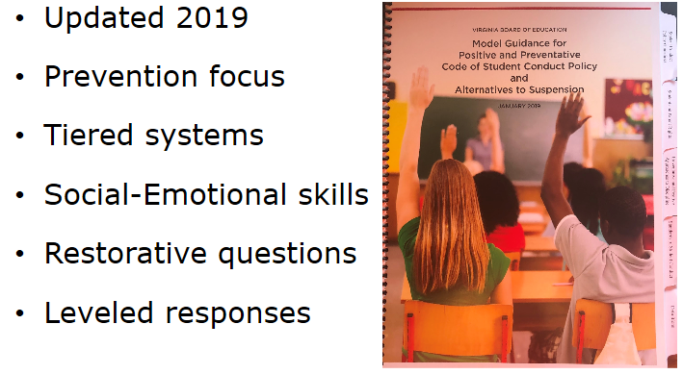
Virginia’s Model Code of Conduct
Notes:
To Know: The Virginia Department of Education has released a new guidance document around the Code of Conduct (January 2019).
Link to Model Code: http://www.doe.virginia.gov/support/student_conduct/code-of-conduct.docx
To Say: The VDOE has released Model Guidance on the Code of Conduct. It has been revised to provide guidance for creating safe, supportive, effective learning environments, address data inequities in outcomes for children of color and students with disabilities and reduce exclusionary approaches to discipline
The focus of the model code is on prevention, and it encourages an instructional model to address behavior. It incorporates understanding “what happened” to the student, assessing skill deficits based on CASEL’s five competencies, determining academic and behavioral instruction, as well as sanctions, to address behavior, and utilizing restorative practices.

Slide 26
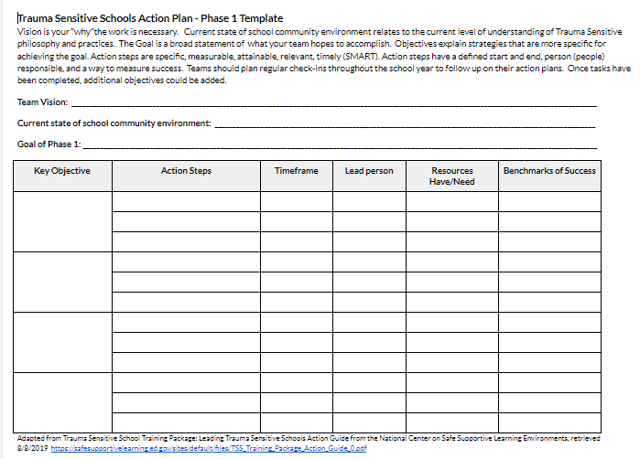
Action Planning
Notes:
To Know: Action planning supports engagement in the work and next steps
To Say: We’ve now completed the module “” . This your time to pause and reflect on the “how”. Are you ready to engage in the work? How will you begin implementation of the work? Please fill this in on your action plan under objectives and action planning.

