Slide 1
Module Introduction
Welcome to our on-line trauma learning modules for Virginia Tiered Systems of Supports. We believe that becoming a Trauma-Sensitive School is a journey. Throughout this journey will provide you tools to develop the systems to gain knowledge, to build practices, and to have the skills to support a Trauma-Sensitive School. Your professional journey includes engaging and practical learning modules. Within the learning modules you will interact with content that is focused on developing a Trauma Sensitive School. Supplemental activities, resources, and an action planner are included to help guide your implementation. Videos from experts and division staff implementers are also included with each module to enrich your experience.
Finally, our six modules are focused on the following topics: Module 1: Introduction to Trauma and Becoming a Trauma-Sensitive School; Module 2: Families and Communities as Partners; Module 3: How Trauma Impacts Learning; Module 4: Strategies and Classroom Practices (academic, social emotional learning, trauma-sensitive environments, regulation, cognitive problem solving, relationships, school wide discipline, self care); Module 5: Implementation and Systems; Module 6: Resilience.

Slide 2
Hidden Slide #1
This Section of the Learning Module 6 was designed to be used in the following manner.
The audience for this Module is division and school teams, families, communities.
This Module is meant for whole staff presentations.
Following this training, participants should complete the Action Plan document to determine next steps.
There are two sections in this module. Teams are not required to complete all sections of the learning modules. Instead, participants will complete only those sections of the learning modules that fit the needs of their school.
Notes:
This section of Learning Module 6 is designed to be completed in 30 minutes to 1 hour.

Slide 3
Hidden Slide #2
In person training
Presenter notes and information
Notes:
In-person training suggestions
The Resilience Module in-person training should take about 1 hours in its entirety. This presentation provides the basics of resilience. You may want to add or enhance portions with visuals and examples that will resonate with your audience. As a reminder, always be sure to include appropriate citations when adding resources. Also, you might look to the resources and activities sections for additions that may be helpful.
In summary
This module outlines the basics of resilience
It can be adapted to individual contexts
The training should last about 1 hour for the entire module
Presenter notes information
Presenter notes are included in the PowerPoint. Background information for the presenter is shown as “To Know.” Statements to be shared with participants are shown as “To Say.” In some instances, the “To Know/To Say” are combined.The presenter notes also include “To Do” prompts and cues for “Handouts”.
Additional activities, examples, videos, etc. are being developed. A presenter may add material from the resources and activities section on the website.
Breaks should be inserted at the discretion of the presenter based on the needs of participants.

Slide 4
Hidden Slide #3
Supplies needed
WIFI access for presenter and participants
Access to videos (through WIFI if available, but download to flash drive as a back-up)
Chart paper
Markers
Post-it-Notes
Notes:
To Know
These supplies are needed for the Trauma Professional Learning Modules.

Slide 5
Hidden Slide #4
Handouts for this Module
Action Planner
Notes:
To Know
The Participant and Presenter Materials are located on the vtss-ric website.

Slide 6
Hidden Slide #5
Key Terms in This Module:
Resilience
Growth mindset
Adversity
Competence
Confidence
Connection
Character
Contribution
Coping
Control
Notes:
To Know
These are the key terms used throughout the module.

Slide 7
Resilience
Notes:
To Know:
VTSS Professional Learning Modules are organized in the same manner. All schools can begin their journey with Module 1 which introduces the foundational knowledge around trauma and trauma sensitive schools. This powerpoint is part of Module 6 that discusses resilience and strategies to help students develop resilience.
To Say:
Welcome to the learning module, “Resilience”. Let’s get started!

Slide 8
What We Will Know and Do
Understand the components of resilience.
Leave with strategies or techniques that you could try in the classroom to support your students in developing resilience.
Notes:
To Know:
Go over the learning intentions targeted for this session
To Say:
During this module we hope you will gain an understanding of the importance of resilience, as well as provide strategies to help build resilience within your students.

Slide 9
Resilience Defined
Resilience is the process of adapting well in the face of adversity, trauma, threat of significant sources of stress - such as family and relationship problems, serious health problems or workplace and financial stressors.
American Psychological Association
Notes:
To Know: Supportive relationships and teaching resilience skills can mitigate the effects of ACEs.
To Say: We shouldn’t have a conversation around trauma or adverse experiences without mentioning it’s nemesis, Resilience. As cliche as it may be, it is still our reality, that Resilience DOES trump ACEs and that is the thought we would like to leave everyone with this. While there is a plethora of headlines regarding the origins of resilience, we would be naive to learn about all of the neuroscience thus far and not recognize the role that environment or the Nurture in Nature vs. Nurture plays in fostering resilience.

Slide 10
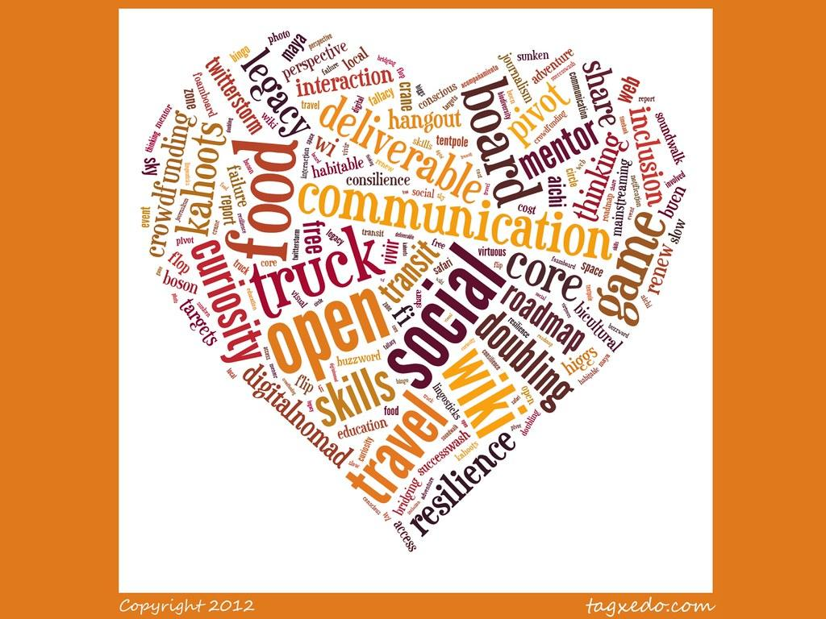
Why Do We Need Resilience?
Notes:
To Do: Activity - Create a word cloud around “Why do we need resilience?”
To Say: Some other things to consider: Greater resilience leads to improved outcomes learning and academic achievement. Resilience is related to lower absences from school due to sickness. It contributes to reduced risk-taking behaviors including excessive drinking, smoking, and use of drugs. Resilience makes us stronger and better able to cope with life’s problems.

Slide 11
Characteristics of Resilient People
The ability to set goals
Close and secure attachment to others
A sense of self-efficacy and perceived control
Good self-awareness and emotional management
The ability to express gratitude and appreciation
Adaptable
Notes:
To Know/To Say: These are just some characteristics of resilient people. Resilient people believe that the actions they take will affect the outcomes of an event. It is important to feel that they have a sense of control and the power to make choices. When a problem arises resilient people are able to work out a solution that will lead to a safe outcome. They are able to calmly and rationally problem solve. Social connectivity is key for resilient people. Having people in your corner to offer support is a great way to talk about the challenges you are facing, gain perspective, and express emotions. Resilient people understand that life is full of challenges and they can remain flexible and willing to adapt to change. Increasing your resilience takes time and intentionality.

Slide 12
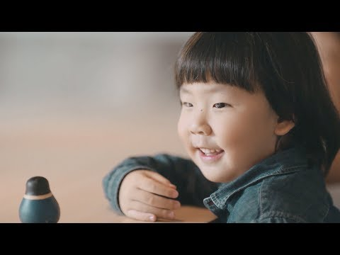
A Lesson on Resilience
Notes:
To Know: This video is under 2 minutes - https://youtu.be/sKpBJjsZ7EE
To Say: This video teaches students how to embody the word resilience by teaching them how to bounce back no matter how many times they get knocked down.

Slide 13
Adversity
“It’s your reaction to adversity, not adversity itself that determines how your life’s story will develop.”
– Dieter F. Uchtdorf
Notes:
To Know/To Say: Bouncing back is the ability to cope with adversity or hardship. Bouncing back means that people can carry on, and even flourish, after setbacks. When facing adversity, mental health is going to be of the most importance. Having strong resilience makes you likely to cope better with challenges that may come your way.

Slide 14
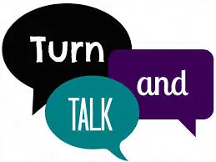
Discussion
Why is it becoming harder for young people to bounce back after setbacks?
As we proceed, think about some ways that you can help your students or children bounce back.
Notes:
To Know: This activity can be done with families and school staff
To Do: Have participants work through these questions.

Slide 15
Strategies for Fostering Resilience
Notes:
To Know: Transition Slide
To Say: We will now explore some specific strategies for fostering resilience.

Slide 16
Activity: Everyday Strategies for Building Children’s Resilience
What are things that you do in your classroom every day that help build your student’s resiliency?
Notes:
To Do: Have participants talk about the question above.
To Know/To Say:
Remind children that it’s OK for them to ask for support
Brainstorm with them about where and who they can go to when they need support
Talk to children about when they might need support, such as when something bad happens, when they’re going through a difficult time, or when they need to talk to someone about how they’re feeling
Explain to children that facing challenges in life can be useful – they help us grow as a person and give us knowledge and skills that make us better prepared the next time something challenges us
Provide children with opportunities to practice empathy
Encourage children while undertaking a challenging task
Promoting environments that support a child’s sense of belonging
Brainstorming with children about how they can support their friends during a challenging time
Incorporate mindfulness, breathing activities or other relaxation techniques into everyday routines and activities in educational settings
Reading and discussing diverse stories to students about people who have overcome difficult situations

Slide 17
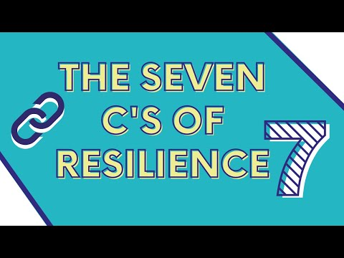
The 7 Cs of Fostering Resilience
Confidence
Competence
Connection
Character
Contribution
Coping
Control
Notes:
To Know: The 7 Cs are an adaptation from The Positive Youth Development movement. Rick Little and colleagues at The International Youth Foundation first described the 4 Cs of confidence, competence, connection, and character as the key ingredients needed to ensure a healthy developmental path. They later added contribution because youth with these essential 4 characteristics also contributed to society. The additional two C’s – coping and control – allow the model to both promote healthy development and prevent risk
To Say: Pediatrician Kenneth Ginsburg developed the 7 Cs model to provide a practical approach for families and communities to prepare children to thrive.
To Do: Watch video - 7 minutes https://youtu.be/DTmi4kHor_s
Resource: https://youtu.be/DTmi4kHor_s

Slide 18
Confidence & Competence
Focus on strengths
Provide Behavior Specific Praise
Set goals to gives a sense of accomplishment, hope, competence, and confidence
Personal Goals
Contribution Goals
Collective Goals
Notes:
To Know: Confidence is the solid belief in one’s own abilities. Competence is the ability to handle situations effectively.
To Say: As educators and families it is important to acknowledge young people's achievements but we need to go further and encourage the development of personal qualities like integrity, kindness, and fairness. Praise is a powerful tool to engage and motivate our children and it is even more effective when it is specific feedback. To give behavior specific praise, you clearly tell students what they have done correctly. You can also use this evidence based strategy at home.
In PBIS (Positive Behavior Intervention Supports), we talk a lot about feedback and acknowledgment. When we highlight what young people are doing well and give them an opportunity to acquire new skills, they start to feel competent. As families, it is sometimes hard when we see our children failing at something. We undermine competence when we prevent young people from trying new things or recovering on their own when they fail at something. We want to focus on strengths but also let them learn from their mistakes. It is helpful in the classroom to break lessons into chunks so that students have an opportunity to understand and practice what they are learning. We also want them to feel some ownership over this learning.
It is also important for us to help our student develop skills to maintain a positive self-image. To begin with, it is important to help them set goals. Setting goals and achieving them gives a sense of accomplishment, competence, hope, and confidence. Students can practice setting personal goals, contribution or service oriented goals, and collective goals. Collective goals allow groups of students to work together and build a sense of accomplishment through community.

Slide 19
Change in Mindset
Resilience incorporates a shift from a problem-based deficit model to a strengths-based one.
This model of resilience is positive, protective, and preventive.
Notes:
To Know/To Say: Being strength-based suggests that the way we interact and respond to children is rooted in the way we view them.When focusing on building resilience we must maintain a positive focus even when children are difficult for us to understand. When children exhibit challenging behaviors, deficit mindsets are more prevalent. Some examples of this would be:
Deficit-Based Thinking
What’s wrong with him?
Look at her behavior.
That student doesn’t even want my help.
Punishment will get his attention.
Strength-Based Thinking
What’s right with him?
I wonder what is making her act that way?
Caring people will get their attention.
If we give him a chance, he could go far!

Slide 20
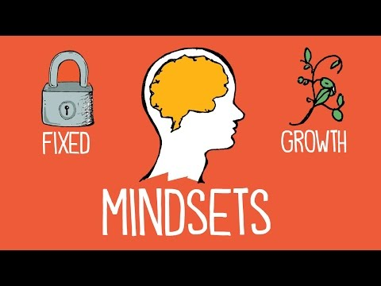
Growth Mindset
Notes:
To Know: This video is 2.14 minutes. https://youtu.be/M1CHPnZfFmU
To Say: Carol Dwek (2015) urges teachers to ask students to reflect on personal growth often. She recommends the following statements and questions for teachers to ask students:
You can control your thoughts. If you use them in the right way, you can strengthen your mind.
Wow, that was a really good grade. You must have worked really hard to be able to achieve it.
What have you learned today?
What is a mistake today that you learned from?
What were you persistent at today?
What can you learn from this?
What will you do the next time you are in this situation?

Slide 21
What Does this Change Look Like?
I can succeed at this
My ability and confidence grow with effort
Challenge is inevitable for success
This work is in line with my interests, values, or goals
I belong in this academic community
Notes:
To Know/To Say: When working with our students and helping them to shift their mindsets we need them to understand that things don’t always work out the way they planned it. Look at Michael Jordan. After being cut from his high school basketball team, he went home, locked himself in his room and cried. Walt Disney was fired from a newspaper because they felt he lacked imagination and originality. Oprah was demoted as news anchor because they felt she wasn't fit for television. This is a great example of three people who overcame adversity and went on to become incredibly successful.

Slide 22
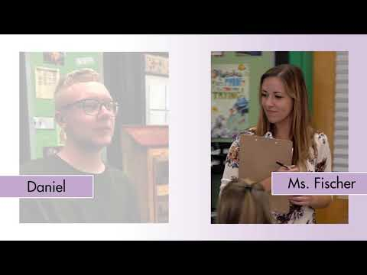
High School Example of Behavior Specific Praise
Notes:
To Know: This video is 2 minutes. https://youtu.be/oCnZu8sqWhA
To Say: Research has demonstrated that having the mindset that you are either smart or not smart has negative consequences for student learning. A powerful way that you can intervene is by being cautious on how you use give praise. Offering praise for effort or work can help to alter a students mindset so that they can begin to view their own intelligence as something that can be developed. This change in mindset also helps increase a students ability to “bounce back” in the face of setbacks. Behavior specific praise is a low intensity strategy that help to reinforce everything we just discussed. This occurs when you observe a particular behavior and compliment the student for this behavior. This video is a great example of behavior specific praise at the secondary level.

Slide 23
Connection
Allow students to express emotions
Help students work to resolve conflicts
Encourage children to develop close relationships
Notes:
To Know/To Say: In order to build resiliency, it is important to stay connected to others. When a person experiences trauma, a key to healing and building resilience is connection. Children with close ties to friends, family, and their community are likely to have a stronger sense of belonging. This helps us understand that we are all human and can share experiences. It also allows us to contribute to others with acts of services. When students demonstrate service they begin to understand the joy that comes from giving. Finally, it is important that we model and teach vulnerability. It is ok to need and ask for help and it is essential we teach our student to do that.

Slide 24
Character & Contribution
Teach empathy
Serve Others
General: https://www.randomactsofkindness.org/kindness-ideas
For Educators: https://www.randomactsofkindness.org/for-educators
Notes:
To Know/To Say: Children need a sense of right and wrong to ensure that they are prepared to contribute to the world. When children are able to contribute to the world they live in it gives them a sense of purpose and motivates them to improve the world we live in.

Slide 25
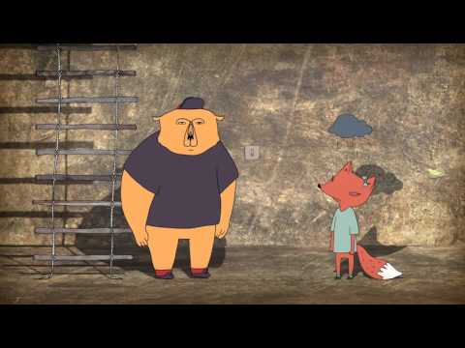
Empathy
Notes:
To Know: This video is 3 minutes https://youtu.be/KZBTYViDPlQ
To Say: Research supports that empathy training to enhance empathic feelings and understanding and increase pro-social behaviors is effective. One way in which you can do this is by teaching children what empathy is and how to recognize different emotions in themselves and others.

Slide 26
Coping & Control
Making self-care a priority
Practice self-compassion
Meditation: Body Scan
Breathing: Mindful breathing
Relaxation: Guided Imagery
Notes:
To Know/To Say: As adults, we understand the importance of managing stress. As educators, it is up to us to help teach our students the importance of managing their stress as well. We have included a variety of strategies throughout the previous modules so we will cover only a few today. Helping students understand that they have to make their own self-care a priority is extremely important. Self-compassion increases your well being and therefore helps to build resilience to stress and trauma. It’s ok to treat yourself with the same care and kindness you would treat someone else going through difficult times. To practice self-compassion we can help students be aware of how we talk to ourselves, how we are celebrating ourselves and are strengths and how are we encouraging ourselves.
We have included three links with specific strategies related to meditation, breathing, and relaxation below. Practicing mindfulness offers techniques of dealing with negative emotions. It helps us work through these emotions deliberately. The Body Scan is a very effective technique in calming our negative thoughts. Mindful breathing is a great way to bring attention to the physical sensations of the breath. Guided imagery uses all of your senses. You can imagine you are in a forest surrounded by trees and the birds.
To Do: You can click on the links to explore the strategies.

Slide 27
Research on Mindfulness
Enhanced memory
Increased ability to concentrate
Increased ability to use attention to regulate emotion
Increased ability for empathy and compassion
Reduced distress and increased positive affect
Brain changes that support emotion regulation
Increased density in the hippocampus after 8 weeks of
MBSR compared to controls. Hölzel et al. 2008
Notes:
To Know/To Say: Mindfulness is basically being attentive to the present moment, seeing what is happening

Slide 28
Four Beliefs that result in students perseverance
I belong in this academic community.
My ability and competence grow with my effort.
I can succeed at this.
This work has value for me.
Notes:
To Know/To Say: As students gain confidence in the previously mentioned skills, their confidence will grow. As they develop confidence, they will be more likely to demonstrate resilience or perseverance in the face of adversity. Here are four beliefs that help students persevere. Keep these in mind as you consider implementation of any of the skills we have covered so far. I belong in this academic community. My ability and competence grow with my effort. I can succeed at this. This work has value for me. As a reminder, when students learn to adopt these beliefs, their ability to persevere grows. They gain confidence and are more likely to exhibit resilience during tough times.

Slide 29
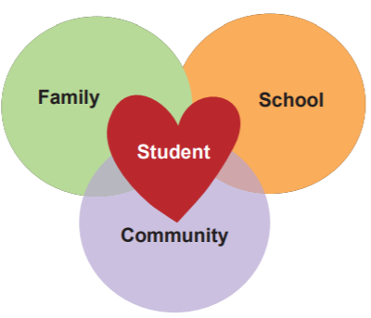
It Takes a Village
Notes:
To Know/To Say: This slide illustrates the collective efforts we feel are necessary to help students overcome trauma, demonstrate resilience, and succeed physically, emotionally, socially and academically in the school setting.

Slide 30
Team Talk: Review the “How”
Are we ready to engage in the work?
How will we begin implementation of the work?
Fill this in on your Action Plan under “Objectives and Action Planning”
Notes:
To Know: Action planning supports engagement in the work and next steps
To Say:
We’ve now completed the module “Resilience”. This your time to pause and reflect on the “how”. Are you ready to engage in the work? How will you begin implementation of the work? Please fill this in on your action plan under objectives and action planning.

Slide 31
References/Resources
Random Acts of Kindness Foundation:
https://www.randomactsofkindness.org/
Self-Compassion: Dr. Kristin Neff
https://self-compassion.org/the-three-elements-of-self-compassion-2/
Greater Good in Action: https://ggia.berkeley.edu/?_ga=2.30317439.115042320.1589503978-286002487.1589382464
Increased density in the hippocampus after 8 weeks of MBSR compared to controls. Hölzel et al. 2008

