Slide 1
Module Introduction
Welcome to our on-line trauma learning modules for Virginia Tiered Systems of Supports. We believe that becoming a Trauma-Sensitive School is a journey. Throughout this journey will provide you tools to develop the systems to gain knowledge, to build practices, and to have the skills to support a Trauma-Sensitive School. Your professional journey includes engaging and practical learning modules. Within the learning modules you will interact with content that is focused on developing a Trauma Sensitive School. Supplemental activities, resources, and an action planner are included to help guide your implementation. Videos from experts and division staff implementers are also included with each module to enrich your experience.
Finally, our six modules are focused on the following topics: Module 1: Introduction to Trauma and Becoming a Trauma-Sensitive School; Module 2: Families and Communities as Partners; Module 3: How Trauma Impacts Learning; Module 4: Strategies and Classroom Practices (academic, social emotional learning, trauma-sensitive environments, regulation, cognitive problem solving, relationships, school wide discipline, self care); Module 5: Implementation and Systems; Module 6: Resilience.

Slide 2
Hidden Slide #1
This Section of the Learning Module 5 was designed to be used in the following manner.
The audience for this Module is division and school teams.
This Module is meant for whole staff or team presentations.
Following this training, participants should complete the Action Plan document to determine next steps.
There is one section in this module.
Notes:
This section of Learning Module 5 is designed to be completed in 1 hour.

Slide 3
Hidden Slide #2
In person training
Presenter notes and information
Notes:
In-person training suggestions
Module 5 in-person training should take about 1 hours in its entirety.
This presentation provides the basics of implementation science. You may want to add or enhance portions with visuals and examples that will resonate with your audience. As a reminder, always be sure to include appropriate citations when adding resources. Also, you might look to the resources and activities sections for additions that may be helpful.
In summary
This module outlines the basics of implementation of a trauma sensitive school.
It can be adapted to individual contexts.
The training should last about 1 hours for the entire module.
Presenter notes information
Presenter notes are included in the PowerPoint. Background information for the presenter is shown as “To Know.” Statements to be shared with participants are shown as “To Say.” In some instances, the “To Know/To Say” are combined.The presenter notes also include “To Do” prompts and cues for “Handouts”.
Additional activities, examples, videos, etc. are being developed. A presenter may add material from the resources and activities section on the website.
Breaks should be inserted at the discretion of the presenter based on the needs of participants.

Slide 4
Hidden Slide #3
Supplies needed
WIFI access for presenter and participants
Access to videos (through WIFI if available, but download to flash drive as a back-up)
Chart paper
Markers
Post-it-Notes
Notes:
To Know
These supplies are needed for the Trauma Professional Learning Modules.

Slide 5
Hidden Slide #4
Handouts for this Module
Action Planner
Resource Map Activity
Hexagon Tool
Evidence Based Selection Tool
Initiative map
Notes:
To Know
The Participant and Presenter Materials are located on the vtss-ric website.

Slide 6
Hidden Slide #5
Key Terms in This Module:
Virginia Tiered Systems of Supports (VTSS)
Multi-tiered Systems of Supports (MTSS)
Alignment
Resource Mapping
Evidence Based Selection Tools
VTSS Implementation Logic and Framework
Implementation Science
Readiness
Phases of Implementation
Notes:
To Know
These are the key terms used throughout the module.

Slide 7
Implementation and Systems
Divisions and Schools
Notes:
To Know:
VTSS Professional Learning Modules are organized in the same manner. All schools can begin their journey with Module 1 which introduces the foundational knowledge around trauma and trauma sensitive schools. This powerpoint shares key information on implementation and systems of a trauma sensitive school.
To Say:
Welcome to the learning module, “Implementation and Systems”. Let’s get started!

Slide 8
What We Will Know and Do
Gain a deeper knowledge and understanding of the best practices of implementation infrastructure from trauma sensitive schools.
Assess current use of best practices and prioritize next steps.
Knowledge of strategies and tools to support an aligned infrastructure for implementation of trauma sensitive practices.
Notes:
To Know:
Go over the learning intentions targeted for this session
To Say:
During this module we will be gaining a deeper understanding of the best practices for of implementing a trauma sensitive school.

Slide 9
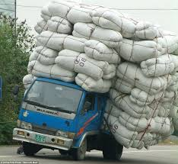
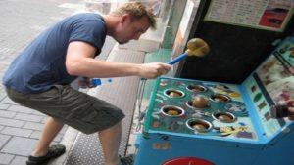
Slide 9
Roller coaster up and down
Not sure which way to go
All Systems Go!
Too many resources
Road Block
Whack a Mole
Notes:
To Say/To Do: This is a good group activity:
Think about your work with divisions and schools around implementing practices for example: Restorative Practices, Positive Behavior Intervention Supports, Social Emotional Learning, or Reading Intervention.
Which picture is the best metaphor for YOUR experience? Why?

Slide 10
Traditional vs Trauma Sensitive Mindset
Traditional
Trauma Sensitive
Student’s challenging behaviors are a result of individual deficits (e.g., what's wrong with you?)
Understands difficult student behaviors as purposeful and personal.
Focuses on changing the individual to “fix” the problem.
Adults need to uphold authority and control with students and families.
Punitive discipline works.
Support for students exposed to trauma is provided by counseling professionals.
Students challenging behaviors may be ways of coping with traumatic experience(s).
Understands difficult student behaviors may be automatic responses to stress.
Focuses on changing the environment.
Adults need to offer flexibility and choice to students and families.
Positive discipline that is instructional and focuses on teaching and reinforcing prosocial replacement behaviors works.
Support for students exposed to trauma is the shared responsibility of all staff.
Restorative practices.
*Adapted from the Colorado Department of Education
Notes:
To Know/To Say:
When we are talking about trauma sensitive practices this can require a shift in mindset for many. Let’s review a traditional mindset compared to a trauma sensitive mindset. Where do you think your division or school is? Where are you as an individual? What would it take to allow continued learning and reflection?
Resource: Colorado Department of Education

Slide 11
Why Use an MTSS Framework for Implementing Trauma Sensitive Practices?
Provides whole system response/prevention
Provides instructional framework
Focuses on the use of data to evaluate impact
Increases sustainability
DATA
SYSTEMS
PRACTICES
STUDENT OUTCOMES
Notes:
To Know: Move through the bullet points individually leading up to the fruition of student outcomes.
To Say: When we use a Multi-Tiered Systems of Support framework we are providing that whole system support. These systems rely on evidence based practices that start with those universal schoolwide supports, known as Tier 1. These supports can serve as a preventive measure before students may need a more targeted or intensive support system (Tier 2 or Tier 3). We focus on the use of data to evaluate the impact and eliminate barriers. Ultimately, we want to create a school environment that addresses the needs of all students, staff, and families and that we are creating those systems to increase sustainability.

Slide 12
Implementation Logic
Implement behavior, academic and social emotional supports through a single team.
SYSTEMS
Promote adult wellness by creating a nurturing environment
DATA
Expand the data that teams use to identify which skills to teach
PRACTICES
Teach SEL Competencies using VTSS Instructional Systems
Notes:
To Say:
When we think of implementing a practice in a school, we want to consider 4 key elements.
Four key elements.
1. Let’s start with outcomes. What do we want to achieve by using trauma-sensitive practices?
2. Then we have Data. What Data will we use to inform that outcome?
3. Then practices…what practices
will we put in place that are evidence-based and that we can commit to doing
with fidelity?
4. Then…what systems will we put in place to support our staff in implementing trauma sensitive practices?
This is how you get sustainability. This is MTSS.
Reference: https://www.pbis.org/Common/Cms/files/pbisresources/TeachingSocialEmotionalCompetenciesWithinAPBISFramework.pdf

Slide 13
Key Implementation Considerations
Supporting staff development
Create a safe and supportive environment
Assess needs and provide supports
Building strong social and emotional skills
Collaboration with students and families
Policies and procedures
Notes:
To Say:
The Implementation Logic model is an integration of the following key implementation .
Supporting staff development. Staff must be trained with a baseline understanding of trauma and its’ impact on students and staff. Staff development includes ongoing learning and coaching in trauma-informed practices to support implementation across academics, assessment, behavioral supports, and family, caregiver, and community partnerships. Additionally, staff need to receive ongoing professional learning in evidence-based practices that are essential in supporting students including problem solving, cognitive skills, emotional regulation, and social emotional learning. Staff are taught student triggers and how to avoid them, including recognizing verbal and nonverbal early warning signs of student escalation. Skills and strategies to de-escalate and defuse situations is equally emphasized and explicitly trained. Self-care is an essential component of staff development to prevent and mitigate vicarious trauma and compassion fatigue. Staff development is utilized to teach and encourage staff to participate in self-care activities in their work and personal lives.
Creating a safe and supportive environment. All adults must be responsible for creating and maintaining a physically, socially, and emotionally safe learning environment. This includes training and expertise in culturally responsive practices to learn and value the cultural history of students and their families. All crisis prevention and intervention practices integrate trauma-informed strategies and practices. Belonging and safety is a priority. Building relationships among staff and students is the foundation of this environment. All interactions between students and adults are healing and build resilience skills in the students. Attention is given more as a means to build relationships than to correct unwanted behavior. A ratio of 5 positive interactions to reinforce prosocial behavior to every 1 interaction aimed at decreasing undesired behavior will assist in supporting connectedness, build relationships, and promote the feeling of mastery.
Assessing Need and Providing Appropriate Supports. This requires that all school-based screening and assessments consider potential impact of trauma and plans consider ways to address trauma. A variety of academic, behavioral, and social emotional assessment methods are used to allow students to demonstrate knowledge and skill. It also requires a mechanism to measure and progress monitor a school’s ongoing implementation of trauma-informed approaches.
Building Strong Social and Emotional Skills. School must integrate universal strategies to model, teach, and practice self-regulation, self-awareness, social awareness, relationship skills, and responsible decision making. Explicit emphasis is paid to problem-solving and emotional and physiological regulation. Students are taught how to identify and process their emotions.
Collaborate with Students and Families Students, families, and caregivers are given a voice to express their concerns. The school environment and practices within it is built on students’ strengths. The school builds trusting relationships with families and caregivers. Families and caregivers are encouraged to take a leadership role in the community. Family and caregiver voice is integral in developing school policies and procedures.
Policies and Procedures Existing policies and procedures are reviewed regularly against trauma-informed core beliefs, principles, and values and modifications are made when inconsistencies arise to ensure full alignment. Discipline, communication, and safety procedures reflect an understanding of trauma and are consistent with beliefs, principles, and values. Policies and procedures at the local school level are presented to the school board to educate the board on trauma and its impacts in order to modify school board policies as needed.

Slide 14
Meaningful Change
Kids get help early…
Actions based on outcomes (data!), not procedures
We provide supports to staff to do it right…
Fidelity: Coaching and Training
And make sure they are successful…
Ongoing coaching and support
Progress monitoring and performance feedback
Problem-solving process
Increasing levels of intensity
We organize our resources…
Resource Mapping, Gap Analysis, Teaming Structures
Notes:
To Say: How do we make meaningful integration happen? Implementation Science.
We want to start with effective practices. That refers to what is being implemented. What is the evidence for the effectiveness? Who is it for? (This is your DATA piece)
Effective Implementation is about moving interventions into practice and requires the interaction, collaboration, and participation of stakeholders at multiple levels of an organization or system of care (This is a balance of your SYSTEMS and PRACTICES pieces)
So going back to our “Formula for Success”, where do aspects of the Implementation Framework fit in?
Does this not sound like our way of work!!!
Fidelity - What are you currently doing with fidelity at Tier 1? What are the decision rules around assessing the effectiveness?
How effective are your teaming structures? Do they include people on the team that have experience in mental health? Does your team have a structure in which they review attendance, mental health, academics and discipline data for trends and action plan around that?
What is the valued outcome for this initiative? For example - improved social emotional competence for all students?
Consider expansion or repurposing of existing efforts. We know we do this through resource mapping. We also need to identify core system features (alignment).
If the team determines that a new, evidence based intervention is needed, do they have an established process for selection? - Have your divisions and schools used a formal process to determine evidence based practices and if they can be implemented effectively? Annotate X for no and check for yes.
Data - evidence of need, data informed decision making
Reference(s):
Adapted from 2012 Dean Fixen and Karen Blasé,
National Implementation Research Network

Slide 15
Stages of Implementation
Notes:
To Know: The videos walk through each of the stages for deeper learning.
To Say/To Do: Continuous improvement and implementation is a journey and takes time and effort. When implemented in phases it enables schools to be able to identify and meet all students needs. Key to the learning process is a Stage Based Approach. In a Stage Based Approach, there are four stages.
In the Exploration stage, diverse teams define the innovation. May ask yourself similar questions to the following…
What is the need/problem?
Does the organization agree to the desired outcome?
What evidence-based practices or systems are currently available to address the need/problem?
In the Installation stage, diverse teams develop training, coaching, and data systems. May ask yourself similar questions to the following…
Is a leadership team or structure in place to guide coordinated implementation?
Does the organization have a plan for continuous professional development?
Is a data system in place for monitoring of progress and fidelity?
Are materials in place to support implementation?
In the Initial Implementation stage, teachers and school staff provide support to use the innovation. May ask yourself similar questions to the following…
Do size and place of initial implementation support successful implementation?
Are data systems in place to monitor benefit and satisfaction of stakeholders?
In the Full Implementation stage, 80% of the district is using the innovation and successfully improving outcomes.
Has fidelity of implementation been demonstrated by majority of implementers across settings?
Does leadership team provide continuous implementation support and guidance?
Has the implementation been identified as an institutionalized component of the organization’s daily operation?
Data use for continuous improvement occurs across all of the stages, and sometimes a decision may be made to return to a previous stage, based upon the data available.

Slide 16
Stages of Building a Trauma Sensitive School
Stage | Description | Data | Systems | Practices
Exploration | Build knowledge | X | X | X
 | Assess readiness | X | X | X
 | Garner staff and community buy-in | X | X | X
 | Determine need | X | X | X
Installation | Establish infrastructure | X | X
 | Envision your trauma-informed approaches in school | X |  | X
 | Develop plan – identify framework and practices to organize your vision |  | X | X
 | Create team to lead implementation efforts |  | X
 | Train team, staff, and community in trauma-sensitive approaches |  | X | X
Initial Implementation | Begin implementation with a just a few sites (schools) | X | X | X
 | Work out Details |  | X | X
 | Learn and improve | X | X | X
 | Align and integrate with other practices (e.g., PBIS, restorative practices, social emotional learning, emergency planning) |  | X | X
 | Ensure implementation of strategies across academics, assessment, behavioral supports, educator capacity, and family, caregiver, and community partnerships |  | X | X
Full Implementation | Evaluate impact | X | X
 | Adjust to changing needs of the school community based on student population and types of trauma experienced |  | X | X
 | Sustain systemic changes | X | X
Adapted From the Colorado Department of Education
Notes:
To Know: We talk about Exploration in Module 1 - Becoming a Trauma Sensitive School. In this module we will focus on Installation and Implementation. We have phases we go through for implementation (SEL, trauma, academic). Everything we do follows the same way of work.
Emphasize the connection to the Data, Systems, Practices model so that participants can see that as they are working within each stage, they are addressing multiple components of the Implementation Logic model concurrently.
To Say: This is an illustration of what the stages of implementation can look like when building a trauma sensitive school. Everything we do follows the same way of work whether it be social emotional learning, restorative practices, or literacy.
Reference: Colorado Department of Education

Slide 17
Exploration
How does a team explore?
What are some ways that a division is exploring what their knowledge and readiness is?
Notes:
To Say: Teams should engage in extensive exploration with the goal of determining which practice it the best fit. This is the phase that we often do not spend enough time in. What we typically do is identify a need or practice and we jump to solution finding. Our goal is to make the best match between what we say our needs are and what it is we need the practice to do for us. We also want to make sure that the practices are feasible and doable.
To Do: Discuss the questions on the slide.

Slide 18
Integrated Team Process
Teacher
Parent
Student
Anyone else?
Administrator
Staff
Counselor
Notes:
To Know: Discussing the teaming structures and ensuring that you have an established team process in place is a crucial place to begin the work at the division or school level. Do division and school-based teams include an individual who has knowledge, expertise, and the ability to provide coaching/support about impact of trauma?
To Say/To Do:
Can a team be repurposed or built upon?
Do our teams represent our school faculty/staff (departments/grade levels, specialists,
How are we seeking input from multiple sources (students, families, stakeholders, etc.?)
Why is it important to include additional perspectives in a teams? Allow participants to answer in the chat or verbally.
Any team is going to be limited by the lived experiences of its members. The makeup of the team could lead to possible blind spots in identifying data concerns, causes and solutions. It is not practical to include everyone in every meeting and decision, but teams should have a plan for regularly seeking input from students, families and other community stakeholders.
Crucial for the team to come together with an understanding that there are common values, common language, and common experiences (meaning what we expect to experience together, not expected to have previous experiences that are similar).

Slide 19
Role of Team
Problem-solving
Planning
Collecting Data
Communicating
Analyzing &
Studying Data
Notes:
To Say: The purpose of the team (division or school) is to make sure the program components are identified and operationalize. How does this program or practice push or pull on the existing work? How are we communicating the plan out? Another important role of this team is to build commitment and champion the initiative.

Slide 20
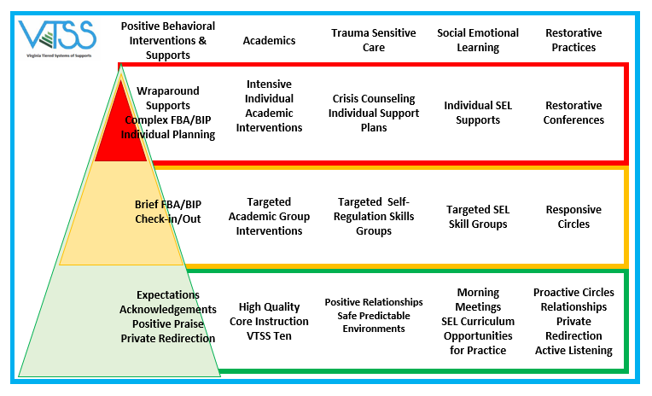
Sample Resource Map of All Areas
Notes:
To Know/To Say:
In just a moment, we will ask you to consider resource mapping your tiered systems of support. First, we wanted to share an example of what that might look like. You’ll notice behavioral, academic, and social-emotional wellbeing supports are all a part of their tiered system that supports an effective learning environment.
To Do: This is a great place for the team to look at the Resource Map or Initiative Map under handouts in this module (website - Module 5). Have the team look at what are we already doing around trauma sensitive practices, how well they are being implemented, and fidelity measures.
References:
Adapted from Chesterfield County Public Schools

Slide 21
Evidence Based Practices
Hexagon Tool
Evidence Based Selection Tool
Notes:
To Say: If we resource map and still find that we need an evidence based practice, we want to use a selection tool to help guide us. In this module we talk about 2 tools, the Hexagon Tool from the National Implementation Research Network (NIRN) and the VTSS Evidence Based Selection Tool. The Hexagon Tool looks at six factors, three of which are related to the implementing site and the other three to the intervention. The tool looks at is this what we need, do we have the capacity to do this, and can we implement this well. The VTSS Evidence Based Selection Tool combines questions from the Hexagon Tool and other resources. The VTSS toll also utilizes a separate page to evaluate practices.

Slide 22
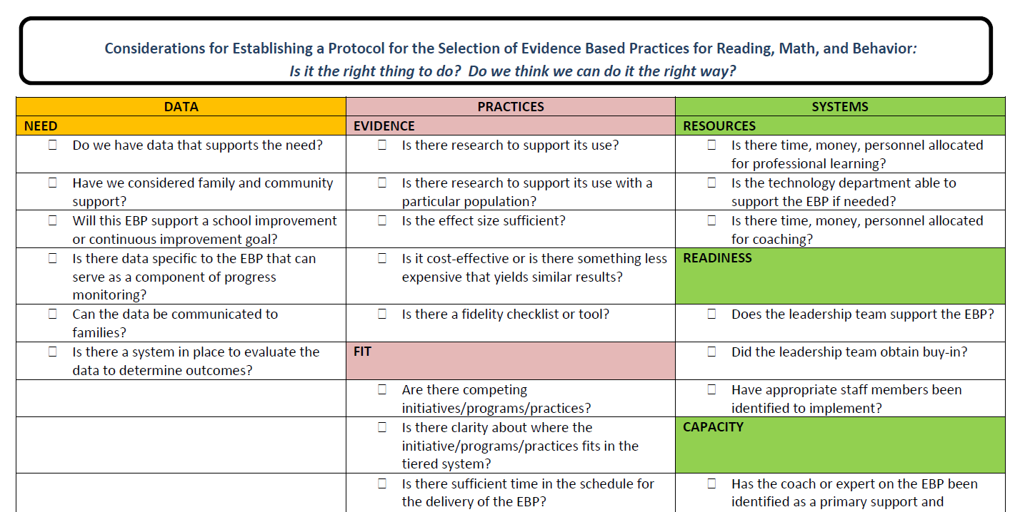
Practice
Notes:
To Do: As a team, use one of these tools to assess the need for trauma sensitive practices. The tools can be found on under Module 5 on the website.

Slide 23
Installation
Assure resources
Use data
Develop plan
Training
Feedback loops
Notes:
To Say: When the decision is made to move forward on the program or practice then we move into installation. This is the stage in which we want to be intentional about planning and building the infrastructure. This is the stage where we are clearing defining what these practices are (what do they look like and sound like). The implementation/action plan should include the human resources and resources, fidelity, capacity, and outcome data, decision making processes, training, and equitable implementation. It is also important during this stage to develop the skills of the people who will be expected to implement and carry the practice out as intended.

Slide 24
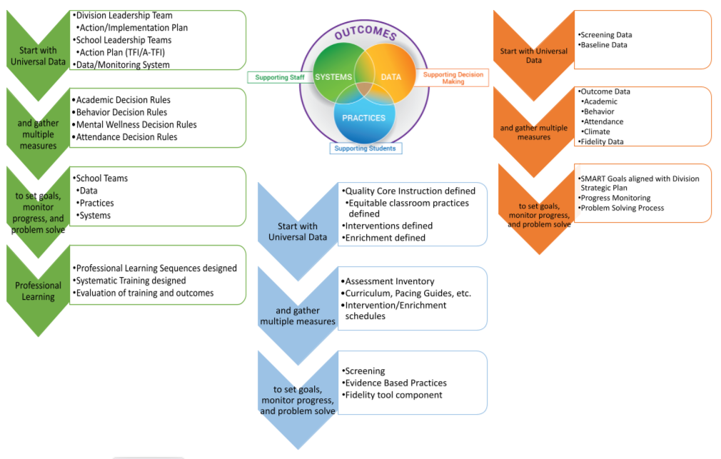
Team Starts with Data
Notes:
To Say: Who gets to tell the data story? What does that look like?
Having an established process for discussing data is crucial. When the team starts with data, the process is more effective when you plan out the conversation. As you know by now, practices are what is implemented to support the students (interventions, instruction, etc.) and systems are what is implemented to support the staff (processes, trainings, procedures, etc.). The data will look differently depending on whether the team is discussing the practices or systems. This graphic illustrates how to begin the data conversation and provides examples of types of data to consider if you are working in the data, systems, or practices. It is imperative to gather multiple sources of measurement to expand upon the initial universal data. This aids the team in having a deeper understanding of the issues in order to create more concise precision statements to build action steps around.

Slide 25
Current Data
Behavior
Academic
ODR’s
Suspension/Expulsion
Attendance
Nursing/Counselor visits
Minor incident reports
At risk factors
Fidelity (TFI) data
Universal screening data
Benchmark data
Common formative assessments (classroom performance)
Progress monitoring data
Historical SOL results
Early Warning Systems
Notes:
To Know: Examples of data that schools often use.
To Say: By using a system with a mix of data, divisions are able to apply the information for instructional, curricular, resource allocation and planning decisions.

Slide 26
Expanded Data
Equity
Mental Wellness
Disaggregated Behavior and Academic Data
Graduation rates and types of diplomas (standard vs advanced) for different groups
Enrollment in Honors and AP classes
Community Data: poverty, unemployment, incarceration, etc.
School Climate and Safety
Nurse/Counselor visits
Student Engagement
Community Data: statistics on prevalence of mental illnesses in the U.S. or your community, trends in the use of mental health services
Notes:
To Know: Examples of expanded data

Slide 27
Expanded Data Part 2
Attendance
Climate
Average daily attendance? (ADA)
Truancy
Chronic absence*
Suspension
Expulsion
Absences due to health
*includes tardy, excused, unexcused
Student/Parent/Staff Climate surveys or focus groups
Harassment/bullying
Hot spots (Environment)
Physical aggression/fighting
Attendance (staff and student)
Notes:
To Know: Examples of expanded data.
To Do: Have teams identify what types of expanded data they review regularly.

Slide 28
Professional Development
Develop PLO that outlines/supports the systems required for implementing practices
Using data to identify and develop a precision statement targeting trauma specific need(s)
Systems
Data
Practices
Selecting evidence-based practices that meets the trauma specific need(s)
Notes:
To Say: One of the ways in which we build capacity is by providing high quality professional learning and development.
Professional development should be determined by where they need is to support staff as they work with students. That need can be determined as you analyze the baseline or screening data (Data circle), resource mapping or student outcome data (Practices circle), or measurement of fidelity of implementation (Systems circle). What you are purposefully working through as a team are the following steps
Establishing the needs (through data talks)
Resource mapping practices (measuring effectiveness)
Overlapping the needs and resource mapping to see if the resources are addressing the needs identified
Identify supports staff require in order to enhance current practices or new practices to begin developing the professional development plan. The triangulation of data provided and analyzed in the first 3 steps is important to be certain that your professional development plan is appropriate to the needs of the school/division.

Slide 29
Who Will Implement?
Start small- e.g. couple of grade levels
Notes:
To Say: We want to look at who is it that we want to implement this practice first as we move into implementation. This small group will be our first implementers. This helps us to work out the implementation kinks in a much smaller way.

Slide 30
Initial Implementation
Meet monthly
Begin delivery of practice with a small group
Implement coaching supports
Provide training
Gather feedback and data
Use decision making criteria for expansion
Notes:
To Say: When we talk about initial implementation we are talking about trying out the new skills and practices so that we can get better at implementing them. How are we integrating trauma sensitive practices into MTSS? In this stage, our team is meeting monthly to see how implementation is going. We are looking at our data and gathering feedback to see where we can improve. We want to look at how we are embedding strategies into ongoing coaching and how we gather data on what this looks like.
To Do: Have participants view Module 5D video - https://vtss-ric.vcu.edu/trauma-learning-modules/

Slide 31
Full Implementation
Data is used regularly for decision making
Sustained use of practices
Staff is delivering the trauma sensitive practices with fidelity
There is evidence that identified outcomes are improving through the use of trauma sensitive pracrices.
Notes:
To Say: Full implementation is where we are looking at integration and fluency being built amongst everybody in the school. We are refining practices, building capacity, and showing proficiency.
To Do: Have participants view Module 5E video - https://vtss-ric.vcu.edu/trauma-learning-modules/

Slide 32
At all Stages - Collaborate with Students and Families
Increases Awareness
Increases Accessibility
Increases Engagement
Increases Expected Student Outcomes
Notes:
To Say: At all stages of implementation, we are collaborating with students and families.

